Slide 1



Lending Club Case Study
Lending Club is the largest online loan marketplace, facilitating personal loans, business loans, and financing of medical procedures. Borrowers can easily access lower interest rate loans through a fast online interface.
It provides loans to valued customers. In this presentation, we will walk you through our customer data, understand the data, data cleaning and manipulation, data analysis done with python code and presentation and recommendations.
by Prem Subudhi and Shilpa Pandey

Slide 2
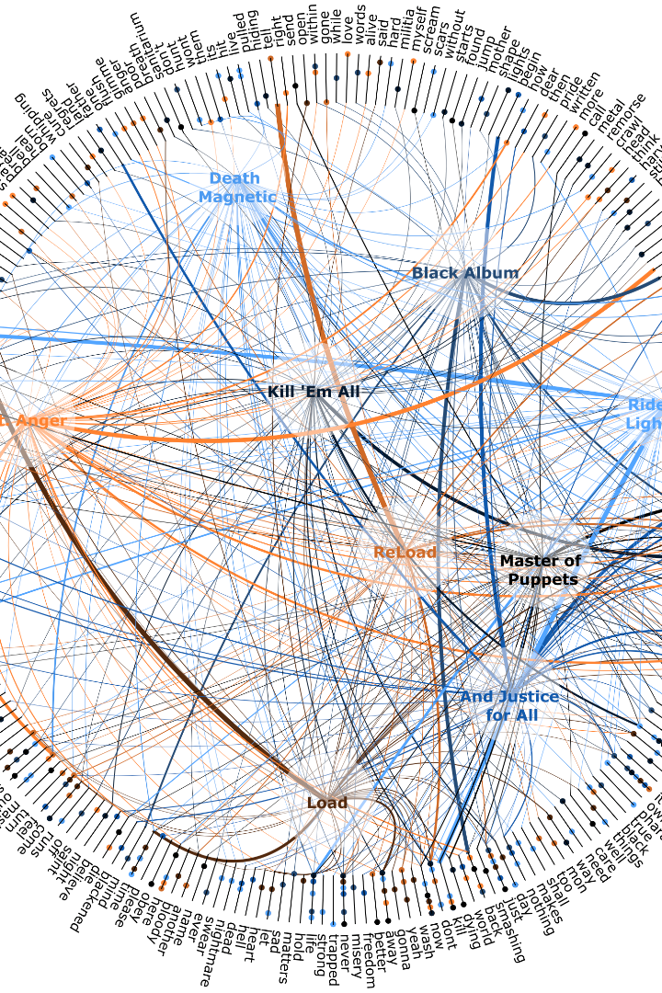
Data Understanding:
In this presentation, we will explore the key steps in data understanding. From identifying data quality issues to analyzing and interpreting variables.

Slide 3

Data Cleaning and Manipulation
1
Identifying and Addressing Data Quality Issues
All the missing values, outliers, and redundancies, are correctly identified and cleaned. The necessary steps are taken to address these issues.
Out of 111 columns 71 column have been removed.
2
Converting Data to Suitable Format
The data is formatted using appropriate methods, which ensured that the data is ready for analysis and manipulation. Example : For numerical analysis the relevant columns modified to floats.
3
Manipulation of Strings and Dates
String and date manipulation is performed accurately and effectively whenever necessary. This allows for deeper analysis and understanding of the data. Example : The data attempted to numeric for few categorical data like loan status "Fully Paid Charged Off Current" to "1,2,3“ and emp_length is formatted to number of years by removing the > + years from the value string. The % character is removed in column int_rate 10.65% to 10.65.

Slide 4
Data Analysis: Uncovering the Insights
1
Coherent Problem Solving
The analysis focuses on a relevant problem that aligns with the business needs. The structure of the analysis is clear and easy to follow, ensuring that the insights are easily understood.
Univariate and Segmented Univariate Analysis
2
Univariate analysis is conducted accurately, taking into account segments and making realistic assumptions. At least five important driver variables, which strongly indicate default, are identified through the analysis.
3
Creation and Utilization of Metrics
Business-driven, type-driven, and data-driven metrics are created for important variables and effectively used for analysis. The derived metrics are well-explained and reasonable in their approach.
Bivariate Analysis and Identifying Combinations
4
Bivariate analysis is performed correctly, identifying the crucial combinations of driver variables. The chosen combinations make both business and analytical sense, leading to valuable insights.

Slide 5
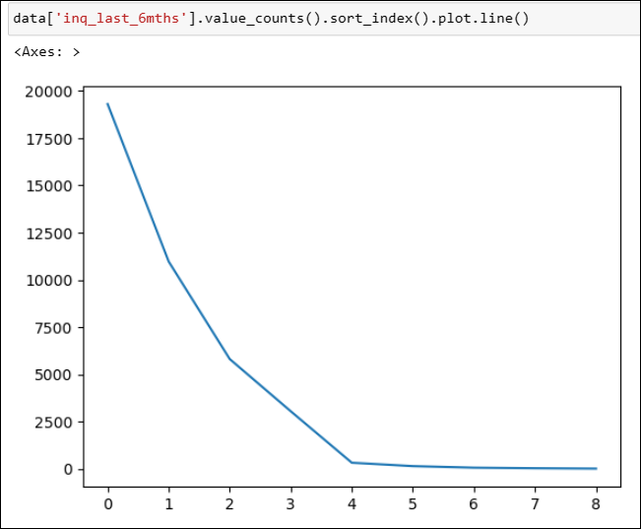
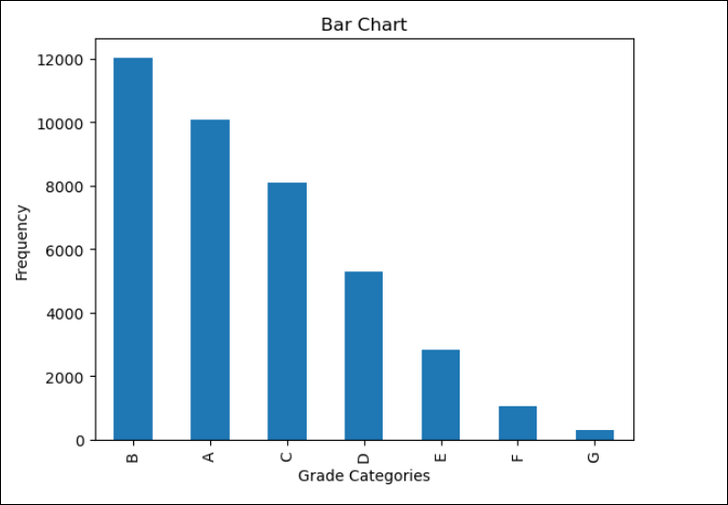
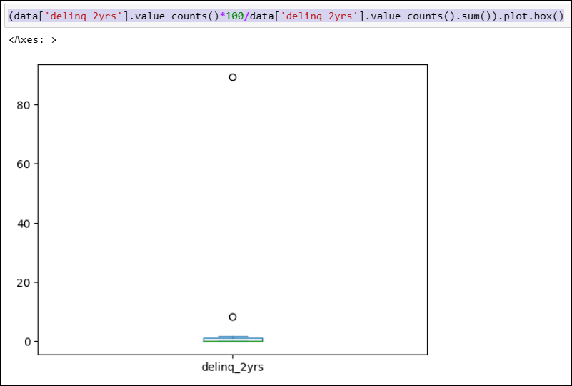
0 100.0
Visualizing Insights: Univariate Variable Analysis
The enquiries made during last six month shows around 20000 made by customer which demonstrates a huge credit requirement by customers which declined over 6months, It provide a business decision to capture this market opportunity. 0 : 100 for query
(data['delinq_amnt'].value_counts()/data['delinq_amnt'].value_counts().sum()) *100
The grades of loan offered
over the time period.
Deli nq reported in 2 years
The quality of loan reduces form A to G. the above plot shows mix of all the customer have and it lets us understand the consumer type and how this grading is made w.r.t consumer profile.
The box plot shows data points where around 11 time the payments were not made, and good number of defaults seen with customers to understand the risk of the loan can be given in this customer segment.

Slide 6
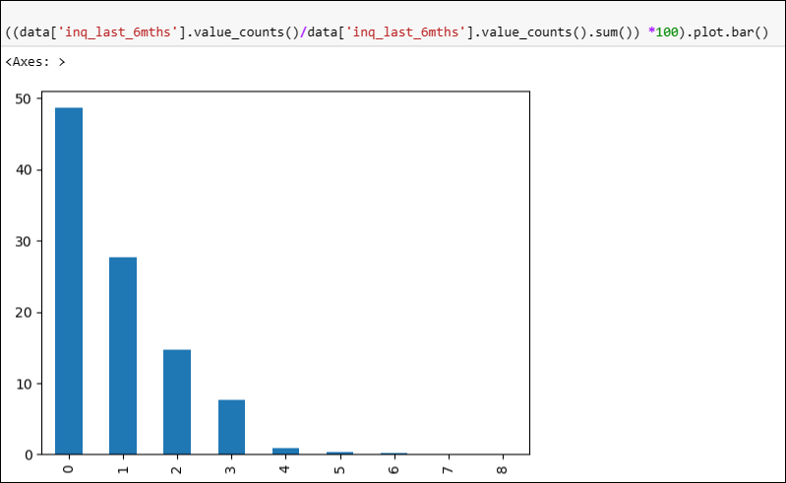
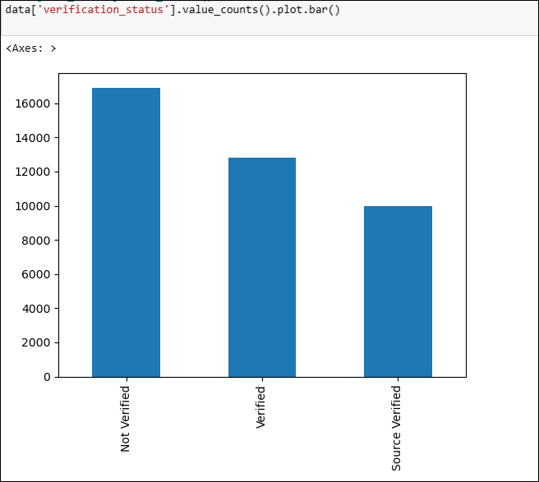
Visualizing Insights: Univariate Variable Analysis
(data['acc_now_delinq'].value_counts()/data['acc_now_delinq'].value_counts().sum()) *100
(data['delinq_amnt'].value_counts()/data['delinq_amnt'].value_counts().sum()) *100
Returns 0 : 100
The enquiries does provide
the input to the risk assessment.
With number of enquiry
increases the chances of
disbursing the loan will be
subject to enquiry.
Verification Status seems
in little risk as all are not verified yet.
This column poses some kind risk as all the customers information is not verified yet.
Around 16+k records status does not have data yet to provide loan.

Slide 7
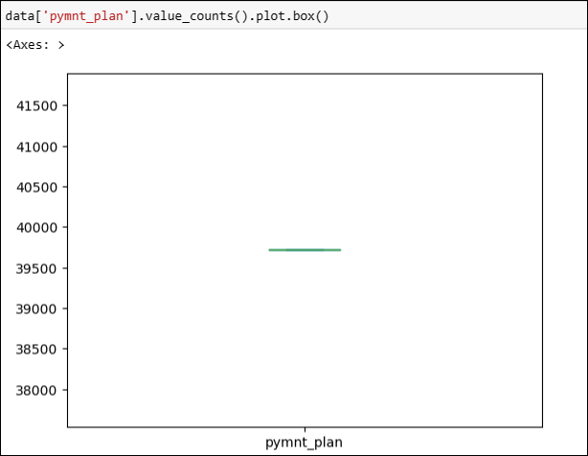
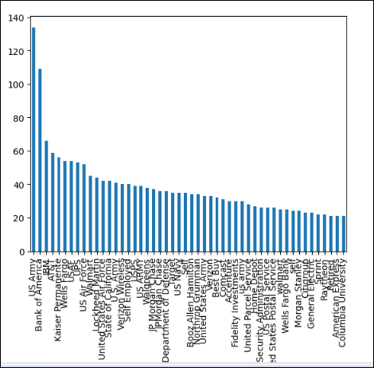
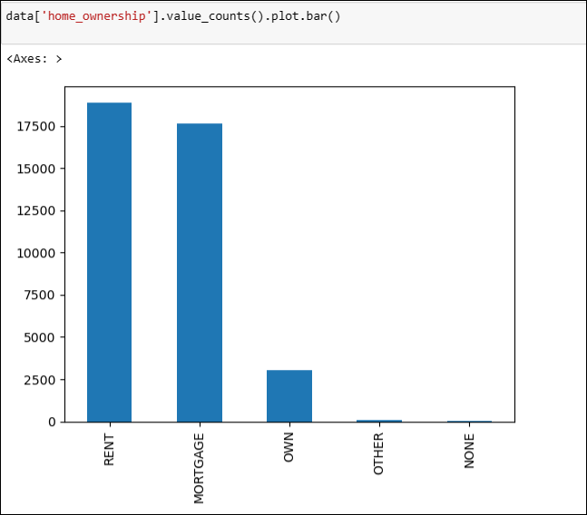
Visualizing Insights: Univariate Variable Analysis
All the records does not have a plan i.e all are expected to pay they emi’s in regular as per installments chosen. This is a positive factor as it does not have any complexity to deal with.
.
The home ownership shows most
customers have Rental and Mortgage.
The ownership has very low number it’s a
one of risk factor to consider before
providing the approval to the loan. We may
derive another information, like there may
Many first time loan property who stays in
Rental house and going for a own home,
then the risk factor would be low which can
be can be verified.
The employee title graph looks good and if all the information verified true then the risk level are low.

Slide 8
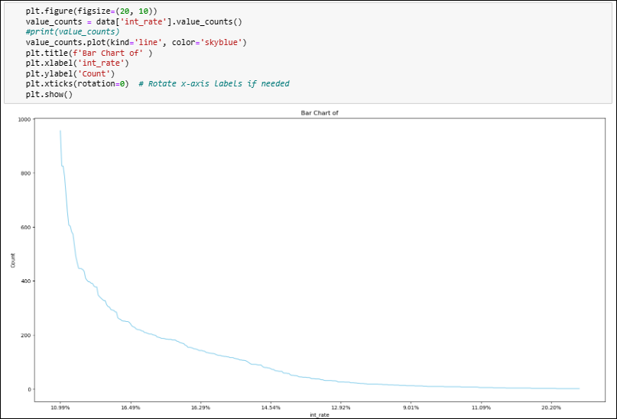
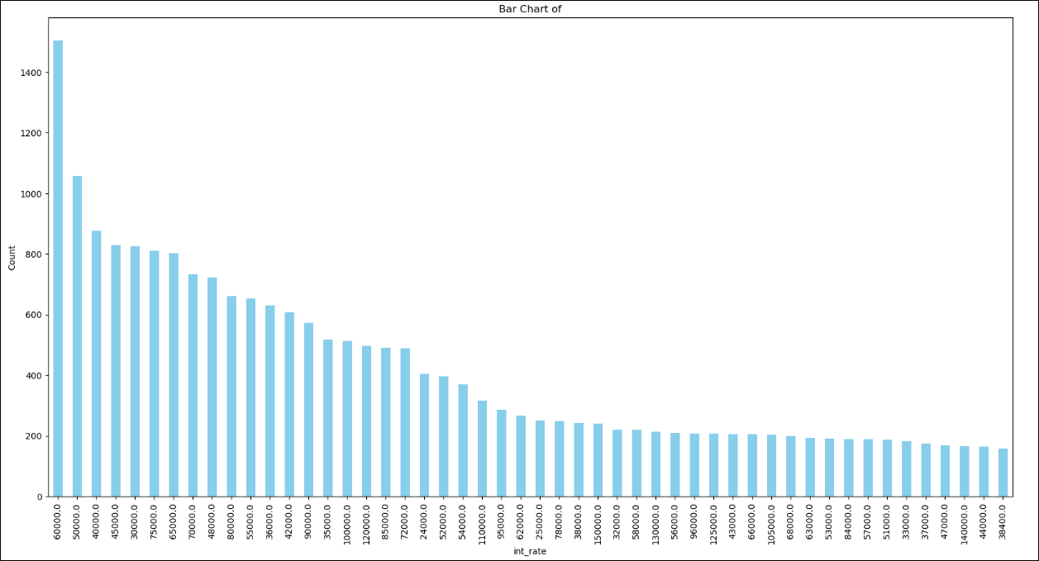
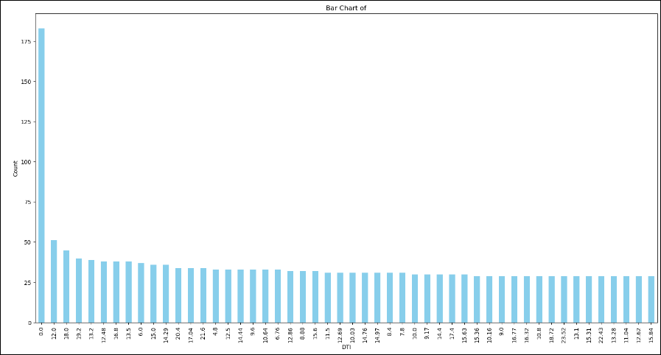
The int_rate column has most customers
Fall in the range interest for 10.99 to 0,
the risk factor for lending the loan interest
rate of 10.99 may posses risk in repayment
for lower income group
The highest income group who has applied for loan is 60k it give a great insight the market segment who is taking loan in this amount. For less amount the risk is distributed to may customers.
It may be viable option for lender with lower risk.
.
.
For DTI column the plot show a good number of amount who has not taken loan any before and it has good market segment where
The risk is the lowest to invest.

Slide 9
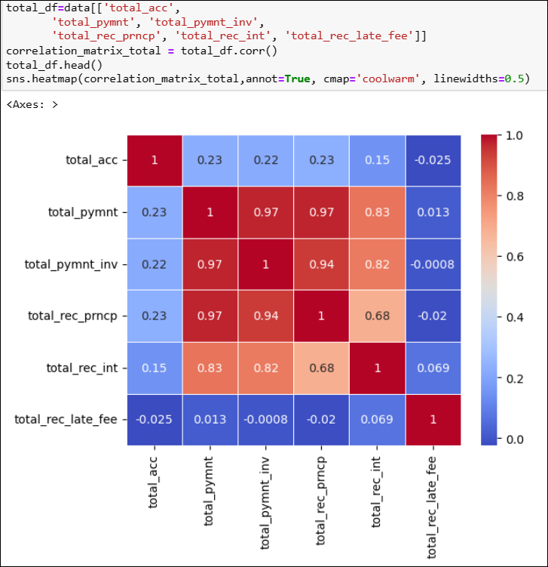
This heatmap shows the total values of account, payments, principal , interest and late fee the correlation matrix. The total payments done by investors and principal got high correlation with the total payments made.
And the correlation between late fee and received principal is negative which is obvious.
The data seems as expected and a good input for the risk analysis.
.
.

Slide 10
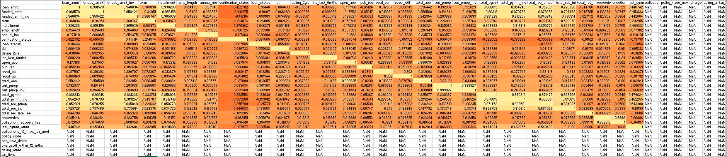
Visualizing Insights: Correlation Metrics
On the cleaned data we created a correlation metrics demonstrates the correlation among the columns, it will help to understand how the columns are affected by the other variables.

Slide 11
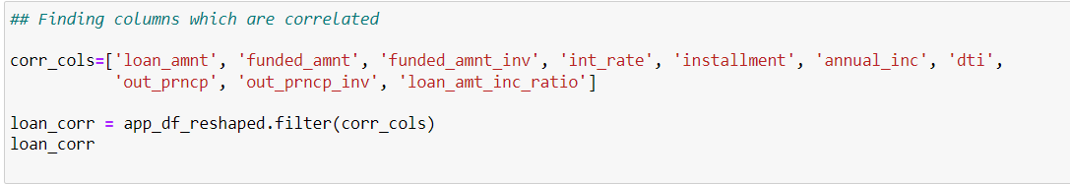
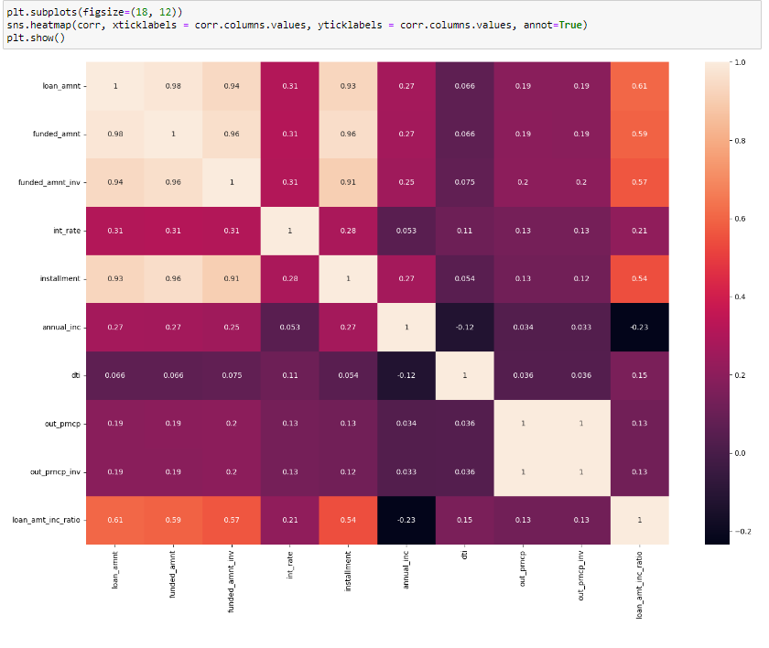
Visualizing Insights: Bivariate Analysis
Generating another heatmap to find correlation between loan amount, funded amount, interest rate, installment, annual income, out principal, dti, loan amount income ration.
Inference from the heatmap : Loan Amount, Funded Amount and Annual Income is highly correlated.

Slide 12
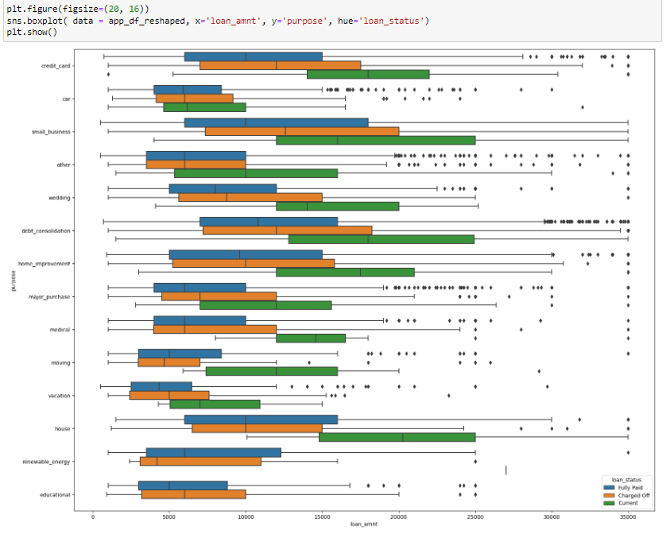
Visualizing Insights: Bivariate Analysis
Analyze the purpose of loan to find the motive between loan and the amount with respect to each loan status.
Inference : Purpose having 'other' and 'major purchase' type are having lot of outliers in charge off which will result in more loss to the bank. 'Small business' purpose type also needs an attention. So overall, 'other', 'major purchase' and 'small business' types needs to be considered while lending loan to the customers.

Slide 13
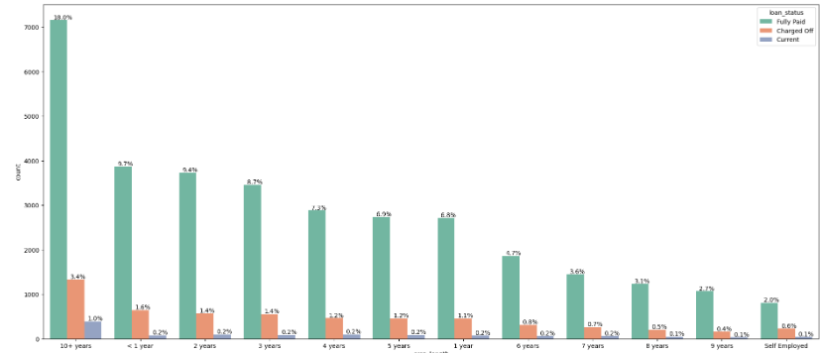
Visualizing Insights: Bivariate Analysis
Analyze loan status and employee’s year of service/experience.
Inference : Maximum loan is taken by 10+ years employees, approximately 18%.

Slide 14
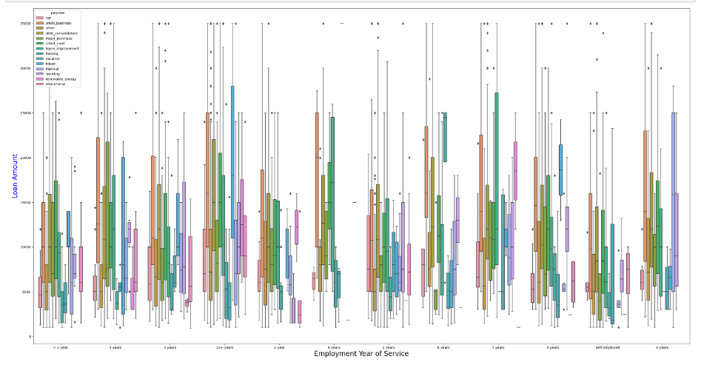
Visualizing Insights: Bivariate Analysis
Deriving relationship between employee's years of experience and purpose of loan
Inference : Employees with 10+ years of experience have taken loan in 'small business' , 'other, 'car', credit card' categories.

Slide 15
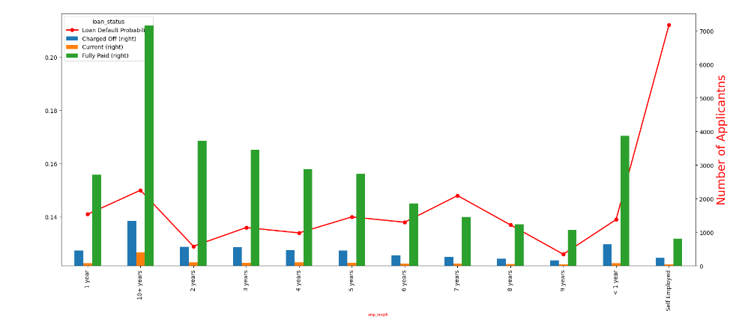
Visualizing Insights: Bivariate Analysis
Deriving defaulter probability for employment year of service
Finding out factors for loan defaulters, in other words, we are trying to find derived variables.
Following factors, we assume will be good for analysis :
Loan status
Charged Off
Employment Year of Service
Employment Grades
Annual Income
Inference : Applicants who are Self Employed and having less than 1 year of experience are more likely to be Defaulter.

Slide 16
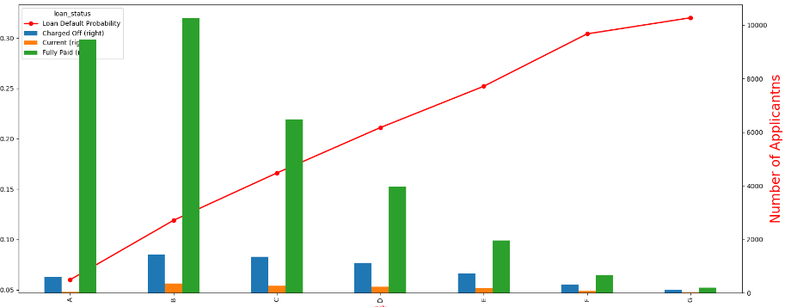
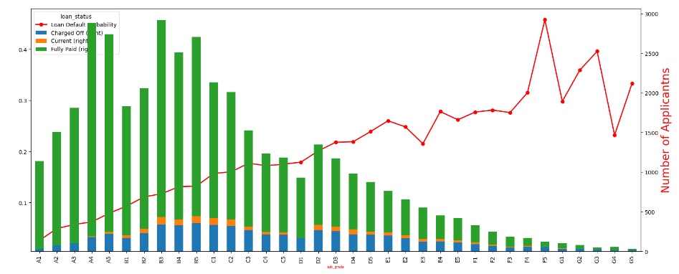
Visualizing Insights: Bivariate Analysis
Analyze defaulter probability for grades and sub-grades
Inference : From Grade A to G defaulter probability is increasing
Fig 1: Grade vs Number of Applications
Fig 2: Sub Grade vs Number of Applications

Slide 17
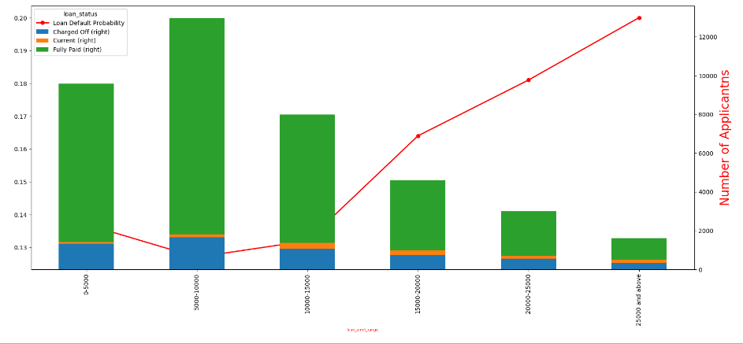
Visualizing Insights: Bivariate Analysis
Analyze defaulter probability based on Loan Amount
Inference : From the graph, we can say that when loan amount is increasing defaulter rate is increasing so bank should pay attention for higher loan amount

Slide 18
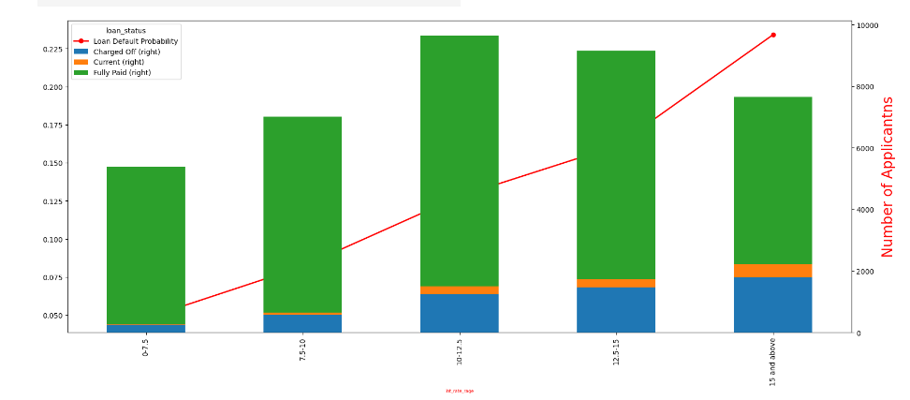
Visualizing Insights: Bivariate Analysis
Analyze defaulter probability based on Interest Rate
Inference : As the interest rate is increasing the defaulter rate, so banker should be cautious on this front.

Slide 19
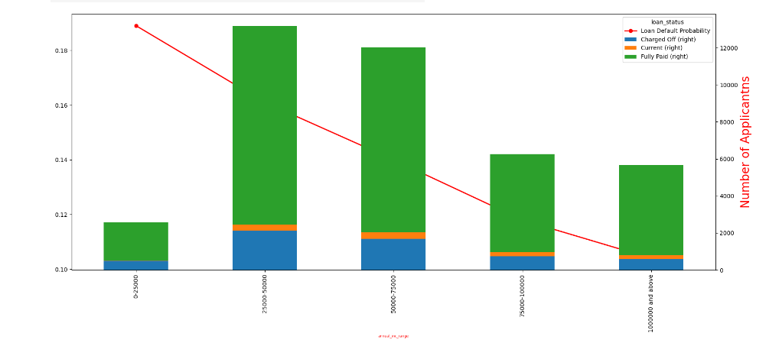
Visualizing Insights: Bivariate Analysis
Analyze defaulter probability based on Annual Income
Inference : As annual income is decreasing loan defaulter is increasing with highest of 19% approx. (annual income range - 0-25000)

Slide 20
Conclusion: Unlocking the Power of Data
Through this comprehensive guide, we have explored the essential steps in data understanding. By correctly identifying data quality issues, conducting thorough analysis, and presenting actionable recommendations, this analysis empower organizations to harness the power of data to drive success and growth.

