Slide 1
Geo-temporal Data Mining and Knowledge Discovery
USC Shoah Foundation Institute
Rodrigo Mendoza Smith
Anna Kuznetsova
Margo Smith
Peter Sugihara
AM: Peter Broadwell

Slide 2

What is the Shoah Foundation?

Slide 3
Introduction
  51,696 testimonies in the archive.
  105,000 hours of testimony.
  One-minute segments tagged with appropriate keywords.
  Users can now search throughout the database for segments containing specific keywords.
Notes:
The Shoah Foundation institute has collected thousands of hours of video testimonies from survivors of the Holocaust.
Each one-minute segment of video testimony has been painstakingly tagged by a Holocaust historian with appropriate keywords.
Users can now search throughout the database for segments containing specific keywords

Slide 4
This is a typical segment.
geo-keyword
Berlin (Germany)
extended family members
degenerate art
Shiffer, Nikolaus
general keywords

Slide 5
This is how search works now
Insert picture from iWitness – how it sucks
No easy access to the huge amount of geographic data in testimony

Slide 6
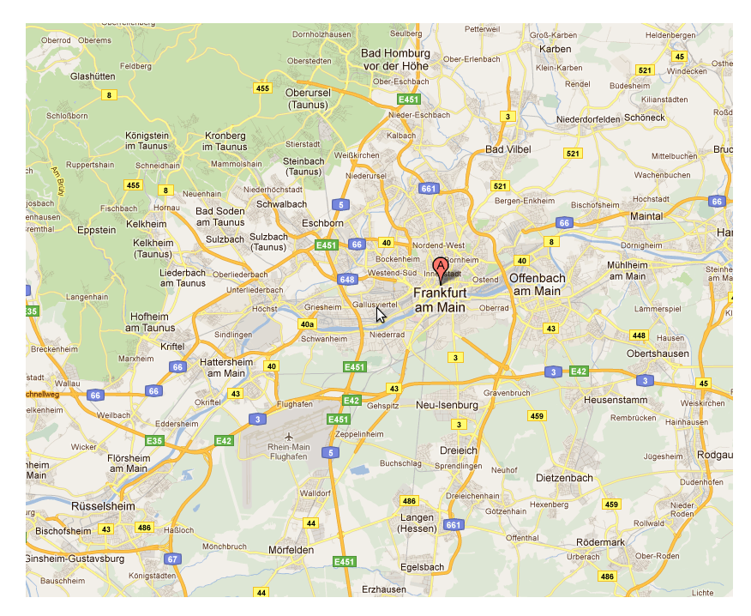
This is what we'd like to add
Rank
1
2
3
...
Topic
sabotage
ghetto escapes
organization (stills)
…
suggest general keywords associated with a queried location

Slide 7
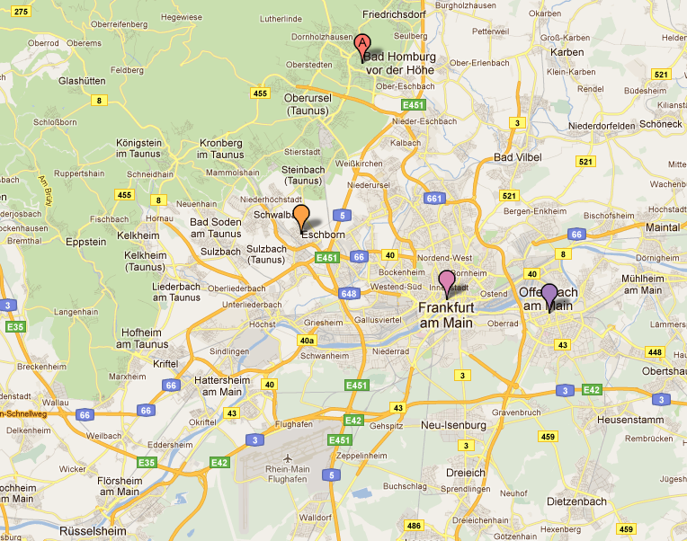
More things to add
Rank
1
2
3
4
5
6
...
Topic
sabotage
ghetto escapes
organization (stills)
Baum, Herbert
death camp
housing conditions
...
incorporate general keywords associated with the region of the initial location

Slide 8
Further improvements
More locations
Heat maps of topics
Segments close in topic and location

Slide 9
Objectives
  Improve search suggestions.
    General keywords associated with a place.
    General keywords associated with locations close to the initial location.
    Cluster locations that are semantically similar.
  Create visualization tools.
    Allow user to create heat maps associated with particular general keywords.
    Provide regional keywords related to area of map displayed by GoogleMaps mash-up.
    Visualize clusters.
  Time-permitting we will investigate clip similarity.
Notes:
Results from our first two objectives may naturally lead to finding clips that are related to each other. This information could be presented in a "YouTube" style suggested clips section.

Slide 10

This is what we will talk about
  Data preprocessing
  Data analysis
  Next steps
Notes:
We will proceed through the discussion of our approach in roughly chronological order, so this slide shows the basic layout of the heart of our talk.

Slide 11
Co-occurrence Matrix
...
hiding
Baum, Herbert
...
...
...
...
Berlin, Germany
...
10
621
Frankfurt, Germany
...
1
35
...
...
...
...

Slide 12
Data selection

Slide 13
Data selection

Slide 15
Data preprocessing: data selection
43,000 Keywords
38,000 Locations
38,000 Locations
Notes:
Filtered out geo-keywords from a list of over 43 thousand keywords.
Not every keyword represented a "point" location: regions + ambiguous locations that could be linked to multiple points in space
Limited ourselves to points only: camps, villages, cities etc that could be associated with a single set of longitude and latitude coordinates.
The matrix had to be stored as an adjacency list because it was HUGE.

Slide 16
Data preprocessing: Our data
High dimensional feature space.
Highly sparse data.
Curse of Dimensionality.
General Keywords
6,003
Co-occurrence Matrix
38023 x 6003 =
228,252,069
Location Keywords
38,023
Non-zero entries
250,610
All Keywords
43,026
Percent sparsity
99.99%
Notes:
What can we say about our data?
This three aspects reduce to the fact that if we want to infer some knowledge easily with standard data-mining algorithms we would need an incredibly large amount of data.
This doesn't mean we can't infer any knowledge, just that we have to be careful about which algorithms we choose to use.
Curse of dimensionality refers to the fact that in high dimensions some techniques that normally work start to do strange things, details on that later.

Slide 17
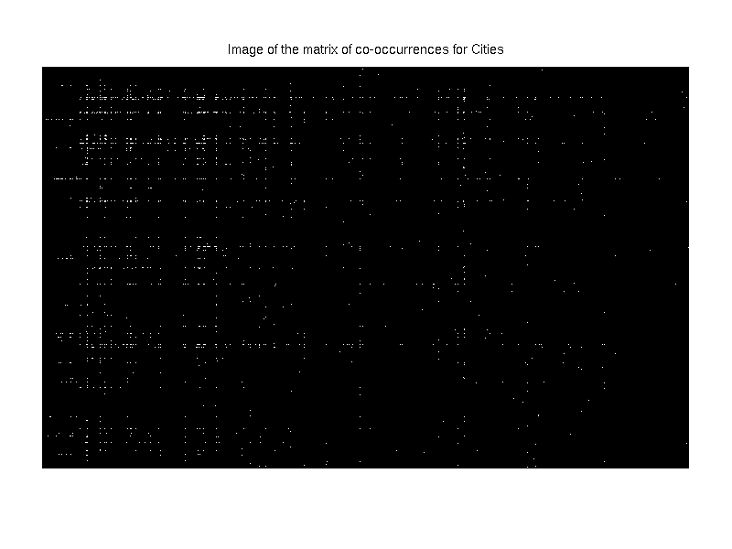
over 5000 dimensions
Notes:
sparse!

Slide 18
Data preprocessing: questions?
  What do we want to do with all this data?
  Allow the user of VHA to access geographic data in their exploration of testimonies, e.g.
I. suggest general keywords, or topics, relevant to the region of the initial query
II. suggest geo-keywords that the user might be interested in based on their initial query, e.g
      Geo-keywords geographically close
      Geo-keywords linked by topics
      Geo-keywords linked by segment
Notes:
Why is this slide here?
I also think this is mostly redundant, see "objectives" slide.

Slide 19
Data analysis: Principal Components Analysis (PCA)
  Preliminary data exploration step - which dimensions are most important?
  How it works
    Plot all locations based upon their general keyword co-occurrence vectors
    Each keyword is a dimension of the space.
    Principal components are hybrid uncorrelated variables that have as high a variance as possible, i.e. they explain a large proportion of the variation in the data points.
  Result: words related to camps and transportation are highly weighted in the first principal component.

Slide 20
Data analysis (visual): Heat maps
  Historical maps generally show physical things such as trade routes, concentration camps, and battlegrounds.
  From our data, we can associate other interesting keywords such as "hunger", "hiding", and "transport" with geo-locations.
  Allowed us to see the spatial distribution of geo-keywords heavily linked to topics highlighted by the PCA analysis
  Used Natural Neighbors Interpolation method from ArcGIS toolbox
Notes:
The heat maps display co-occurrence between geo-keywords and specific groups of general keywords.

Slide 21
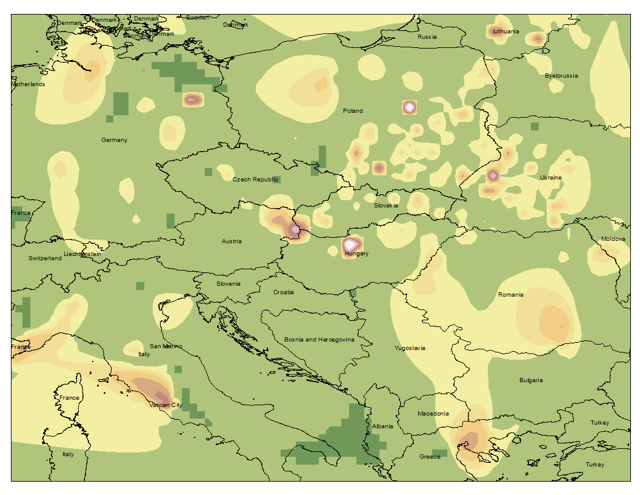
"Hiding"

Slide 22
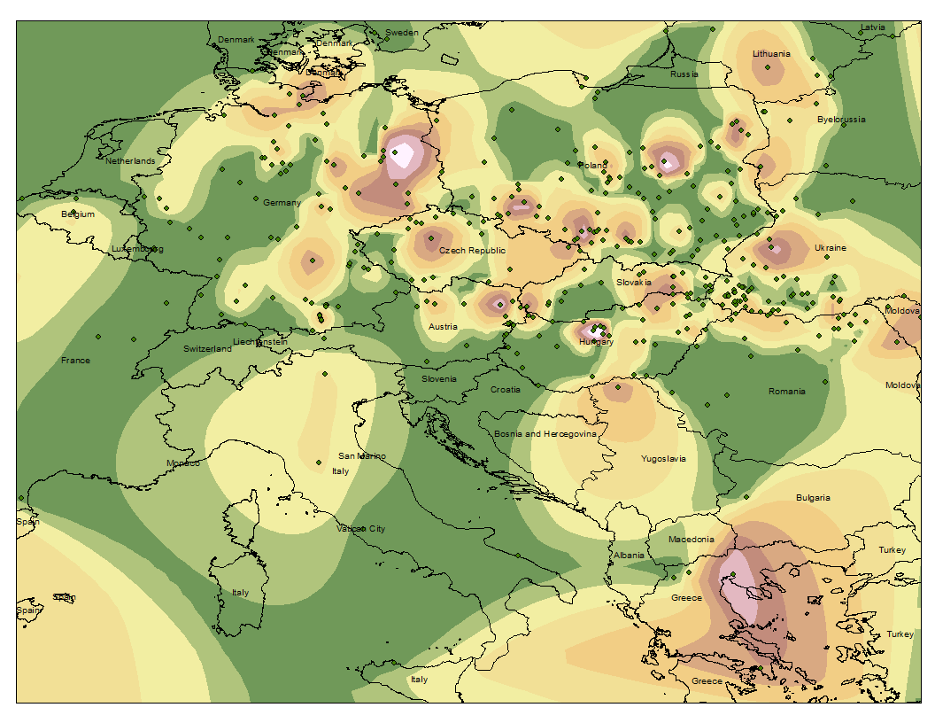
"Transport"

Slide 23
Data analysis: clustering
  Grouped geo-keywords using the following criteria:
a) the frequency of their occurrence in the same segment.
b) the overlap of their vectors of general keyword
co-occurrences = "stories".
  Motivation: the user may be interested in the keywords clustered together with a location in their initial query.

Slide 24
Data analysis: clustering I
  Clustering geo-keywords based on their occurrence in the same segment
  Allows us to see regions based upon locations that people often talk about in relation to one another, rather than arbitrary political boundaries.
  Success indicates that for certain keywords, co-occurrence does indicate geographic closeness.
Notes:
Show fusion tables clusters.

Slide 25
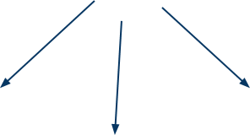
Data analysis: clustering II
  Clustering geo-keywords based on their general keyword co-occurrence vectors.
Berlin, Germany
Vienna, Austria
transport
hunger
Herbert Baum
hiding
deportation
  Initial question: Is it possible that geo-keywords that are geographically close share similar stories?
  Correlation analysis of geographic and semantic proximity.
Notes:
In order to find relationships between geo-keywords, we need to describe them in a mathematical way.
Count which general keywords surround each geokeyword in each one-minute segment and then we can describe each geokeyword using this information.
We focus on the edge weights.
one general keyword might me attached to several geo keywords. When this happens we are gaining information about the relationship of these two geokeywords. There are stories around each geographical keywords, we want to know whether this relate the same story.
Initial question.
We need to asses whether geographc and semantic proximity are correlated.

Slide 26
Data analysis: Semantic Similarity and Geographic Distance
Intuitively, testimonies that reference a particular location (geo-keyword) are prone to relate similar stories (general keywords) around that particular location.
We expect that places that are close in the map will also be semantically similar.
Challenges:
  Noisy Data:
    Bag-of-words approach.
    Keywords don't capture all the information in the clip.
  What is "close"?
Notes:
intuitively...
we expect... that is, we expect to find correlation between semantic similarity and geographic proximity.
The nature of our data is noisy for several reasons.
Keywords initial purpose was to facilitate database search of the video database, not finding relationships.
We had to mine a database to obtain our initial data!
Bag of words approach says we are not taking into account the order in which the keywords appear in the segment. Information is clearly lost here, but otherwise the analysis would be extremely complicated!
WE HAVE TO USE BAG OF WORDS APPROACH. WE ARE FORCED TO.
How can we define two cities as being close to each other. It's difficult to impose a number that easily discriminates what is and what isn´t close. Now we can say that Santa Monica is close to UCLA, but in wartime, imaginary boundaries played a critical role!

Slide 27
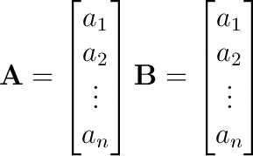
Data analysis: Similarity measure
A and B represent the number co-occurrences between geo-keywords "A" and "B" and the set of n general keywords. For example, a₂ may be equal to the number of times "A" and "hunger" are tagged in the same segment.
How do we measure their "distance" from one another?
Notes:
Now we get to some mathematical details.

Slide 28

Data analysis: Similarity measure
  Euclidean distance:
    Does not take into account the widely varying sparsity of the vectors.
    Curse of Dimensionality.
  Cosine Similarity:
    Vectors are normalized.
    Very general vector comparison. Does not account for semantic knowledge (synonyms, word relationships).
Notes:
A small town may be mentioned in only a few segments but its keyword distribution may be very similar to that of Paris, France (a city with many co-occurrences). In short, there is too much emphasis on the magnitude of the vector.
High dimensional spaces behave in a strange way. As dimensionality increases, the concept of proximity may not be qualitatively meaningful.
Cosine similarity:
It's often more suitable for "variables" rather than "data points".
Semantic vectors lie all in the positive sector of the space.
We will always have 0<=cos<=1
Unlike Euc dist, it is equal to 0 if vectors are perpendicular. so we can easily see which locations have NO keywords in common!
If two vectors just differ proportionally between each other i.e. k*x₁ "more or less equal to" x₂, then the two vectors are proportionally similar and will have a high cosine similarity.

Slide 29

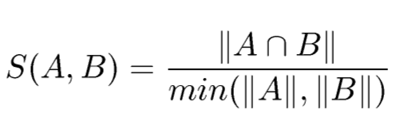
Data analysis: Similarity measure
  Correlation Distance: deals with normalized vectors and shifts all variables by their mean so that we can compare un-like variables.
  Hamming distance: element by element comparison 010111 and 011011 have hamming distance 2.
    Heavily favors distances between common cities.
    Doesn't account for multiple co-occurrences.
  Our own distance metric: consider A and B as sets of general keywords corresponding to locations A and B.
Notes:
These all seem to be purpose built for specific applications (hamming distance is good for information stored as binary).

Slide 30
Data analysis: criteria for an ideal similarity measure
  Shouldn't favor big cities.
  Should give a useful distribution (not all 1's and 0's).
  It should be easy to articulate the relationship between its value and the two word vectors being compared (and moreover the keyword co-occurrences which those vectors represent).

Slide 31
Data analysis: correlation investigation
  Calculated pairwise distances (in degrees) for all points in the set.
  Set a threshold of T=300 km=2.7degrees.
  Threw out all the zero distances.
  Calculated the corresponding pairwise semantic distances.
  Used sample linear correlation, or Pearson correlation coefficient.
  Similar results for cosine similarity and higher T.

Slide 32
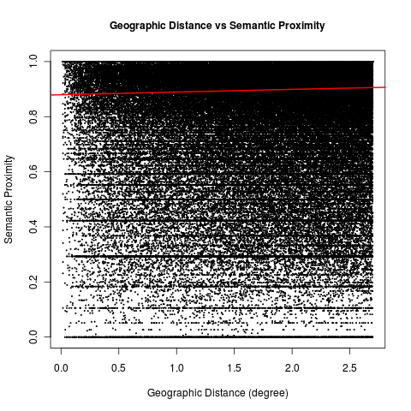
Data analysis: correlation investigation

Slide 33
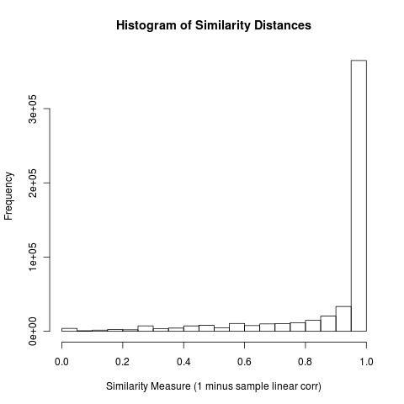
Data analysis: correlation investigation

Slide 34
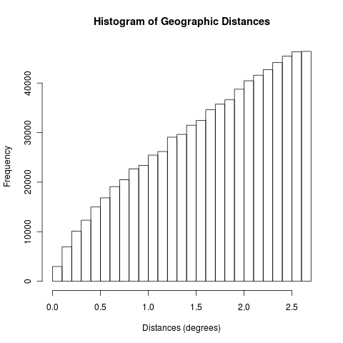
Data analysis: correlation investigation

Slide 35
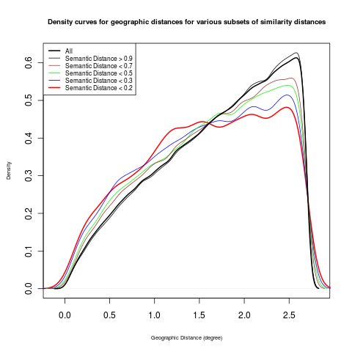
Data analysis: correlation investigation

Slide 36
Data analysis: clustering using affinity propagation
  Found no significant correlation between semantic and geographic distance.
  However, still interested in clustering geo-keywords with similar distribution of general keyword co-occurrences.
  Used affinity propagation algorithm, invented by Brendan Grey and Delbert Dueck at University of Toronto.
Highlights: no predefined number of clusters, user-defined similarity measure
  Matlab code and more information available at http://www.psi.toronto.edu/index.php?q=affinity%20propagation
  Used (Pearson) linear correlation as the similarity measure.

Slide 38
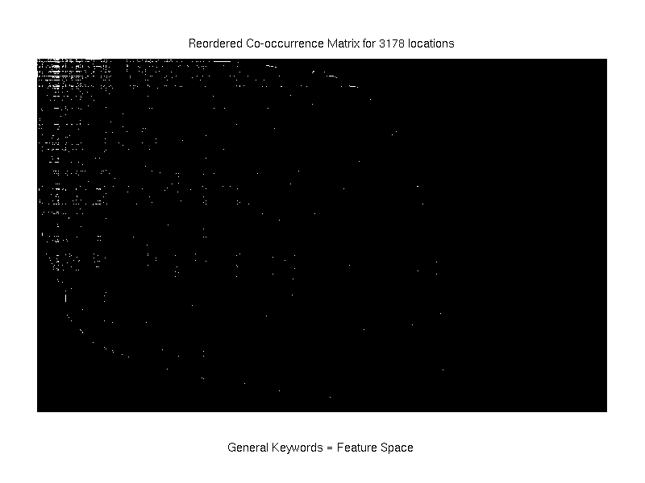
used an algorithm based on RCM (Reverse Cuthill McKee ordering) to minimize the bandwidth of the matrix

Slide 39
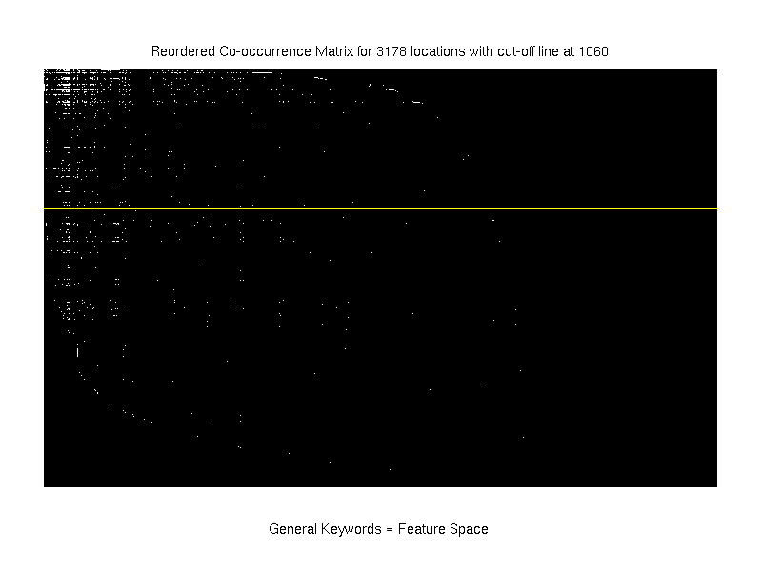

Slide 40
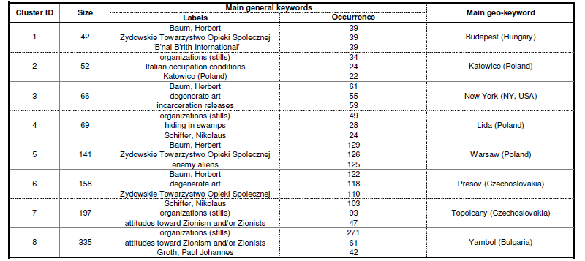
Data analysis: clustering using affinity propagation
Results for clustering 1060 geo-keywords = representative sample

Slide 41
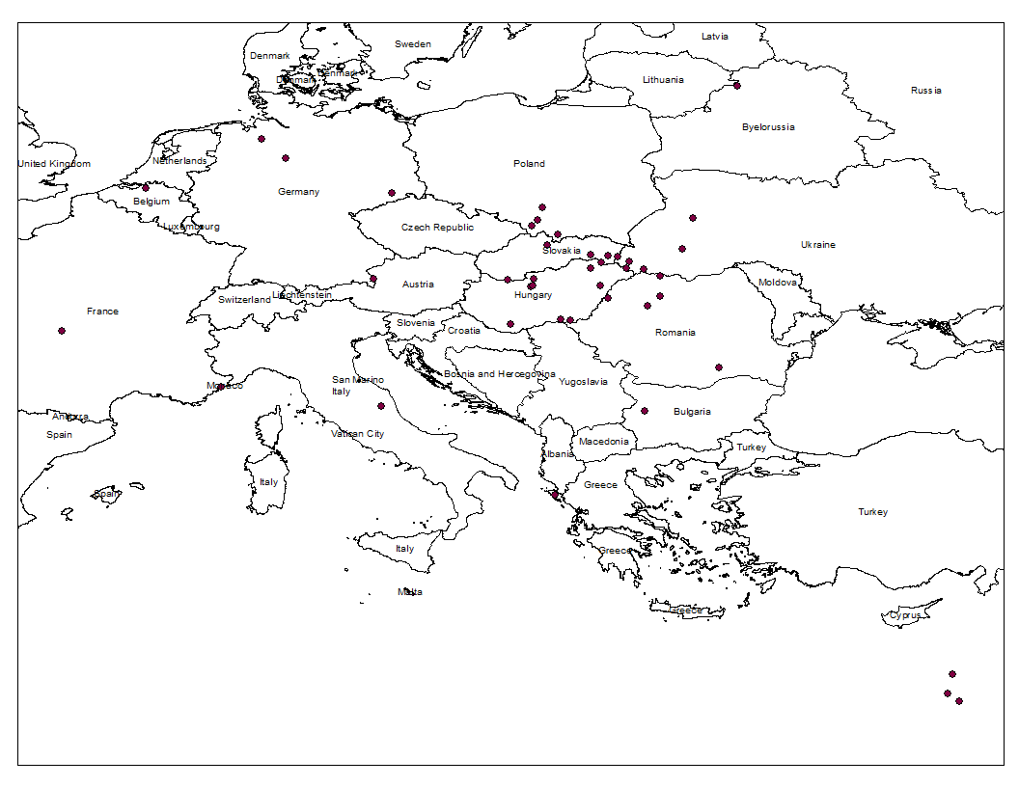
Cluster 1

Slide 42
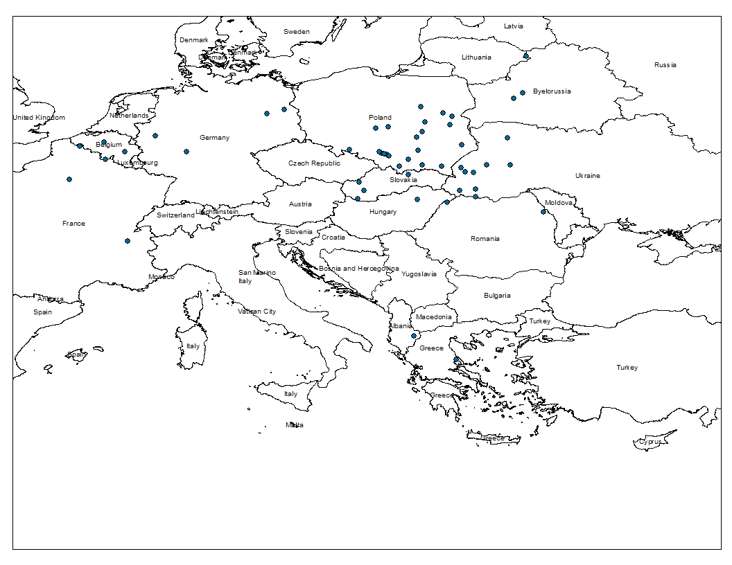
Cluster 2

Slide 43
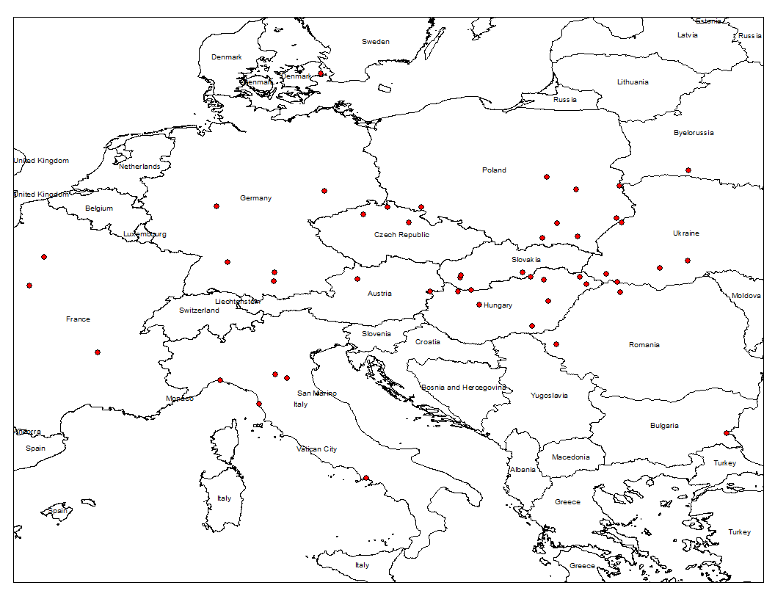
Cluster 3

Slide 44
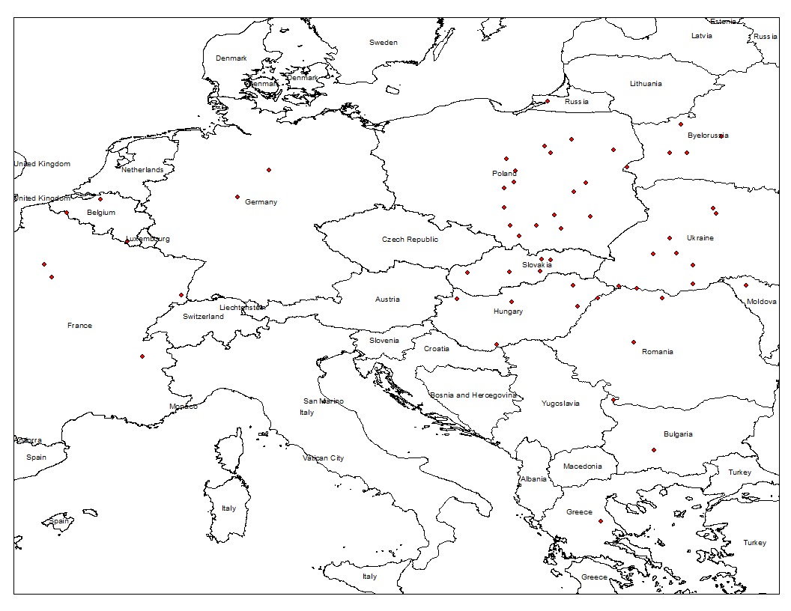
Cluster 4

Slide 45
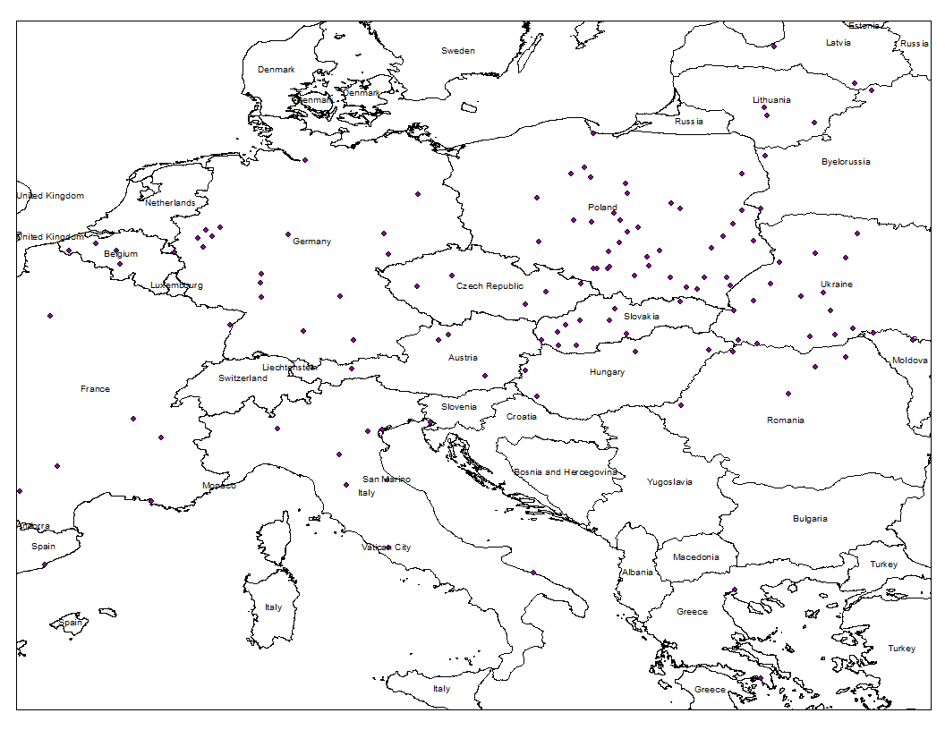
Cluster5

Slide 46
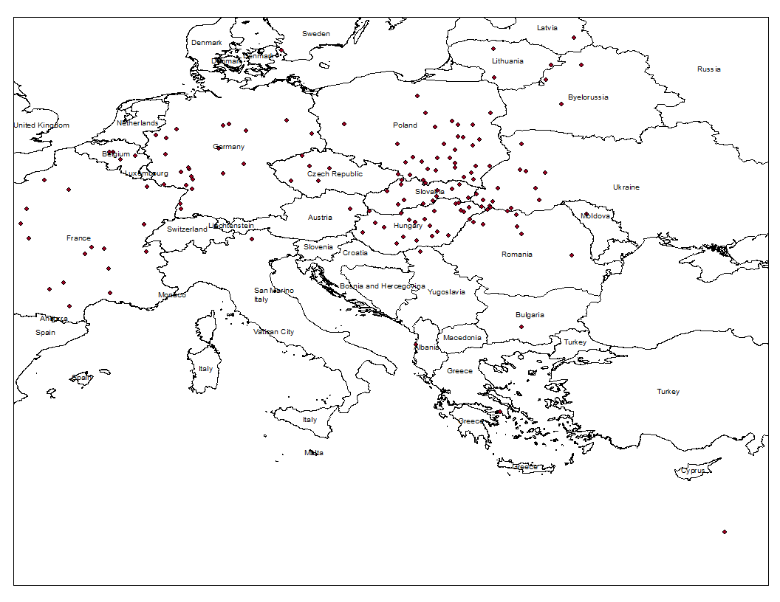
Cluster 6

Slide 47
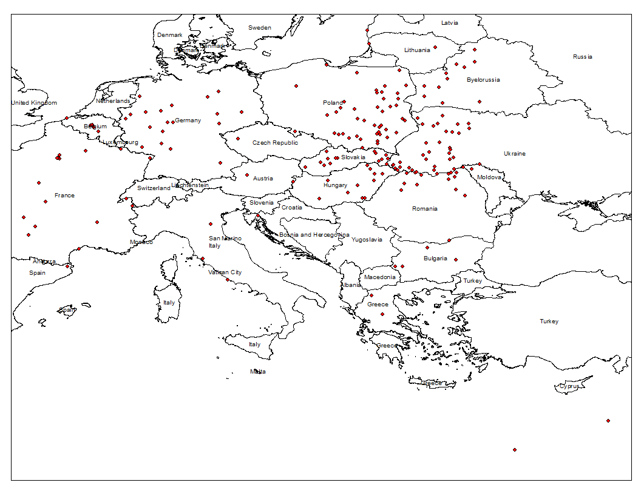
Cluster 7

Slide 48
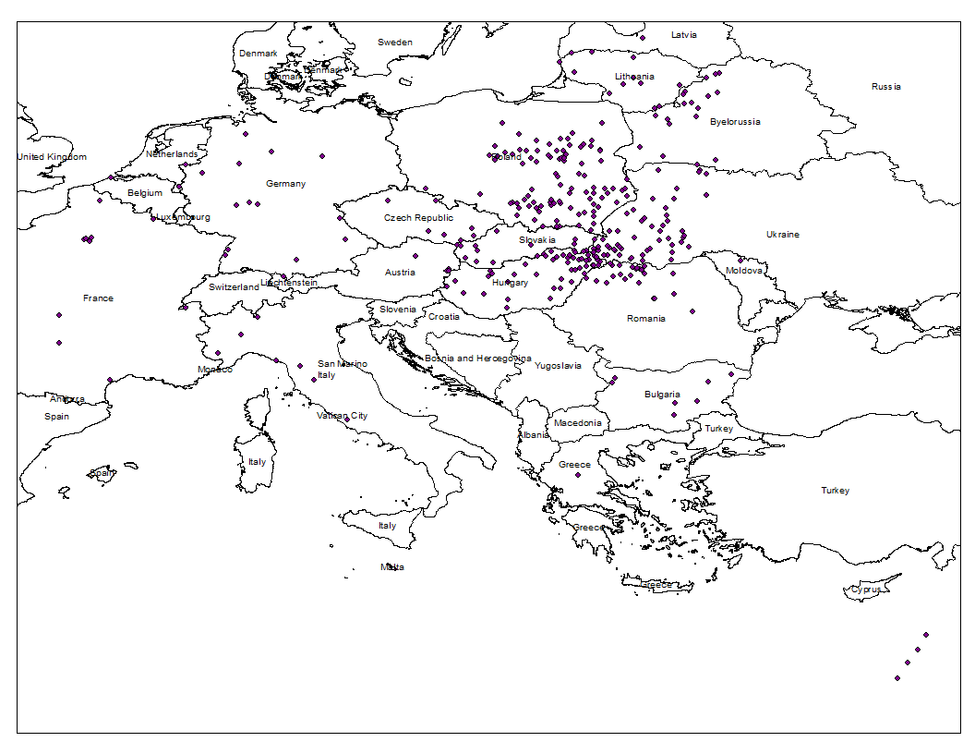
Cluster 8

Slide 49
Current Direction
  Ranking algorithm
    Generate an ordered list of relevant keywords for a given location on the map.
    Bump up keywords that also co-occur with locations that are geographically close to the center.
  Clip Similarity (suggested clips)
    Our current work could easily be applied to the problem of presenting the user with clips that are semantically and/or geographically associated with the clip that they are watching.
    Similarity matrix.
Notes:
We would like to generate a table containing a scalar measure of similarity for each related pair of clips.

Slide 50
Current Direction (cont'd)
  Increase the scope of our co-occurrence window
    Decrease sparsity of data.
    Take into account normal human speech patterns.
    Attempt to mimic costly human separation of stories.
    8 minutes windows or geo-keyword to geo-keyword.
  Make use of generic and regional location keywords
    Keywords that cannot be defined as a single point are still useful, and could provide useful keyword suggestions for search.
    Keywords associated with generic locations may actually be about a specific location that some one is looking for, so they could provide useful suggestions.
Notes:
People don't necessarily talk about things in one minute segments. Part of the reason our data is so sparse is because people will introduce a location and then spend the next 5 to 10 minutes talking about things that are associated with that place. With our current algorithm we are only assigning co-occurences to words that occur within the same one minute segment.
The first 3,000 testimonies collected by the Shoah Foundation were separated into segments based on natural start and end of stories, but this process took far to much man power (6-7 hours for each hour of video as compared to 2 hours per hour) so they stopped. What they found was that stories were typically about 8 minutes long, so we may try that. Ultimately, however, we hope to create a dynamic algorithm that will separate the testimony into segments whenever the interviewee introduces a new location.
Many of the keywords in the database are either regions (such as "Germany" or "Asia") or classified as "generic," which means that the speaker could have been referring to any one of a number of places in the same region with the same name. Ideally we could suggest keywords that heavily co-occur with either the region or a generic location when someone searches for a specific location within that region or with that generic name.

Slide 51
Conclusion
  Accomplishments:
    Organization of data and understanding of database.
    Creation of heat maps.
    Clustering.
    Semantic and Geographic distance correlation.
  Still to work on:
    Co-occurrence window redefinition.
    Ranking algorithm.
    Further visualizations.

Slide 52
Thank you.
Questions?

