Slide 1
KiCad Workshop
Go to https://github.com/psuieee for completed files

Slide 2

Attendance

Slide 3
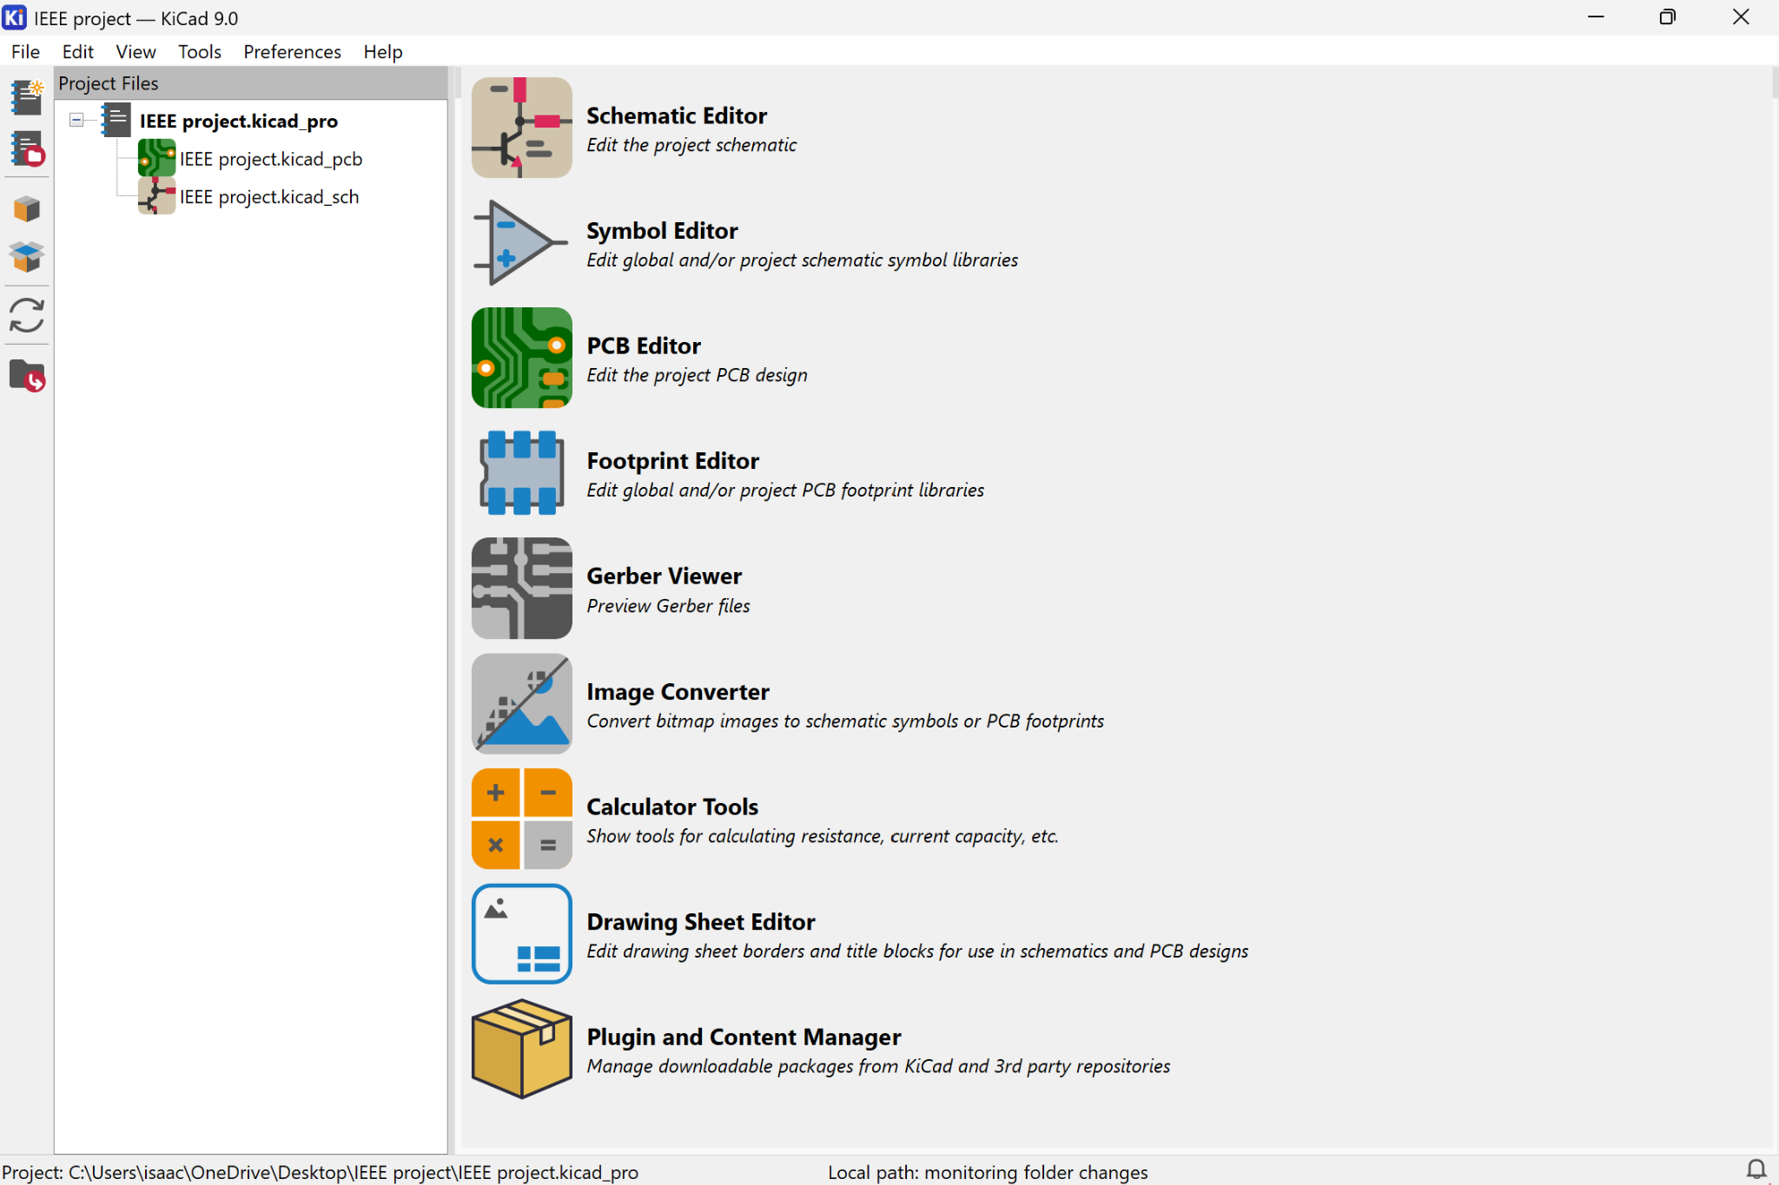
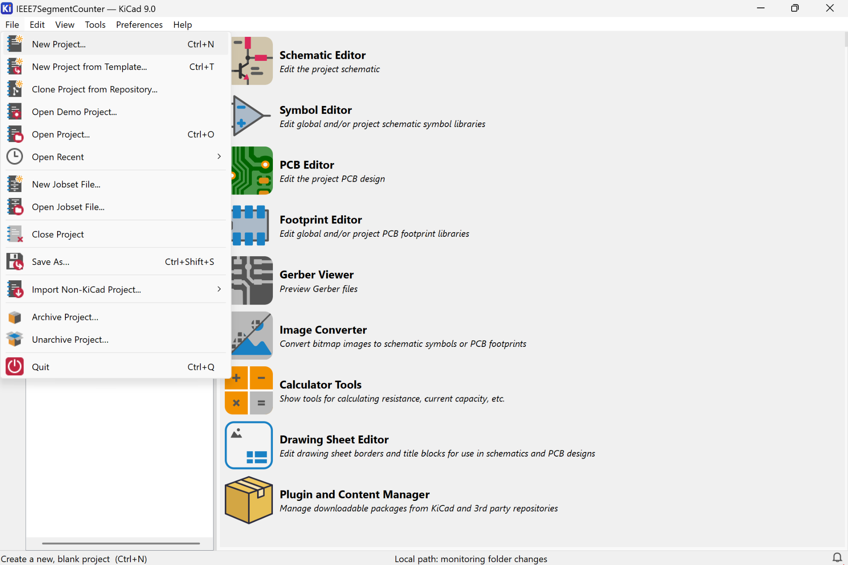
Create a project
Open Schematic Editor

Slide 4
Open Schematic Editor

Slide 5
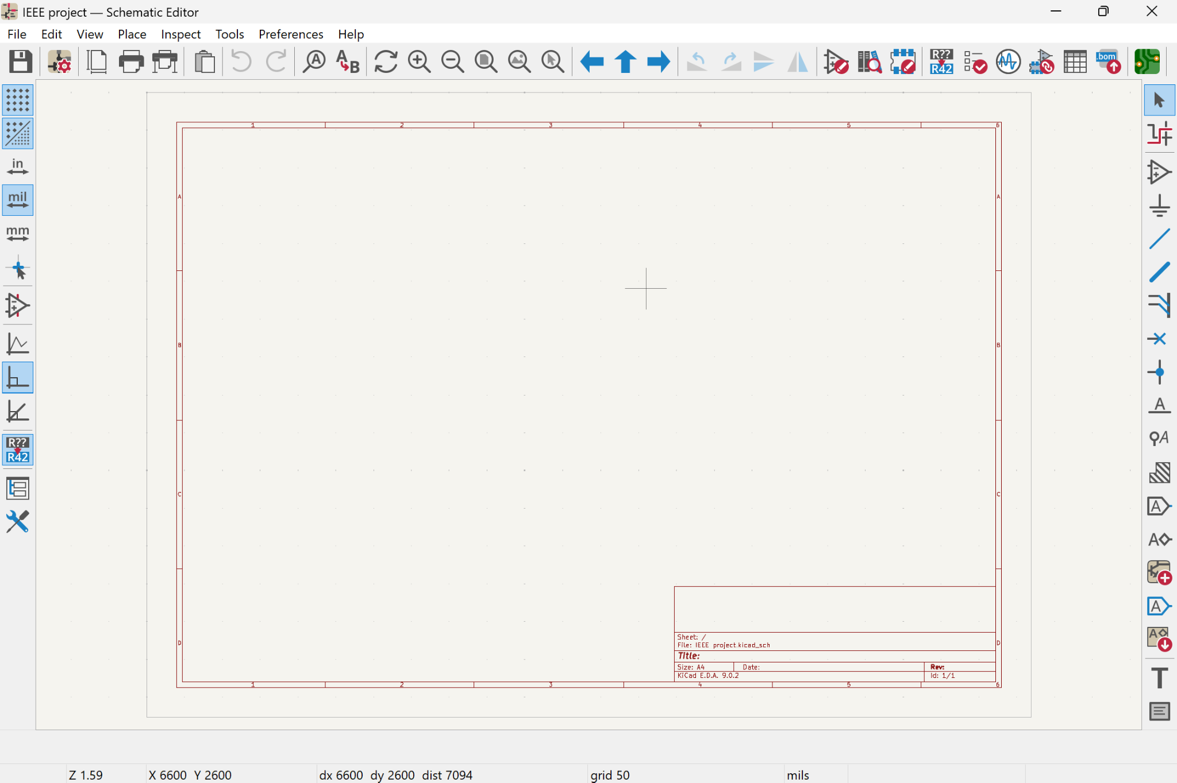
Place Symbols
Shortcut (A)

Slide 6
Required Symbols
Symbol Name | Details
R_US | 330 (x2), 10k ohm
C_Polarized | 10 uF
Thermistor_PTC | 5k ohm
Battery | 5V
AMS1117-5.0
LED | x2
R_Potentiometer_Trim_US | 5k ohm
LM358 (Unit A & C)
Buzzer
PWR_Flag | x2
Shortcut (A)

Slide 7
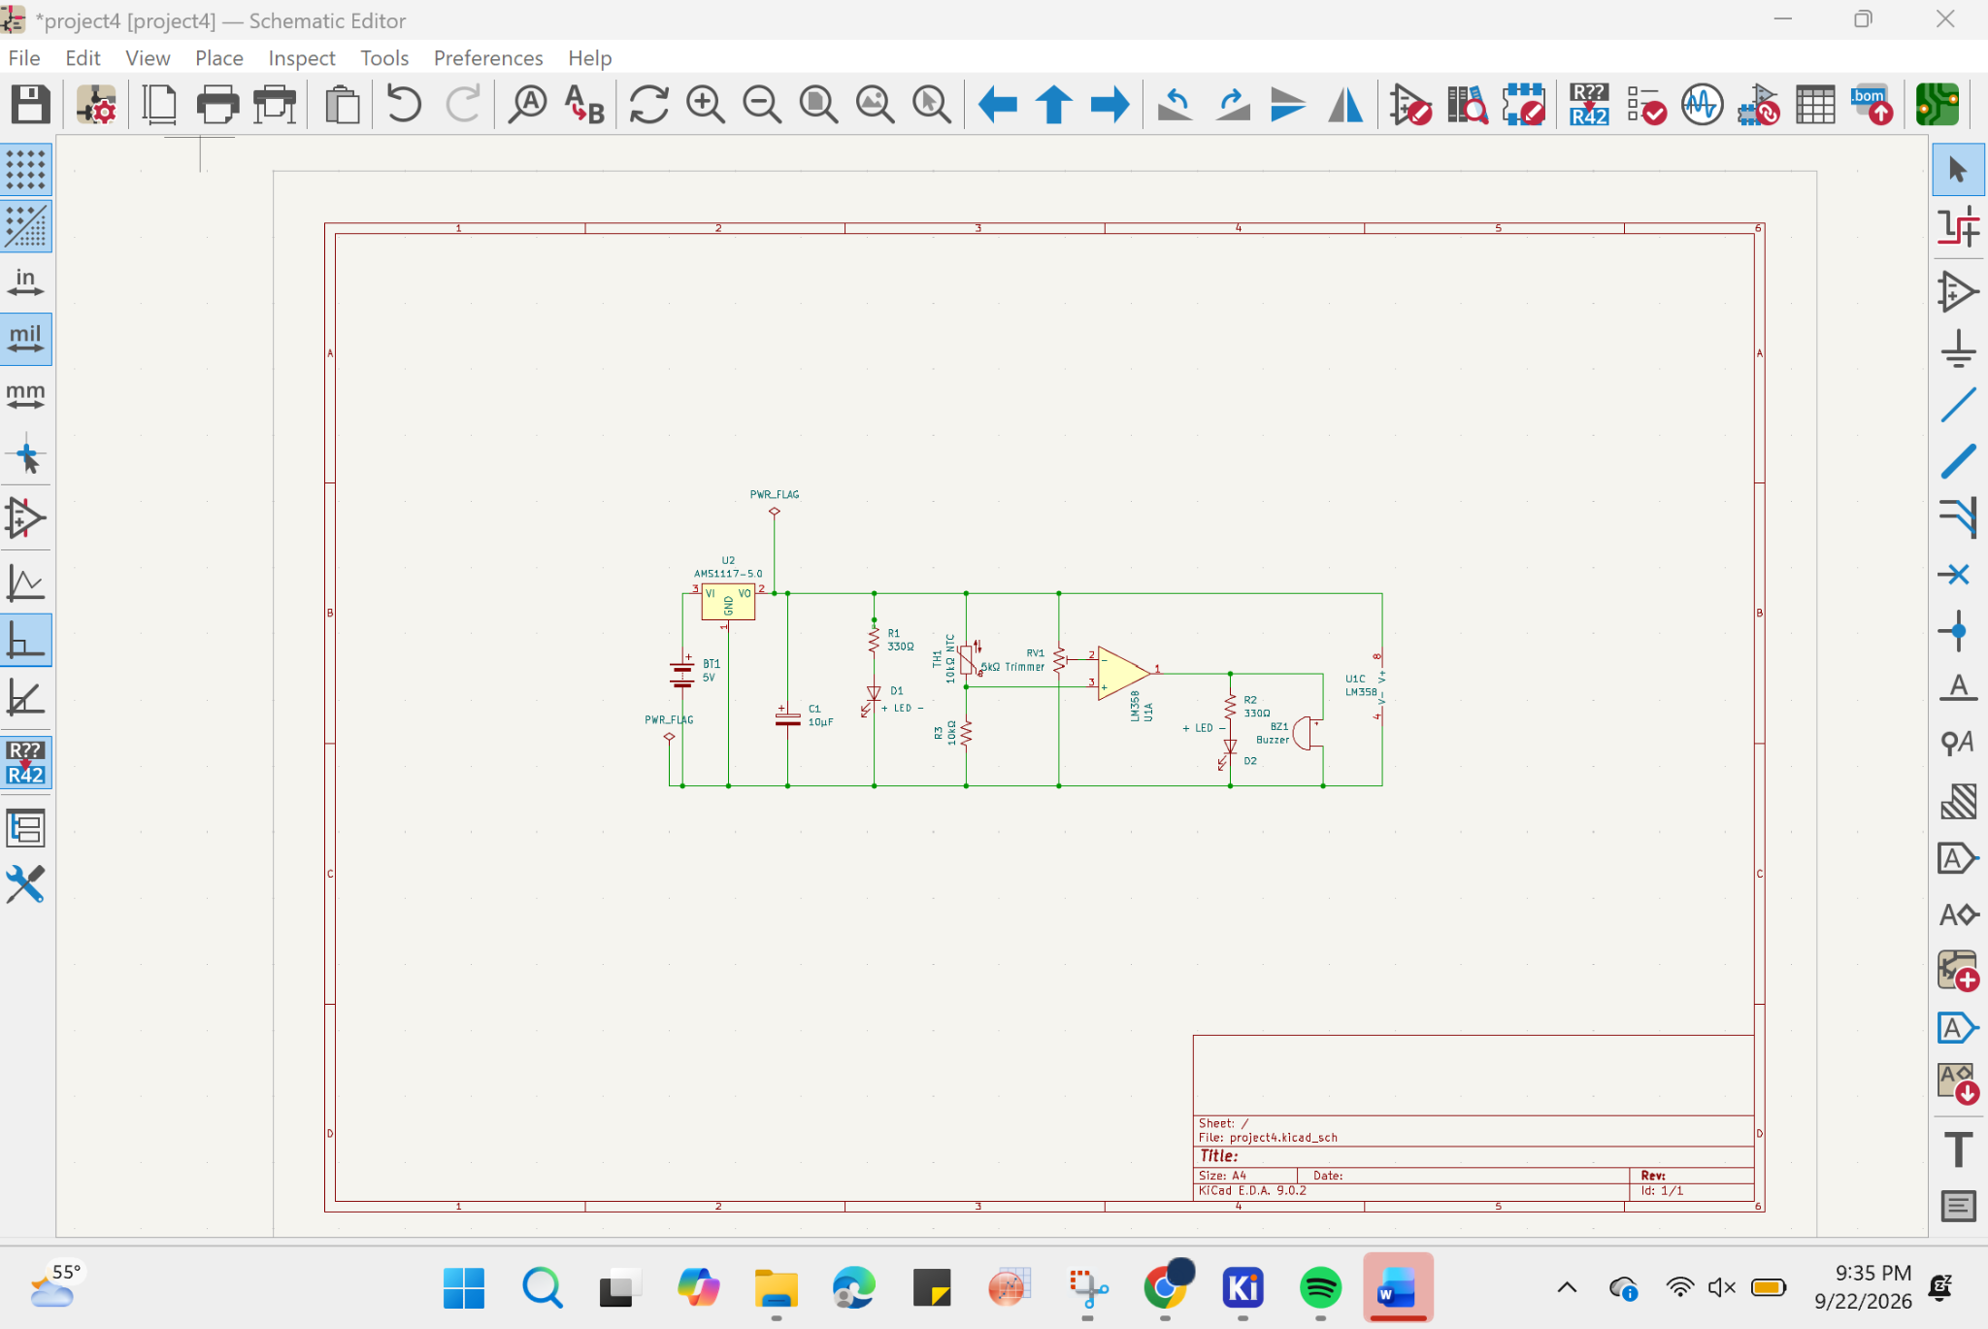
Align Components & Wiring
Wire tab
Shortcut (W)

Slide 8
Circuit Diagram

Slide 9
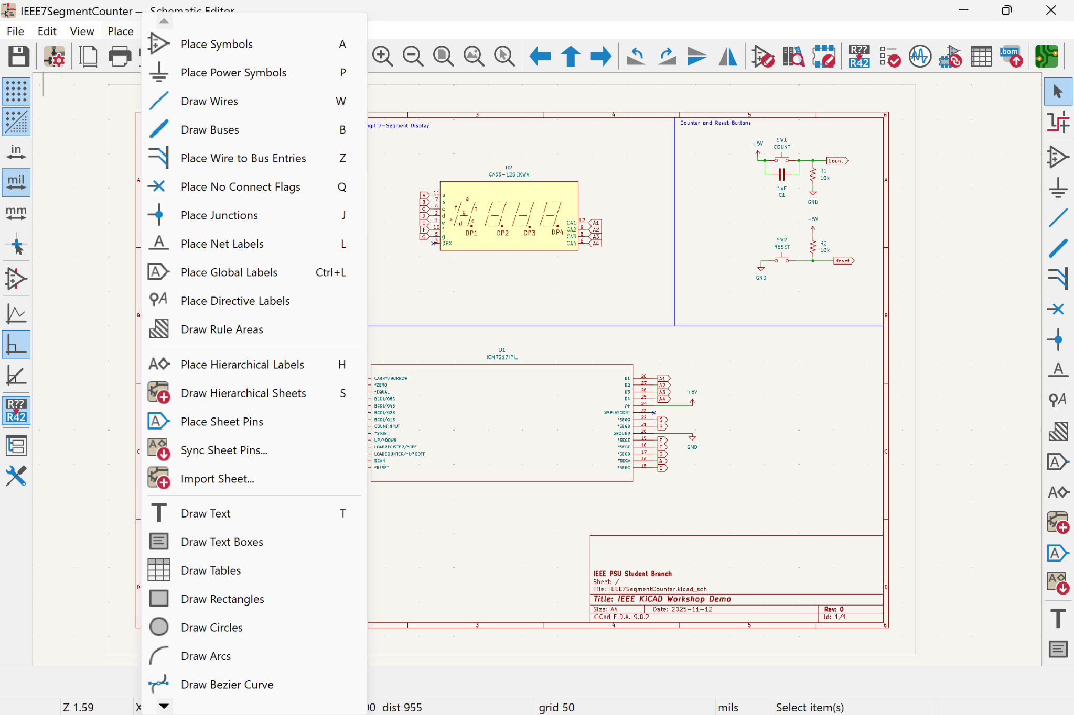
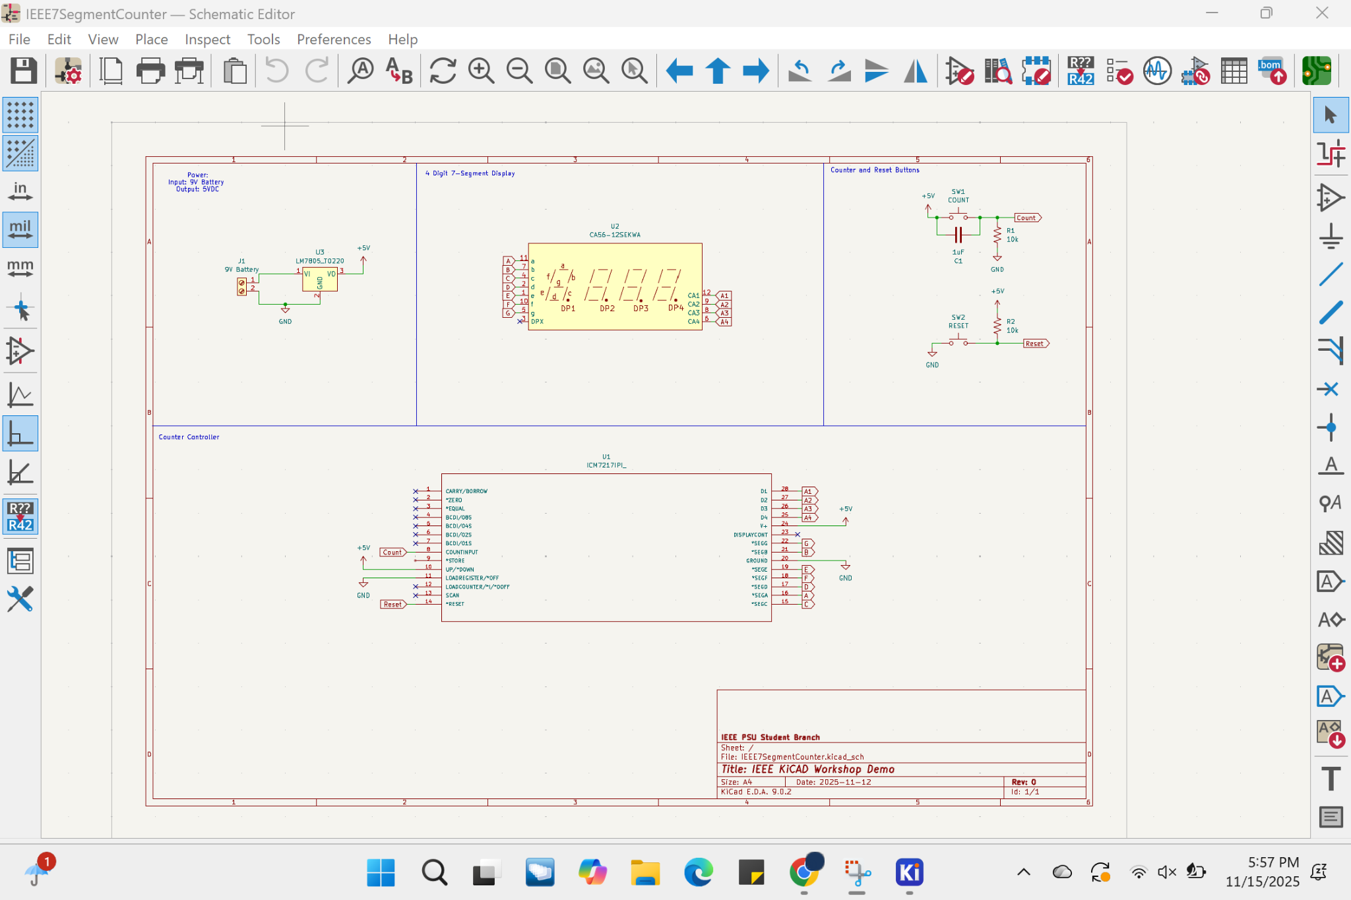
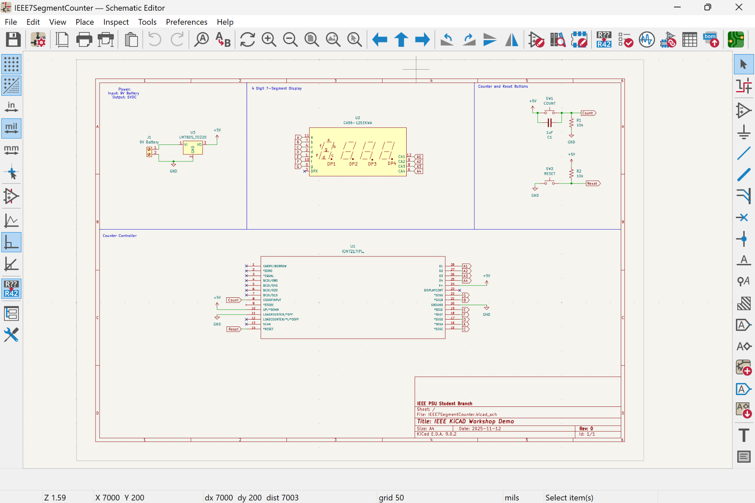
Adding Footprints

Slide 10
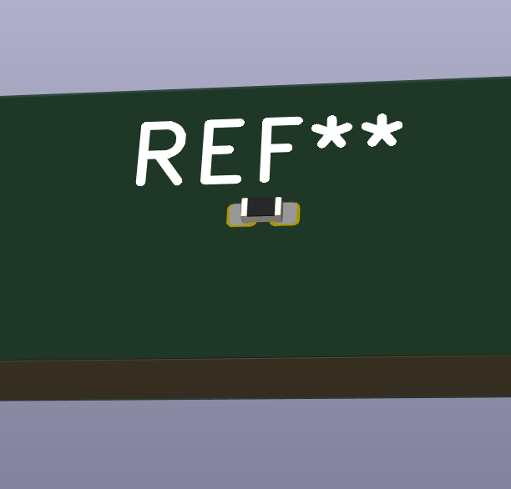
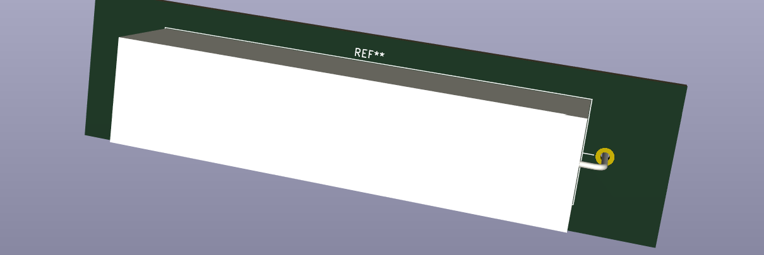
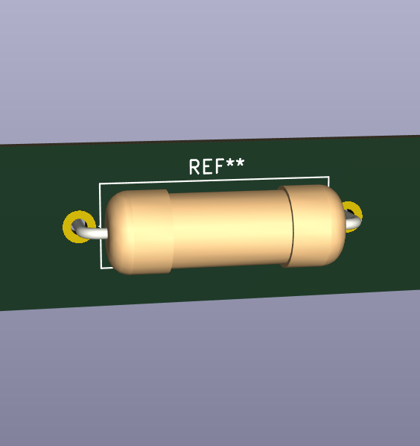
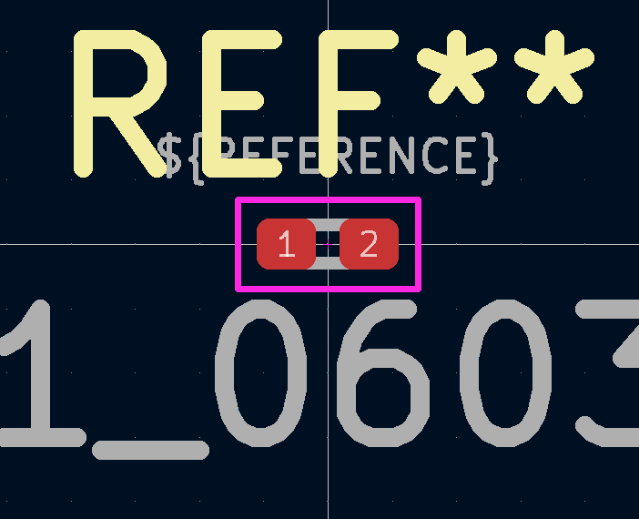
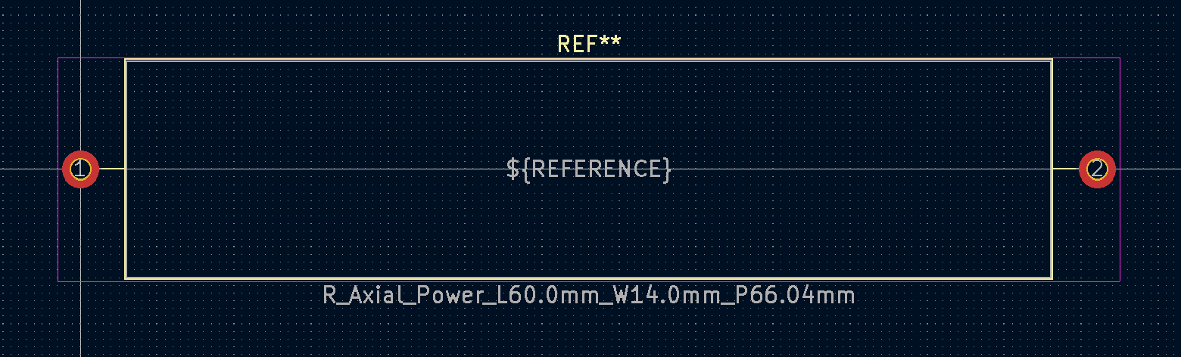
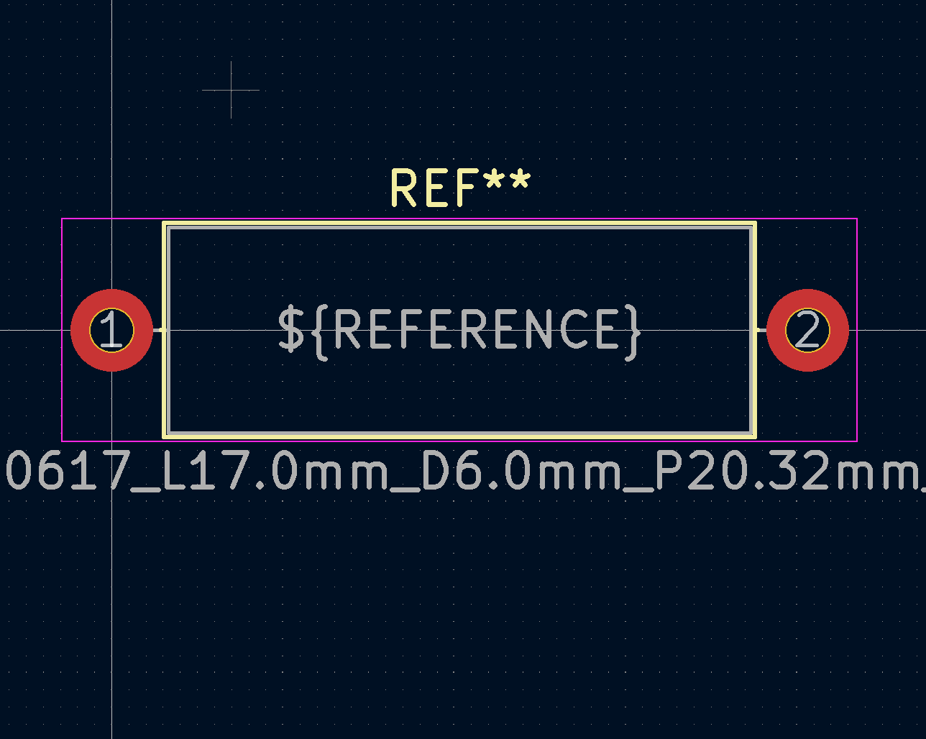
Same Device, Different Footprint

Slide 11
Adding Footprints
Symbol Name | Footprint
BT1 | Connector_PinHeader_2.54mm:PinHeader_1x02_P2.54mm_Vertical
BZ1 | Buzzer_Beeper:Buzzer_12x9.5RM7.6
C1 | Capacitor_SMD:C_1812_4532Metric
D1 | LED_THT:LED_D5.0mm
D2 | LED_THT:LED_D5.0mm
R1 | Resistor_THT:R_Axial_DIN0207_L6.3mm_D2.5mm_P10.16mm_Horizontal
Symbol Name | Footprint
R2 | Resistor_THT:R_Axial_DIN0207_L6.3mm_D2.5mm_P10.16mm_Horizontal
R3 | Resistor_THT:R_Axial_DIN0207_L6.3mm_D2.5mm_P10.16mm_Horizontal
RV1 | Potentiometer_THT:Potentiometer_Piher_PT-10-V05_Vertical
TH1 | Connector_PinHeader_2.54mm:PinHeader_1x02_P2.54mm_Vertical
U1 | Package_DIP:DIP-8_W7.62mm
U2 | Package_TO_SOT_SMD:SOT-223-3_TabPin2

Slide 12
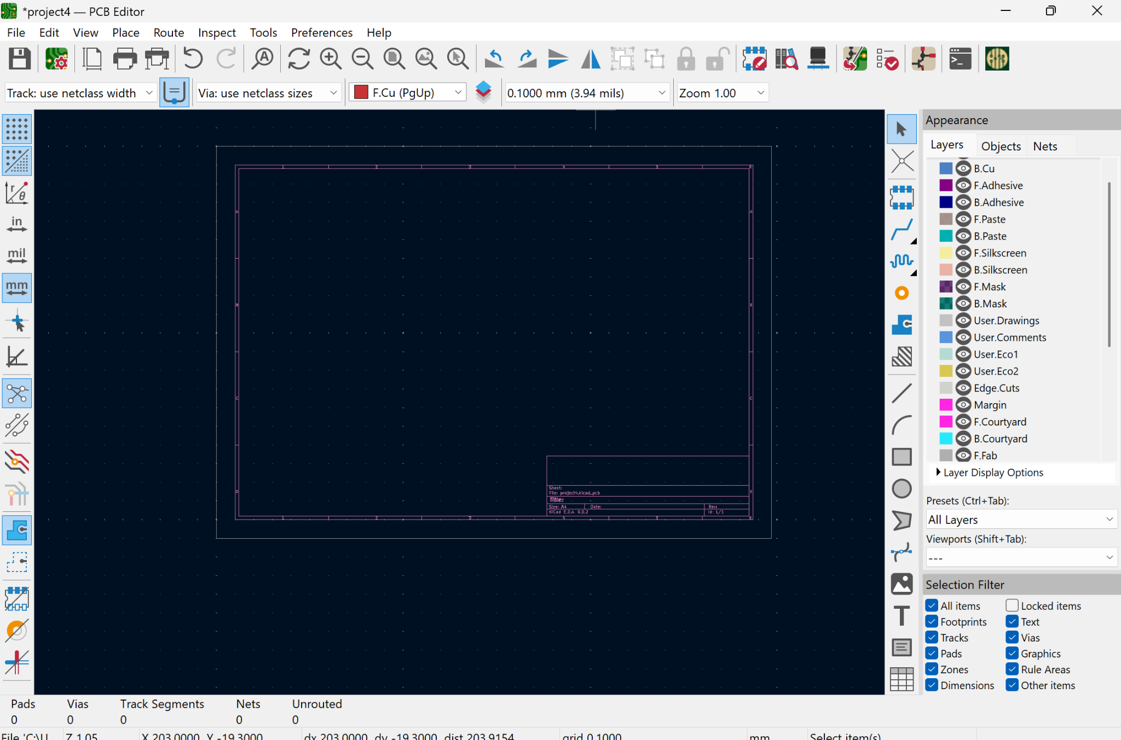
Placing Footprints

Slide 13
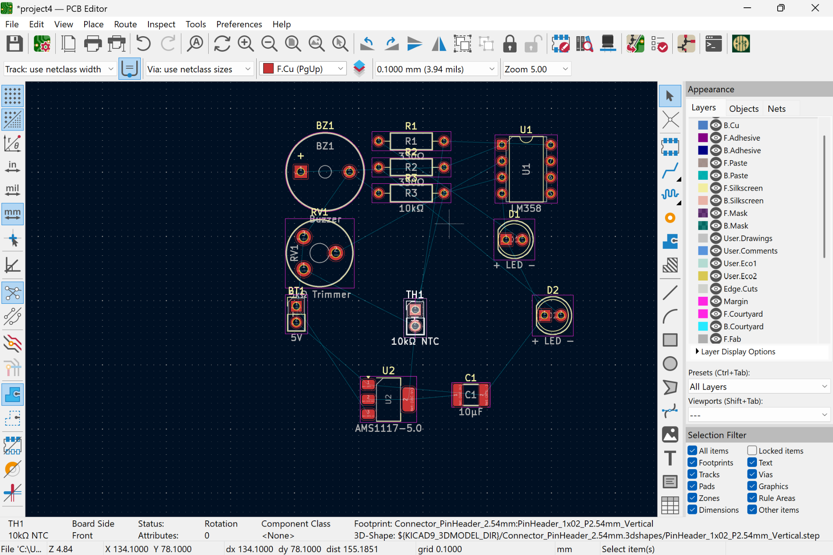
Arrange Footprints
After selecting a component Press (R) to Rotate

Slide 14
Place Traces
Traces: Shortcut (X) & Vias: (Ctrl+Shift+X)

Slide 15
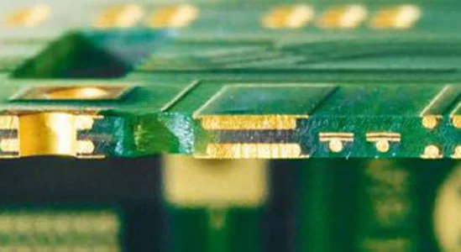
Place Traces
Front Copper
Via
Back Copper
Traces: Shortcut (X) & Vias: (Ctrl+Shift+X)

Slide 16
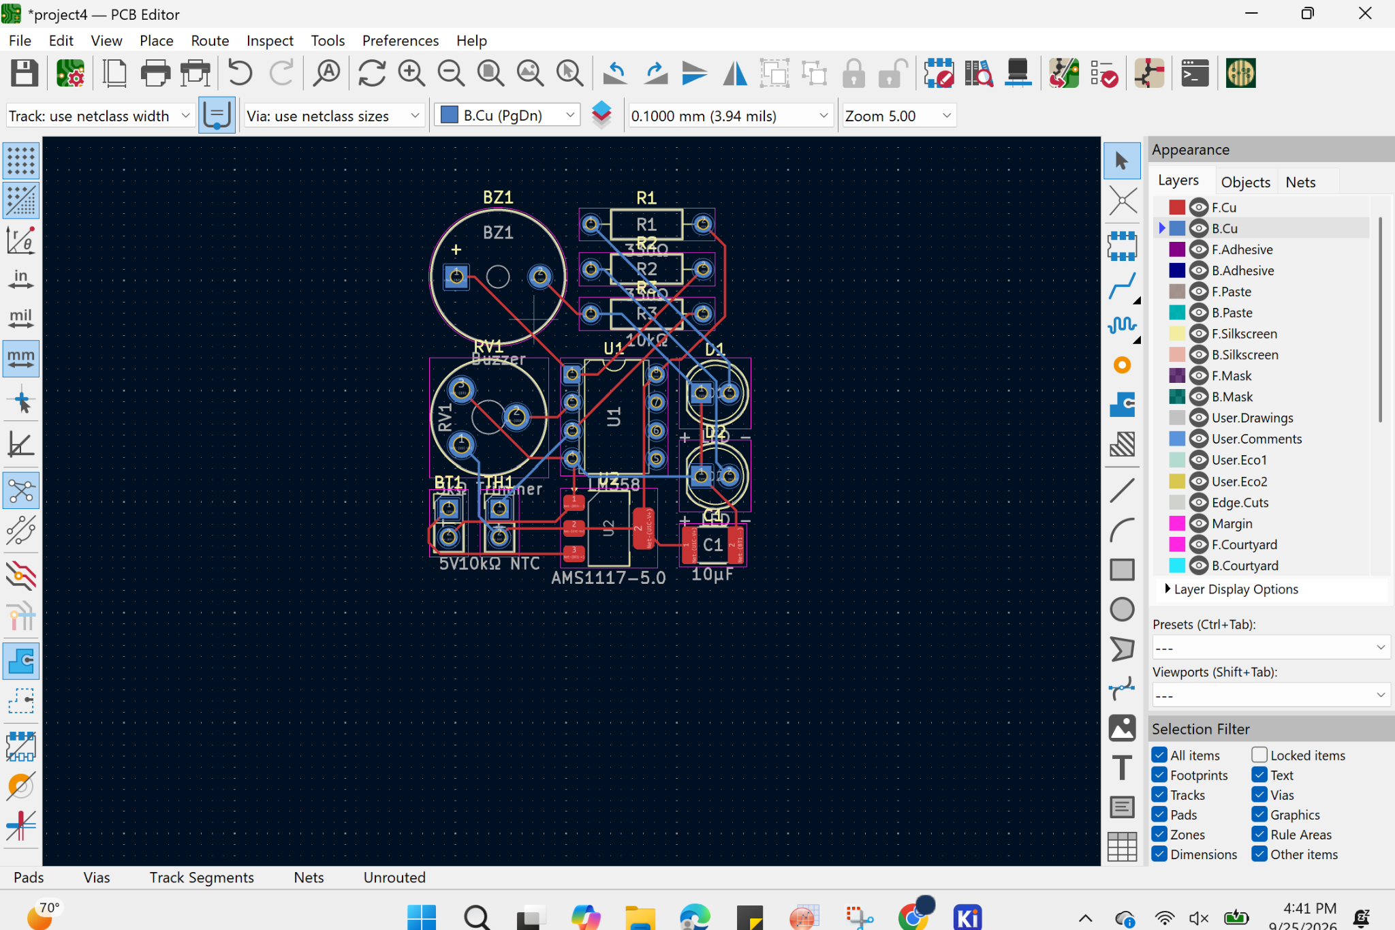
Placing Cut Lines

Slide 17
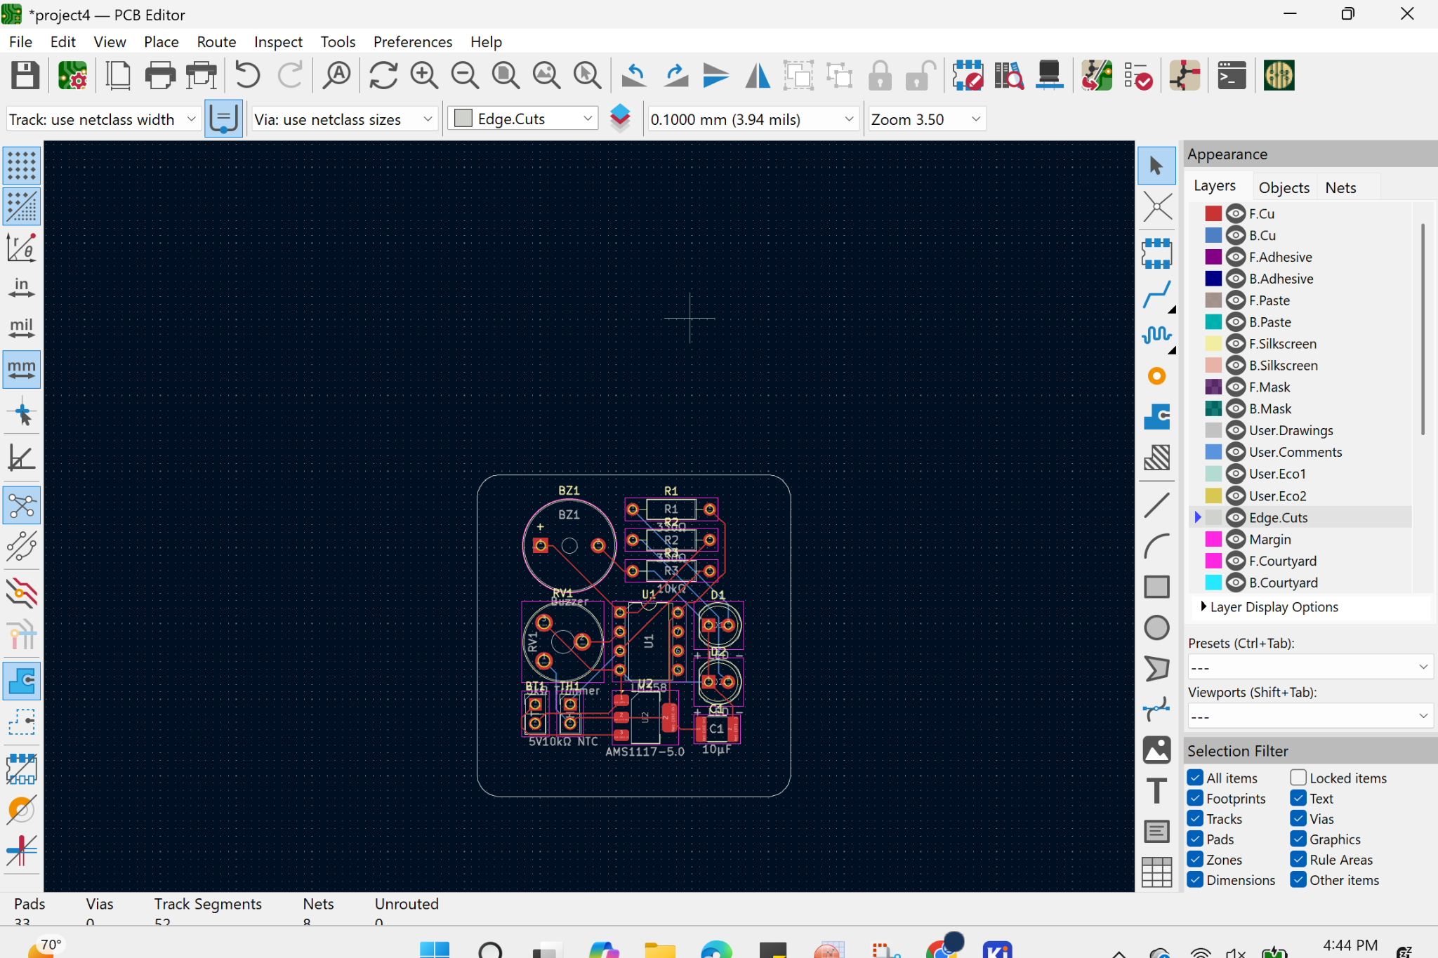
3D Viewer

Slide 18
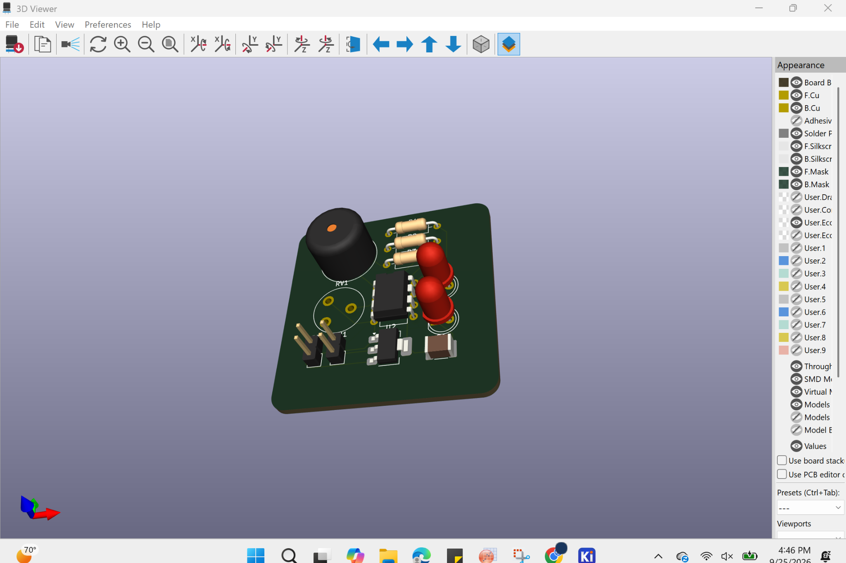
3D Viewer

