Slide 1
Business Cards
PCB
IEEE Penn State - Projects Committee
FA26

Slide 2

Attendance Form

Slide 3
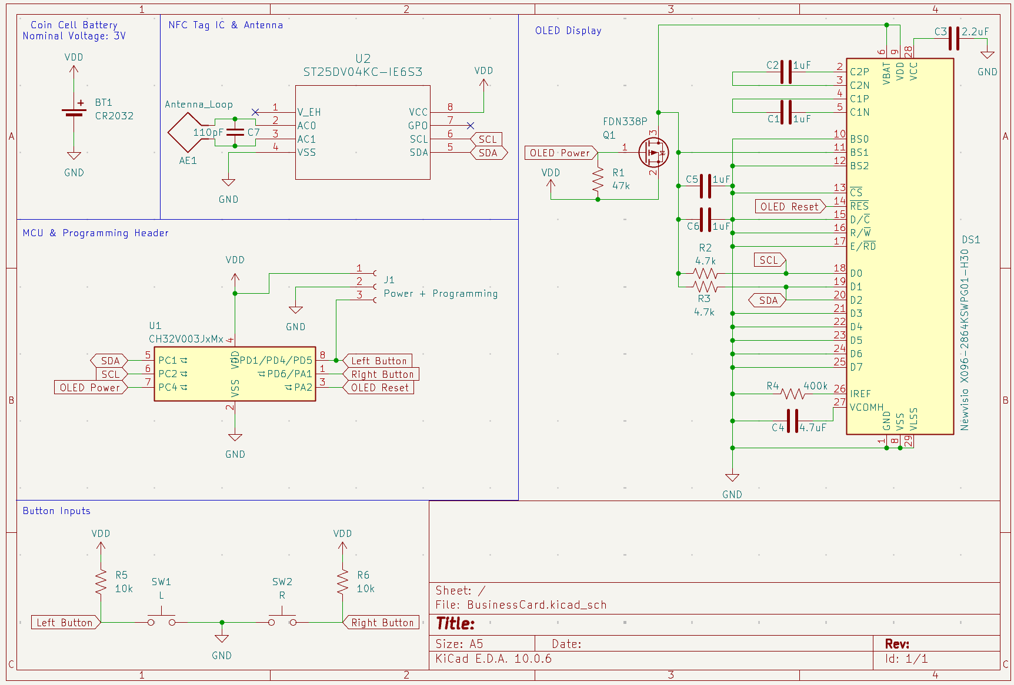

Where we left off

Slide 4
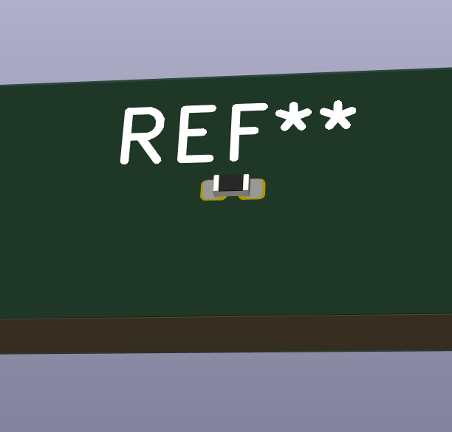
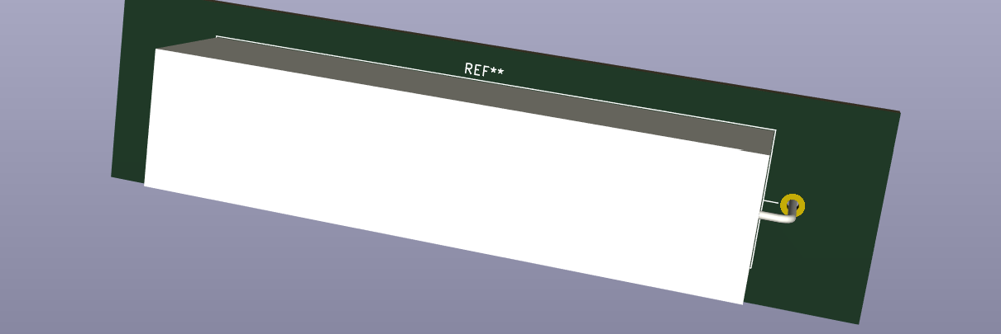
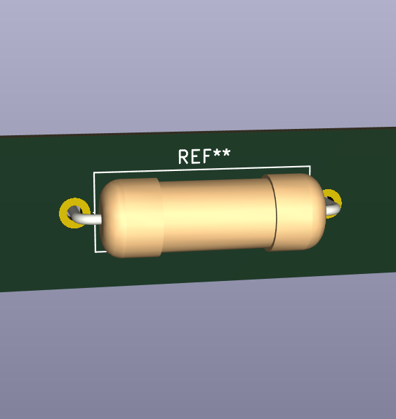
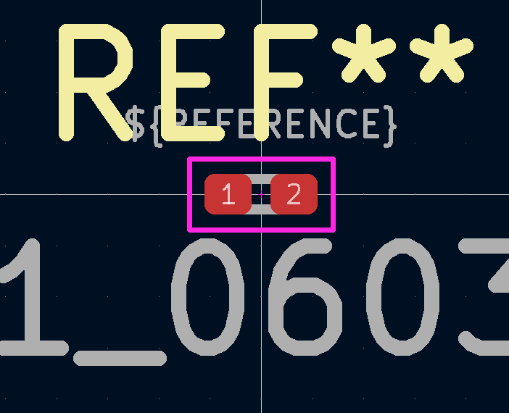
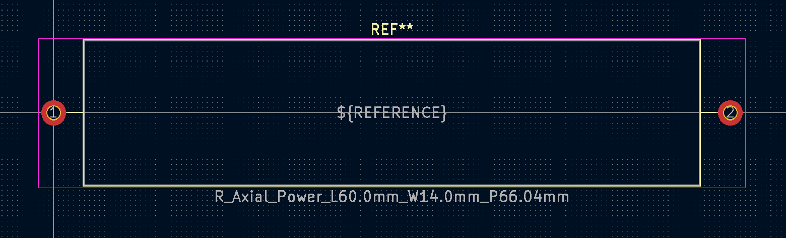
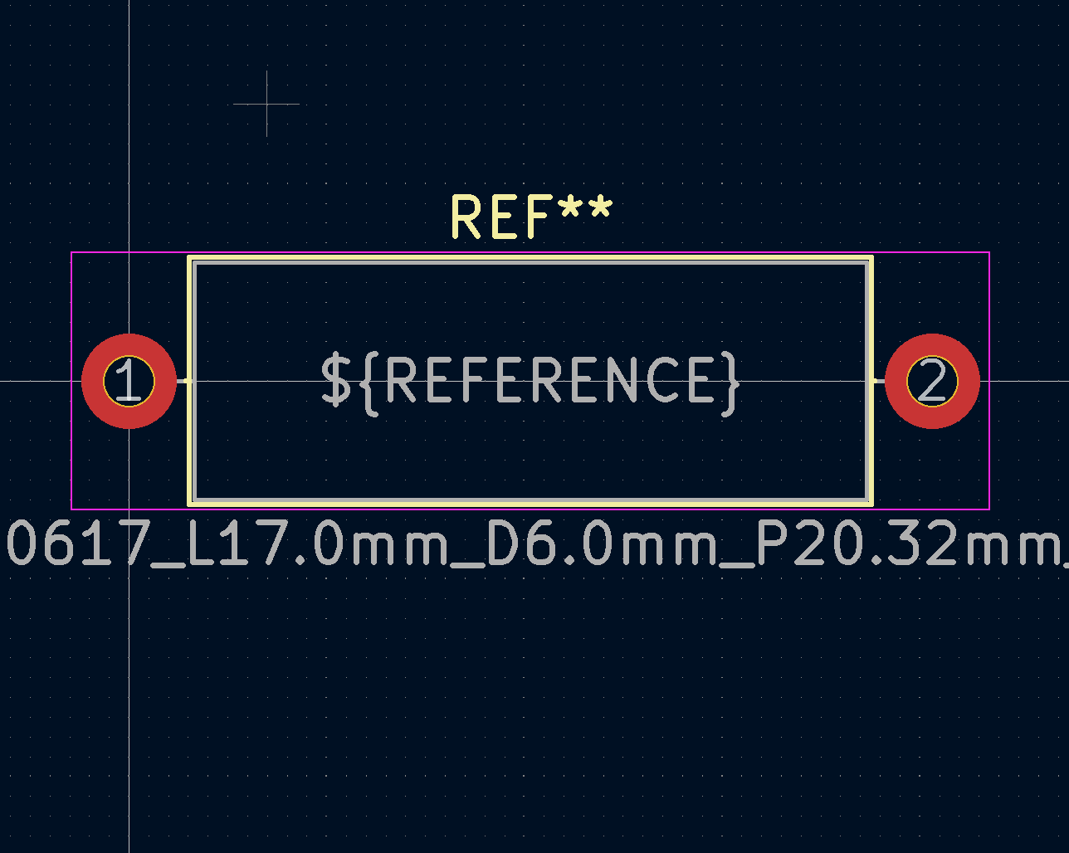
Footprint Comparison
A single part can have multiple different 3D footprints in the schematic editor!

Slide 5
Footprint Time!!
Symbol Name | Footprint
Rx | Resistor_SMD:R_0603_1608Metric
Cx | Capacitor_SMD:C_0603_1608Metric
C1 | Capacitor_SMD:C_1812_4532Metric
DS1 | Display:OLED-128O064D
J1 | Connector_PinSocket_2.54mm:PinSocket_1x03_P2.54mm_Vertical
Q1 | Package_TO_SOT_SMD:SOT-23
BT1 | Battery:BatteryHolder_Keystone_3034_1x20mm
SWx | Button_Switch_THT:SW_PUSH_6mm_H5mm
AE1 | RF_Antenna:{your named footprint here}

Slide 6
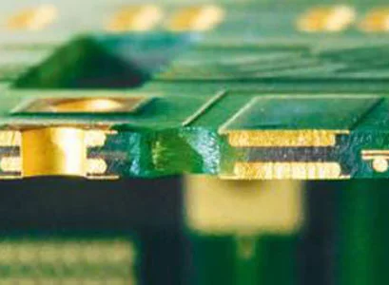
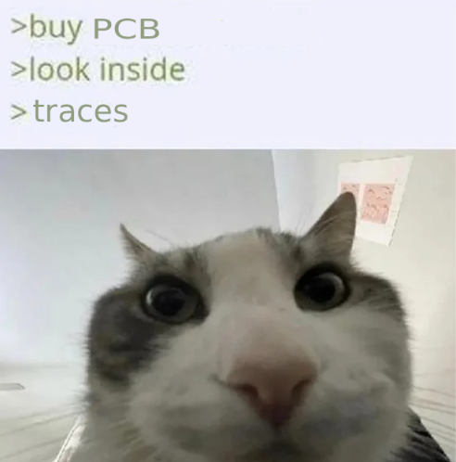
Traces and Vias
The front/back coppers are traces connecting parts on a single side.
Vias bridge the two traces, crossing sides
Via
Front Copper
Back Copper

Slide 7
Design Rules
All surface mount parts (Cx, Rx, Ux) should be on the SAME SIDE!!
Display, battery, and buttons can go on either side.
Generally (especially for SDA and SCL), keep traces as short and possible
Keep circuits together
Board Outline -> Part Placement -> Route Traces -> Silkscreen
Be unique and have fun!!!

Slide 8
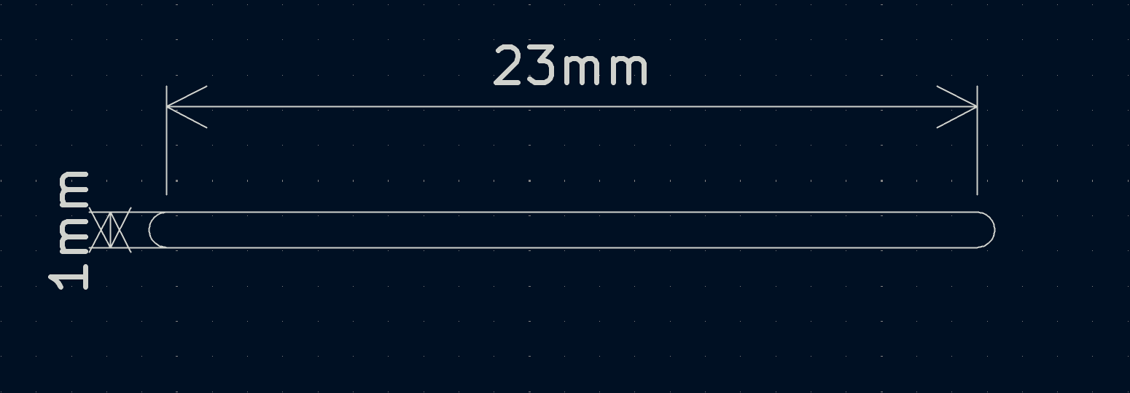
Tip for Display

Slide 9
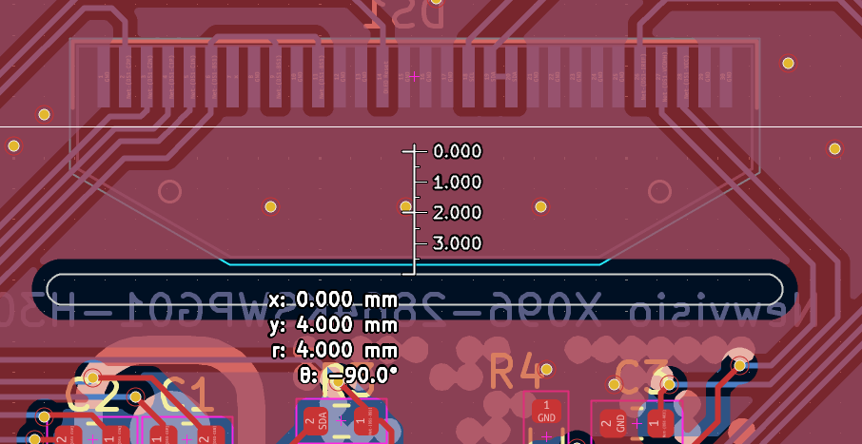
Display cont.

Slide 10
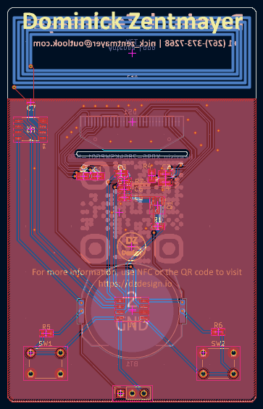
Reference

Slide 11
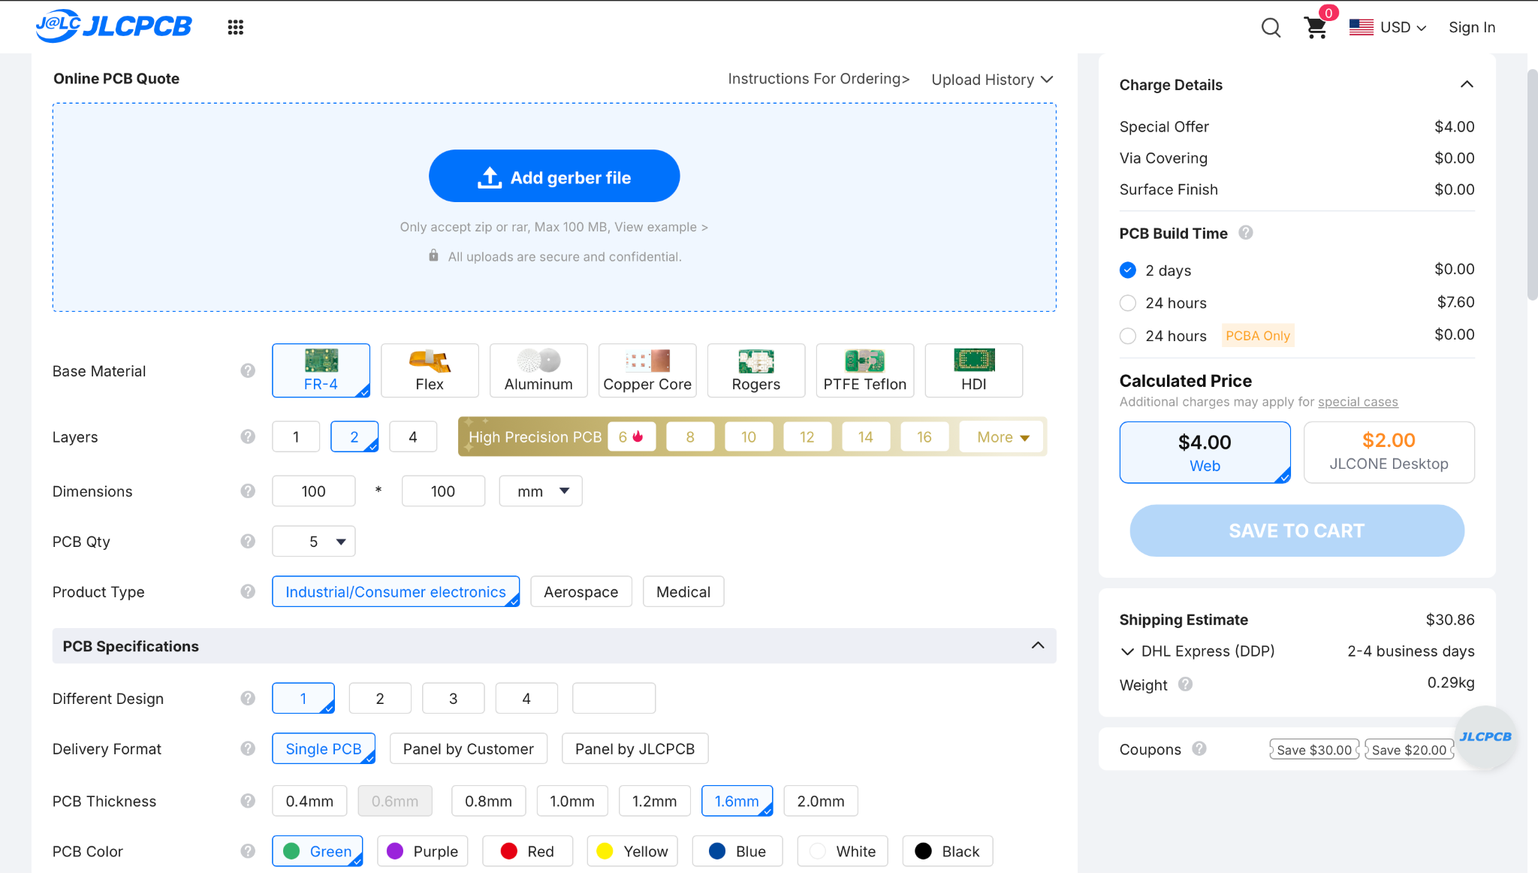
Ordering

