Slide 1
Business Cards
PCB Cont.
IEEE Penn State - Projects Committee
FA26

Slide 2


Attendance Form

Slide 3
Common Design Rules
All surface mount parts (Cx, Rx, Ux) should be on the SAME SIDE!!
Display, battery, and buttons can go on either side.
Generally (especially for SDA and SCL), keep traces as short and possible
Keep circuits together
Board Outline -> Part Placement -> Route Traces -> Silkscreen
Be unique and have fun!!!

Slide 4
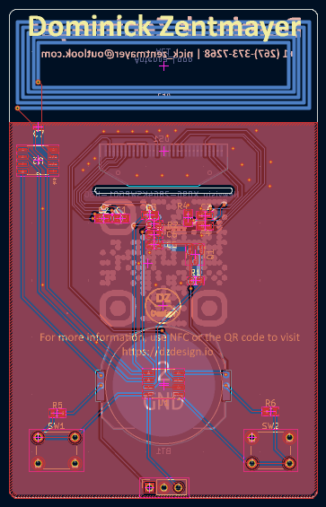
Reference

Slide 5
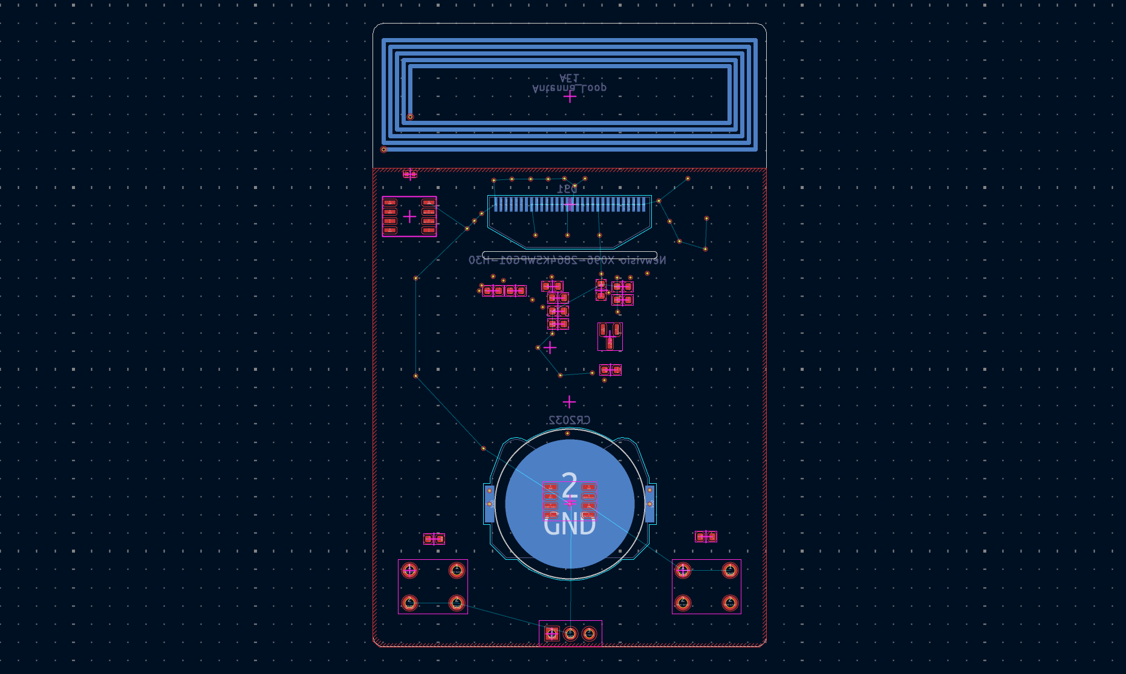

Slide 6
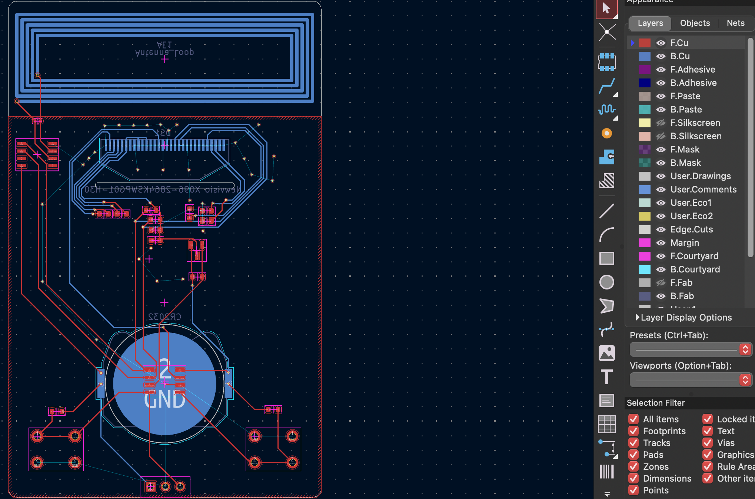
Routing
X ->
V ->

Slide 7
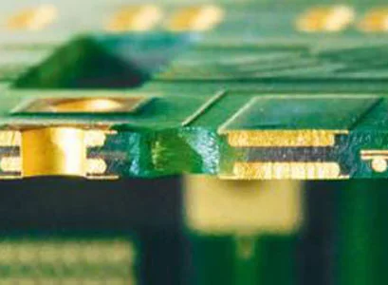

Traces and Vias
The front/back coppers are traces connecting parts on a single side.
Vias bridge the two traces, crossing sides
Via
Front Copper
Back Copper

Slide 8
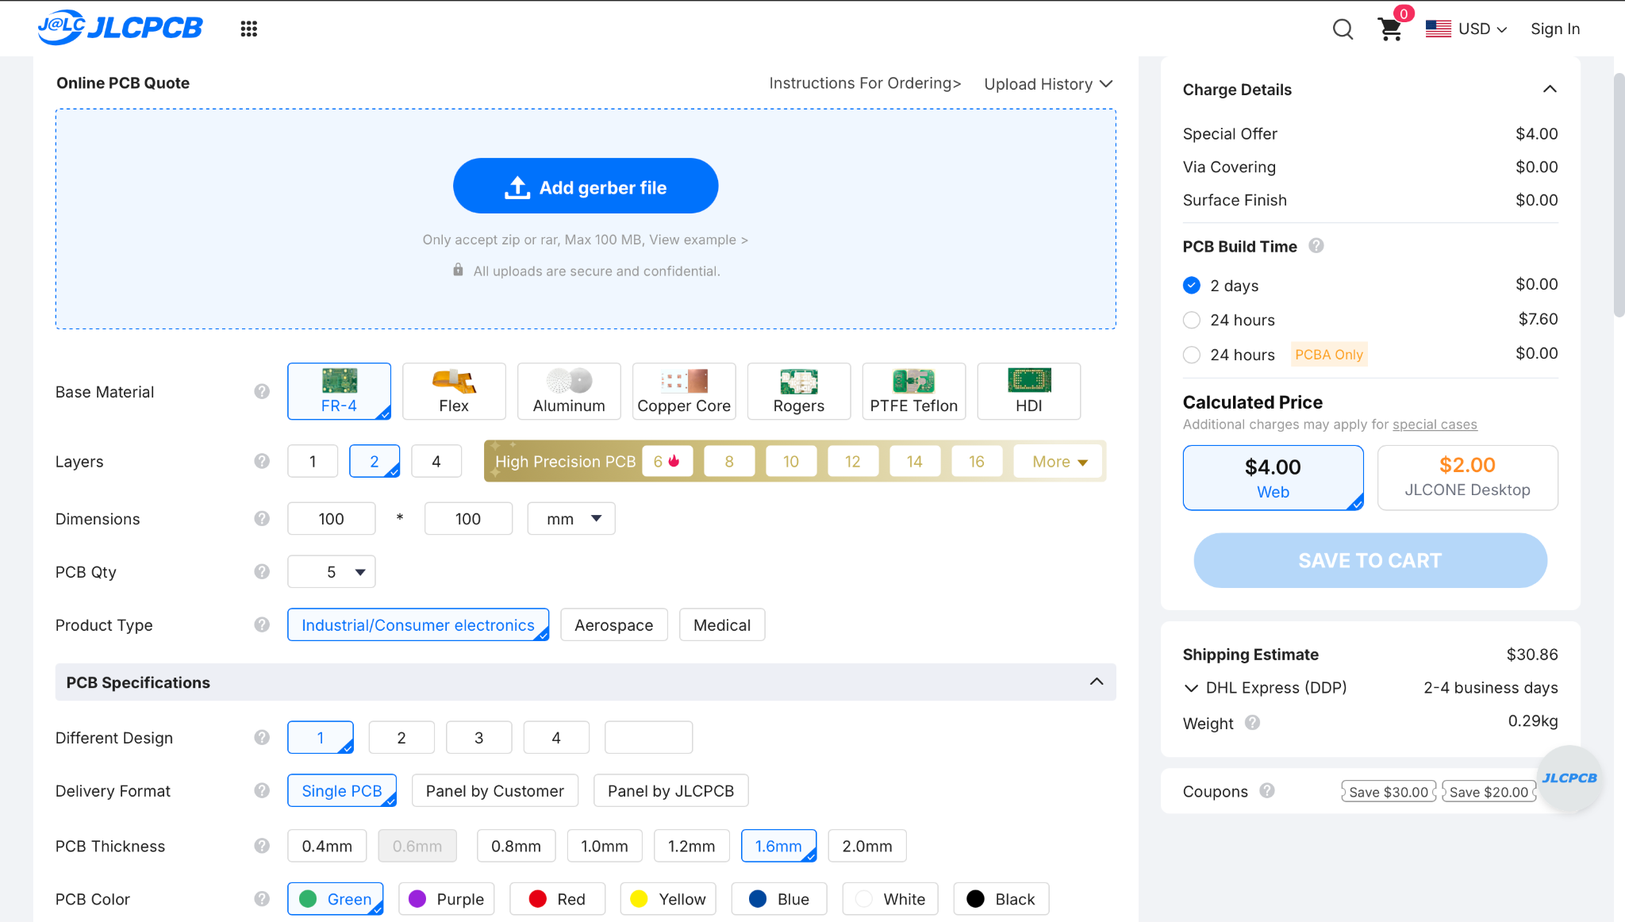
Ordering

