Slide 1
Business Cards - 1
Schematic
IEEE Penn State - Projects Committee
FA26

Slide 2
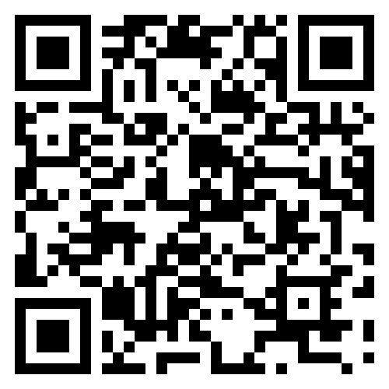
Attendance Form

Slide 3

Getting setup with KiCAD
Please open your browser and navigate to:
https://kicad.org/download
Don’t hesitate to raise your hand if you need help

Slide 4
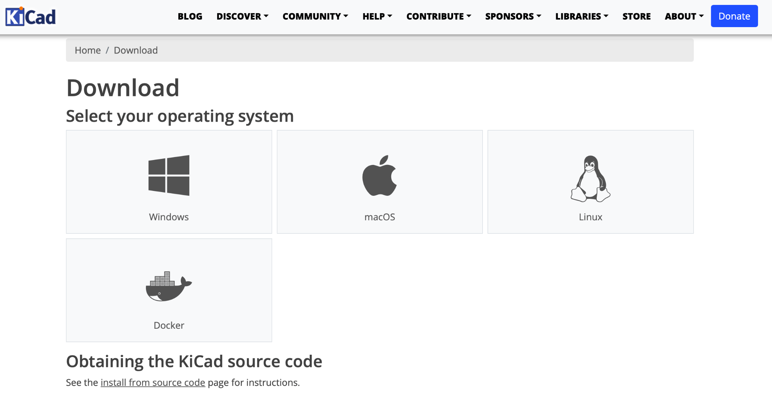


Slide 5

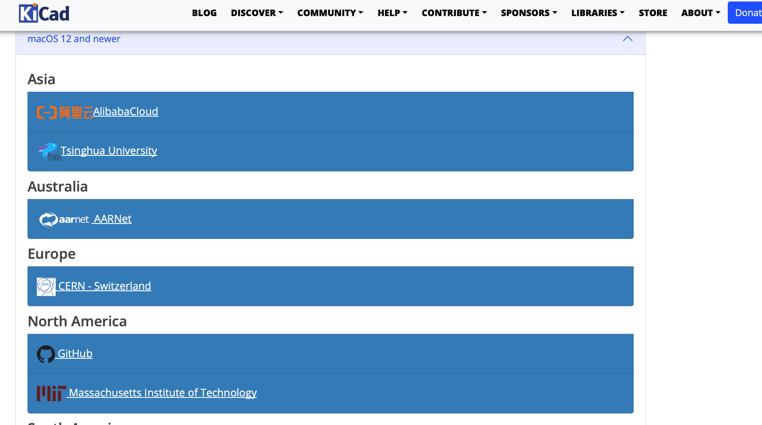

Slide 6

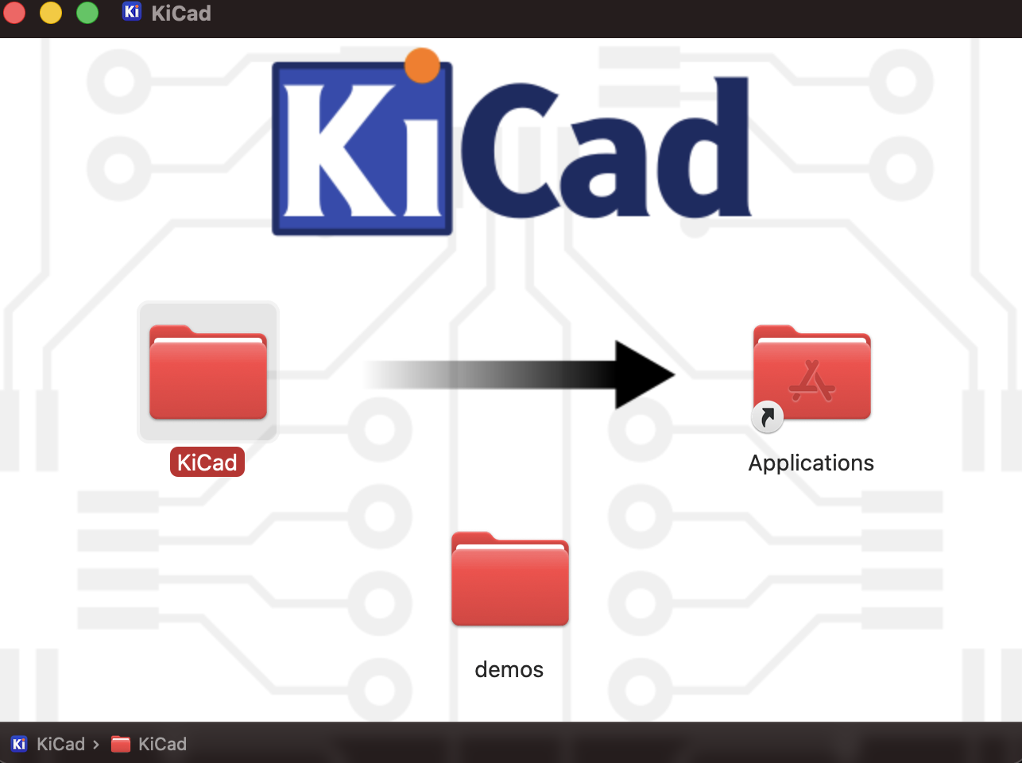
Run the Installer
Please raise your hand if you need any help!

Slide 7
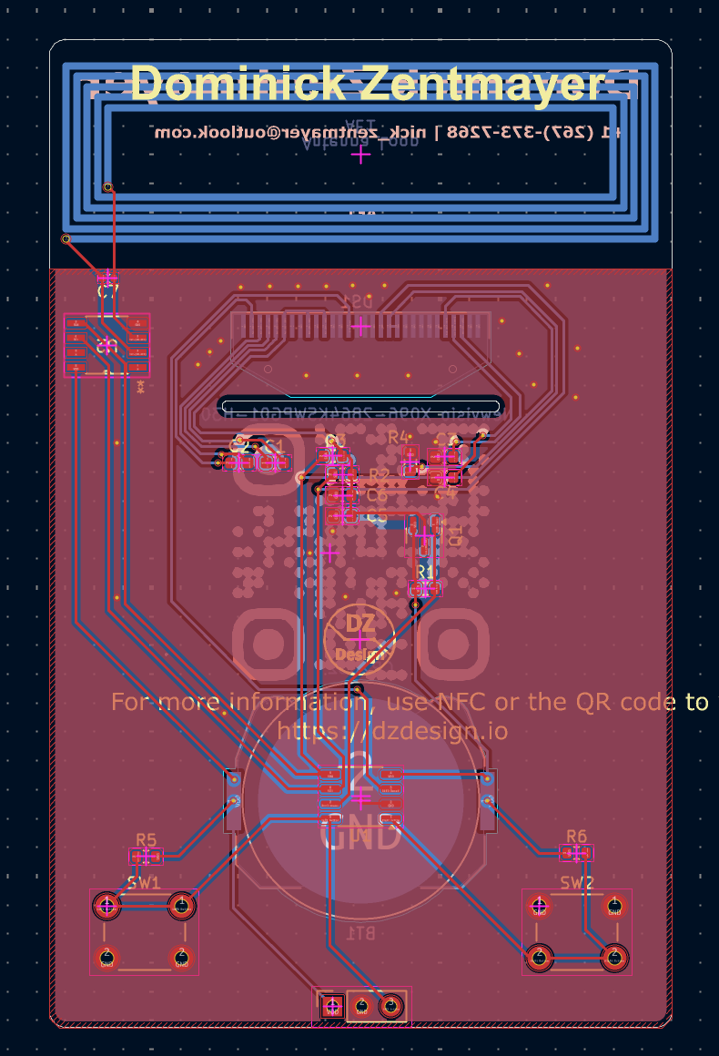
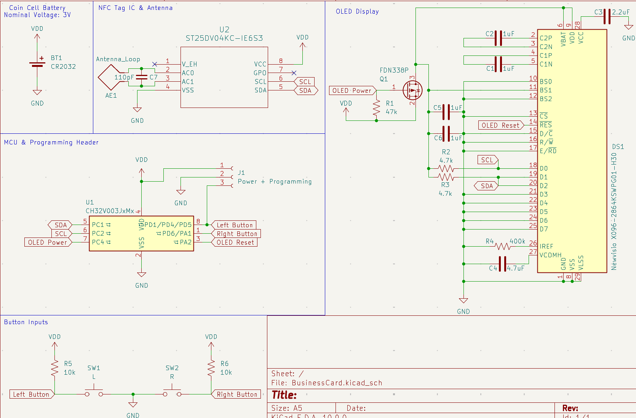
A workflow overview

Slide 8

Template Project
Open https://github.com/psuieee/business-cards
Click on the Template Project link under “Resources”

Slide 9
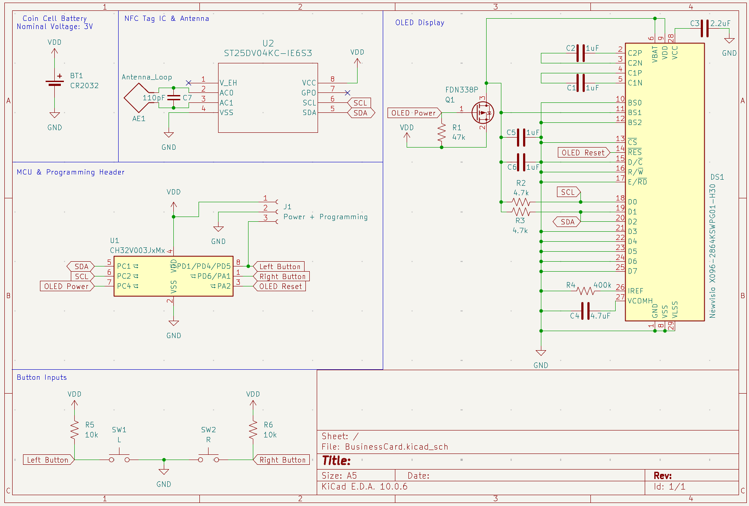
SWV Configuration
Click red circle to start listening!

Slide 10
