Slide 1
WISH MATCHER
WHERE BUYER MEETS SELLER
AMIT NAGAR
MOHAMMAD FAZLUL H.S.
NITHIN THOMAS
SUJIT PRADHAN
Under the guidance of:
Mr. André Freitas

Slide 2
Motivation
Single platform to search products from various e-commerce sites
Easy to use android app
Find out the best product available from internet

Slide 3
DESCRIPTION
Preparing the Application
STEP 1: Forming the corpus by scraping data from craigslist
Step 2: running word2vec, wordnet & dbpedia spotlight on the corpus to find the related words
Step 3: creating pylucene index for the complete set of data
Using the Application
Step 4: Open the application and search for a product
Step 5: the product is searched in the created pylucene index
Step 6: a response is returned along with the url to the corresponding product page on craigslist
Step 7: click on the link to view the product on the application

Slide 4
Processing
PyLucene Framework
Tokenization and Chunking
IndexWriter
Craigslist Website
Products and URLs
DBPedia Spotlight
WORDNet
Word2Vec
Index

Slide 5
PRODUCT
EXAMPLE
88-91 Honda Civic CRX Parts
http://sfbay.craigslist.org/eby/pts/5393876603.html
PROCESSING
PyLucene Framework
IndexWriter
Chunking: honda, civic, crx, parts
DBPedia Matches: Automobile
WordNet and Word2Vec Matches:
Automobile, corp, automobile, motorcycle, moped, outboard, civil, civic, cooperatives, overseeing, personalist, anfe, grassroots, depart, divide, office, component_part, share, theatrical_role, disunite, set_out, set_off, section, break_up, character, start, parts, role, split, percentage, function, division, persona, set_forth, separate, take_off, component, break, part, constituent, parting, piece, start_out, region, split_up, portion, contribution, voice, portions, regions, forms, chana, nordfriesland
Index

Slide 6
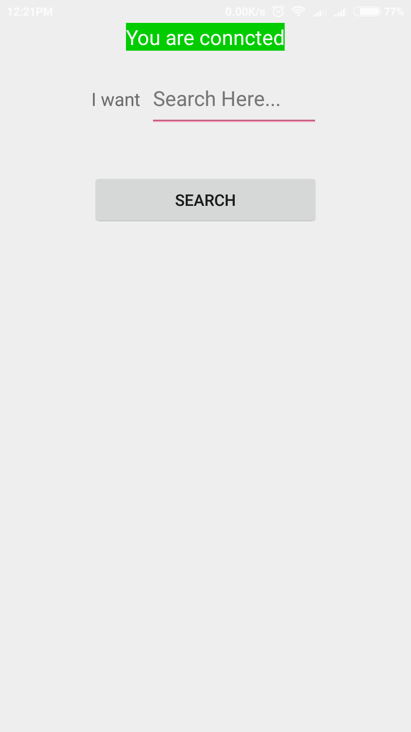

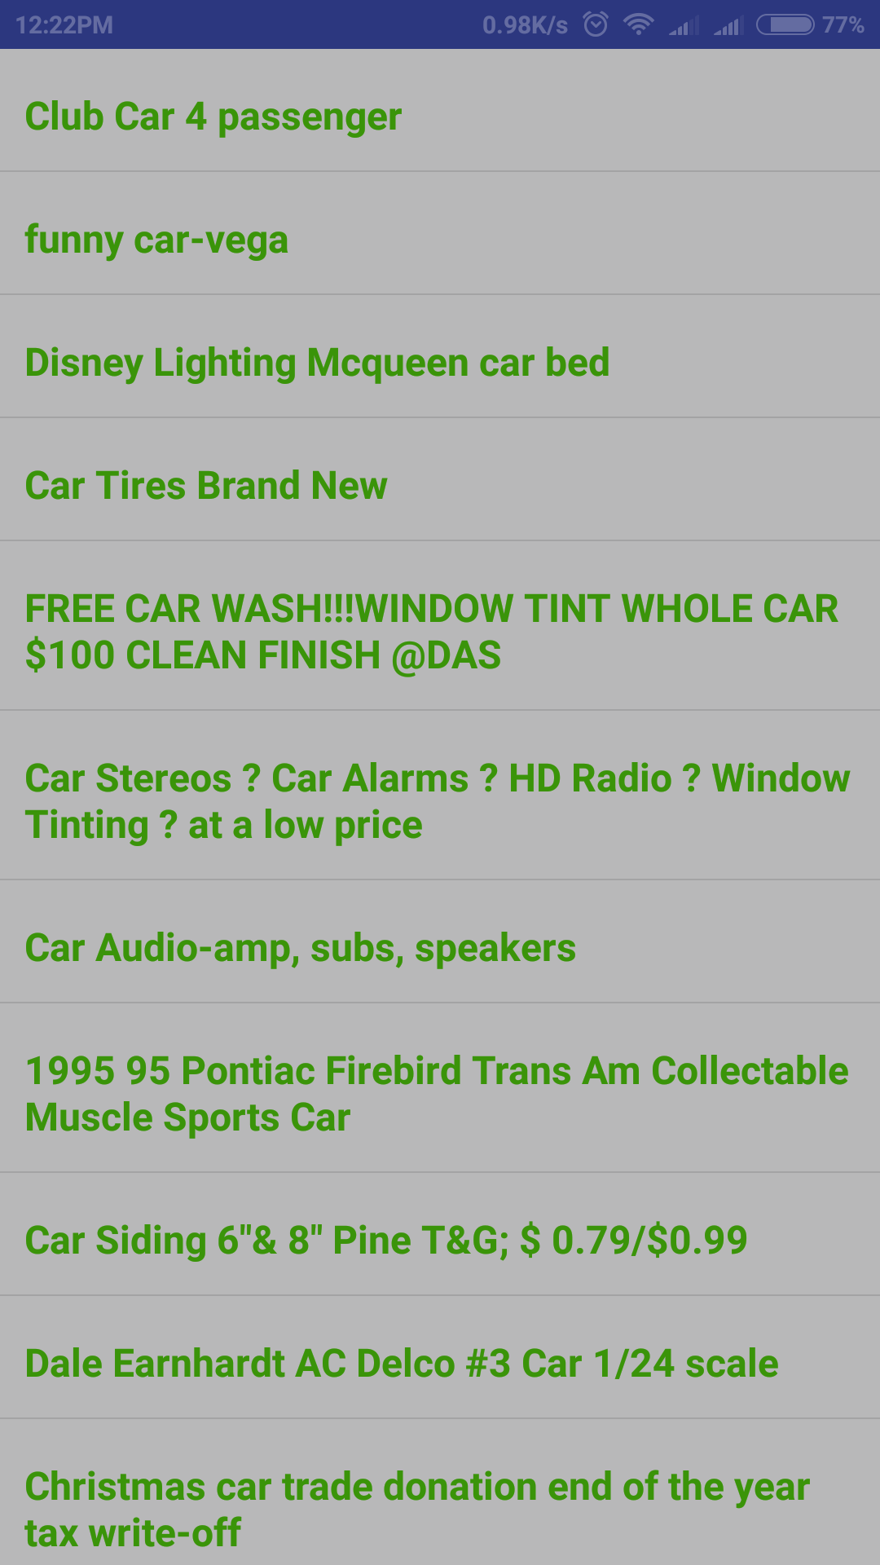
Search flow
PyLucene Framework
IndexReader
Index

Slide 7
System Demonstration
Enter user input
ex : I want a car
Receive set of related results for the input query
Display all the results in a list
Selection of one item in the list will redirect to corresponding website.
User can buy the product from the site or select another product from the list

Slide 8
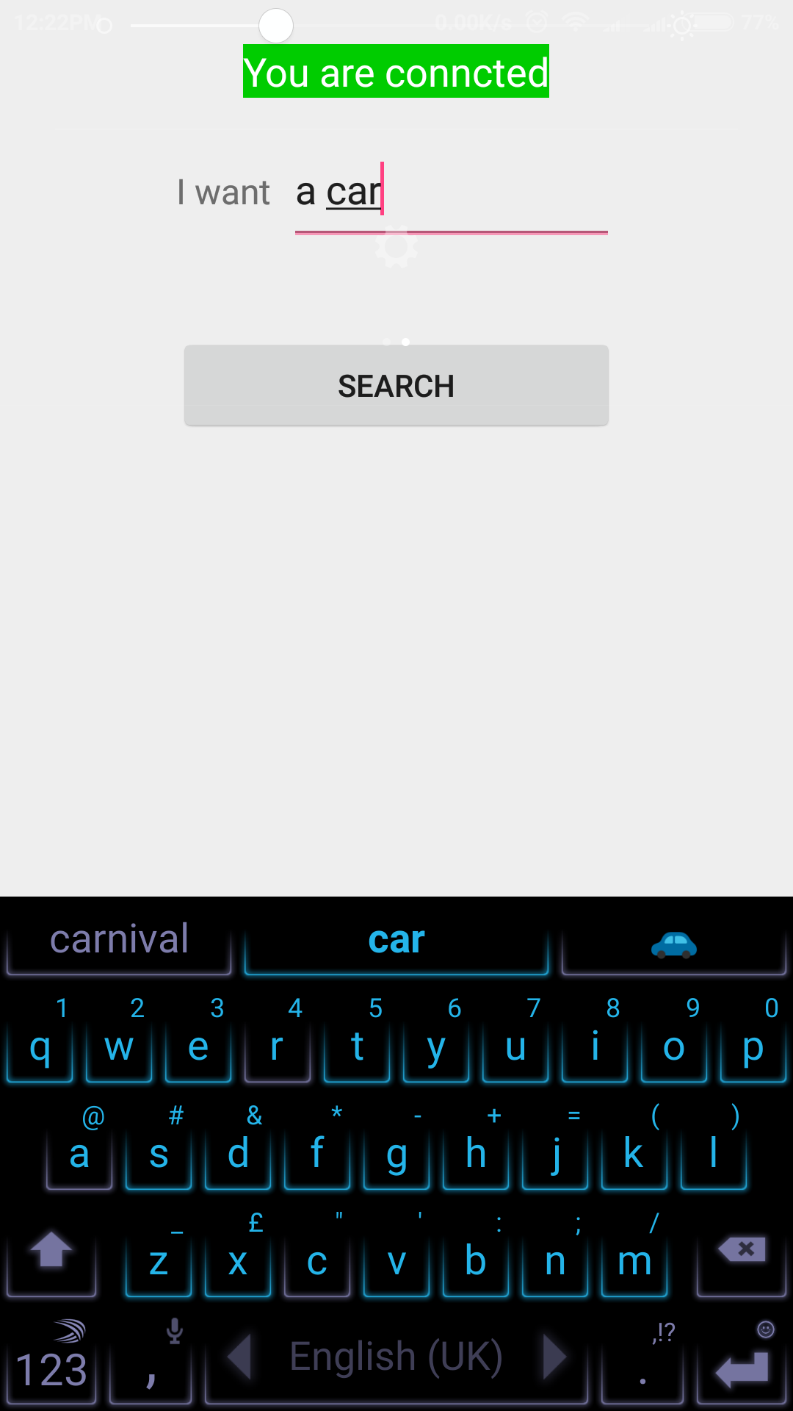
System Demonstration

Slide 9
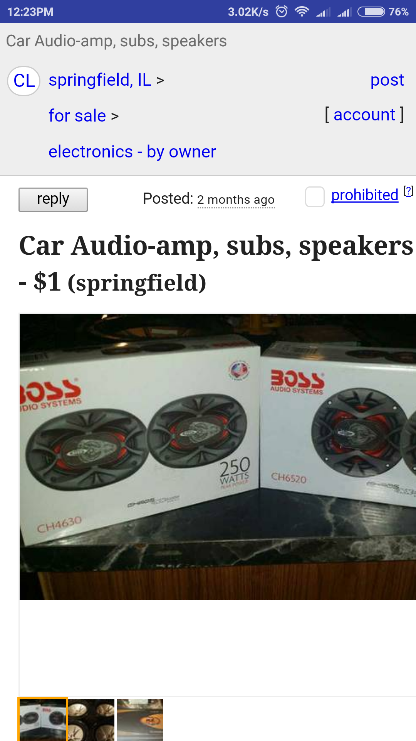
System Demonstration

Slide 10
Challenges
Working with new technologies – PyLucene, Word2Vec, etc
Setting up lucene.
Getting different word and product matches
JSON mapping with Android App
Integrating on the server

Slide 11
Evaluation
Search Term: Car
Received Results: 29; Correct Results: 24; Related Entries in Corpus: 24
Precision: 0.83
Recall: 1
Search Term: Bat
Received Results: 4; Correct Results: 4; Related Entries in Corpus: 4
Precision: 1
Recall: 1

Slide 12
Evaluation
Product | Precision | Recall
Samsung galaxy | 0.8(12/15) | 0.857(12/14)
Apple iPhone | 1(22/22) | 0.8(12/15)
Bike | 0.875(28/32) | 0.95(19/20)
Toys | 1(2/2) | 1(2/2)
Clothes | 1(16/16) | 0.75(9/12)
TV | 0.88(15/17) | 1(15/15)
Shoe | 1(9/9) | 0.75(9/12)
Laptop | 1(8/8) | 1(8/8)
Tyre | 0.75(15/20) | 1(9/9)
Xbox | 0.6(3/5) | 0.66(2/3)

Slide 13
Evaluation
Product | Precision | Recall
Camera | 1(5/5) | 1(1/1)
Fan | 1(4/4) | 1(3/3)
Speaker | 1(6/6) | 1(6/6)
Tablet | 0.8(4/5) | 1(4/4)
Car parts | 0.833(35/42) | 1(25/25)
Books | 1(5/5) | 0.833(5/6)
Food | 1(4/4) | 1(4/4)
Bed | 0.857(18/21) | 0.8(20/25)
Samsung Products | 1(15/15) | 1(11/11)
Phone | 0.533(8/15) | 0.32(8/25)

Slide 14
Evaluation
If we take an average of the above results, we get the following values:
Precision: 0.81
Recall: 0.95
F1 Score: 0.87

Slide 15
Post-mortem analysis
For some searches, the results retrieved were very vague and not precise.
Example:-
PRODUCT: Phone
Precision: 0.533(8/15)
Recall: 0.32(8/25)

Slide 16
Future works
Listing according to customer preference
Ex: price, popular
Creating a user base
Fetching products from the web instead of local corpus
Display offers from various e-commerce sites
Product comparison

Slide 17
Thank You!

