Slide 1

ARM
PRESENT BY : UMESH PRASAD

Slide 2
ADVANCED(ACRON) RISC MACHINE
It’s a British semiconductor company who develops the architecture and licenses it to other companies, who design their own products that implement one of those architectures‍—‌including systems-on-chips (SoC) and systems-on-modules (SoM) that incorporate different components such as memory, interfaces, and radios.

Slide 3
CONTENTS
INTRODUCTION TO ARM
ARM PROCESSOR AND RISC
EXCEPTION AND INTERRUPT HANDLING
FIRMWARE

Slide 4
INTRODUCTION OF ARM
VERSIONS OF ARMS
ARM COMPONENTS/PERIHERALS

Slide 5
ARM1
In 1983, Acron started it’s ARM project and resulting RISC processor become known as 32-bits ARM1
Power was not optimized.
Not for commercial use.

Slide 6
ARM2
ARM1 was using plastic packaging for that cost should be balanced and power should also be under 1W.
In 1987, ARM launched first consumer computer based ARM2 processor.
Added multiply Instructions.
Integrated graphics and I/O
Working at (8-12)MHz 4MIPS (instruction per secode)

Slide 7
ARM3
In 1988, Apple began to use ARM for R&D for what would become the first tablet.
In 1991, RISC is spun off from ARM, with investment from apple and VLSI.
Implementation of Cache(4 KB)
12 MIPS
25 MHz

Slide 8
ARM4
ARM ISA is advanced, satble, cryptography, MTE(Memory tagging extension), etc.
CORTEX-A510, A710, X2, Neoverse N2
Features like SVE implemented which enables better ML, and adds DSP like capablities.
ARM Confidential Compute Architecture(CCA), i.e Realms
Not just smartphone but also for cloud computing

Slide 9
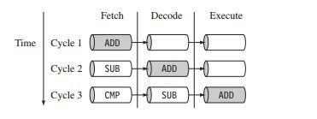
ARM7
3 stage pipelined
40 MHz frequency 60 MIPS
8 KB cache
Von Newmann
co processor is seperted

Slide 10

ARM9
5 stage pipelined
150 MHz frequency
15 KB cache, 200 MIPS
Harvard achitechture
In-built cache

Slide 11

ARM10
6 stage pipelined
260 MHz frequency
32 KB cache, 220 MIPS
Harvard achitechture

Slide 12
ARM11
9 stage pipelined
260 MHz frequency
32 KB cache, 220 MIPS
Variable MMU, unaligned memory access
additional state Thumb, Jazzele

Slide 13
SUMMARY
32 bit is dead for smartphone etc.
From 2023 ARM cortex-A type will be 64 bits only
ARM has 4-types of processor:
Cortex-A → for smartphones, tablets, laptops
Cortex-M → Microcontrollers(32 bits)
Cortex-R → for real time applications
Neoverse → for server(N1, N2, V1)

Slide 14
PROCESSOR
PROCESSOR
RISC ARCHITECTURE
ALU
REGISTER FILES
CO PROCESSOR

Slide 15
PROCESSOR
It is an integrated SoC that performs calculations.
Based on the ARM :-
1. Von Neumann achitecture
2. Hardvard Achitecture
Type of processors :-
1. RISC
2. VLIW
3. CISC

Slide 16
VON NEUMANN ACHITECTURE
Two clock cycles are required to execute single instruction
same physical memory required for address & data.(common bus for address and data)
It’s a non pipelined and cheapest.
Less gates required.

Slide 17
HARDVARD ACHITECTURE
processes can be done at single clock cyle.
seperate physical memory available for address & data.
It’s a pipelined achitecture.
Most commonly used by RISC processor

Slide 18
RISC
RISC which stands for Reduced Instructions Set Computing
Design is license free
more instructions and less hardware used.
instructions can be of 8, 16, 32 or 64 bits.
ARM uses the RISC architecture for its design.

Slide 19
ARM PROCESSOR ARCHITECTURE
It uses the von-neuman achitecture for data & instructions.
Harvard implementations of ARM uses two different buses.
It uses similar to RISC for LOAD-STORE architecture.(Harvard) means 2 instructions type for transferring data i.e load into the processor and then store to memory.

Slide 20
PROCESSOR FLOW
ID(intsruction Decoder)
PC(Program counter) address to next
instructions
Register Files
ALU

Slide 21
PROCESSOR FLOW(cont.)
Register files :- It consist of data or addresses.
CPSR(current program status register) :-
It is used to monitor & control internal operations. It is 32 bits register in the register files.
It’s divide in 4 field :
flag(contains conditional flag)
status (reserved)
extension(reserved)
control(contains processor mode, state, intr)

Slide 22
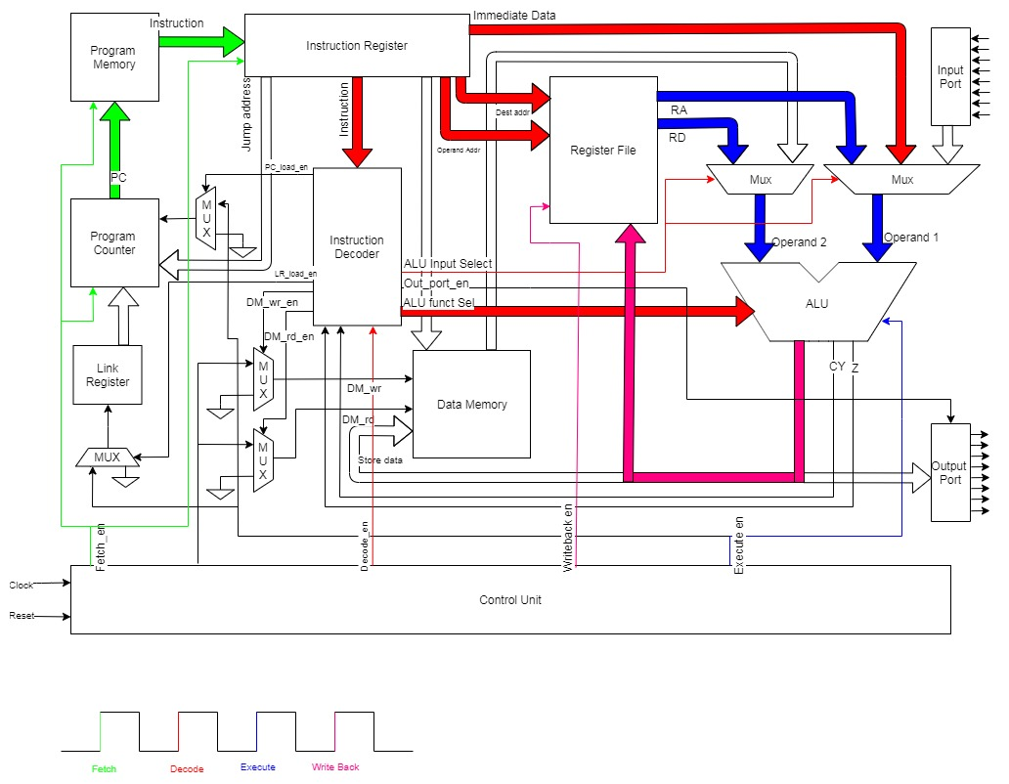
PROCESSOR FLOW(cont.)

Slide 23
PROCESSOR MODE
It determines which registers is activated and accessed right to cpsr.
7 processor mode :-
abort(enters when failed to access the memory)
fast interrupt request(on priorities)
interrupt request(on priorities)
supervisor(when reset)
system(it’s a special mode allows full R/D operation)
undefined(when instruction undefined and process has to encounter)
user(non priviledged mode) (used for program & application)

Slide 24
MODE OF INSTRUCTION SET(ARM)
It has 3 modes :-
ARM(activate when processor in in ARM state)
Thumb(activate when processor is in thumb state,
once in thumb state the processor is executing purely
thumb 16-bits instructions, we cannot inetrmigle
sequential ARM, jazelle or thumb)
Jazelle
J | T | Processor mode
0 | 0 | ARM state
X | 1 | Thumb state
1 | 0 | Jazzele state

Slide 25
MODE OF INSTRUCTION SET(CONT.)
Title | ARM state | Thumb state | Jazzele state
Instruction Size | 32-bits | 16-bits | 8-bits
Conditional instr | Mostly | Only branch | -
Program status reg | Previledged mode | No direct access
Register uses | 15 general purpose + pc | 8 general purpose + pc + 7 high register
Core instructions | 58 | 30 | 60% of java byte codes in h/w rest in s/w

Slide 26
CONDITIONAL FLAG
In cpsr register we already saw the condition flag
Flag | Flag name | Set when
Q | Saturation | When result cause over flow/or in saturation
V | Over flow | Result cause signed overflow
C | Carry | Result caused unsigned carry
Z | Zero | When result cause zero, used to indicate equality
N | Negative | Bit 31 of result is binary 1

Slide 27
EXCEPTION AND INTERRUPT HANDLING
EXCEPTION HANDLING
INTERRUPTS
INTERRUPT HANDLING SCHEMES

Slide 28
EXCEPTION HANDLING
WHAT IS EXCEPTION HANDLING?
Any event that can halt the normal sequential
execution of instructions.
Most exceptions have an associated software called exception handler.
Handler is a software routine that is executes when an exception occurs.

Slide 29
ARM EXCEPTION MODES
What are the exception made by the processor when an exception occured?
Save the cpsr to spsr(saved program special register) of the exception mode.
Save the pc to the lr of the exception mode.
Sets the cpsr to the exception mode.
Set pc to the address of the exception handler.

Slide 30
ARM EXCEPTION MODES(cont.)
ARM processor has seven different exceptions:
Data abort
Fast interrupt request(FIQ)
interrupt request(IRQ)
Prefetch abort
Software interrupt(SWI)
Reset
Undefined instruction

Slide 31
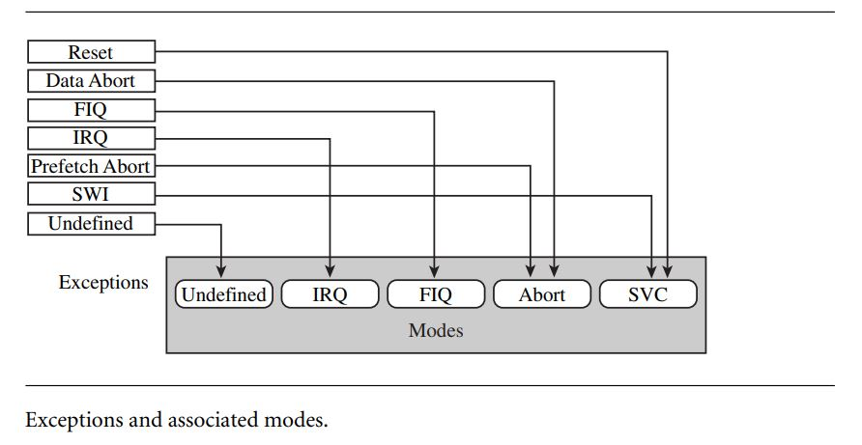
ARM EXCEPTION MODES(cont.)

Slide 32
VECTOR TABLE
It is a table of exception of addresses halt the ARM core branches to when an exption is raised, commonly contain branch instructions of the following forms:
B<address>
LDR pc, [pc, #offset]
LDR pc, [pc, #-oxoff]
MOV pc, #immedicate

Slide 33
VECTOR TABLE(cont.)
B<address>
It provides branch instruction relative from the pc.
LDR pc, [pc, #offset]
this instruction load the handler address from memory to pc.the address is an absolute 32-bit value stored close to the vector table.
Example :
LDR R0, [R1], #0x08 ; After the access to memory[R1]; R1 is incremented by 0x8.
LDR pc, [pc, #-oxoff]
It load a specific interrupt service routine from address 0xFFFFF010 to the pc. It is only used when vector controller is present.
MOV pc, #immedicate

Slide 34
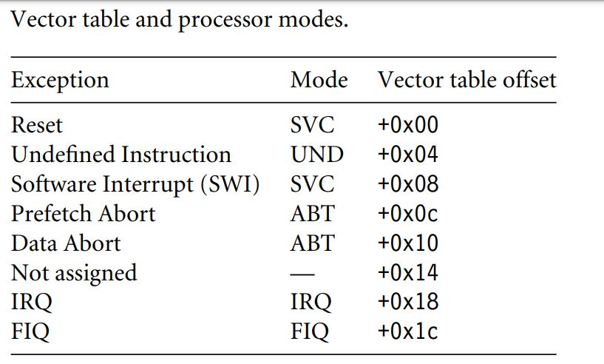
VECTOR TABLE(cont.)

Slide 35
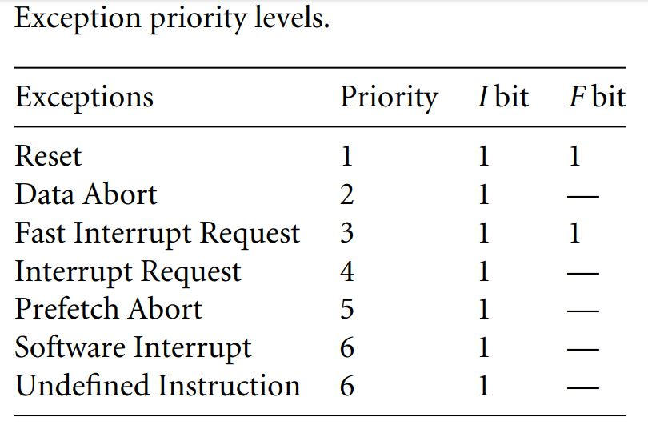
EXCEPTION PRIORITIES

Slide 36
RESET EXCEPTION
It has the highest priority exception and is always taken whenever it is signaled.
The reset handler initializes the system, including setting up memory and caches.
The reset handler must setup the stack for all processor mode.

Slide 37
DATA ABORT EXCEPTION
Data abort exception occurs when th ememory controller or MMU indicates that an invalid memory address has been accessed.
When the current code attempts ro read or write to memory without the correct access permisions.
An FIQ exception can be raised within a Data Abort hanlder since FIQ exceptions are not disabled.

Slide 38
FAST INTERRUPT REQUEST(FIQ)
FIQ exception occurs when an external peripheral sets the FIQ pin to nFIQ.
An FIQ exception is the highest priority interrupt.
The core disables both IRQ and FIQ exceptions on entry into the FIQ handler.

Slide 39
INTERRUPT REQUEST(IRQ)
FIQ exception occurs when an external peripheral sets the IRQ pin to nIRQ.
An FIQ exception is the second highest priority interrupt.
The IRQ handler will be entered if neither an FIQ exception nor Data Abort exception occurs.

Slide 40
PREFETCH ABORT EXCEPTION
A Prefetch Abort exception occurs when an attempt to fetch an intruction results in a memory fault.
This exception id raised when the instruction is in the execute of the pipleline.

Slide 41
SOFTWARE INTERRUPT
An SWI occurs when th eSWI instruction is executed.
The cpsr will be set to supervisor mode.
I fthe ssystem uses nested calls, the LR R14 and spsr must be stored away before branching to the nested SWI.

Slide 42
Undefined Instruction Exception
It occurs when an instruction not in ARM or Thumb
instruction mode.
Both Software and undefined instruction have the
same level of prioprity.
Both exception won’t occur at the same time.

Slide 43
Interrupts
Types of interrupt in ARM:
FIQ(Highly priority and less latency)
IRQ(less priority and high latency)
SWI(call priviledged OS routines)

Slide 44
Interrupts latency
It is the interval of time from an external interrupt request signal being raised to the first fetch of an instruction of a specific interrupt service routine.
How to decrease the interrupt latency?
1. Using a nested interrupt handler.
2. Using prioritization.

Slide 45
IRQ and FIQ exceptions
The processor enters a mood dependent on the interrupt
The previous mode’s cpsr is saved into the spsr of the new interrupt request mode.
The pc is saved in the lr of th enew interrupt request mode.
Interrupt(s) are disabled- either th eIRQ or both IRQ and FIQ exceptions are disabled in the cpsr. This immediately stops another interrupt request of the same type being raised.
The processor brnaches to a specific entry in the vector table.

Slide 46
INTERRUPT HANDLING SCHEME
Nested
Non nested

Slide 47
NON NESTED INTERRUPT HANDLING SCHEME
The interrupt are disabled until control is returned back to the interrupted task or process.
Can only service a single interrupt at a time.
High interrupt latency.
Advantages :
Easy to implement & debug
Disadvantages
can’t be used to handle complex embedded systems

Slide 48
NESTED INTERRUPT
Allows for another interrupt to occur within the current called handler.
This is achieved by re-enabling the interrupts before the handler has fully serviced the current interrupt.
It increase the system complexity.
protecting the context restoration from interruption, so that the next interrupt will not fil the stack(cause stack overflow) or, corrupt any of the registers.

Slide 49
NESTED INTERRUPT
Advantages :
Can enable interrupts before the servicing of an individual interrupt is complete reducing interrupt latency.
Disadvantages
Doesn’t handle prioritization of interrupts, so lower priority interrupts can block high priority interrupts.

Slide 50
Reentrant Interrupt Handler
Handles multiple interrupts where interrupts are filtered by priority.
Interrupts are re-enabled early on in the reentrant interrupt handler, which can reduce interrupt latency.
Advantages:
Handles interrupt with different priorities.
Disadvantages:
Tends to be more complex.

Slide 51
Prioritized Simple Interrupt Handler
Advantages:
Deterministic interrupt latency since the priority level is identified first and then the service is called after the lower-priority interrupts are masked.
Disadvantages:
The time taken to get the low-priority service routine is the same as for a high-priority routine.

Slide 52
Prioritized Standard Interrupt Handler
Low interrupt latency
The prioritization simple but interrupt handler tests all the interrupt to establish the higher priority.
An alternative approach is to jump early when the highest priority interrupt has been identified to a routine that will handle the masking of the lower priority interrupts and then jump again via a jump table to the appropriate ISR.
Handle higher-priority interrupts in a shorter time than lower-priority interrupts.

Slide 53
Prioritized Standard Interrupt Handler
Advanatges:
It treated with great urgency with no duplication of code to set external interrupt masks.
Disadvantages:
There is a time penalty since this handler requires two jumps, resulting in the pipeline begin flushed each time a jump occurs.

Slide 54
Prioritized Direct Interrupt Handler
Some processing is moved out of the handler into the individuals ISRs. The moved code mask out the lower-priority interrupts. Each ISR will have to mask out the lower-priority interrupts for the particular priority level.
Jump directly ISR is responsible for disabling the lower priority interrupts.

Slide 55
Prioritized Direct Interrupt Handler
Advantages :
Uses a single jump and saves valuable cycles to go to the ISR.
Disadvantages:
Each ISR has a mechanism to set the external interrupt mask to stop lower priority interrupts from halting the current ISR, which adds extra code to each ISR

Slide 56
Prioritized Grouped Interrupt Handler
Low latency interrupt.
Grouping interrupts together & forming a subset, which can then be a priority level.
Grouping the interrupt sources together tends to reduce the complexity every interrupt to determine the priority level.
If a prioritized group interrupt handler is well designed , it will dramatically imporve overall system response times.

Slide 57
Prioritized Grouped Interrupt Handler
Advantages:
Useful when the embedded system has to handle a large number of interrupts, and also reduces the response time since the determining of the priority level is shorter.
Disadvantages:
Determining how th interrupts are grouped together.

Slide 58
VIC PL190 Based Interrupt Service Routine
Load an ISR address from a predefined memory mapped location, which bypasses any software interrupt handler.
Advantages:
Reduces interrupt latency since there is only a single jump to a specific ISR.
Disadvanatges:
Since the VIC is basically a hardware interrupt handler, the array of ISR addresses must be preprogrammed into the VIC before it is activated.

Slide 59
FIRMWARE
FIRMWARE & BOOTLOADER
SANDSTONE

Slide 60
FIRMWARE
It is a low level software that provides an interface between hardware and software or OS level software, executes when power is on.

Slide 61
BOOTLOADER
It is a small application that installs the OS or applications onto a hardware target.
The bootloader only exists upto the point that the OS or application is executing, and it is commonly incorporated into the firmware.

Slide 62
FIRMWARE EXECUTION FLOW
Stage | Features
Set up target platform | Program the hardware system registers Platform identification Diagnostics Debug interface Command line interpreter
Abstract the hardware | Hardware abstract layer Device driver
Load a bootable image | Basic Filing system
Relinquish control | Alter the pc to point into the new image

Slide 63
I-a. Indetify the platform
It’s coomon for the same executable to operate on different cores and platforms.
In this case, the firmware has t identify and discover the exact core and platform it is operating on.
→ CP15:r0 = processor type
→ Platform indetification: a set of particular peripheral

Slide 64
I-b. Diagnosing
Diagnosing software provides a useful way for quickly indentifying basic hardware malfunctions.
Debug cabablity is provided in the form of a module or monitor
Setting up breakpoints in RAM
Loisting & modifying memory(peek & poke)
Showig current process register contents
Disassembling memory into ARM or Thumb mnemonics.
Interactive method
→ CLI(command line interpreter)(via RS-232)
→ A dedicated host debugger (via LAN + C/S)

Slide 65
II- HARDWARE ABSTRACT LAYER
It’s a software layer that hides the underlying hardware by providing a set of defined programming interfaces.
It communicate with specific hardware peripheral is called device driver.
→ THE HAL driver provides a standard application programming interface(API) to rad and write to a specific peripheral.

Slide 66
III- LOAD TO A BOOTABLE IMAGE
The ability of firmware to carry out this activity depends upon the type of media used to store the image.
→ note that NOT alll OS images or applications images need to be copied into RAM, they could be directly from ROM(XIP).
→ FFS: Flash ROM filing system
Network File System
Image format
Plain Binary: doesn’t contain any header or debug information
Executable and linking Format(ELF)
i. Developed for unix, and replaced the COFF.
ii. ELF file come in three forms: relocatable, executable & shared object
iii. Compressed image

Slide 67
IV- RELINQUISH THE CONTROL
This is where the firmware hards over control of the platform to an OS or application.
→ Note that not all firmware hands over control. Alternatively, the MIL or HAL part of the firmware can remain active. This layer expose, through SWI mechanism, a standard application interface for specific hardware devices.
Relinquishing control means
→ udating the vector table & modifying the PC.
→ passing environment Data Structure (EDS) to some sophisticated OS, e.g., Linux
EDS field : memory size, MMU type, etc.

Slide 68
ARM FIRMWARE SUITE
ARM as its own firmware package called “ARM FIRMWARE SUITE” which is designed purely for ARM based embedded system. It provides supports for number of boards including INTEL XSCALE and strongARM processor.
This packge includes two major piece of technology:
Harware abstract layer(HAL or uHAL)
Angel(debug monitor)

Slide 69
uHAL
Initializing, UART Driver, LED control(for indicating)
Timer(for preemtive context switch)
Interrupt controller(IC) (many types supported)

Slide 70
ANGEL
Communication between hpst & target
CLI(for commands)
APIs(via SWI)

Slide 71
Redboot
Open Source License
CPI : ARM, MIPS, SH
HAL is heart of redboot
It provides both GDB(debug) and bootloader
Redboot supports three main features
→ Communication: X-modem, TCP, bootp, telnet, tftp
→ Flah Managemnet : Download, update, Flush
→ Full OS Support : Linux, eCos(Redhat)

