Slide 1
LESSON 2
Data Analysis with AI
32 hypothetical projects. One question. Your on-call analyst.
CASHMAN · AI TRAINING

Slide 2
THREE CONCEPTS
Pivot · Variance · Correlation
• Pivot table — summarize by category.
• Variance — actual minus expected.
• Correlation ≠ Causation. Don't confuse the two.

Slide 3
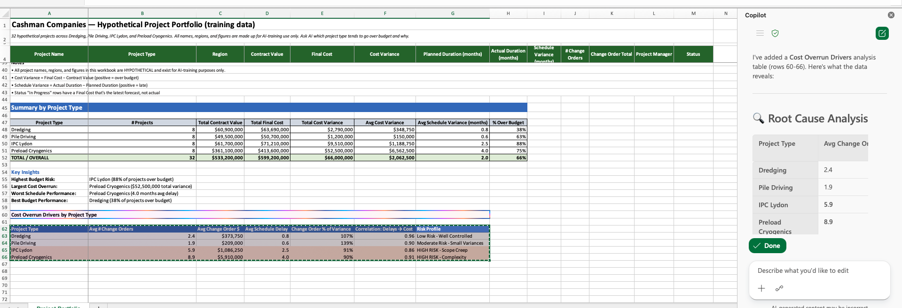
COPILOT IN EXCEL — LIVE
Cost overrun drivers, in seconds.
Copilot in Excel built the Summary by Project Type, the Cost Overrun Drivers table, and the risk profile column from one prompt. Read it — but always verify the numbers tie back to the source rows.

Slide 4
THE JUDGMENT CALL
AI suggests. You decide.
32 projects across 4 categories isn't enough for regression.
Apply your domain expertise to AI's suggestions.

