Slide 1
LESSON 3
Closing Out a Messy Project
Seven files. Three deliverables. One afternoon.
CASHMAN · AI TRAINING

Slide 2
THE IPC LYDON BUNDLE
What you have. What you owe.
• Inputs — Word logs, Excel cost + payment, txt transcripts, emails.
• Outputs — 1-page Word summary · Excel sequence-of-events · (bonus) PowerPoint.
• Always cite the source file for every number.

Slide 3
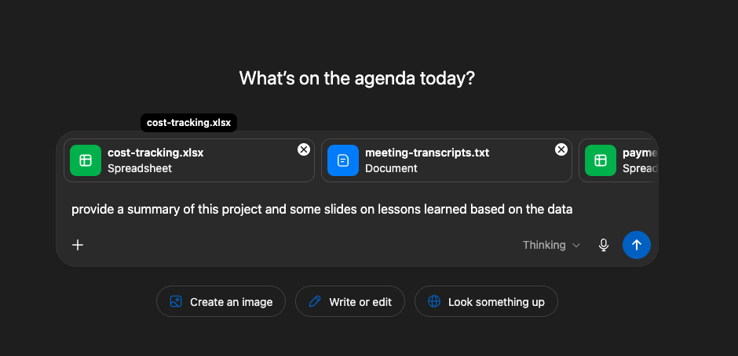
CHATGPT — THE WHOLE BUNDLE AT ONCE
Drop the zip. Ask one focused question.
Attach every file from the bundle in a single message, then ask for a chronological event list with source-file citations. Fastest cross-file synthesis — but the data leaves your network, so use it on hypothetical or public data only.

Slide 4
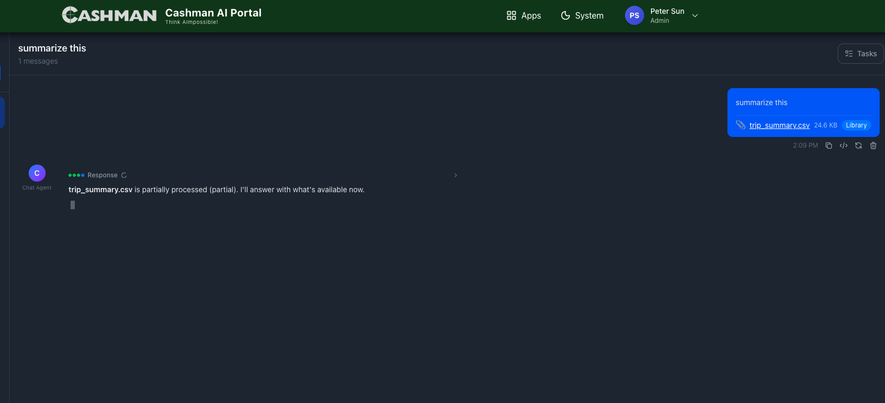
CASHMAN AI PORTAL — INTERNAL DATA
Same approach. On-prem.
For real Cashman files, attach to the Portal instead. Files stay on company infrastructure. Best paired with Microsoft Copilot inside Word/Excel for per-file follow-ups.

Slide 5
THE AUDIT TRAIL
AI is the typist. You are the auditor.
Every dollar in your timeline must tie to cost-tracking.xlsx.
Dates chronological. No invented quotes.

