Slide 1
JavaEE (J2EE) ?
드디어 프레임워크

Slide 2
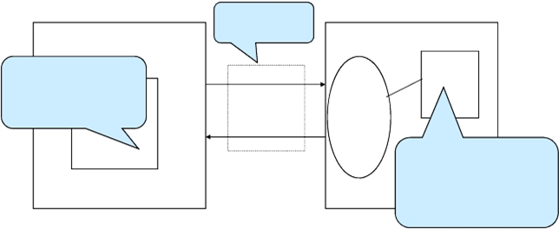
JavaEE 및 기반 웹 개발 기술
HTTP protocel
클라이언트 (FrontEnd)
서버 (BackEnd)
HTML, CSS, JavaScript
jQuery
AJAX
디자인
request
웹서버
&
WAS
response
Java EE
JSP, Servlet
Java Framework(Spring, Struts)
DB연동 (JDBC, myBatis, ...)
웹브라우저
XML JSON

Slide 3
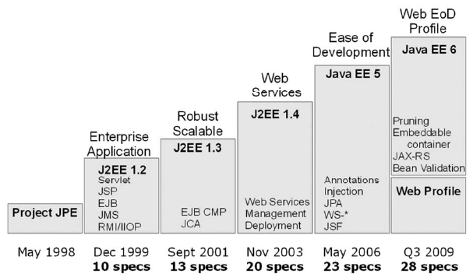
Java EE : Java Platform, Enterprise Edition
쉽게 말해서 Java 를 이용한 서버개발 플랫폼이다

Slide 4
WAS : Web Application Server 란?
Java EE 6 인증 (2010년 1월 5일 기준)
글래스피시 엔터프라이즈 서버 3, 썬 마이크로시스템즈사 제품
제우스 7, 티맥스소프트사 제품
Java EE 5 인증[편집]
썬 자바 애플리케이션 서버 9.0, 오픈 소스인 글래스피시 기반의 썬 마이크로시스템즈사 제품
제우스 6, 티맥스소프트사 제품
웹로직 10.0, 오라클에 인수된 BEA사 제품
넷위버, SAP사 제품
아파치 제르니모 2.0, 오픈 소스
웹스피어 애플리케이션 서버 커뮤니티 에디션 2.0, 오픈 소스인 아파치 제르니모 기반의 IBM사 제품
OC4J 11, 오라클사 제품
글래스피시, 오픈 소스
Java EE 스펙에 따라 제품으로 구현한 것을 웹 애플리케이션 서버 또는 WAS 라 한다
인증된 WAS 목록
자바 기반이긴 하나 Java EE 비준수 웹 애플리케이션 서버 아파치 톰캣(Apache Tomcat): 오픈 소스 재단 아파치 소프트웨어 재단의 오픈 소스 소프트웨어 레진(Resin): Caucho사의 제품 제이런(JRun): 매크로미디어사의 제품.

Slide 5
컨테이너 (Container)
– Java EE is a set of specifications implemented by different containers.
– Containers are Java EE runtime environments that provide certain services to the components they host such as life-cycle management, dependency injection, and so on. These components use well-defined contracts to communicate with the Java EE infrastructure and with the other components.
– Java EE is a superset of the Java SE platform, which means Java SE APIs can be used by any Java EE components.

Slide 6
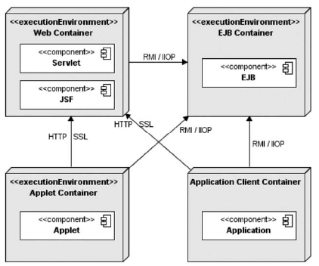
Standard Java EE Container들
JavaServer Faces ( JSF ) is a Java-based Web application framework intended to simplify development integration of web-based user interfaces.

Slide 7
Components
JavaEE runtime 환경은 다음의 4가지 타입의 component 를 정의하였고, JavaEE runtime 구현시 반드시 이들 component 가 있어야 한다.
Applets are GUI applications that are executed in a web browser.
Applications are programs that are executed on a client. They are typically GUIs or batch-processing programs that have access to all the facilities of the Java EE middle tier.
Web applications (made of servlets, servlet filters, web event listeners, JSP pages, and JSF) are executed in a web container and respond to HTTP requests from web clients. Servlets also support SOAP and RESTtul web service endpoints.
Enterprise Java Beans are container-managed components for processing transactional business logic. They can be accessed locally and remotely through RMI (or HTTP for SOAP and RESTful web services).

Slide 8
Components
Containers provide underlying services to their deployed components.
– HyperText Transfer Protocol/HyperText Transfer Protocol Secure sockets (HTTP/HTTPS) — Both of these protocols must be supported by J2EE servers.
– Java Transaction API (JTA) — JTA provides an interface for demarcating transactions. It enables the developer to attach transaction-processing systems.
– Remote Method Invocation to Internet Inter-ORB Protocol (RMI-IIOP) —EJB components use this service for communication. The underlying IIOP protocol can be used to access compliant CORBA objects residing in external systems.
– Java Database Connectivity (JDBC) — JDBC provides a Java interface for executing SQL statements without understanding the specifics of the underlying data store. JDBC 3.0 merged with the previously optional JDBC Extension package.
– Java Message Service (JMS) — JMS is an asynchronous messaging service that enables the user to send and receive messages via point-to-point or publish-subscribe models.
– Java Mail — JavaMail enables the delivery and retrieval of e-mail via message transports and message stores, respectively.

Slide 9
Components
– Java Naming and Directory Interface (JNDI) — JNDI is used to access directories such as Lightweight Directory Access Protocol (LDAP). Typically, components use the API to obtain references to other components.
– JavaBeans Activation Framework (JAF) — JavaMail uses JAF to handle various different Multipurpose Internet Mail Extensions (MIME) types that may be included within an e-mail message. It converts MIME byte streams into Java objects that can than be handled by assigned JavaBeans.
– Java API for XML Parsing (JAXP) — JAXP includes both Simple API for XML (SAX) and Document Object Model (DOM) APIs for manipulating XML documents. The JAXP API also enables Extensible Stylesheet Language Transformation (XSLT) engines to be plugged in.
– J2EE Connector Architecture — The connector architecture specifies a mechanism by which to attach new resource adaptors to a J2EE server.
– Security Services — These are provided via Java Authentication and Authorization Service (JAAS), which allows J2EE servers to control access to services.

Slide 10
Components
– Web Services — Support for Web services is provided via Simple Object Access Protocol (SOAP) for attachments; API for Java (SAAJ) 1.1 for handling of SOAP messages; Java API for XML Registries (JAXR) 1.0 for
access to Universal Description, Discovery, and Integration (UDDI); and Java API for XML-based RPC (JAX-RPC) 1.0 to specify how clients can use Web services.
– Management — The Java 2 Platform, Enterprise Edition Management API, and Java Management Extensions (JMX) are used to provide management support for querying a server during runtime.
– Deployment — The Java 2 Platform, Enterprise Edition Deployment API allows tools to plug into a J2EE server for deployment purposes.
– Java Authorization Service Provider Contract for Containers (JACC) — JACC is the interface between application servers and authorization policy providers.

Slide 11
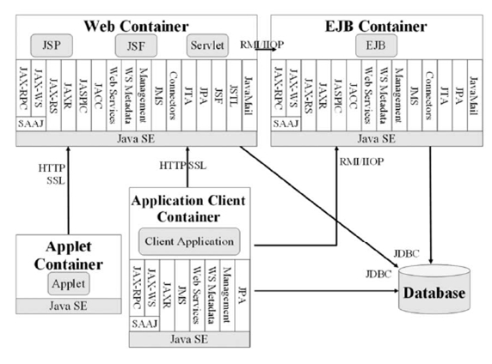
Components

Slide 12
JaveEE Application Model
‘일반적’ 으로 SW 시스템은 다음 세부분으로 구성된다.
Monolithic architecture 는 위 세부분이 단일 SW (혹은 모듈, 프로세스) 로 구현된것을 말함
Presentation
Logic
Business
Logic
Data Access
Logic
Presentation.L + Business. L + Data Access. L

Slide 13
JaveEE Application Model
2-tier architecture
여러 응용프로그램들이 분산환경에서 데이터의 공유를 위하여 Data Access Logic 부분만 별도의 머신에 구현한 구조
Presentation.L + Business.L
Presentation.L + Business.L
Data Access. L
…
...
Presentation.L + Business.L
DataBase
JSP model1 (DAO + DTO 버젼) 생각하시면 됩니다.

Slide 14
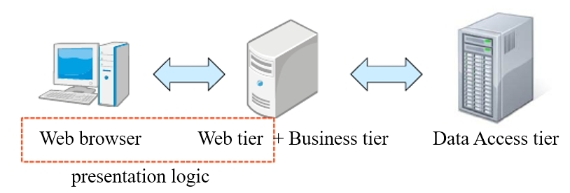
JaveEE Application Model
3-tier architecture
요즘 기업 웹 시스템의 대표적인 SW 구조
Presentation
Logic
Business
Logic
Data Access
Logic
DataBase
tier 는 물리적으로 분리 되어있다는 개념이 강함

Slide 15
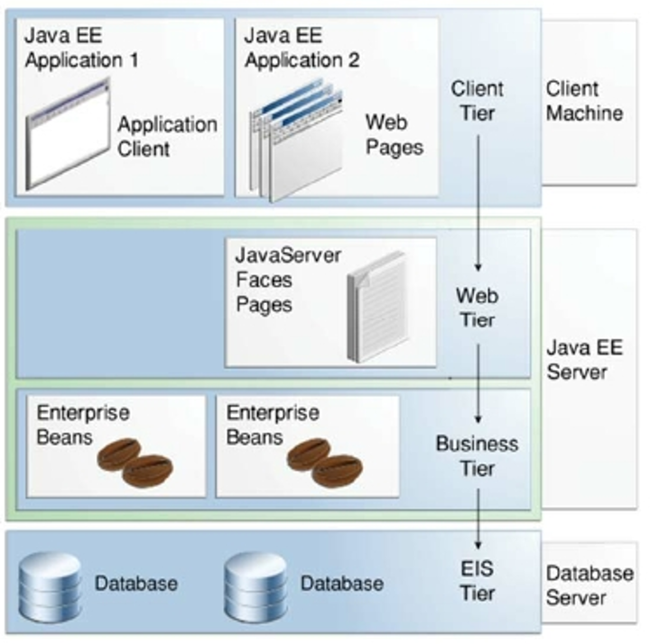
JaveEE Application Model
multi-tiered application

Slide 16
JaveEE Application Model
A Java EE component is a self-contained functional software unit that is assembled into a Java EE application
Application clients and applets are components that run on the client.
Java Servlet, JavaServer Faces, and JavaServer Pages (JSP) technology components are web components that run on the server.
Enterprise JavaBeans (EJB) components (enterprise beans) are business components that run on the server

Slide 17
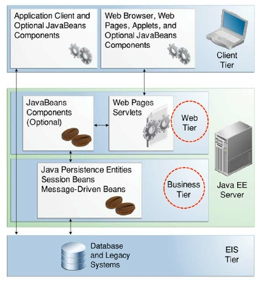
JaveEE Application Model
components of each tier

Slide 18
JaveEE Application Model - Container
Containers are the interface between a component and the low-level platform-specific functionality that supports the component.
Before it can be executed, a web, enterprise bean, or application client component must be assembled into a Java EE module and deployed into its container.
Enterprise JavaBeans (EJB) container: Manages the execution of enterprise beans for Java EE applications. Enterprise beans and their container run on the Java EE server.
Web container: Manages the execution of web pages, servlets, and some EJB components for Java EE applications. Web components and their container run on the Java EE server.
Application client container: Manages the execution of application client components. Application clients and their container run on the client.
Applet container: Manages the execution of applets. Consists of a web browser and Java Plug-in running on the client together.

Slide 19
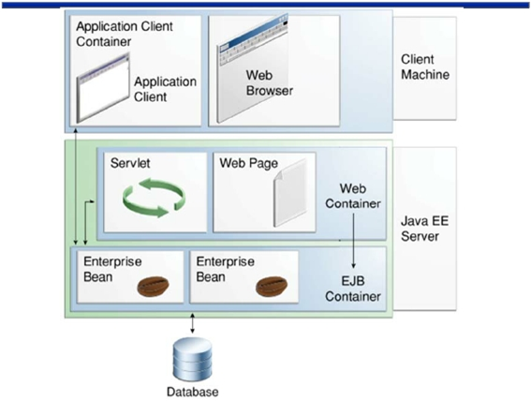
JaveEE Application Model - Container

Slide 20
JaveEE Application Model : JavaEE 모듈
A Java EE module
consists of one or more Java EE components for the same
container type and, optionally, one component deployment
descriptor of that type.

Slide 21
JaveEE Application Model : JavaEE 모듈
• Java EE modules are of the following types:
– EJB modules, which contain class files for enterprise beans and an EJB
deployment descriptor. EJB modules are packaged as JAR files with a .jar
extension.
– Web modules, which contain servlet class files, web files, supporting class
files, GIF and HTML files, and a web application deployment descriptor.
Web modules are packaged as JAR files with a . war (web archive)
extension.
– Application client modules, which contain class files and an application
client deployment descriptor. Application client modules are packaged as
JAR files with a .jar extension.
– Resource adapter modules, which contain all Java interfaces, classes,
native libraries, and other documentation, along with the resource adapter
deployment descriptor. Resource adapter modules are packaged as JAR
files with an .rar (resource adapter archive) extension.

Slide 22
다음 질문에 답해보세요
다음 질문에 답하시오 .
– Java EE Application Model 을 일반적으로 구성하는 4 가지 tier 는 ?
– Java EE 에서 말하는 component 는 무엇이고 어떤 것이 있는가 ?
– Java EE Server 가 포함하고 있는 두가지 Container 는 무엇인가 ?

