Slide 1
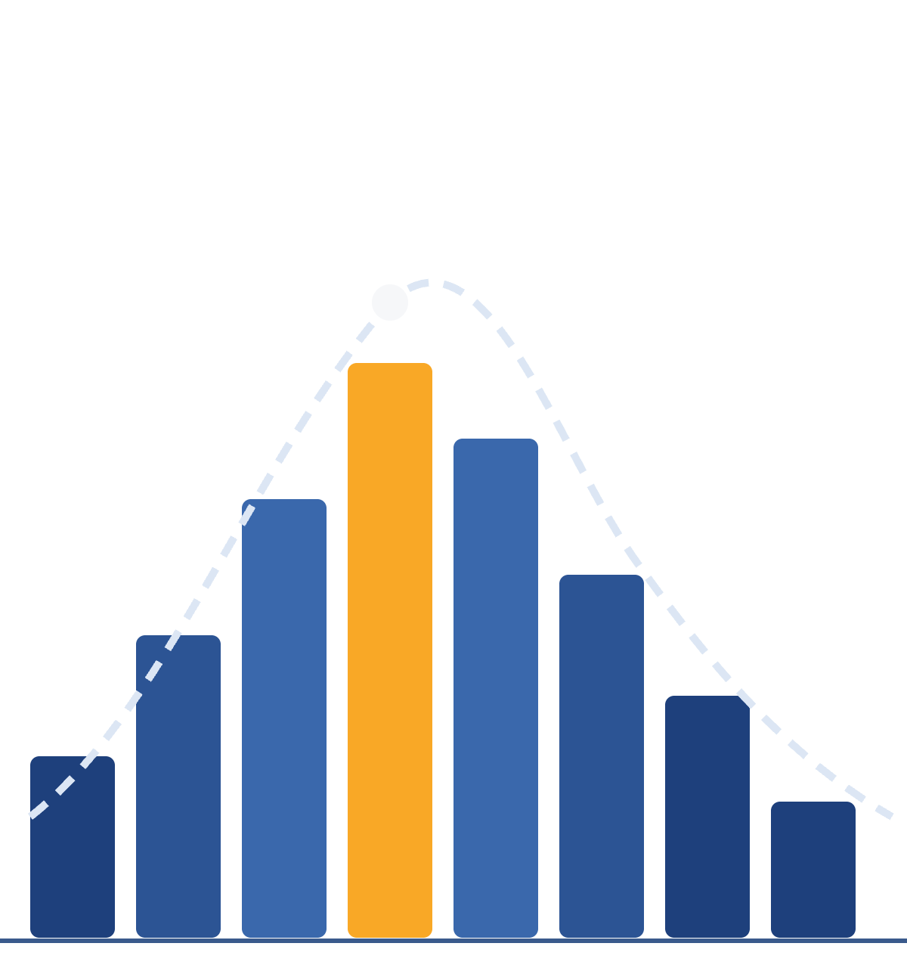
Please sit in first 3 rows!
NITTANY DATA LABS
Exploratory
Data Analysis
Getting to Know Your Data
Bootcamp #2
Notes:
Welcome everyone to Nittany Data Labs. Today we're covering exploratory data analysis, or EDA, which is basically how you get to know a dataset before you do anything fancy with it. No experience needed: we'll go through the ideas for about 20 minutes, then you'll try it yourself in Google Colab.

Slide 2

Attendance - “EDA”

Slide 3






THE BASICS
What is EDA?
Exploring, summarizing, and visualizing clean data to understand it before building any model.
Cleaning
EDA
Raw data
Modeling
Insights
Last week
Today
Understand its structure
Spot patterns and trends
See how variables relate
Come up with questions to test
Nittany Data Labs · Exploratory Data Analysis
2
Notes:
Last week we cleaned data: fixing missing values, types, and messy entries. Today picks up right after that. EDA is where you take clean data and start asking what it's telling you: what it looks like, what patterns show up, and how variables relate, all before you build any model.

Slide 4
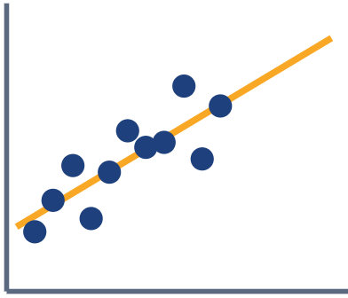
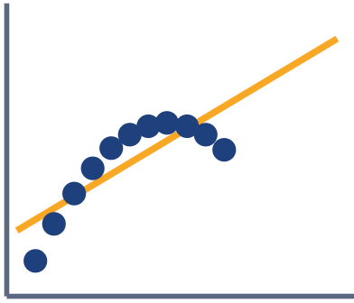
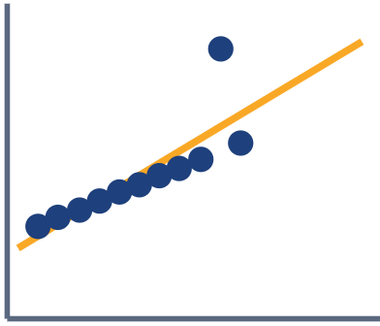
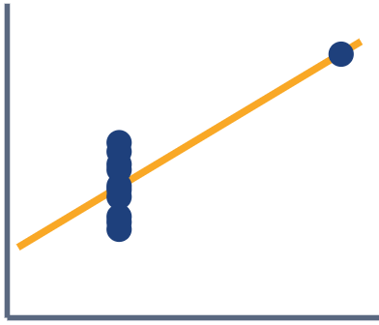
THE BASICS
Why EDA matters
Same stats, different data
Summary stats can hide the story
Anscombe's quartet: all four datasets share the same mean, variance, and correlation (r ≈ 0.82).
Find patterns and relationships
See which features matter
Pick the right model for the job
Linear
Curved
One odd point
One far point
Always plot your data.
Nittany Data Labs · Exploratory Data Analysis
3
Notes:
This is Anscombe's quartet, a famous example from 1973. All four datasets have the same averages, the same spread, the same correlation, and even the same best-fit line, but once you plot them they're completely different: a line, a curve, one weird point, and one extreme point doing all the work. That's the whole argument for EDA: the numbers alone can lie, so you have to look.

Slide 5
THE ROADMAP
6 steps of EDA
Start simple, add one variable at a time.
1
2
3
Ask questions
First look
One variable
What do we want to learn?
Size, types, summary stats
Distributions and counts
4
5
6
Two variables
Many variables
Share findings
Relationships and group gaps
Heatmaps, pair plots, color
Insights and next questions
Nittany Data Labs · Exploratory Data Analysis
4
Notes:
Here's today's plan in six steps. We start with a question and a quick first look, then build up: one variable at a time, then pairs, then many at once, and finally we share what we found. In real projects you loop back a lot, since a surprise in step 4 usually sends you back to look at one column more closely.

Slide 6

1
2
3
4
5
6
STEP 1 OF 6
Ask questions first
EXAMPLE COLUMNS
height_cm
city
price
color
num_rooms
category
What do we want to learn?
What does each column mean?
Numerical
Categorical
Which columns are numerical vs categorical?
Plot with histograms, scatters
Plot with bar charts, counts
height_cm
city
Write 2–3 questions before any plots
price
color
num_rooms
category
Nittany Data Labs · Exploratory Data Analysis
5
Notes:
Good EDA starts with a question, not a chart. Before plotting anything, write down two or three things you want to learn, and sort the columns into numerical and categorical, because that decides which charts make sense. Numbers get histograms and scatter plots; categories get bar charts and counts.

Slide 7
1
2
3
4
5
6
STEP 2 OF 6
Take a first look
df = pd.read_csv("clean.csv")
last week's cleaned data
df.shape
(rows, columns)
df.head()
eyeball the first 5 rows
df.dtypes
type of each column
df.describe()
mean, std, min, quartiles, max
df.nunique()
unique values per column
df["col"].value_counts()
how often each category shows up
Nittany Data Labs · Exploratory Data Analysis
6
Notes:
We're starting from last week's cleaned data, so this first look isn't about fixing anything; it's about getting a feel for it. describe gives you the mean, spread, and range of every numeric column in one shot, and value_counts shows how common each category is. Read the describe output out loud and ask: does this match what I expected?

Slide 8
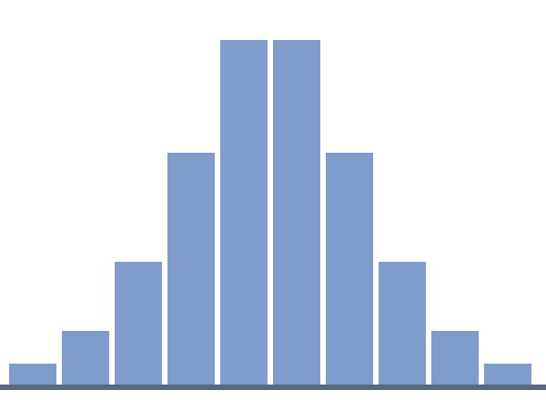
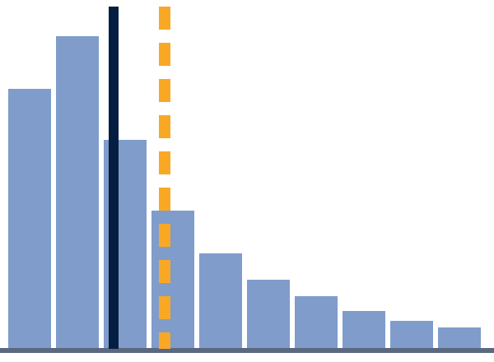
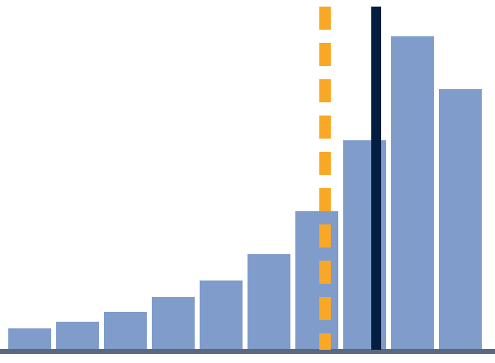
1
2
3
4
5
6
STEP 3 OF 6
One variable: distributions
Shape: how are the values spread out?
Center: mean, median, mode
Spread: standard deviation, range
Normal
Right-skewed
Left-skewed
Skew: a long tail drags the mean
Median (solid)
Mean (dashed)
Sample data. The mean gets pulled toward the long tail; the median stays put.
Nittany Data Labs · Exploratory Data Analysis
7
Notes:
Now we look at one column at a time: what shape it has, where the center is, how spread out it is, and whether it's skewed. In a normal distribution the mean and median sit together, but when there's a long tail, a few extreme values drag the mean toward it while the median barely moves. That's why for skewed data like incomes or prices, the median is usually the better "typical" value.

Slide 9

1
2
3
4
5
6
STEP 3 OF 6
One variable: box plots & counts
IQR (middle 50%)
Why is this here?
A box plot summarizes a column in one picture
The box = the middle 50% (IQR)
Whisker
Q1
Median
Q3
Whisker
Far-out points are clues: what's going on there?
COUNTS PER CATEGORY
Category A
48
Categories: a bar chart of counts
Category B
32
Category C
15
Category D
5 (rare)
Nittany Data Labs · Exploratory Data Analysis
8
Notes:
A box plot squeezes a whole column into one picture: the box is the middle half of the data, the thick line is the median, and the whiskers show the normal range. Since the data's already clean, a far-out point isn't something to fix; it's a clue, so ask what's special about it. For categories, just count them with value_counts and a bar chart, and notice rare groups like Category D, because they matter when you compare groups later.

Slide 10
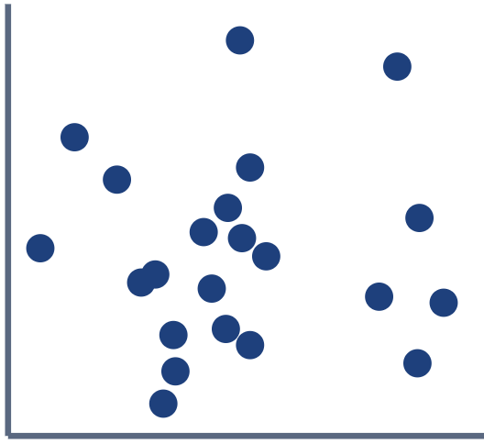
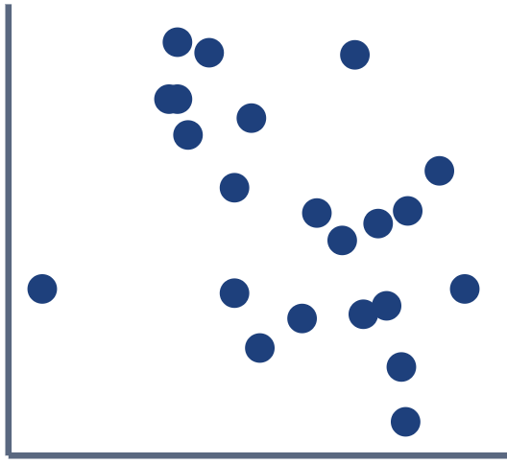
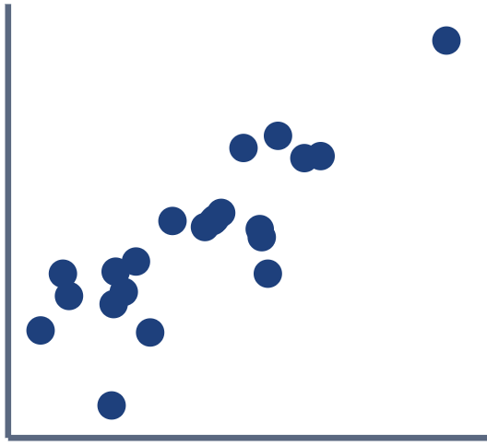
1
2
3
4
5
6
STEP 4 OF 6
Two variables: relationships
Scatter plots for two numeric variables
Correlation r runs from −1 to +1
Sign = direction, size = strength
r ≈ 0
r ≈ −0.4
r ≈ +0.85
Near 0 = no straight-line link
no linear link
weak negative
strong positive
−1 perfect negative
0 none
+1 perfect positive
Nittany Data Labs · Exploratory Data Analysis
9
Notes:
Now we look at how variables move together. Correlation goes from −1 to +1: the sign tells you direction and the size tells you strength, so +0.85 is a tight upward trend while −0.4 is a loose downward one. In pandas, df.corr() gives you every pair at once, which leads right into the next few slides.

Slide 11
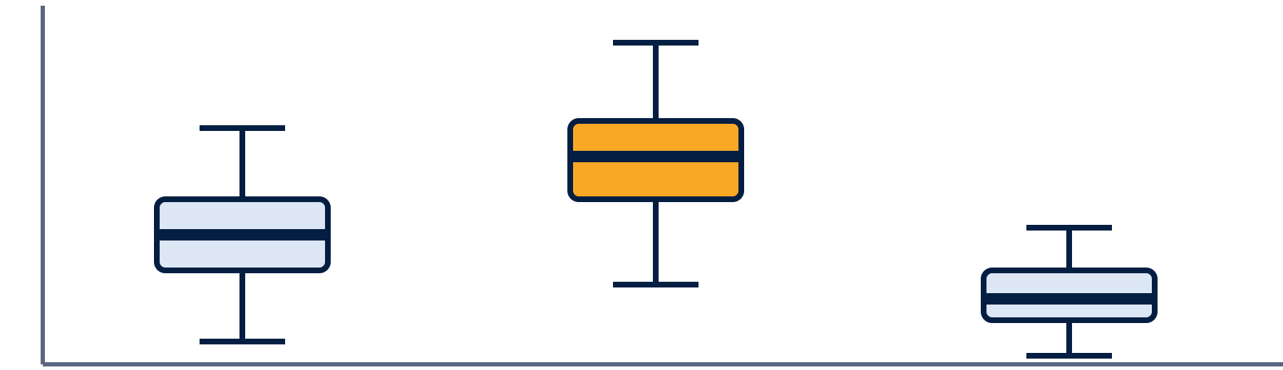
1
2
3
4
5
6
STEP 4 OF 6
Two variables: comparing groups
Number vs category: box plots side by side
Compare group averages with groupby
Category vs category: a cross-tab
Category A
Category B
Category C
Group | A | B | C
X | 12 | 20 | 8
Y | 18 | 6 | 14
Ask: is the gap big enough to matter?
df.groupby("cat")["value"].mean()
pd.crosstab(df["grp"], df["cat"])
Nittany Data Labs · Exploratory Data Analysis
10
Notes:
Not every pair is two numbers. When you've got a number and a category, put box plots side by side; here Category B clearly sits higher than A and C. When both are categories, a cross-tab counts how they overlap. Then always ask whether a gap is big enough to actually matter or just noise.

Slide 12
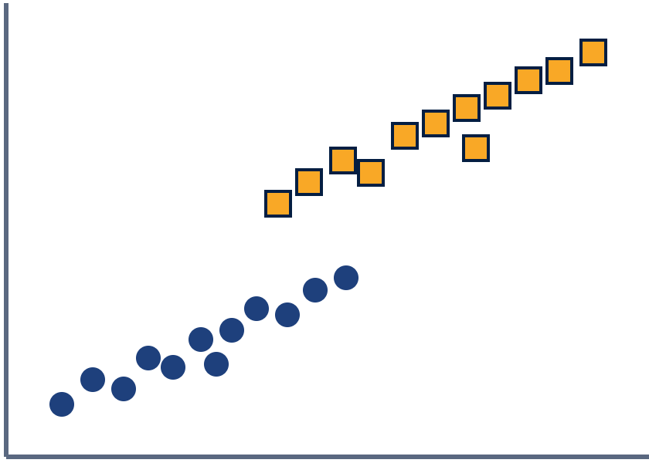
1
2
3
4
5
6
STEP 5 OF 6
Many variables at once
Heatmap: every correlation at a glance
A
B
C
D
A
1.00
0.85
−0.40
0.05
Pair plot: a grid of scatter plots
B
0.85
1.00
−0.30
0.10
C
−0.40
−0.30
1.00
0.60
Color by category to add a 3rd variable
D
0.05
0.10
0.60
1.00
Correlation heatmap
Look for clusters that behave differently
Navy = positive · orange = negative · pale = near 0
A (circles)
B (squares)
Scatter colored by a 3rd variable
Nittany Data Labs · Exploratory Data Analysis
11
Notes:
Once you've looked at pairs, zoom out to many variables at once. A correlation heatmap shows every pair in one grid, so you can spot the strong ones fast, and seaborn's pairplot draws a scatter plot for every pair. Coloring points by a category adds a third variable, and it can reveal that two groups follow totally different patterns that you'd miss if you lumped them together.

Slide 13
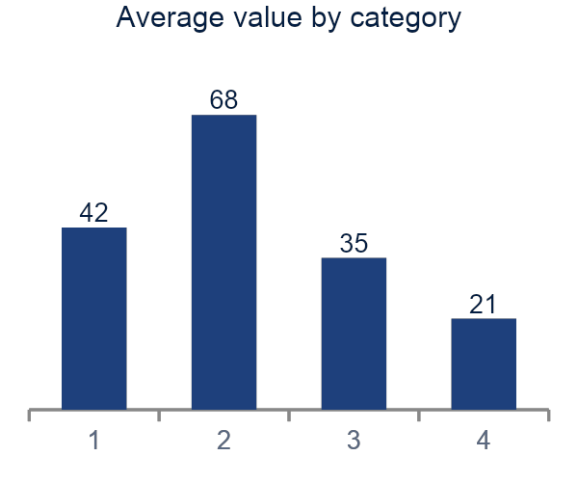
STEP 6 OF 6
1
2
3
4
5
6
Share your findings
Start with your question
Findings
Q: Which category has the highest values?
1
B is highest
Show only the key charts
About 1.6× Category A
2
D is rare
Highlight patterns and surprises
Too few rows to trust yet
3
Skewed values
End with open questions and next steps
A
B
C
D
Median beats mean here
Open questions: Why is B higher? Does it hold across groups?
Nittany Data Labs · Exploratory Data Analysis
12
Notes:
~1:00 min
- EDA isn't done until you can explain it to someone else.
- Go back to your step 1 questions and answer them.
- Show 1-2 key charts, not all 20 you made.
- Call out patterns and surprises, then end with open questions and next steps.

Slide 14
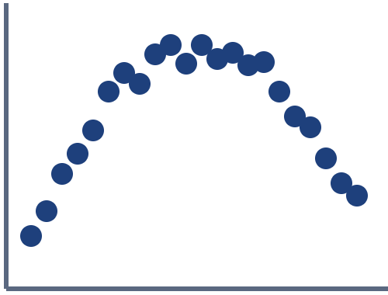
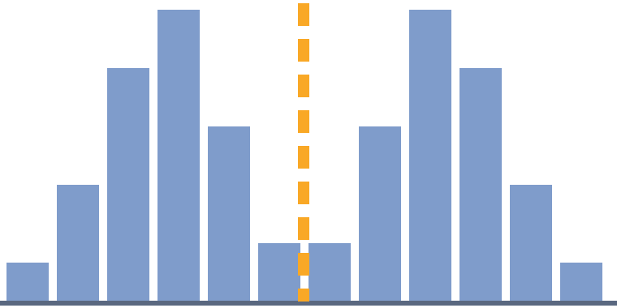


WATCH OUT
Three common EDA traps
Correlation ≠ causation
r ≈ 0 can hide a curve
Averages hide groups
X
Hidden Z
Y
X and Y can move together because something else drives both.
Clearly related, but not in a straight line. Plot it, don't just trust r.
Two groups, and the mean (dashed) lands where there's almost no data.
Nittany Data Labs · Exploratory Data Analysis
13
Notes:
Before we wrap up, three traps that catch everyone. First, two variables moving together doesn't mean one causes the other; there's often a hidden third variable driving both. Second, a correlation near zero only rules out a straight line, so this arch is clearly a relationship. Third, an average can describe nobody: with two groups, the mean lands in the gap, which is why you split by category.

Slide 15

YOUR TURN
Let's explore some data
Nittany Data Labs · Exploratory Data Analysis
14
Notes:
That's the full process, and now it's your turn. In the Colab notebook you'll load last week's cleaned data with pandas and explore it with matplotlib, seaborn, or plotly. Screenshot this checklist and work through it top to bottom; if you get stuck, raise your hand or grab someone next to you.

Slide 16

Interactive Notebook
Nittany Data Labs · Exploratory Data Analysis
15
Notes:
That's the full process, and now it's your turn. In the Colab notebook you'll load last week's cleaned data with pandas and explore it with matplotlib, seaborn, or plotly. Screenshot this checklist and work through it top to bottom; if you get stuck, raise your hand or grab someone next to you.

Slide 17
Thank you for coming!
Next Meeting: 10/4 - Feature Engineering
Nittany Data Labs · Exploratory Data Analysis
16
Notes:
That's the full process, and now it's your turn. In the Colab notebook you'll load last week's cleaned data with pandas and explore it with matplotlib, seaborn, or plotly. Screenshot this checklist and work through it top to bottom; if you get stuck, raise your hand or grab someone next to you.

