Slide 1
Data Modeling
NDL Bootcamp #4 – Sunday, October 11th, 2026

Slide 2


Slide 3
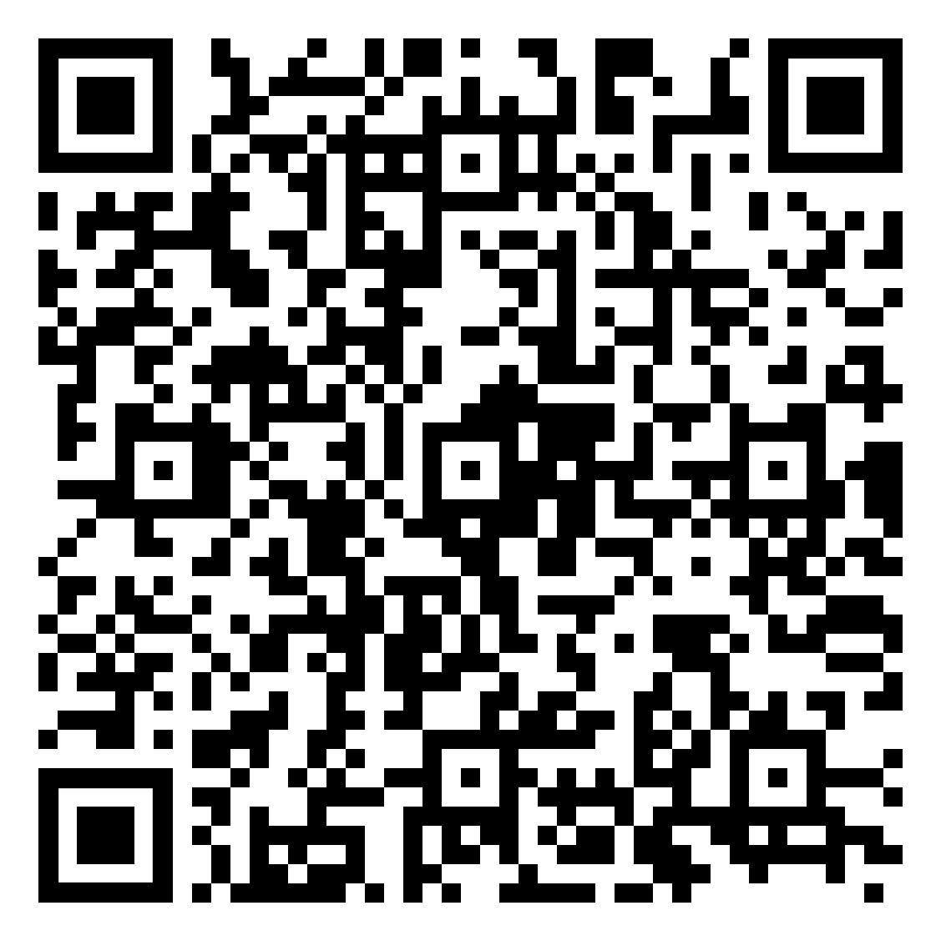
Attendance – “Modeling”

Slide 4

Example problem
The task: Our company wants to estimate how much a house will sell for.
What we have: Records of past sales, listing each house’s size, age, distance to the city, and the price it sold for.
The question: Given a new house’s size, age, and distance to the city, can we predict its price?

Slide 5
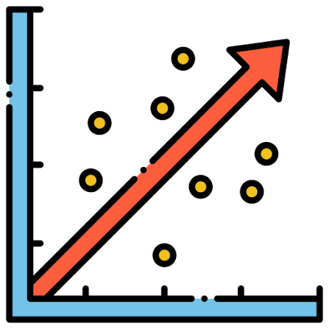
Regression
Definition:
Regression is a statistical method for predicting a numerical dependent variable from one or more independent variables.

Slide 6
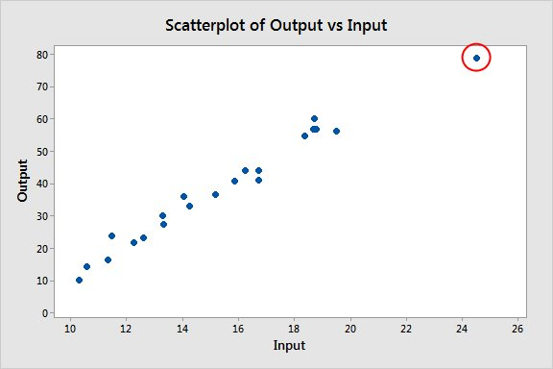

Slide 7
Linear Regression

Slide 8
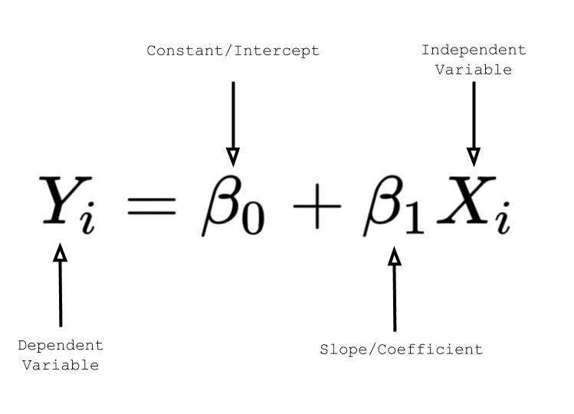
Linear Regression
Uses one independent variable to predict the dependent variable
Example: predicting price from house size alone
Finds the straight line that best fits the data
The slope shows how much the price changes for each extra square foot

Slide 9

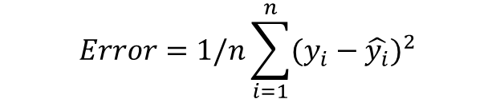
LR Error
yᵢ − ŷᵢ is the gap between a data point’s actual and predicted value
The gaps are squared so that misses above and below the line don’t cancel out
Squaring also makes large misses count more
Σ adds up the squared gaps for every data point
The best model makes this total as small as possible
GOAL: find β₀ and β₁ such that the error is minimized
$$\hat{y_{i}}=β_{0}+β_{1}x_{i}$$
$$Error=1/n\sum_{i=1}^{n}{{(y_{i}−\hat{y_{i}})}^{2}}$$

Slide 10
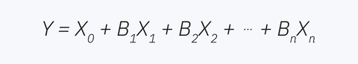
Multiple Linear Regression
ŷ is the predicted value of the dependent variable
x₁, x₂, …, xₚ are the independent variables
β₀ is the intercept, the predicted value when all independent variables are zero
β₁, β₂, …, βₚ are the weights showing how much each independent variable affects the prediction
Each weight shows that variable’s effect while the other variables are held constant

Slide 11

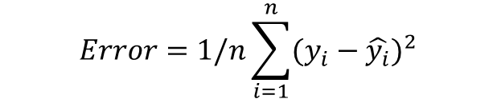
Multiple LR Error
yᵢ − ŷᵢ is the gap between a data point’s actual and predicted value
The gaps are squared so that misses above and below the line don’t cancel out
Squaring also makes large misses count more
Σ adds up the squared gaps for every data point
The best model makes this total as small as possible
$$\hat{y_{i}}=β_{0}+β_{1}x_{i,1}+β_{2}x_{i,2}. . . . . . .$$
$$Error=1/n\sum_{i=1}^{n}{{(y_{i}−\hat{y_{i}})}^{2}}$$

Slide 12
Ridge Regression

Slide 13
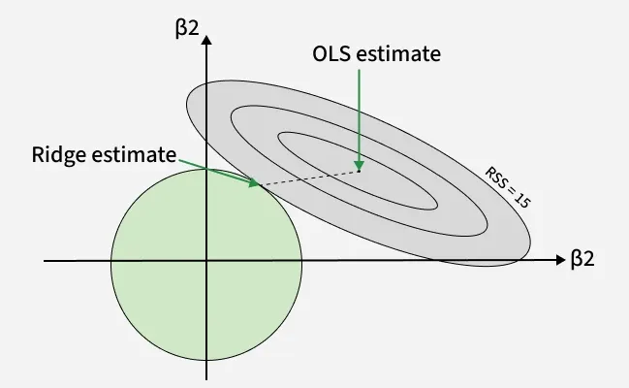
Ridge Regression
Multiple linear regression fits the training data as closely as possible, which can make its weights large and unstable
This is especially likely when there are many variables or the variables move together
The model then chases noise and predicts new data poorly
Ridge adds a penalty for large weights, so no single variable can dominate the prediction
It gives up a little accuracy on the training data in exchange for better predictions on new data

Slide 14
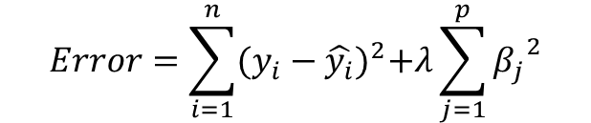
Ridge Regression Equation
The first part is the same error total as before ​
The second part adds a cost for large weights ​
The model can’t rely too heavily on any one variable ​
λ (lambda) controls how strong the penalty is ​
The result is more stable predictions on new data​
$$Error=\sum_{i=1}^{n}{{(y_{i}−\hat{y_{i}})}^{2}+λ\sum_{j=1}^{p}{{β_{j}}^{2}}}$$

Slide 15
Random Forest Regression

Slide 16
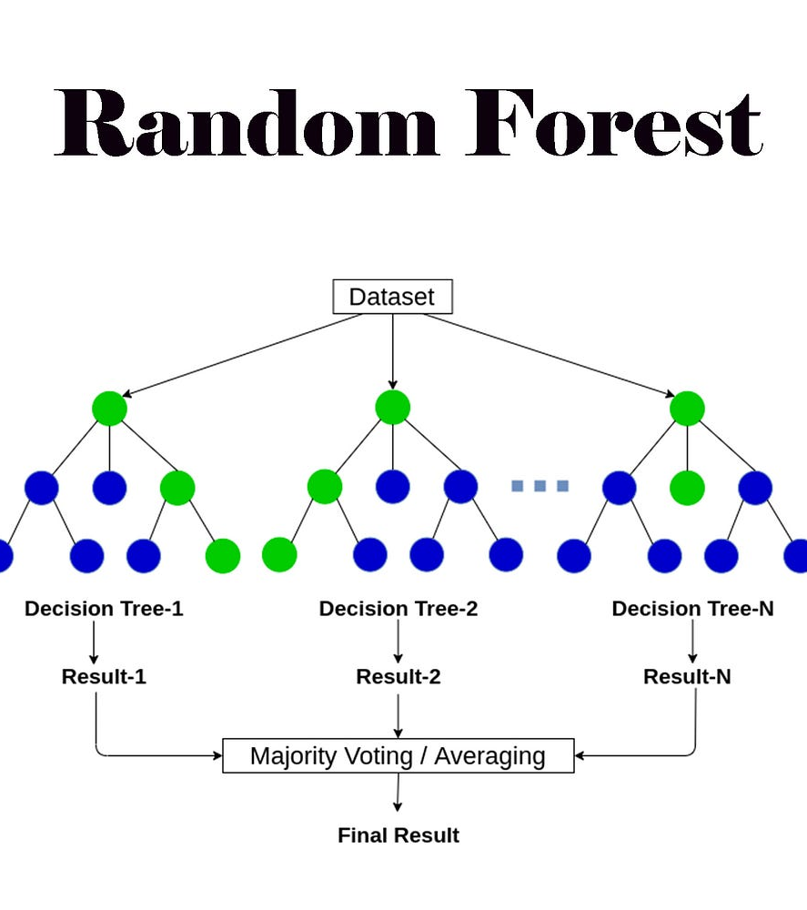
Random forest regression
Linear and ridge regression assume each variable affects price in a straight-line way
Real data often doesn’t follow straight lines. For example, price might drop sharply past a certain distance from the city
Variables can also interact. For example, age might matter more for large houses than for small ones
A random forest can capture these curved patterns and interactions without us specifying them
It also resists overfitting by combining many models instead of relying on just one

Slide 17
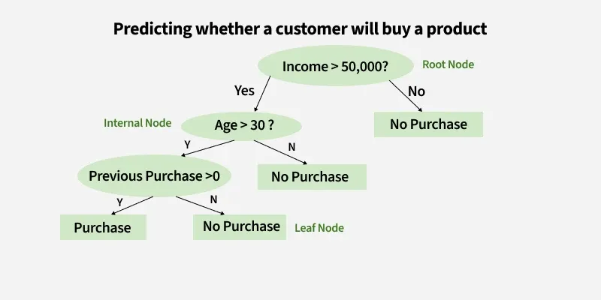
Decision Tree
A decision tree splits the houses into groups by asking yes/no questions
Example questions: “Is it larger than 2,000 sq ft?” or “Is it within 10 miles of the city?”
At each step, the tree picks the question that best separates cheap houses from expensive ones
The final groups are called leaves, and each leaf predicts the average price of its houses
Weakness: a single tree is unstable, so small changes in the data can produce a very different tree

Slide 18
Building The Forest
Instead of one tree, a random forest grows many trees, often hundreds
Each tree is trained on a random sample of the houses
At each split, each tree considers only a random subset of the variables
This randomness makes the trees different from one another, so they make different mistakes
Each tree on its own is imperfect, but together they cover each other’s weaknesses

Slide 19
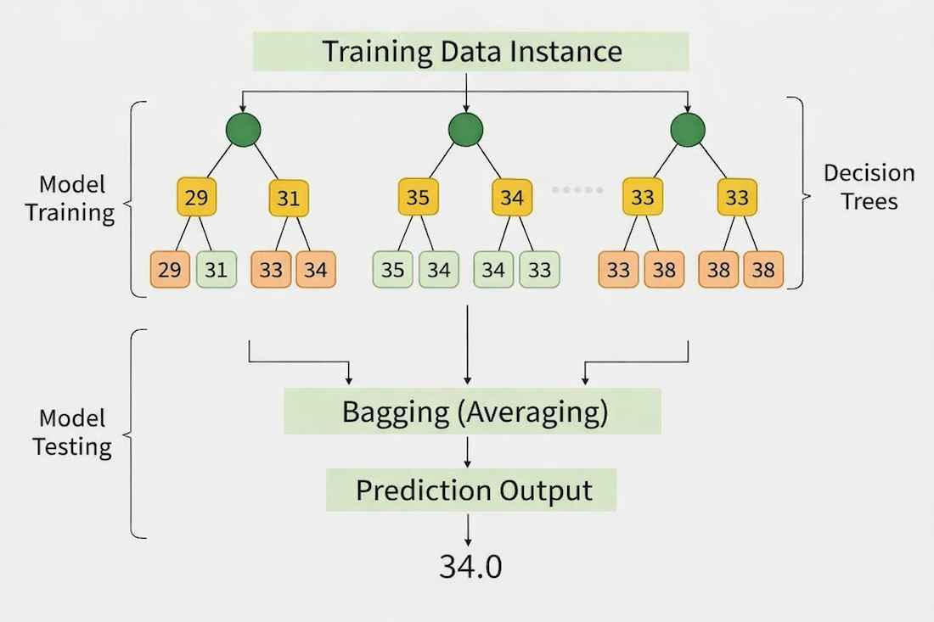
Making the prediction
A new data point is run through every tree in the forest
Each tree gives its own prediction
The forest’s final prediction is the average of all the trees’ predictions
Averaging cancels out the errors of individual trees, like the wisdom of the crowd
As a bonus, the forest can show which variables mattered most for the prediction

Slide 20
Elements of Modeling

Slide 21
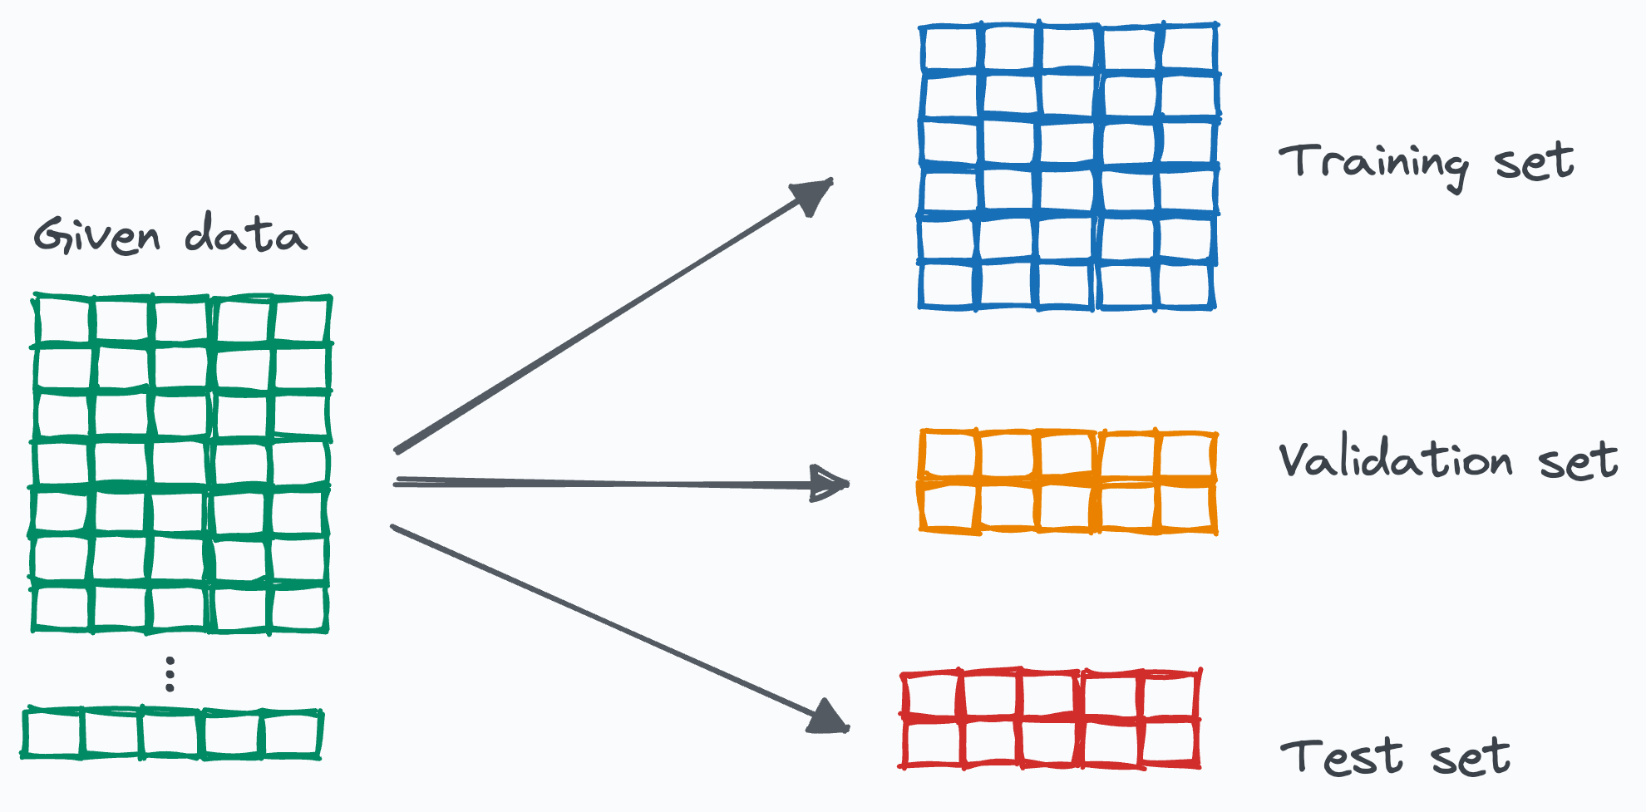
Train/Test Split
Regression is a supervised learning method, which means the models need to “train” on data that has the target variable accessible
A model “learns” the relationship between the independent variables and the dependent variable
Then, it can be used on the test set to evaluate model’s accuracy
For a given dataset, the usual split is about 80% train, 20% test
  May add validation set for hyperparameter tuning/model comparison

Slide 22
Evaluation Metrics
R² score : falls between 0 and 1, proportion of variance in the dependent variable that is explained by the independent variable(s)
Root Mean Squared Error : square root of the average squared difference between the predicted and actual values of the target variable, this is our evaluation metric in the competition
Mean Absolute Error : the average absolute difference between the predicted and actual values of the target variable

Slide 23
Certificate/Competition Info
Ways to get Bootcamp Certificate:
  (1): Attend all 4 bootcamp meetings (9/20, 9/27, 10/4, 10/11)
  (2): Attend 3 bootcamp meetings and make a Kaggle submission
Prizes for Kaggle Competition:
  1st = $20 gift card of your choosing
  2nd = $15 gift card of your choosing
  3rd = $10 gift card of your choosing

Slide 24
Thank you For coming!
Next Meeting: 10/18 - TBD

