Slide 1
S3-101
S3 is one of the first services that has been produced by aws.
S3 stands for Simple Storage Service.
S3 provides developers and IT teams with secure, durable, highly scalable object storage.
It is easy to use with a simple web services interface to store and retrieve any amount of data from anywhere on the web.

Slide 2

What is S3?
S3 is a safe place to store the files.
It is Object-based storage, i.e., you can store the images, word files, pdf files, etc.
The files which are stored in S3 can be from 0 Bytes to 5 TB.
It has unlimited storage means that you can store the data as much you want.
Files are stored in Bucket. A bucket is like a folder available in S3 that stores the files.
S3 is a universal namespace, i.e., the names must be unique globally. Bucket contains a DNS address. Therefore, the bucket must contain a unique name to generate a unique DNS address.
If you create a bucket, URL look like:

Slide 3
Advantages of Amazon S3
Create Buckets: Firstly, we create a bucket and provide a name to the bucket. Buckets are the containers in S3 that stores the data. Buckets must have a unique name to generate a unique DNS address.
Storing data in buckets: Bucket can be used to store an infinite amount of data. You can upload the files as much you want into an Amazon S3 bucket, i.e., there is no maximum limit to store the files. Each object can contain upto 5 TB of data. Each object can be stored and retrieved by using a unique developer assigned-key.
Download data: You can also download your data from a bucket and can also give permission to others to download the same data. You can download the data at any time whenever you want.
Permissions: You can also grant or deny access to others who want to download or upload the data from your Amazon S3 bucket. Authentication mechanism keeps the data secure from unauthorized access.
Standard interfaces: S3 is used with the standard interfaces REST and SOAP interfaces which are designed in such a way that they can work with any development toolkit.
Security: Amazon S3 offers security features by protecting unauthorized users from accessing your data.

Slide 4
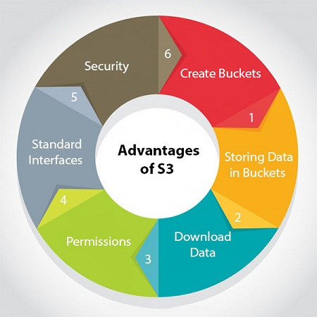

Slide 5
S3 is a simple key-value store
S3 is object-based. Objects consist of the following:
Key: It is simply the name of the object. For example, hello.txt, spreadsheet.xlsx, etc. You can use the key to retrieve the object.
Value: It is simply the data which is made up of a sequence of bytes. It is actually a data inside the file.
Version ID: Version ID uniquely identifies the object. It is a string generated by S3 when you add an object to the S3 bucket.
Metadata: It is the data about data that you are storing. A set of a name-value pair with which you can store the information regarding an object. Metadata can be assigned to the objects in Amazon S3 bucket.
Subresources: Subresource mechanism is used to store object-specific information.
Access control information: You can put the permissions individually on your files.

Slide 6
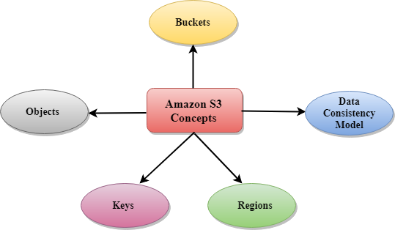
Amazon S3 Concepts

Slide 7
Buckets
A bucket is a container used for storing the objects.
Every object is incorporated in a bucket.
For example, if the object named photos/tree.jpg is stored in the treeimage bucket, then it can be addressed by using the URL http://treeimage.s3.amazonaws.com/photos/tree.jpg.
A bucket has no limit to the amount of objects that it can store. No bucket can exist inside of other buckets.
S3 performance remains the same regardless of how many buckets have been created.
The AWS user that creates a bucket owns it, and no other AWS user cannot own it. Therefore, we can say that the ownership of a bucket is not transferrable.
The AWS account that creates a bucket can delete a bucket, but no other AWS user can delete the bucket.
Objects
Objects are the entities which are stored in an S3 bucket.
An object consists of object data and metadata where metadata is a set of name-value pair that describes the data.
An object consists of some default metadata such as date last modified, and standard HTTP metadata, such as Content type. Custom metadata can also be specified at the time of storing an object.
It is uniquely identified within a bucket by key and version ID.
Key
A key is a unique identifier for an object.
Every object in a bucket is associated with one key.
An object can be uniquely identified by using a combination of bucket name, the key, and optionally version ID.
For example, in the URL http://jtp.s3.amazonaws.com/2019-01-31/Amazons3.wsdl where "jtp" is the bucket name, and key is "2019-01-31/Amazons3.wsdl"
Regions
You can choose a geographical region in which you want to store the buckets that you have created.
A region is chosen in such a way that it optimizes the latency, minimize costs or address regulatory requirements.
Objects will not leave the region unless you explicitly transfer the objects to another region

Slide 8
DataConsistencyModel Amazon S3 replicates the data to multiple servers to achieve high availability. Two types of models:
Read-after-write consistency for PUTS of new objects.
For a PUT request, S3 stores the data across multiple servers to achieve high availability.
A process stores an object to S3 and will be immediately available to read the object.
A process stores a new object to S3, it will immediately list the keys within the bucket.
It does not take time for propagation, the changes are reflected immediately.
Eventual consistency for overwriting PUTS and DELETES
For PUTS and DELETES to objects, the changes are reflected eventually, and they are not available immediately.
If the process replaces an existing object with the new object, you try to read it immediately. Until the change is fully propagated, the S3 might return prior data.
If the process deletes an existing object, immediately try to read it. Until the change is fully propagated, the S3 might return the deleted data.
If the process deletes an existing object, immediately list all the keys within the bucket. Until the change is fully propagated, the S3 might return the list of the deleted key.

Slide 9
Creating S3 bucket
Important points to remember
Buckets are a universal namespace, i.e., the bucket names must be unique.
If uploading of an object to S3 bucket is successful, we receive a HTTP 200 code.
S3, S3-IA, S3 Reduced Redundancy Storage are the storage classes.
Encryption is of two types, i.e., Client Side Encryption and Server Side Encryption
Access to the buckets can be controlled by using either ACL (Access Control List) or bucket policies.
By default buckets are private and all the objects stored in a bucket are also private.

Slide 10
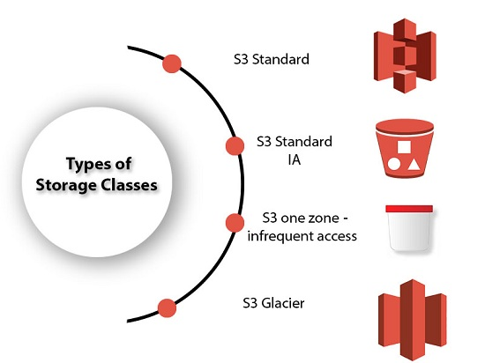
AWS Storage Classes
S3 storage classes are used to assist the concurrent loss of data in one or two facilities.
S3 storage classes maintain the integrity of the data using checksums.
S3 provides lifecycle management for the automatic migration of objects for cost savings.

Slide 11
S3 contains four types of storage classes:
S3 Standard
S3 Standard IA
S3 one zone-infrequent access
S3 Glacier
S3 Standard
Standard storage class stores the data redundantly across multiple devices in multiple facilities.
It is designed to sustain the loss of 2 facilities concurrently.
Standard is a default storage class if none of the storage class is specified during upload.
It provides low latency and high throughput performance.
It designed for 99.99% availability and 99.999999999% durability

Slide 12
S3 Standard IA
IA stands for infrequently accessed.
Standard IA storage class is used when data is accessed less frequently but requires rapid access when needed.
It has a lower fee than S3, but you will be charged for a retrieval fee.
It is designed to sustain the loss of 2 facilities concurrently.
It is mainly used for larger objects greater than 128 KB kept for atleast 30 days.
It provides low latency and high throughput performance.
It designed for 99.99% availability and 99.999999999% durability

Slide 13
S3 one zone-infrequent access
S3 one zone-infrequent access storage class is used when data is accessed less frequently but requires rapid access when needed.
It stores the data in a single availability zone while other storage classes store the data in a minimum of three availability zones. Due to this reason, its cost is 20% less than Standard IA storage class.
It is an optimal choice for the less frequently accessed data but does not require the availability of Standard or Standard IA storage class.
It is a good choice for storing the backup data.
It is cost-effective storage which is replicated from other AWS region using S3 Cross Region replication.
It has the same durability, high performance, and low latency, with a low storage price and low retrieval fee.
It designed for 99.5% availability and 99.999999999% durability of objects in a single availability zone.
It provides lifecycle management for the automatic migration of objects to other S3 storage classes.
The data can be lost at the time of the destruction of an availability zone as it stores the data in a single availability zone.

Slide 14
S3 Glacier
S3 Glacier storage class is the cheapest storage class, but it can be used for archive only.
You can store any amount of data at a lower cost than other storage classes.
S3 Glacier provides three types of models:
Expedited: In this model, data is stored for a few minutes, and it has a very higher fee.
Standard: The retrieval time of the standard model is 3 to 5 hours.
Bulk: The retrieval time of the bulk model is 5 to 12 hours.
You can upload the objects directly to the S3 Glacier.
It is designed for 99.999999999% durability of objects across multiple availability zones.

Slide 15
Performance across the Storage classes
 | S3 Standard | S3 Standard IA | S3 One Zone-IA | S3 Glacier
Designed for durability | 99.99999999% | 99.99999999% | 99.99999999% | 99.99999999%
Designed for availability | 99.99% | 99.9% | 99.5% | N/A
Availability SLA | 99.9% | 99% | 99% | N/A
Availability zones | >=3 | >=3 | 1 | >=3
Minimum capacity charge per object | N/A | 128KB | 128KB | 40KB
Minimum storage duration charge | N/A | 30 days | 30 days | 90 days
Retrieval fee | N/A | per GB retrieved | per GB retrieved | per GB retrieved
First byte latency | milliseconds | milliseconds | milliseconds | Select minutes or hours
Storage type | Object | Object | Object | Object
Lifecycle transitions | Yes | Yes | Yes | Yes

