Slide 1
What is IAM?
IAM stands for Identity Access Management.
IAM allows you to manage users and their level of access to the aws console.
It is used to set users, permissions and roles. It allows you to grant access to the different parts of the aws platform.
AWS Identity and Access Management is a web service that enables Amazon Web Services (AWS) customers to manage users and user permissions in AWS.
With IAM, Organizations can centrally manage users, security credentials such as access keys, and permissions that control which AWS resources users can access.
Without IAM, Organizations with multiple users must either create multiple user accounts, each with its own billing and subscriptions to AWS products or share an account with a single security credential. Without IAM, you also don't have control about the tasks that the users can do.
IAM enables the organization to create multiple users, each with its own security credentials, controlled and billed to a single aws account. IAM allows the user to do only what they need to do as a part of the user's job.

Slide 2
Features of IAM
Centralised control of your AWS account: You can control creation, rotation, and cancellation of each user's security credentials. You can also control what data in the aws system users can access and how they can access.
Shared Access to your AWS account: Users can share the resources for the collaborative projects.
Granular permissions: It is used to set a permission that user can use a particular service but not other services.
Identity Federation: An Identity Federation means that we can use Facebook, Active Directory, LinkedIn, etc with IAM. Users can log in to the AWS Console with same username and password as we log in with the Active Directory, Facebook, etc.
Multifactor Authentication: An AWS provides multifactor authentication as we need to enter the username, password, and security check code to log in to the AWS Management Console.
Permissions based on Organizational groups: Users can be restricted to the AWS access based on their job duties, for example, admin, developer, etc.
Networking controls: IAM also ensures that the users can access the AWS resources within the organization's corporate network.
Provide temporary access for users/devices and services where necessary: If you are using a mobile app and storing the data in AWS account, you can do this only when you are using temporary access.
Integrates with many different aws services: IAM is integrated with many different aws services.
Supports PCI DSS Compliance: PCI DSS (Payment Card Industry Data Security Standard) is a compliance framework. If you are taking credit card information, then you need to pay for compliance with the framework.
Eventually Consistent: IAM service is eventually consistent as it achieves high availability by replicating the data across multiple servers within the Amazon's data center around the world.
Free to use: AWS IAM is a feature of AWS account which is offered at no additional charge. You will be charged only when you access other AWS services by using IAM user.

Slide 3
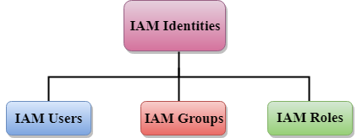
IAM Identities
IAM identities are created to provide authentication for people and processes in your aws account.
IAM identities are categorized as given below:

Slide 4
AWS Account Root User
When you first create an AWS account, you create an account as a root user identity which is used to sign in to AWS.
You can sign to the AWS Management Console by entering your email address and password. The combination of email address and password is known as root user credentials.
When you sign in to AWS account as a root user, you have unrestricted access to all the resources in AWS account.
The Root user can also access the billing information as well as can change the password also.

Slide 5
What is a Role?
A role is a set of permissions that grant access to actions and resources in AWS. These permissions are attached to the role, not to an IAM User or a group.
An IAM User can use a role in the same AWS account or a different account.
An IAM User is similar to an IAM User; role is also an AWS identity with permission policies that determine what the identity can and cannot do in AWS.
A role is not uniquely associated with a single person; it can be used by anyone who needs it.
A role does not have long term security credential, i.e., password or security key. Instead, if the user uses a role, temporarily security credentials are created and provided to the user.
You can use the roles to delegate access to users, applications or services that generally do not have access to your AWS resources.

Slide 6
Situations in which "IAM Roles" can be used:
Sometimes you want to grant the users to access the AWS resources in your AWS account.
Sometimes you want to grant the users to access the AWS resources in another AWS account.
It also allows the mobile app to access the AWS resources, but not want to store the keys in the app.
It can be used to grant access to the AWS resources which have identities outside of AWS.
It can also be used to grant access to the AWS resources to the third party so that they can perform an audit on AWS resources.

Slide 7
Following are the important terms associated with the "IAM Roles":
Delegation: Delegation is a process of granting the permissions to the user to allow the access to the AWS resources that you control. Delegation sets up the trust between a trusted account (an account that owns the resource) and a trusting account (an account that contains the users that need to access the resources). The trusting and trusted account can be of three types:
Same account
Two different accounts under the same organization control
Two different accounts owned by different organizations.
To delegate permission to access the resources, an IAM role is to be created in the trusting account that has the two policies attached.
Permission Policy: It grants the user with a role the needed permissions to carry out the intended tasks.
Trust Policy: It specifies which trusted account members can use the role.
Federation: Federation is a process of creating the trust relationship between the external service provider and AWS. For example, Facebook allows the user to login to different websites by using their facebook accounts.
Trust policy: A document was written in JSON format to define who is allowed to use the role. This document is written based on the rules of the IAM Policy Language.

Slide 8
Permissions policy: A document written in JSON format to define the actions and resources that the role can use. This document is based on the rules of the IAM Policy Language.
Permissions boundary: It is an advanced feature of AWS in which you can limit the maximum permissions that the role can have. The permission boundaries can be applied to IAM User or IAM role but cannot be applied to the service-linked role.
Principal: A principal can be AWS root account user, an IAM User, or a role. The permissions that can be granted in one of the two ways:
Attach a permission policy to a role.
The services that support resource-based policies, you can identify the principal in the principal element of policy attached to the resource.
Cross-account access: Roles vs Resource-Based Policies: It allows you to grant access to the resources in one account to the trusted principal in another account is known as cross-account access. Some services allow you to attach the policy directly, known as Resource-Based policy. The services that support Resource-Based Policy are Amazon S3 buckets, Amazon SNS, Amazon SQS Queues.

Slide 9
IAM Roles Use Cases
There are two ways to use the roles:
IAM Console: When IAM Users working in the IAM Console and want to use the role, then they access the permissions of the role temporarily. An IAM Users give up their original permissions and take the permissions of the role. When IAM User exits the role, their original permissions are restored.
Programmatic Access: An AWS service such as Amazon EC2 instance can use role by requesting temporary security credentials using the programmatic requests to AWS.

Slide 10
An IAM Role can be used in the following ways:
IAM User: IAM Roles are used to grant the permissions to your IAM Users to access AWS resources within your own or different account. An IAM User can use the permissions attached to the role using the IAM Console. A Role also prevents the accidental access to the sensitive AWS resources.
Applications and Services: You can grant the access of permissions attached with a role to applications and services by calling the AssumeRole API function. The AssumeRole function returns a temporary security credentials associated with a role. An application and services can only take those actions which are permitted by the role. An application cannot exit the role in the way the IAM User in Console does, rather it stops using with the temporary credentials and resumes its original credentials.
Federated Users: Federated Users can sign in using the temporary credentials provided by an identity provider. AWS provides an IDP (identity provider) and temporary credentials associated with the role to the user. The credentials grant the access of permissions to the user.

Slide 11
Following are the cases of Roles:
Switch to a role as an IAM User in one AWS account to access resources in another account that you own.
You can grant the permission to your IAM Users to switch roles within your AWS account or different account. For example, you have Amazon EC2 instances which are very critical to your organization. Instead of directly granting permission to users to terminate the instances, you can create a role with the privileges that allows the administrators to switch to the role when they need to terminate the instance.
You have to grant users permission to assume the role explicitly.
Multi-factor authentication role can be added to the role so that only users who sign in with the MFA can use the role.
Roles prevent accidental changes to the sensitive resource, especially if you combine them with the auditing so that the roles can only be used when needed.
An IAM User in one account can switch to the role in a same or different account. With roles, a user can access the resources permitted by the role. When user switch to the role, then their original permissions are taken away. If a user exits the role, their original permissions are restored.

Slide 12
Providing access to an AWS service
AWS services use roles to access a AWS resources.
Each service is different in how it uses roles and how the roles are assigned to the service.
Suppose an AWS service such as Amazon EC2 instance that runs your application, wants to make request to the AWS resources such as Amazon S3 bucket, the service must have security credentials to access the resources. If you embed security credentials directly into the instance, then distributing the credentials to the multiple instances create a security risk. To overcome such problems, you can create a role which is assigned to the Amazon EC2 instance that grants the permission to access the resources.

Slide 13
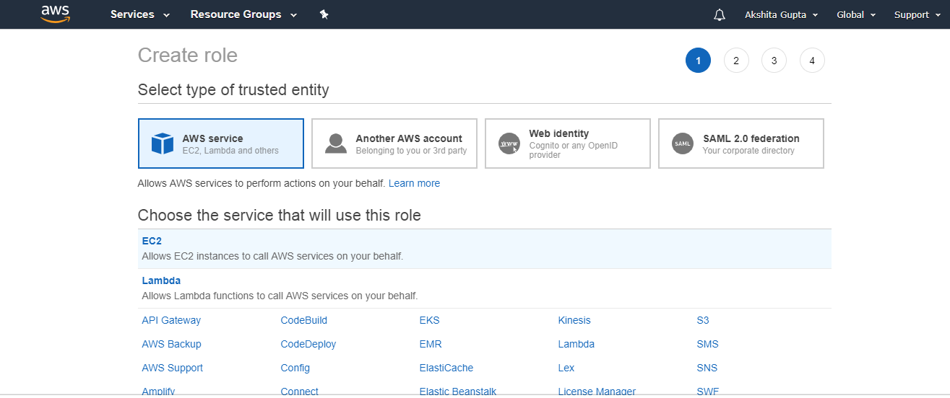
Creating IAM Roles for a service
Creating a Role for a service using the AWS Management Console.
In the navigation pane of the console, click Roles and then click on "Create Role". The screen appears shown below on clicking Create Role button.

Slide 14
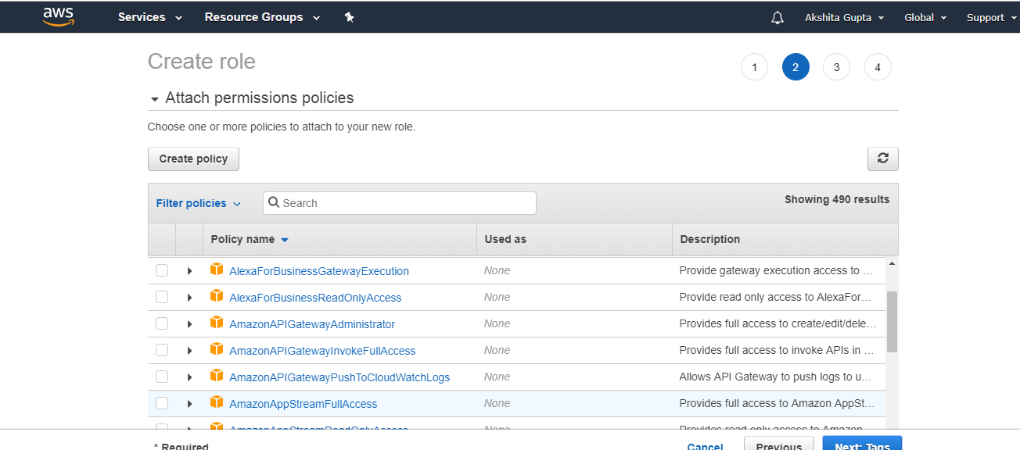
Choose the service that you want to use with the role. Select the managed policy that attaches the permissions to the service

Slide 15
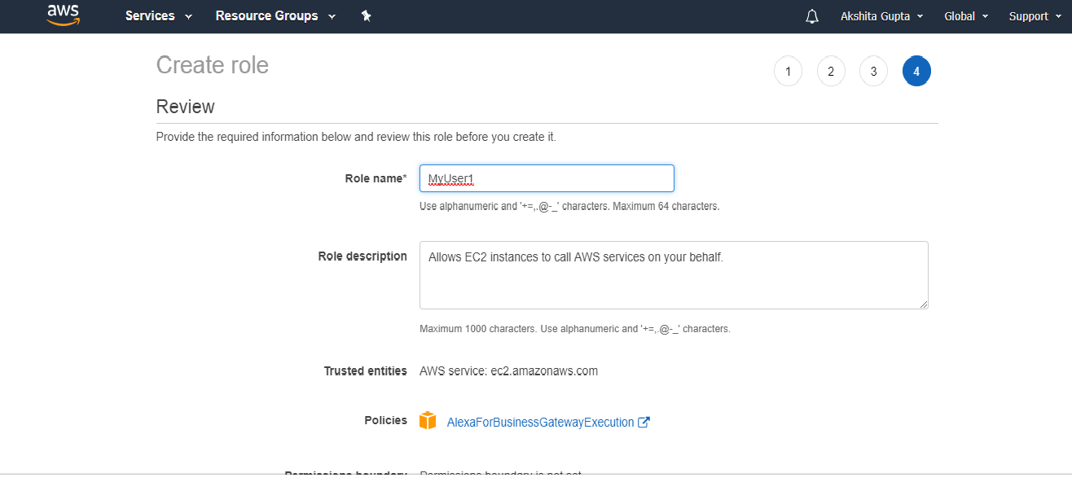
In a role name box, enter the role name that describes the role of the service, and then click on "Create role".

Slide 16
Creating a Role for a service using the CLI (Command Line Interface)
Creating a role using the console, many of the steps are already done for you, but with the CLI you explicitly perform each step yourself. You must create a policy, and assign a permission policy to the role. To create a role for an AWS service using the AWS CLI, use the following commands:
Create a role: aws iam create-role
Attach a permission policy to the role: aws iam put-role-policy
If you are using a role with instance such as Amazon EC2 instance, then you need to create an instance profile to store a role. An instance profile is a container of role, but instance profile can contain only one role. If you create the role by using AWS Management Console, then instance profile is already created for you. If you create the profile using CLI, you must explicitly specify each step yourself. To create an instance profile using CLI, use the following commands:
Create an instance profile: aws iam create-instance-profile
Add a role to instance profile: aws iam add-role-to-instance-profile

Slide 17
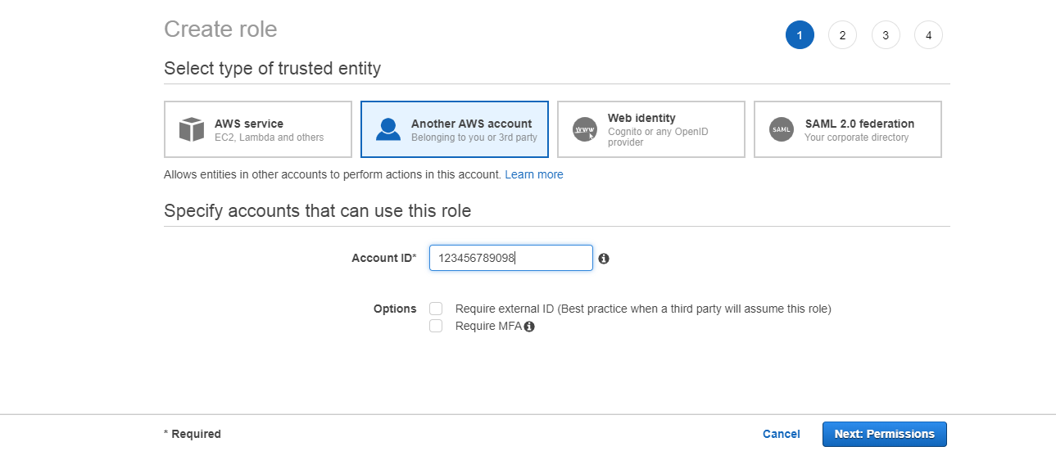
Creating IAM Roles for an IAM User
Creating a Role for an IAM User using AWS Management Console
In the navigation pane of the console, click Roles and then click on "Create Role". The screen appears shown below on clicking Create Role button.

Slide 18
Specify the account ID that you want to grant the access to the resources, and then click on Next Permissions button.
If you selected the option "Require external ID" means that it allows the users from the third party to access the resources. You need to enter the external ID provided by the administrator of the third party. This condition is automatically added to the trust policy that allows the user to assume the role.
If you selected the option "Require MFA" is used to restrict the role to the users who provide Multi-factor authentication.
Select a policy that you want to attach with the role. A policy contains the permissions that specify the actions that they can take and resources that they can access.

Slide 19
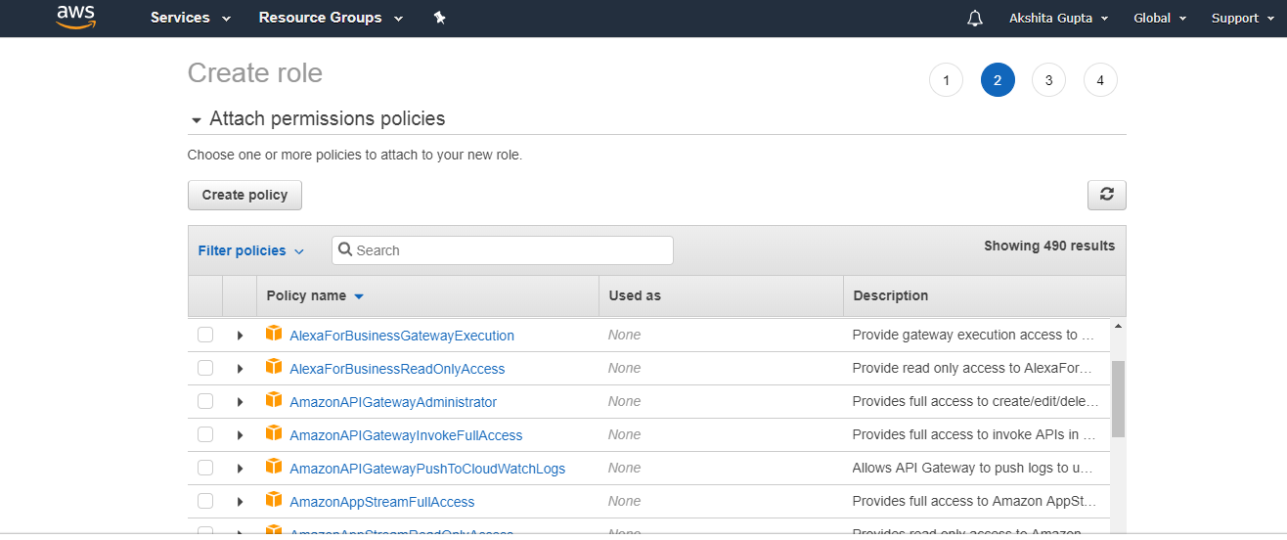

Slide 20
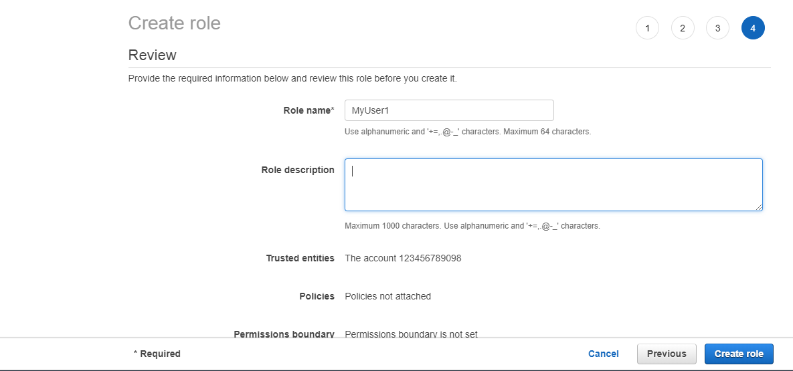
In a role name box, enter the role name and the role description.

