Slide 1

Introduction Of AWS

Slide 2
What is AWS?
AWS stands for Amazon Web Services.
The AWS service is provided by the Amazon that uses distributed IT infrastructure to provide different IT resources available on demand. It provides different services such as infrastructure as a service (IaaS), platform as a service (PaaS) and packaged software as a service (SaaS).
Amazon launched AWS, a cloud computing platform to allow the different organizations to take advantage of reliable IT infrastructure.

Slide 3
Uses of AWS
A small manufacturing organization uses their expertise to expand their business by leaving their IT management to the AWS.
A large enterprise spread across the globe can utilize the AWS to deliver the training to the distributed workforce.
An architecture consulting company can use AWS to get the high-compute rendering of construction prototype.
A media company can use the AWS to provide different types of content such as ebox or audio files to the worldwide files.

Slide 4
AWS provides services to customers when required without any prior commitment or upfront investment. Pay-As-You-Go enables the customers to procure services from AWS.
Computing
Programming models
Database storage
Networking

Slide 5
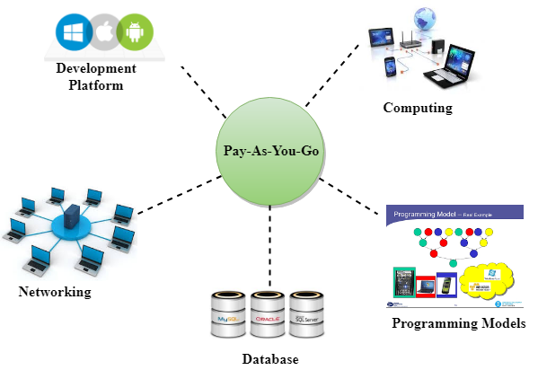

Slide 6
Advantages of AWS
1) Flexibility
We can get more time for core business tasks due to the instant availability of new features and services in AWS.
It provides effortless hosting of legacy applications. AWS does not require learning new technologies and migration of applications to the AWS provides the advanced computing and efficient storage.
AWS also offers a choice that whether we want to run the applications and services together or not. We can also choose to run a part of the IT infrastructure in AWS and the remaining part in data centres.
2) Cost-effectiveness
AWS requires no upfront investment, long-term commitment, and minimum expense when compared to traditional IT infrastructure that requires a huge investment.
3) Scalability/Elasticity
Through AWS, autoscaling and elastic load balancing techniques are automatically scaled up or down, when demand increases or decreases respectively. AWS techniques are ideal for handling unpredictable or very high loads. Due to this reason, organizations enjoy the benefits of reduced cost and increased user satisfaction.
4) Security
AWS provides end-to-end security and privacy to customers.
AWS has a virtual infrastructure that offers optimum availability while managing full privacy and isolation of their operations.
Customers can expect high-level of physical security because of Amazon's several years of experience in designing, developing and maintaining large-scale IT operation centers.
AWS ensures the three aspects of security, i.e., Confidentiality, integrity, and availability of user's data.

Slide 7
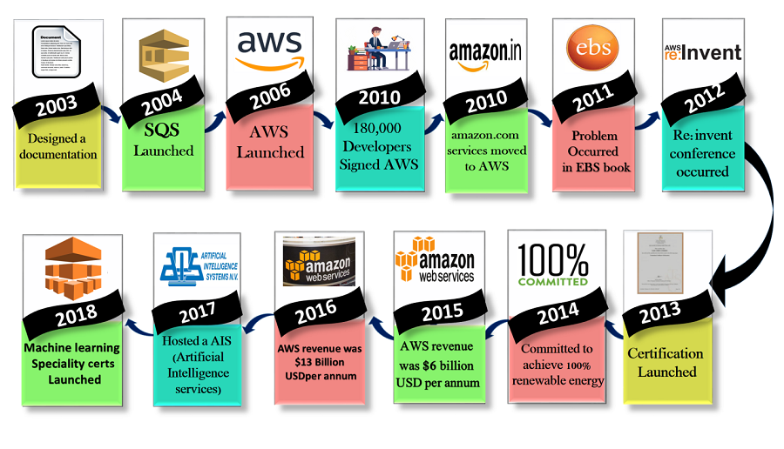
History of AWS

Slide 8
2003: In 2003, Chris Pinkham and Benjamin Black presented a paper on how Amazon's own internal infrastructure should look like. They suggested to sell it as a service and prepared a business case on it. They prepared a six-page document and had a look over it to proceed with it or not. They decided to proceed with the documentation.
2004: SQS stands for "Simple Queue Service" was officially launched in 2004. A team launched this service in Cape Town, South Africa.
2006: AWS (Amazon Web Services) was officially launched.
2007: In 2007, over 180,000 developers had signed up for the AWS.
2010: In 2010, amazon.com retail web services were moved to the AWS, i.e., amazon.com is now running on AWS.
2011: AWS suffered from some major problems. Some parts of volume of EBS (Elastic Block Store) was stuck and were unable to read and write requests. It took two days for the problem to get resolved.
2012: AWS hosted a first customer event known as re:Invent conference. First re:invent conference occurred in which new products were launched. In AWS, another major problem occurred that affects many popular sites such as Pinterest, Reddit, and Foursquare.
2013: In 2013, certifications were launched. AWS started a certifications program for software engineers who had expertise in cloud computing.
2014: AWS committed to achieve 100% renewable energy usage for its global footprint.
2015: AWS breaks its revenue and reaches to $6 Billion USD per annum. The revenue was growing 90% every year.
2016: By 2016, revenue doubled and reached $13Billion USD per annum.
2017: In 2017, AWS re: invent releases a host of Artificial Intelligence Services due to which revenue of AWS doubled and reached $27 Billion USD per annum.
2018: In 2018, AWS launched a Machine Learning Speciality Certs. It heavily focussed on automating Artificial Intelligence and Machine learning.

Slide 9
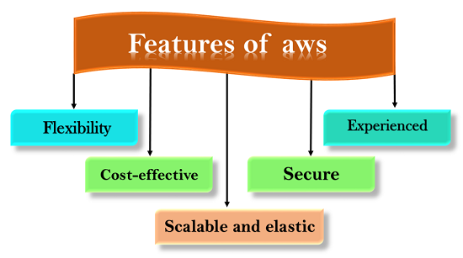
Features of AWS

Slide 10
1) Flexibility
The difference between AWS and traditional IT models is flexibility.
The traditional models used to deliver IT solutions that require large investments in a new architecture, programming languages, and operating system. Although these investments are valuable, it takes time to adopt new technologies and can also slow down your business.
The flexibility of AWS allows us to choose which programming models, languages, and operating systems are better suited for their project, so we do not have to learn new skills to adopt new technologies.
Flexibility means that migrating legacy applications to the cloud is easy, and cost-effective. Instead of re-writing the applications to adopt new technologies, you just need to move the applications to the cloud and tap into advanced computing capabilities.
Building applications in aws are like building applications using existing hardware resources.
The larger organizations run in a hybrid mode, i.e., some pieces of the application run in their data center, and other portions of the application run in the cloud.
The flexibility of aws is a great asset for organizations to deliver the product with updated technology in time, and overall enhancing the productivity.

Slide 11
2) Cost-effective
Cost is one of the most important factors to consider in delivering IT solutions.
For example, developing and deploying an application can incur a low cost, but after successful deployment, there is a need for hardware and bandwidth. Owing our infrastructure can incur considerable costs, such as power, cooling, real estate, and staff.
The cloud provides on-demand IT infrastructure that lets you consume the resources that you need. In AWS, you are not limited to a set amount of resources such as storage, bandwidth, or computing resources as it is very difficult to predict the requirements of every resource. Therefore, we can say that the cloud provides flexibility by maintaining the right balance of resources.
AWS provides no upfront investment, long-term commitment, or minimum spend.
You can scale up or scale down as the demand for resources increases or decreases respectively.
An AWS allows you to access the resources more instantly. It can respond more quickly, and whether the changes are large or small, we can take new opportunities to meet the business challenges that could increase revenue and reduce costs.

Slide 12
3) Scalable and elastic
In a traditional IT organization, scalability and elasticity were calculated with investment and infrastructure while in a cloud, scalability and elasticity provide savings and improved ROI (Return On Investment).
Scalability in aws has the ability to scale the computing resources up or down when demand increases or decreases respectively.
Elasticity in aws is defined as the distribution of incoming application traffic across multiple targets such as Amazon EC2 instances, containers, IP addresses, and Lambda functions.
Elasticity load balancing and scalability automatically scale your AWS computing resources to meet unexpected demand and scale down automatically when demand decreases.
The aws cloud is also useful for implementing short-term jobs, mission-critical jobs, and the jobs repeated at the regular intervals.

Slide 13
4) Secure
AWS provides a scalable cloud-computing platform that provides customers with end-to-end security and end-to-end privacy.
AWS incorporates the security into its services, and documents to describe how to use the security features.
AWS maintains confidentiality, integrity, and availability of your data which is the utmost importance of the aws.
Physical security: Amazon has many years of experience in designing, constructing, and operating large-scale data centers. An aws infrastructure is incorporated in AWS controlled data centers throughout the world. The data centers are physically secured to prevent unauthorized access.
Secure services: Each service provided by the AWS cloud is secure.
Data privacy: A personal and business data can be encrypted to maintain data privacy.

Slide 14
5) Experienced
The AWS cloud provides levels of scale, security, reliability, and privacy.
AWS has built an infrastructure based on lessons learned from over sixteen years of experience managing the multi-billion dollar Amazon.com business.
Amazon continues to benefit its customers by enhancing their infrastructure capabilities.
Nowadays, Amazon has become a global web platform that serves millions of customers, and AWS has been evolved since 2006, serving hundreds of thousands of customers worldwide.

Slide 15
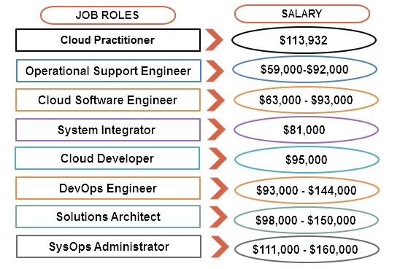

Slide 16
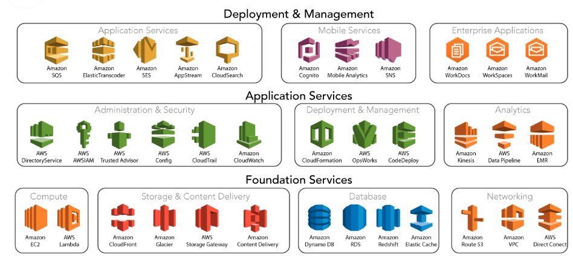

Slide 17
THE END

