Slide 1
Databricks DAG-Based Orchestration with Airflow
A Bronze → Silver → Gold pipeline: Airflow decides what runs and when, Databricks does the work
Airflow 2.10.5
Azure Databricks serverless
Unity Catalog: dev
Demo | 5 November 2026
Notes:
Today: a working data pipeline where Apache Airflow orchestrates Databricks. Airflow holds the order of steps, the schedule and the retries as code. Databricks runs every step on serverless compute. I'll show how it works in 4 slides, then run it live.

Slide 2
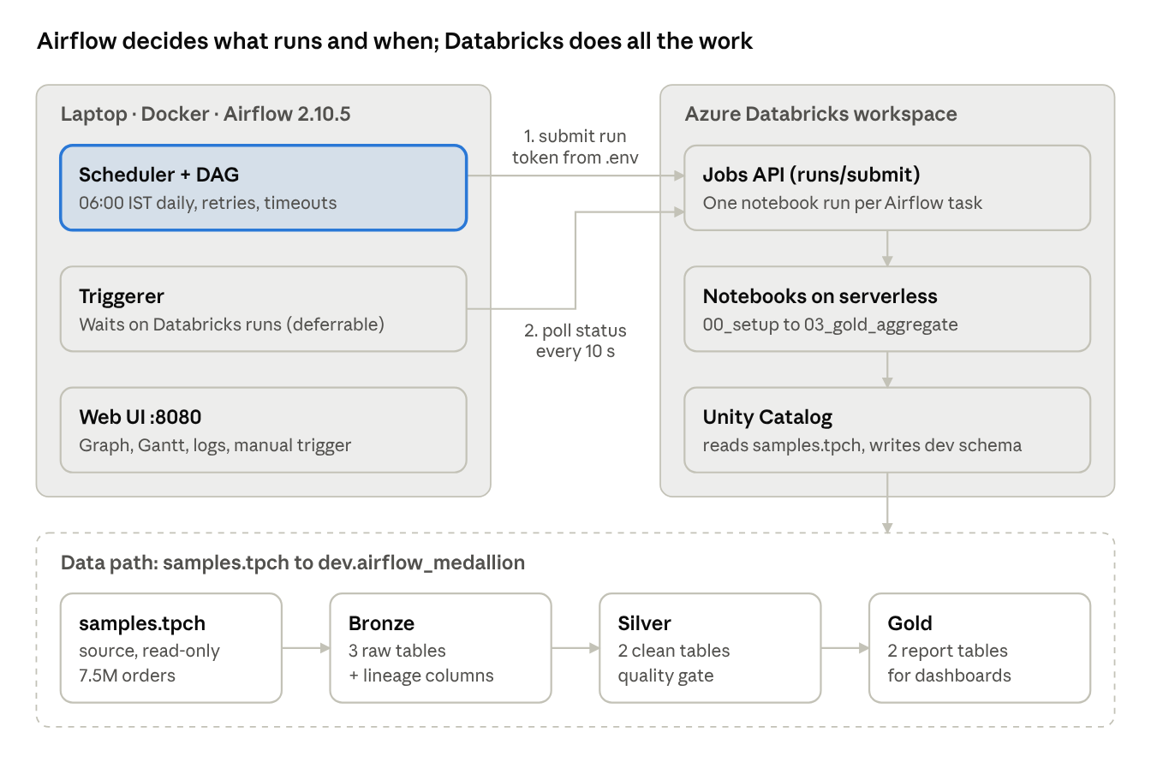
Airflow orchestrates, Databricks executes
Airflow never touches the data; it only calls the Databricks Jobs API
1
Schedule
Airflow starts the DAG every day at 06:00 IST
2
Submit
Each task submits a notebook run through the Jobs API
3
Execute
Databricks runs it on serverless compute
4
Wait & continue
Airflow polls the status, then starts the next step
Databricks DAG-based orchestration with Airflow
2
Notes:
Left: the 4-step loop for every task. Right: the architecture. Airflow runs in Docker on my laptop; it holds the token, the task order and the run history, nothing else. Databricks reads the sample dataset samples.tpch and writes 7 Delta tables into dev.airflow_medallion.

Slide 3
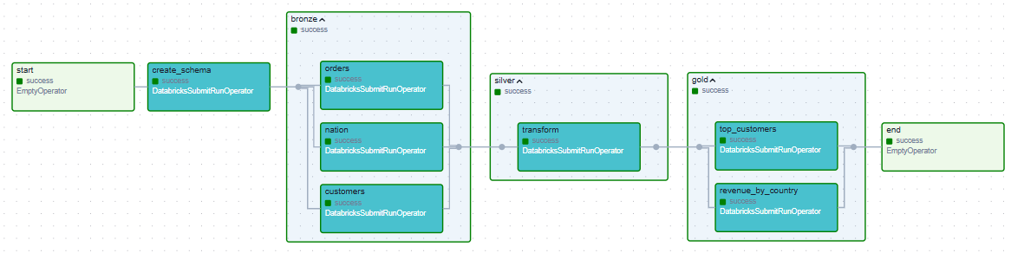
One DAG, 9 tasks, 3 medallion layers
Tasks in the same layer run in parallel; each layer waits for the one before it
B
Bronze 3 parallel tasks
S
Silver 1 task, quality gate
G
Gold 2 parallel tasks
Raw copy of orders, customers, nation + lineage columns
Clean, join, dedupe. Bad data fails here, so Gold never runs
Revenue by country and year; top 100 customers
Databricks DAG-based orchestration with Airflow
3
Notes:
This is the real Airflow Graph view from today's run, all green. create_schema runs once, then 3 Bronze ingests in parallel, Silver transforms and runs data-quality checks, then 2 Gold reports in parallel. Key point: if a quality check fails in Silver, the task fails and Gold is skipped, so dashboards keep the last good data.

Slide 4
Reliability is configured as code, not done by hand
All of this is a few lines in dags/medallion_pipeline_dag.py
06:00
3×
30 min
Daily schedule
Retries with backoff
Timeouts
IST, catch-up of the latest missed run only
1, 2, 4 min; plus 5 API retries to Databricks
per task, and 1 hour for a whole run
3 + 2
4 checks
100%
Parallel runs
Quality gate
Lineage
Bronze and Gold tasks run together; deferrable, so Airflow never waits idle
Silver stops bad data before it reaches Gold
of rows store the Airflow run that loaded them
Databricks DAG-based orchestration with Airflow
4
Notes:
Six things the DAG gives us for free once configured. Schedule at 6 AM. Retries with growing waits, so a temporary blip fixes itself. Timeouts so nothing hangs. Deferrable tasks: think of a laundry with one employee who sets a timer instead of watching each machine, so all machines run together. The quality gate. And lineage: every row says which Airflow run created it.

Slide 5
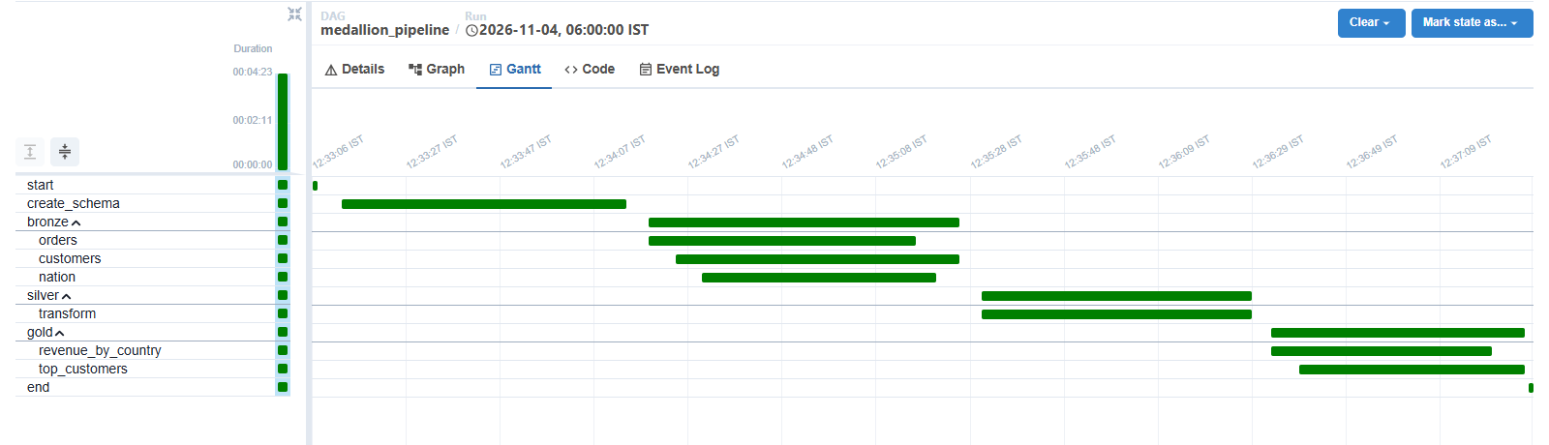
Tested end to end: every full run succeeded
Run of 5 Nov 2026, from the Airflow UI and the Databricks API
4.5 min
9 / 9
7.5M
7
full pipeline run (was 8.5 min before parallel runs)
tasks green on every completed run
orders processed, 0 dropped by quality checks
Delta tables in dev.airflow_medallion
Proof of parallel runs
The 3 Bronze bars overlap, and so do the 2 Gold bars. Silver starts only after the last Bronze run ends.
Databricks DAG-based orchestration with Airflow
5
Notes:
Results. A full run takes about 4.5 minutes; before deferrable tasks it was 8.5 because Bronze ran one after another. 7.5 million orders go through, none dropped by the checks. The Gantt chart is the proof of parallelism: overlapping bars.

Slide 6
Live demo, then next steps
Live demo (about 5 minutes)
To make it production-ready
1
Trigger
Airflow UI → medallion_pipeline → Trigger DAG
Host Airflow
managed service instead of a laptop, so 06:00 always runs
2
Watch
Graph view: layers turn green, purple = waiting on Databricks
Code from Git
git_source or Asset Bundles; no manual notebook import
3
Follow
Task → Logs → Databricks run URL
Incremental loads
MERGE or Auto Loader instead of full refresh
4
Query
SELECT * FROM dev.airflow_medallion.gold_revenue_by_country
Alerts
failure notifications to email or Teams
Databricks DAG-based orchestration with Airflow
6
Notes:
Switch to the browser now. Trigger the DAG, show the Graph turning green, open a task log and click the Databricks run link, then query the Gold table in Databricks. Close with the 4 steps to production: hosted Airflow, Git-based deployment, incremental loads, and alerts.

