Slide 1
Flocking
Porrith Suong

Slide 2
What is flocking?
Flocking is the behavior groups of animals exhibit which allows large groups of organisms to easily move from destination to destination
A leaderless system
Shows spatial awareness amongst organisms

Slide 3
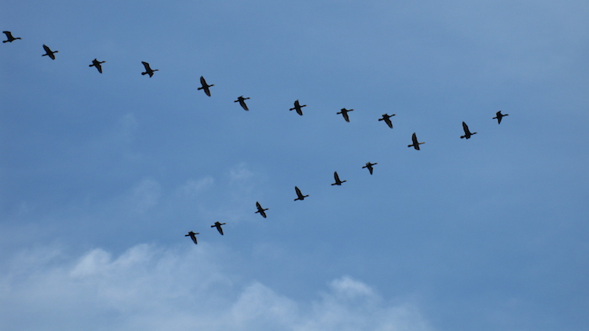
Questions for Flocking
Is it really a leaderless system?
Consider flock formations such as the V formation

Slide 4
Questions for Flocking
Is it really a leaderless system?
Consider flock formations such as the V formation
Is the center bird considered the leader?

Slide 5
Questions for Flocking
How do birds all turn relatively simultaneously?
Does one bird turn first and everyone follows like the rippling affect?
How do other organisms perceive velocity?

Slide 6
Rules of Flocking
Under Craig Reynold’s implementation, flocking can be designed using 3 rules
Alignment
Cohesion
Separation
Of course…you can extend and add more rules
Perching
Avoiding a particular place
Essentially, all Reynolds describes is simply manipulation of velocity to enforce these rules

Slide 7
Alignment
Alignment describes how each boid orients itself to the rest of the flock
Alignment pseudocode:
foreach (var boid in boids) { if (currentBoid != boid) { if (IsNeighbor(currentBoid, boid)) { alignment += velocity; neighborCount++; } } return (alignment / neighborCount).normalized; }

Slide 8
Cohesion
Cohesion describes the perceived center in which boids try to remain close to
Cohesion pseudocode
foreach (var boid in boids) { if (currentBoid != boid) { if (IsNeighbor(currentBoid, boid)) { cohesion += boid.position; neighborCount++; } } return ((cohesion / neighborCount) – currentBoid.position).normalized; }

Slide 9
Separation
Separation determines the distance between each boid
Separation pseudocode:
foreach (var boid in boids) { if (currentBoid != boid) { if (IsNeighbor(currentBoid, boid)) { separation += (boid.position - currentBoid.position); neighborCount++; } } return ((separation / neighborCount) * -1).normalized; }

Slide 10
Other Metrics Related to Velocity
Recap of questions:
How do other organisms perceive velocity/speed?
Velocity – is it a human construct?
Consider how we can possibly give directions in the city
Use blocks
Use time and point a direction

Slide 11
Flocking in Robotics
Use infrared sensors, audio sensors, and GPS to determine position of itself
Uses force of attraction and repulsion to determine offset
Used in search and recue robots

Slide 12
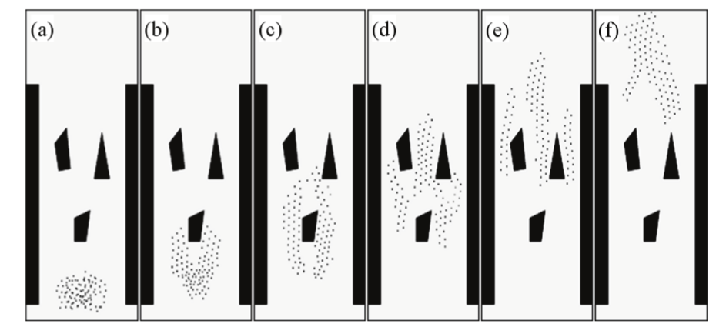
Flocking in Robotics
Can define flocking formations which are adaptive for different situations

Slide 13
Demo…a little GIF of Flocking

Slide 14
Github Link for Source Code and Demo
https://github.com/psuong/boids-controller

