Slide 1
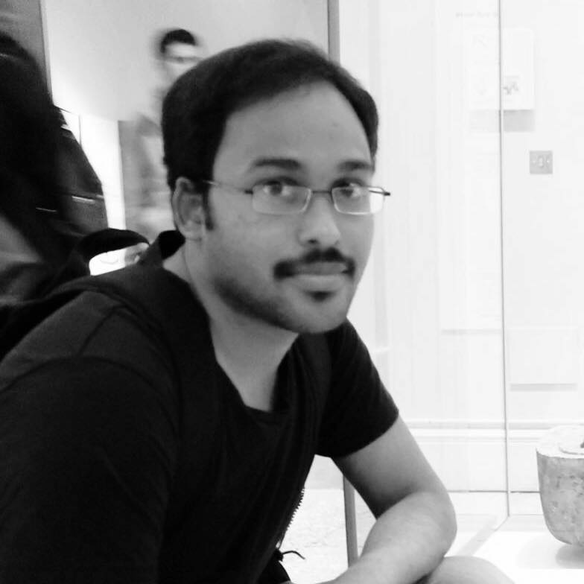
Surya teja P
I am SDET with more than 5 years of experience in testing software related to Gambling, betting, insurance, media and broadcast, logistics, E-Com, and companies like Sky, Thomson Reuters Candy Space Media, Drayson Technologies, Isotrak, Intelligent Environment, Santander, Accenture

Slide 2

Accessibility Testing using Cypress

Slide 3
What’s accessibility testing
Testing a web page or any software to ensure that it works for people having difficulty in reading, recognising colour, partial blindness, motor nerve disease.
Notes:
Its just only about the accessibility testing and what it is… NEXT SLIDE is about the types

Slide 4

Classification of accessibility
Colour contrast
Hearing
Blurred vision
Motor nerve
Notes:
Motor nerve – Parkinsons,

Slide 5
How to test it

Slide 6
In manual approach
We can test using
JAWS – reading the text
Voice over, Talk back – Android and iOS
Colour inversion, high contrast, yellow on black modes in Browsers – Partially impaired
Keyboard tabbing – Motor nerve issues
These are manual tests

Slide 7
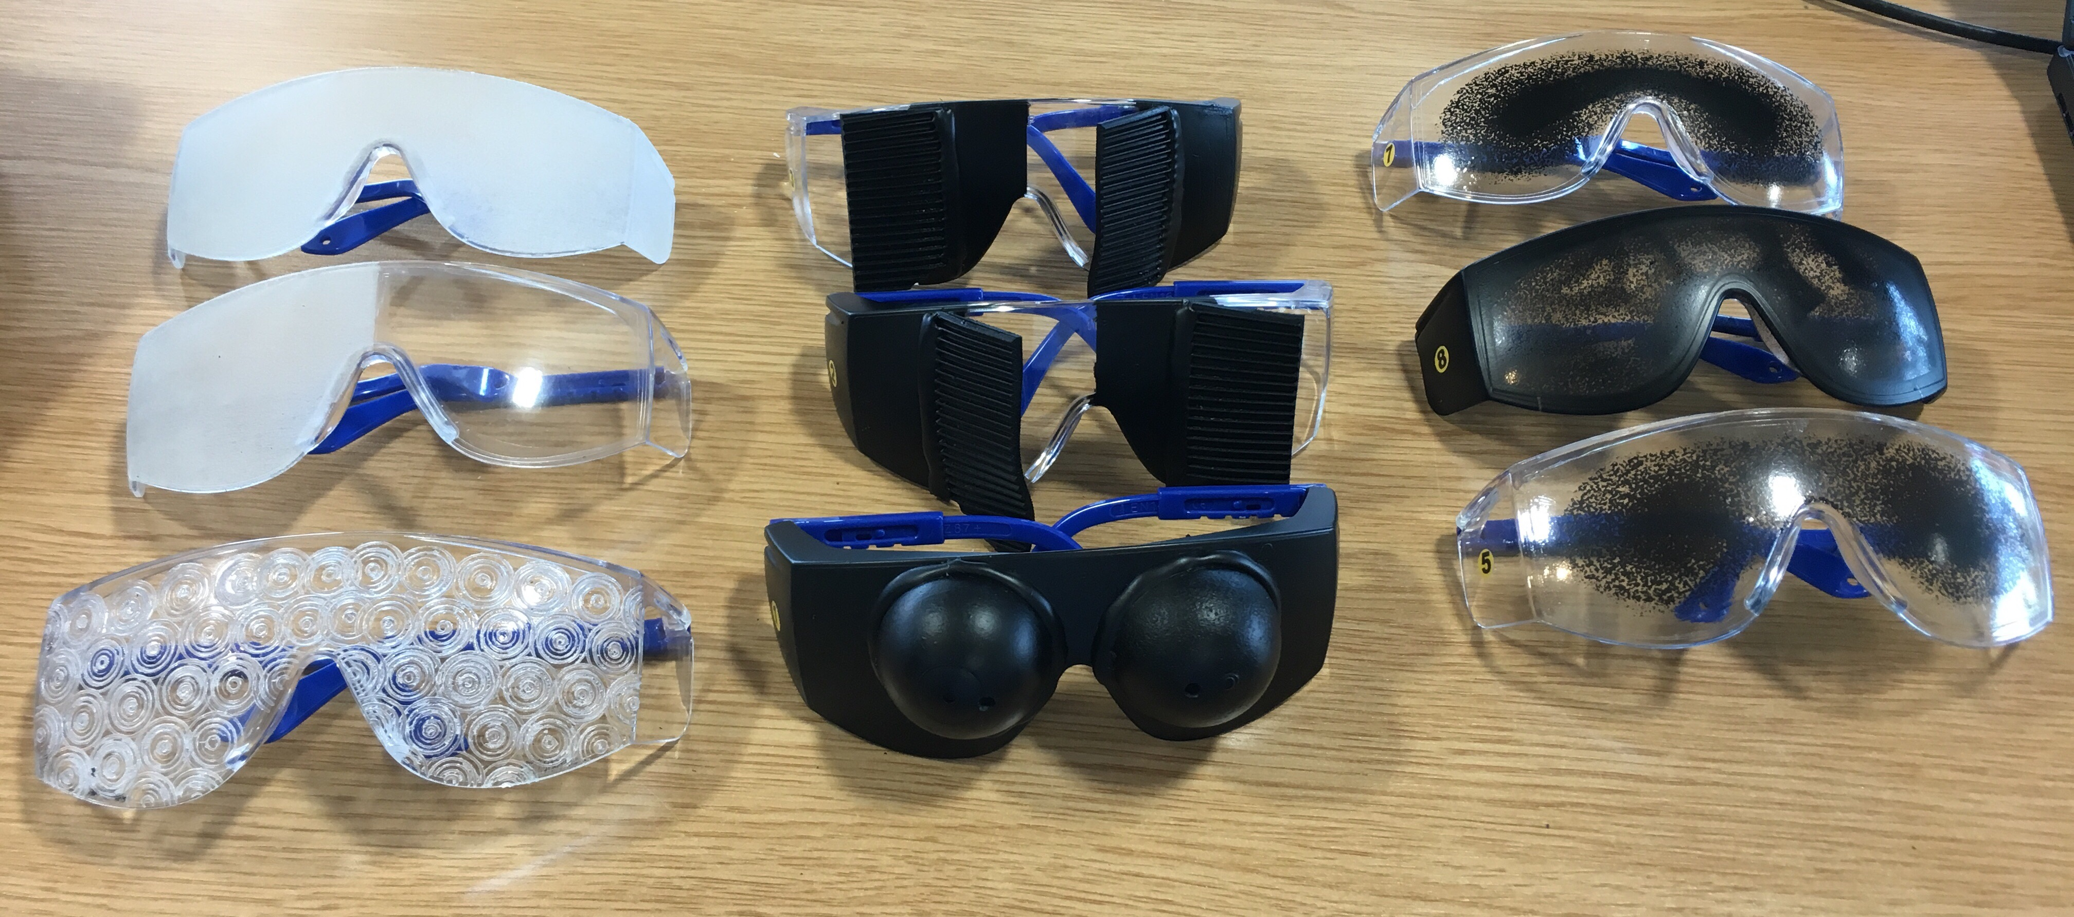
Special glasses
Notes:
VINE glass – they are based in tee side
for partial blindness

Slide 8
How and what to automate them
By just checking the aria attributes, header, labels.
By using aXe library we can check more of the accessibility stuff
Only few test can be automated, but it reduces the significant amount of time required for manual testing.
Notes:
Consider explander - by giving the status of it, people will understand it is expander is opened or closed. Even with image alts and fig captions.

Slide 9
Why Cypress
To run tests on a building headless browser
Has a dashboard to run test and can able to see them running.
Using dashboard we can able to debug the tests and inspect the elements.
Tests will run while editing them.

Slide 10


Slide 11
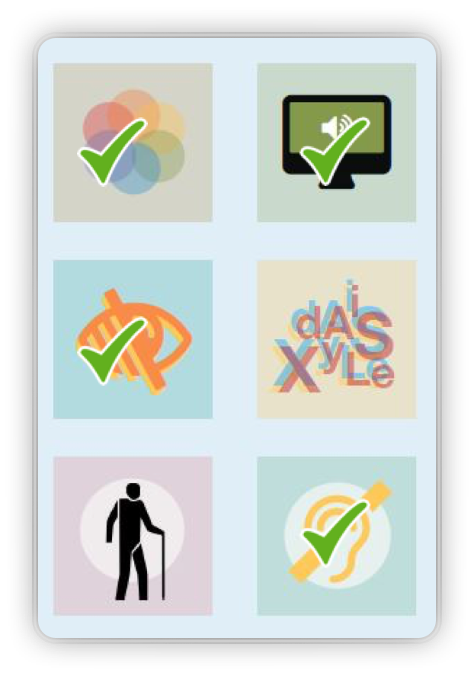
Classification of accessibility
Colour contrast
Hearing
Blurred vision
Motor nerve

Slide 12
IS THERE ANY ALTERNATIVE FOR IT?
Yes, we are looking to
Pa11y
A11y

Slide 13
Questions

Slide 14
Thank you

Slide 15

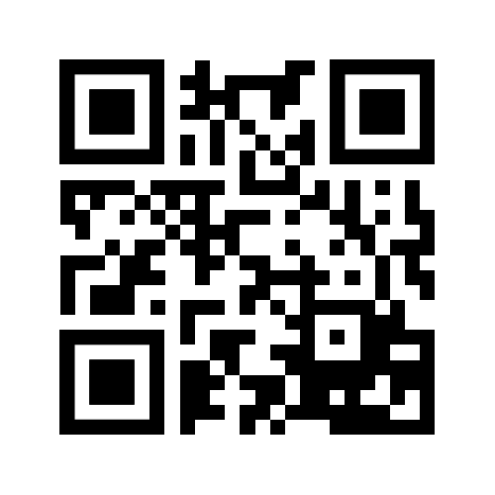

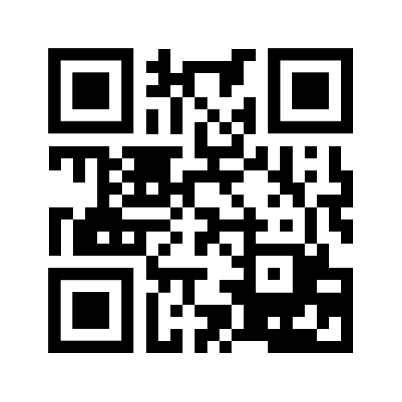

suryateja-pulakhandam
psuryateja123
psuryateja111

Slide 16
Reference
Accessibility design : https://github.com/UKHomeOffice/posters/blob/master/accessibility/dos-donts/posters_en-UK/accessibility-posters-set.pdf
Cypress tests : https://github.com/nhsuk/nhsuk-frontend/tree/master/tests
Or https://github.com/nhsuk/nhsuk-frontend/tree/cypress_tests/tests/cypress/integration/components
https://github.com/psuryateja123/cypress_meetup_demo

