Slide 1
Understanding Constructors and Destructors in PHP

Slide 2
Learning Objectives
- Understand what a constructor is and why it is used
01
- Write PHP classes using __construct() to initialize data
02
- Understand the purpose of __destruct() and how it works
03
- Demonstrate how constructors and destructors run automatically
04

Slide 3
What is a Constructor?
- A constructor is a special method that runs automatically when an object is created
- It is used to set initial values for the object’s properties

Slide 4
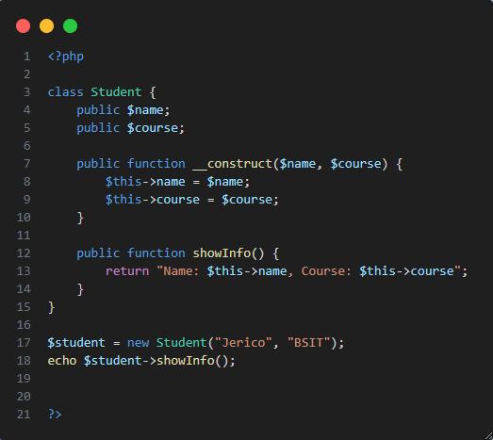
Example – Constructor in PHP

Slide 5
What is a Destructor?
- A destructor is a special method that runs automatically when the object is destroyed
- Useful for cleanup tasks like:
• Closing a file • Closing a database • Goodbye message

Slide 6
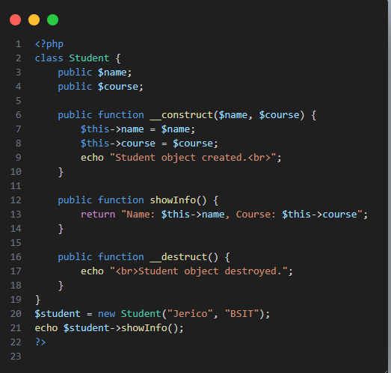
Example – Destructor in PHP

Slide 7
What is a Method Overloading?
Creating multiple methods with the same name but different numbers or types of parameters

Slide 8
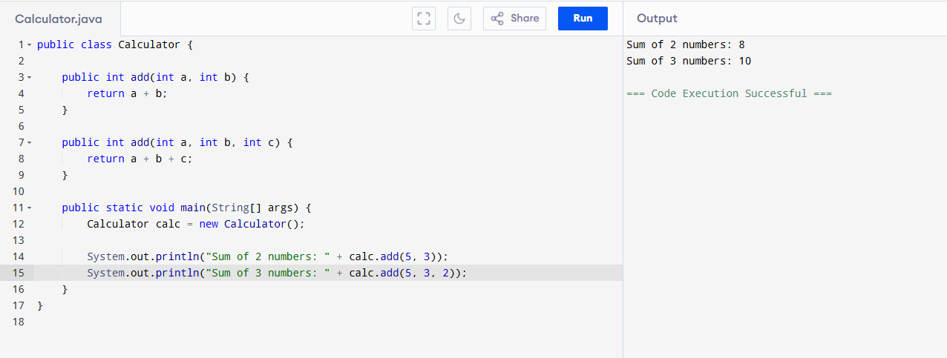
Java Example: Method Overloading

Slide 9
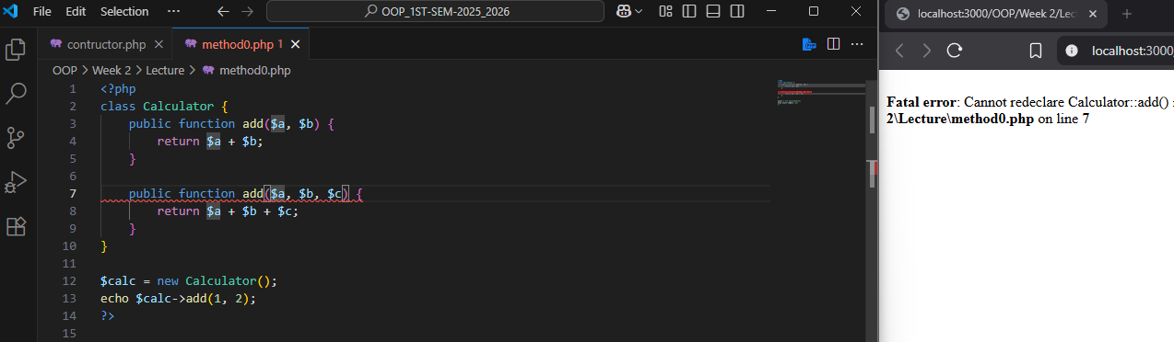
PHP Doesn't Support It Directly
PHP does not allow more than one method with the same name in a class
If you try, it will give a fatal error

Slide 10
How PHP Handles It Instead:
PHP uses a special magic method called __call() to simulate method overloading.
This method:
-Automatically runs when you call a method that doesn't exist
Receives:
The method name as a string
The arguments in an array
You can then check how many arguments were passed and handle each case differently

Slide 11
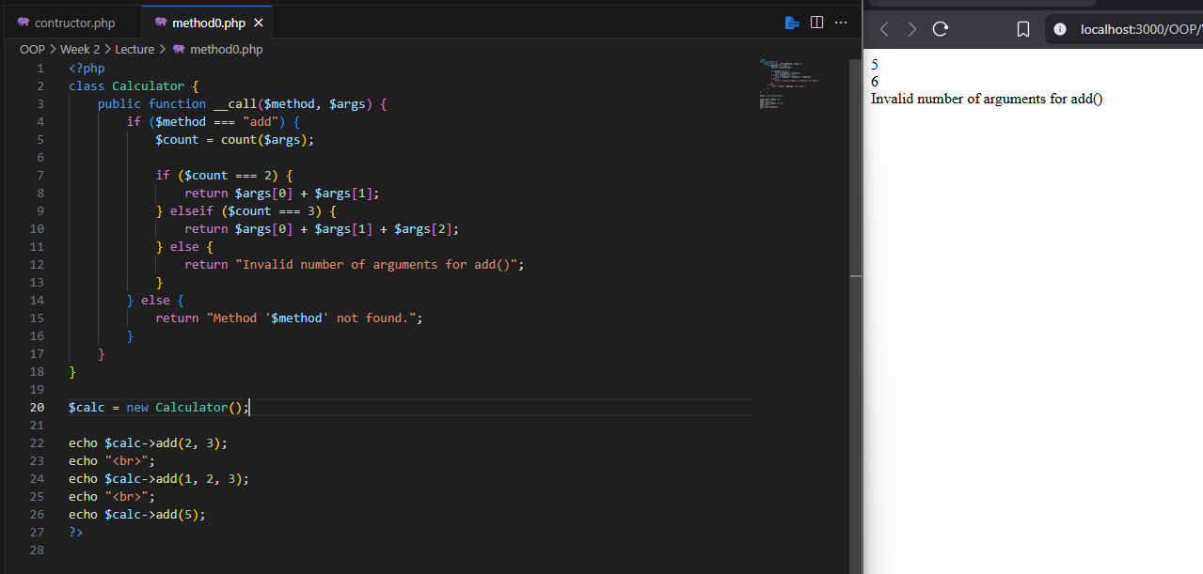
Method Overloading in PHP

Slide 12
SUMMARY
Constructor is a special method that automatically sets initial values when an object is created.
Destructor is a special method that runs when the object is destroyed to clean up or finalize tasks.
Method overloading in PHP is simulated using __call() to handle method calls with different numbers of arguments.

Slide 13
Hands-on Task
Activity:
1. Create a class 'Book'
2. Use a constructor to set title and author
3. Use a method to display the book info
4. Use a destructor to say 'Book object destroyed.'

