Slide 1
Python Programming Fundamentals
Lesson 1

Slide 2
MODULE OVERVIEW
In this module, you will learn about the different concepts under Python Programming and what are the reasons why you should learn Python. Furthermore, you will also know how to implement and install Python Application and Interpreter.

Slide 3
MODULE LEARNING OBJECTIVES
By the end of this module, you should be able to:
Know the different concepts of Python.
Distinguish the reasons why you should learn python.
Implement python environment.

Slide 4
1.1 What is Python?
Python is a popular programming language. It was created by Guido van Rossum, and released in 1991. It is used for web development (server-side), software development, mathematics, and system scripting. Python code mirrors the syntax of all high level programming languages which computers are unable to understand English language. Codes for The Python code we create must be interpreted by a specialized application called Python interpreter which we need before we can code, test, and execute our Python scripts.

Slide 5
1.2 Why Learn Python?
There are many high level programming languages out there, such as Java, C, and C++. The good news is that all programming is high level. There are many similarities across languages. The main difference is the syntax, the available libraries, and how we use those libraries. Simply, a library is a collection of materials and ready-made codes that we can employ when we write our programs. If you are proficient in one language, you are capable of quickly picking up a new language in comparison to the time it took you to learn the language of origin.

Slide 6
1.2 Why Learn Python?
Python is a wonderful programming language to learn if you're just getting started. One of the key features of this language is its simplicity, making it the ideal language for beginners to learn. Compared to other languages like C, most Python programs execute the same task with significantly less lines of code. As a result, there are fewer programming errors and less time is required for development. Furthermore, Python may be applied to a wide range of tasks, including the creation of desktop applications, database applications, network programs, games, and even mobile applications.
Notes:
Last but not least, Python is a cross-platform language, which means that programs created for one operating system, like Windows, will run without modification on Mac OS or Linux.

Slide 7
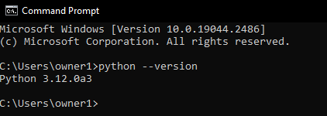
1.3 Implementation of Python Environment
To check if you have python installed on a Windows PC, search in the start bar for Python or run the following on the Command Line (cmd.exe):

Slide 8
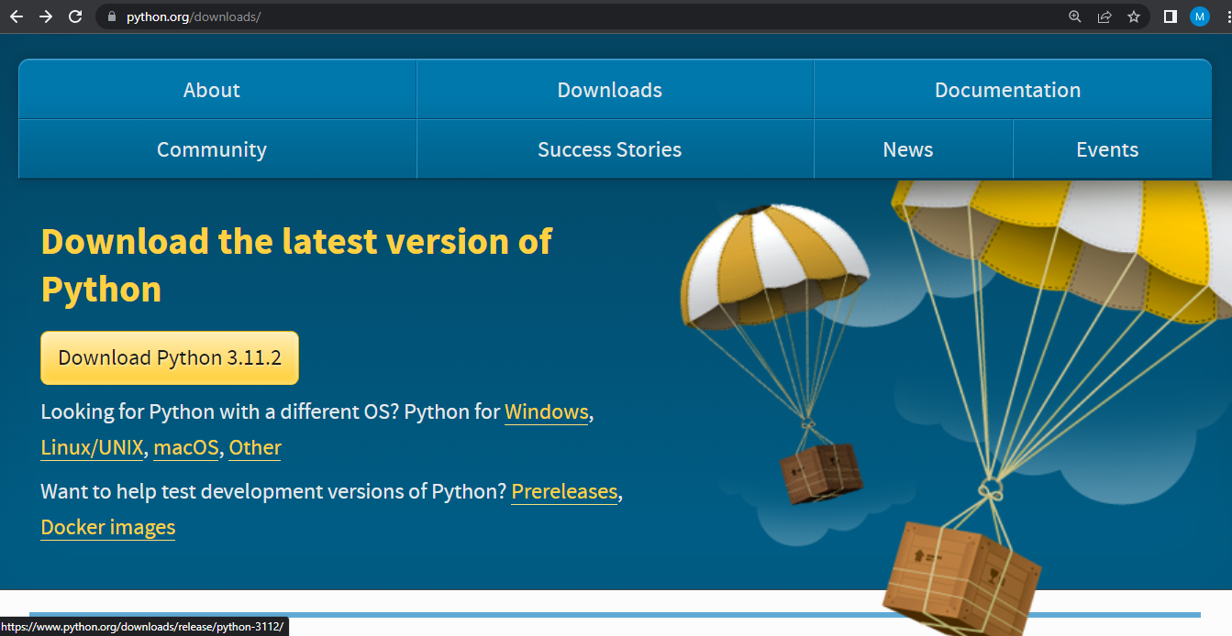
1.3 Implementation of Python Environment
When you do that and python is already installed, you should get the current version of your python. If not, you can download it for free from the following website: https://www.python.org/downloads/ and follow these steps.
1
Click on “Download Python 3.11.2”

Slide 9
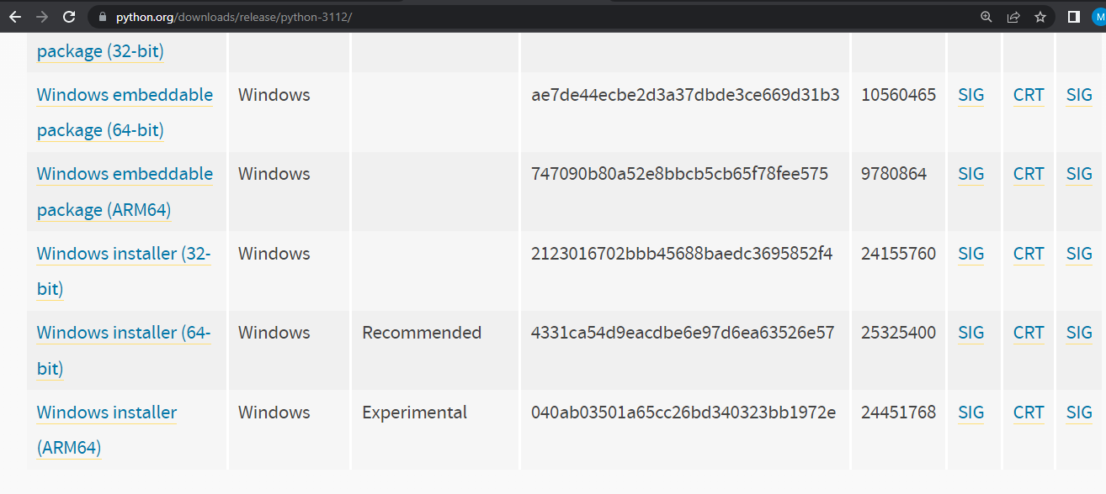
1.3 Implementation of Python Environment
2
Scroll down towards the end of the page and you’ll see a table listing various installers for that version.
Wait for the download to start.
Notes:
Choose the correct installer for your computer. The installer to use depends on two factors:
1. The operating system (Windows, Mac OS, or Linux) and
2. The processor (32-bit or 64-bit) that you are using.
To download it, simply click the provided link. No concerns if you download and launch the incorrect installer. The interpreter won't install and you'll receive an error message. You only need to download the appropriate installer, and you're ready to start. Python coding can begin as soon as the interpreter has been successfully installed.

Slide 10
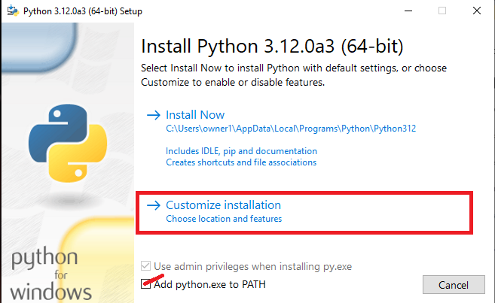
1.3.1 Installation
To install the downloaded .exe file of Python, you should follow these steps.
Step 1
Check on “Add python.exe to PATH” then select “Customize installation”.

Slide 11
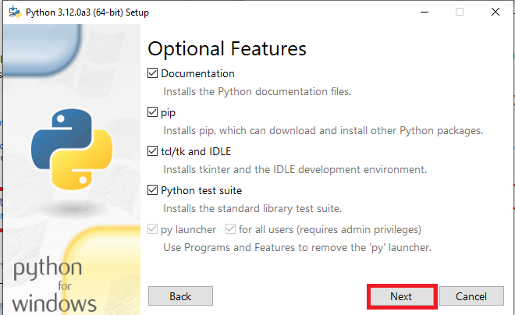
1.3.1 Installation
To install the downloaded .exe file of Python, you should follow these steps.
Step 2
Click on Next.

Slide 12
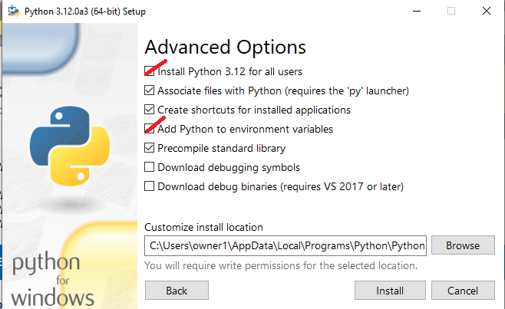
1.3.1 Installation
To install the downloaded .exe file of Python, you should follow these steps.
Check on “Install Python 3.12 for all users” and “Add Python to environment variables” then, click install.
Step 3

Slide 13
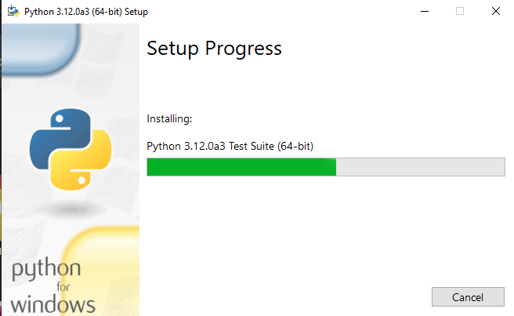
1.3 Installation
To install the downloaded .exe file of Python, you should follow these steps.
Step 4
A dialogue box will appear, click “Yes”.
Step 5
Wait for the installation. Once done, click “Close”.
Notes:
You can run again a Command Prompt to check if it’s successfully installed. Just type python --version, then you should get the current python version installed on your computer.

Slide 14
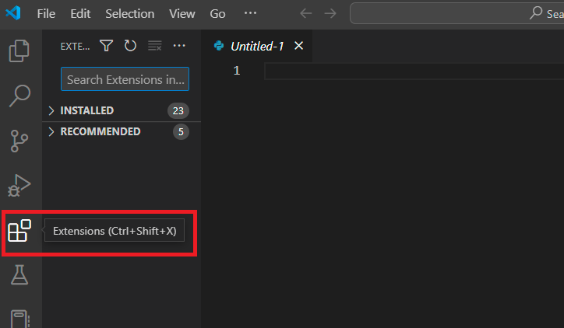
1.3.2 Python Programming in Visual Studio Code (VSCode)
We can also use Visual Studio Code in writing our Python code but, we need to install a python extension to do so. Just follow the steps below:
Step 1
On your VSCode, go to extensions as shown below.

Slide 15
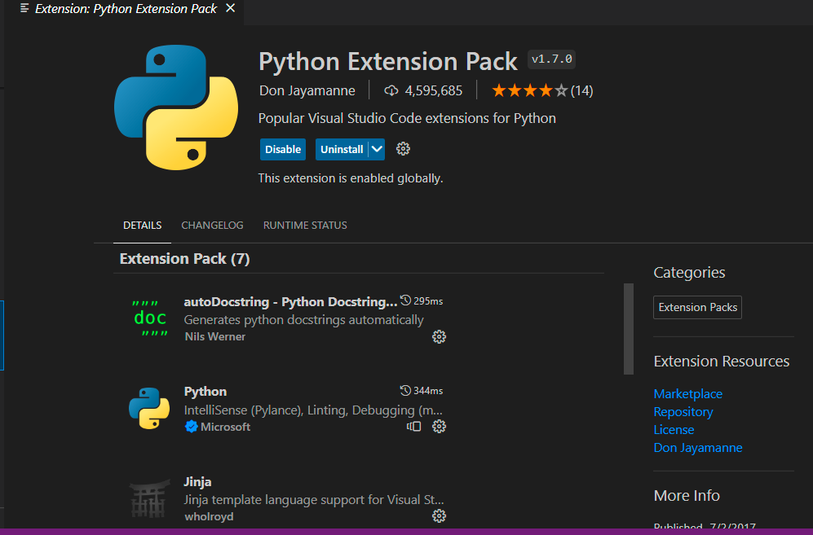
1.3.2 Python Programming in Visual Studio Code (VSCode)
Step 2
Search on “Python Extension Pack v1.7.0” and install it.

Slide 16
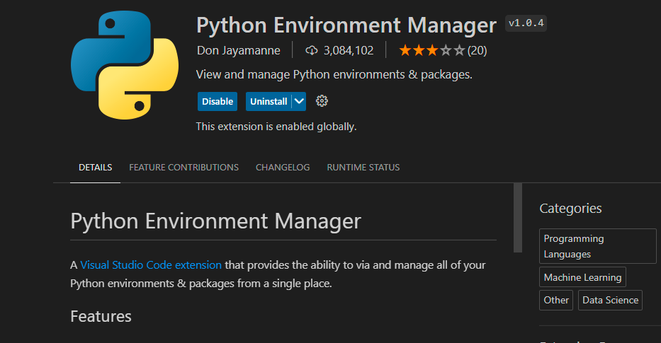
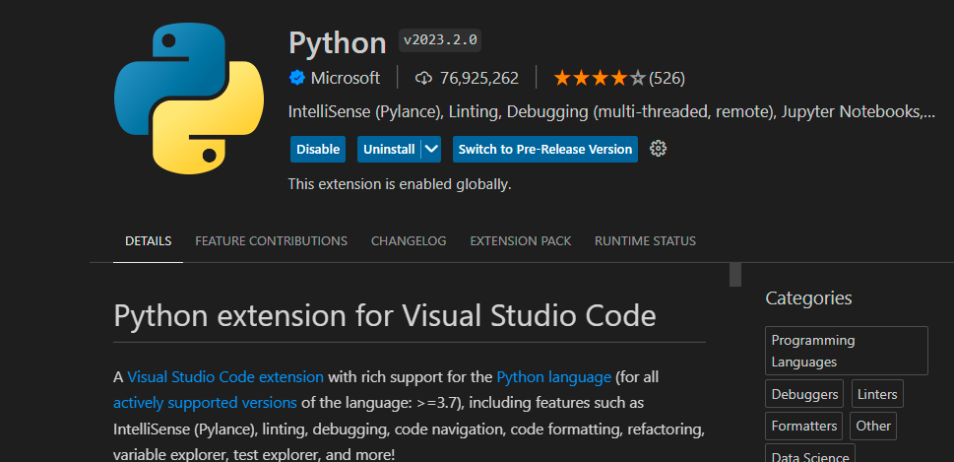
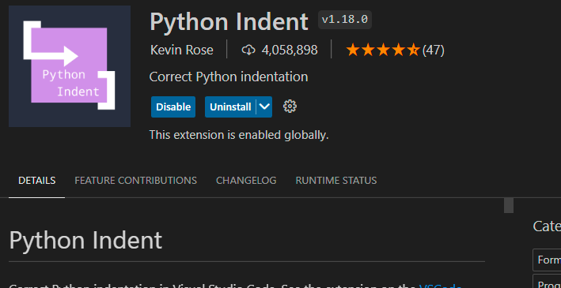
1.3.2 Python Programming in Visual Studio Code (VSCode)
You can also install these extensions for better coding.
Python Indent v1.18.0
Python v2023.2.0
Python Environment Manager v1.0.4

Slide 17
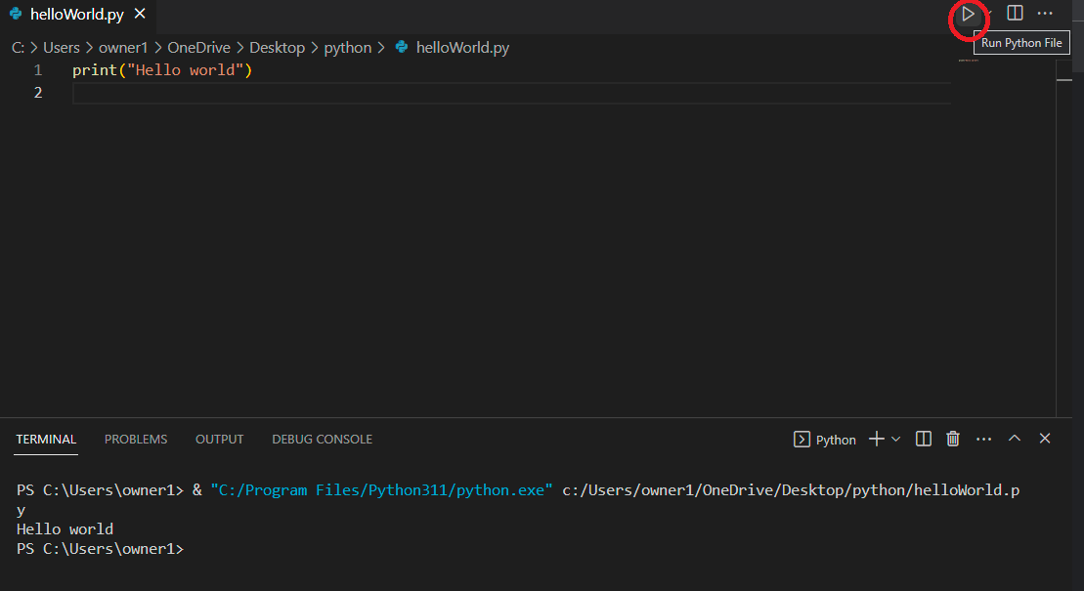
1.3.2 Python Programming in Visual Studio Code (VSCode)
Step 3
You can create now a python file (.py) and run it on VSCode by pressing F5 or the button on the upper right part as shown below.
Notes:
The good thing when using VSCode is that, it has its own terminal where the output of the programs is displayed.

