Slide 1
Basic Elements of Python
Lesson 2

Slide 2
MODULE OVERVIEW
In this module, you will learn how to write a program and familiarize with the different data types under Python Programming. You should be able to create or declare a variable following the correct format. In addition, this module helps you familiarize with the different operators which can be useful in solving logics and creating equations. You can make the program interactive using the input/output operations. And last, an activity will have to be accomplished to assess your proficiency.

Slide 3
MODULE LEARNING OBJECTIVES
By the end of this module, you should be able to:
Create your first program.
Able to declare variables, differentiate each of the operators, and use comments to explain or describe what’s happening in this certain line of code.
Make an interactive program that can ask inputs from a user and display outputs.
Design a program solution on a given problem.

Slide 4
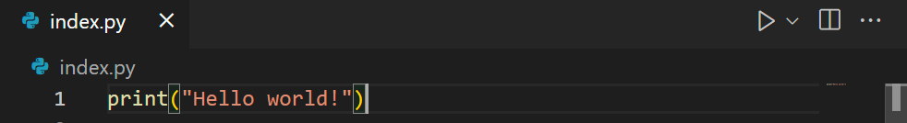
2.1 How to write a program?
Let’s say you have created a python file called index.py which can be done in any text editor.
Python Quick Start
Given that Python is an interpreted programming language, developers must first create Python (.py) files in a text editor before submitting them to the Python interpreter for execution.

Slide 5
2.1 How to write a program?
You can run a python file on a command line following these steps:
a) Option 1: Navigate to the directory where you saved your file. On the address bar, type cmd.
Option 2: If you just search on the Start Bar, navigate to your directory by using the cd command.
b) On the command prompt, type python filename.py
c) See output.

Slide 6
2.2 Python Data Types
A data type in programming consists of a group of values and a group of operations that can be applied to those values. A literal is how a data type value appears to a programmer. In a program, the programmer can refer to a data value using a literal. The literal that is evaluated by the Python interpreter is the only value that is returned.
Notes:
Literals in Python are nothing but a concise way of representing the data types. In simpler words, it is the way to represent a fixed value in our source code. They can either be numbers, text, boolean or any other form of data.

Slide 7
2.2 Python Data Types
Text Type: | str | Strings in python are surrounded by either single quotation marks, or double quotation marks.
Numeric Types: | int, float, complex | Variables of numeric types are created when you assign a value to them.
Collection Types: | list, tuple, sets, dictionaries | Are used to store multiple items in a single variable.
Boolean Type: | bool | represent one of two values: True or False.
None Type: | NoneType | a data type that simply shows that an object has no value/has a value of None

Slide 8
2.2.1 Text Data Type
String
varName = “Hello world!”
varName = ‘Hello world!'

Slide 9
2.2.2 Numeric Data Type
int
x = 1
float
x = 3.5
complex
x = 5 +3j

Slide 10
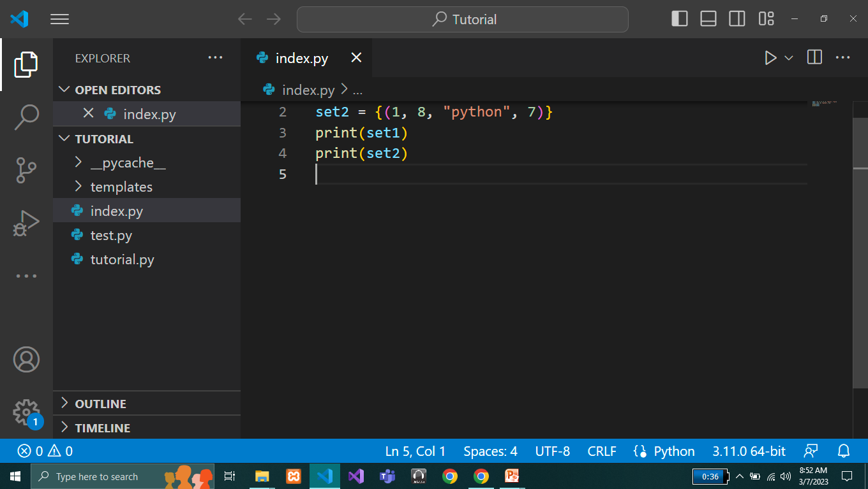
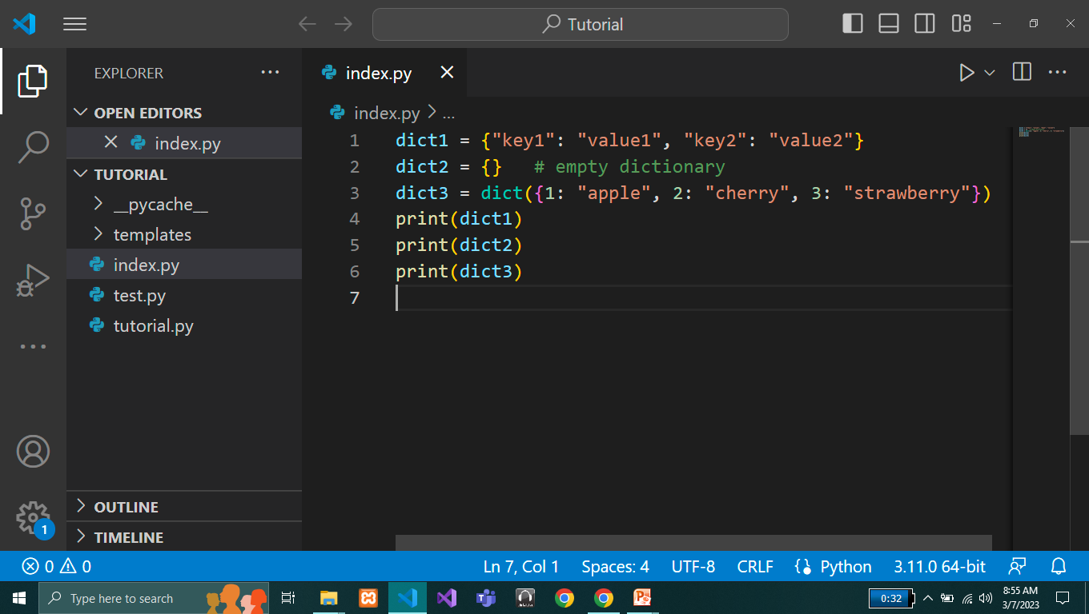
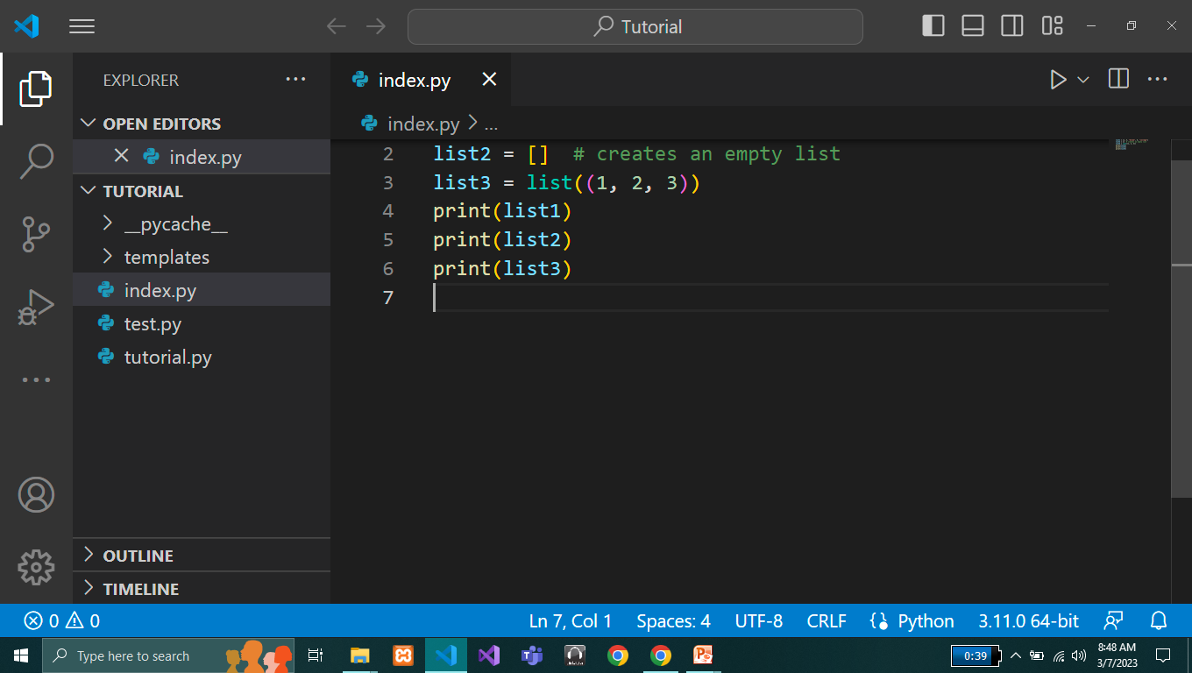
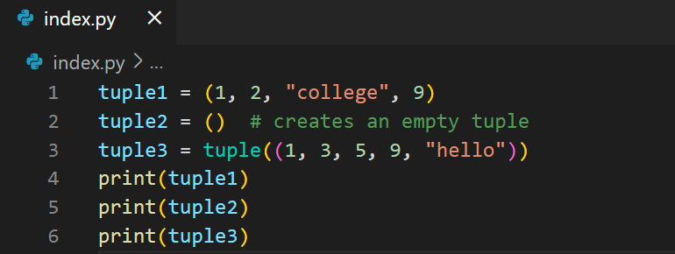
2.2.3 Collection Data Type
COMPARISON
Various ways to create a list.
Various ways to create a tuple
How to create a set
How to create a dictionary

Slide 11
2.2.3 Collection Data Type
LISTS | TUPLES | SETS | DICTIONARIES
A list is a collection of ordered data. | A tuple is an ordered collection of data. | A set is an unordered collection. | A dictionary is an unordered collection of data that stores data in key-value pairs.
Lists are mutable and allow duplicates. | Tuples are immutable. | Sets are mutable and have no duplicate elements. | Dictionaries are mutable and keys do not allow duplicates.
Lists are declared with square braces. | Tuples are enclosed within parenthesis. | Sets are represented in curly brackets. | Dictionaries are enclosed in curly brackets in the form of key-value pairs.
Notes:
Lists
Ordered
When we say that lists are ordered, it means that the items have a defined order, and that order will not change.
Note: There are some list methods that will change the order, but in general: the order of the items will not change.
Changeable
The list is changeable, meaning that we can change, add, and remove items in a list after it has been created.
Allow Duplicates
Since lists are indexed, they can have items with the same value:
Tuples
Ordered
When we say that lists are ordered, it means that the items have a defined order, and that order will not change.
Unchangeable
Tuples are unchangeable, meaning that we cannot change, add or remove items after the tuple has been created.
Allow Duplicates
Since tuples are indexed, they can have items with the same value:
Sets
Unordered means that the items in a set do not have a defined order.
Set items can appear in a different order every time you use them, and cannot be referred to by index or key.
Unchangeable
Set items are unchangeable, meaning that we cannot change the items after the set has been created.
Duplicates Not Allowed
Sets cannot have two items with the same value.
Once a set is created, you cannot change its items, but you can remove items and add new items.
Dictionaries
When we say that dictionaries are ordered, it means that the items have a defined order, and that order will not change.
Unordered means that the items does not have a defined order, you cannot refer to an item by using an index.
Changeable
Dictionaries are changeable, meaning that we can change, add or remove items after the dictionary has been created.
Duplicates Not Allowed
Dictionaries cannot have two items with the same key:

Slide 12
2.2.4 Boolean Data Type
In programming you often need to know if an expression is True or False.
You can evaluate any expression in Python, and get one of two answers, True or False.
When you compare two values, the expression is evaluated and Python returns the Boolean answer:
Ex.
print(10 > 9) print(10 == 9) print(10 < 9)

Slide 13
2.2.5 None Data Type
It is a variable who has an empty or None value
Ex.
myNoneValue = None

Slide 14
2.3 Variables
Variables are containers for storing data values.
A variable can have a short name (like x and y) or a more descriptive name (age, carname, total_volume).
Rules for Python variables:
A variable name must start with a letter or the underscore character
A variable name cannot start with a number
A variable name can only contain alpha-numeric characters and underscores (A-z, 0-9, and _ )
Variable names are case-sensitive (age, Age and AGE are three different variables)

Slide 15
2.3 Variables
Variables are containers for storing data values.
A variable can have a short name (like x and y) or a more descriptive name (age, carname, total_volume).
Rules for Python variables:
A variable name must start with a letter or the underscore character
A variable name cannot start with a number
A variable name can only contain alpha-numeric characters and underscores (A-z, 0-9, and _ )
Variable names are case-sensitive (age, Age and AGE are three different variables)

Slide 16
2.3 Variables
Example:
x = 5 y = "John" print(x) print(y)
Output:
5 John

Slide 17
2.3 Variables
If you want to specify the data type of a variable, this can be done with casting.
Example:
x = str(3)
y = int(3)
z = float(3) print(x) print(y)
print(z)
Output:
3
3
3.0
Remember that variable names are case-sensitive.

Slide 18
2.3 Variables
If you want to specify the data type of a variable, this can be done with casting.
Example:
x = str(3)
y = int(3)
z = float(3) print(x) print(y)
print(z)
Output:
3
3
3.0
Remember that variable names are case-sensitive.

Slide 19
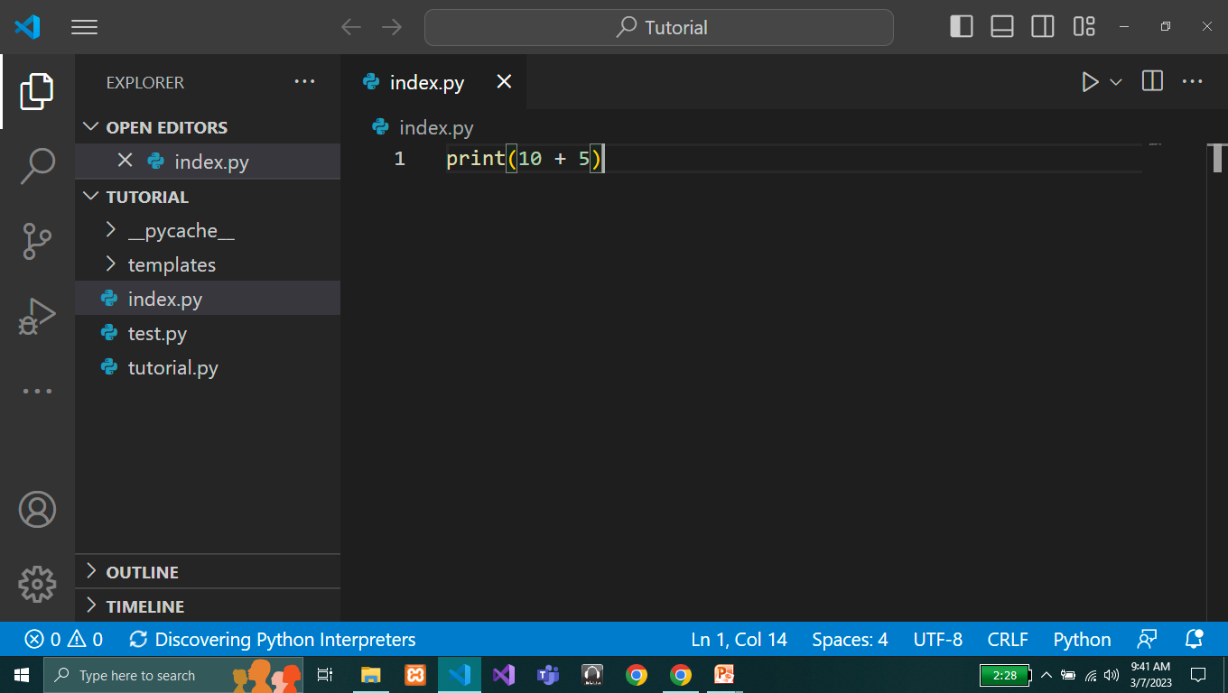
2.4 Operators
Operators are used to perform operations on variables and values.
In the example below, we use the + operator to add together two values:

Slide 20
2.4.1 Arithmetic Operators
Arithmetic operators are used with numeric values to perform common mathematical operations.
Operator | Name | Example
+ | Addition | x + y
- | Subtraction | x - y
* | Multiplication | x * y
/ | Division | x / y
% | Modulus | x % y
** | Exponentiation | x ** y
// | Floor division | x // y

Slide 21
2.4.2 Assignment Operators
Assignment operators are used to assign values to variables.
Operator | Example | Same as
= | x = 5 | x = 5
+= | x += 3 | x = x + 3
-= | x -= 3 | x = x - 3
*= | x *= 3 | x = x * 3
/= | x /= 3 | x = x / 3

Slide 22
2.4.2 Assignment Operators
Assignment operators are used to assign values to variables.
Operator | Example | Same as
%= | x %= 3 | x = x % 3
//= | x //= 3 | x = x // 3
**= | x **= 3 | x = x ** 3
^= | x ^= 3 | x = x ^ 3

Slide 23
2.4.3 Comparison Operators
Comparison operators are used to compare two values.
Operator | Name | Example
== | Equal | x == y
!= | Not equal | x != y
> | Greater than | x > y
< | Less than | x < y
>= | Greater than or equal to | x >= y
<= | Less than or equal to | x <= y

Slide 24
2.4.4 Logical Operators
Logical operators are used to combine conditional statements.
Operator | Description | Example
and | Returns True if both statements are true | x < 5 and x < 10
or | Returns True if one of the statements is true | x < 5 or x < 4
not | Reverse the result, returns False if the result is true | not(x < 5 and x < 10)

Slide 25
2.4.5 Identity Operators
Identity operators are used to compare the objects, not if they are equal, but if they are actually the same object, with the same memory location.
Operator | Description | Example
is | Returns True if both variables are the same object | x is y
is not | Returns True if both variables are not the same object | x is not y

Slide 26
2.4.5 Membership Operators
Membership operators are used to test if a sequence is presented in an object.
Operator | Description | Example
in | Returns True if a sequence with the specified value is present in the object | x in y
not in | Returns True if a sequence with the specified value is not present in the object | x not in y

Slide 27
2.5 Input/Output Operations
In Python, input and output operations (OI Operations) are performed using two built-in functions. Following are the two built-in functions to perform output operations and input operations.
print( ) - Used for output operation.
input( ) - Used for input operations.
Notes:
The built-in function print( ) is used to output the given data to the standard output device (Screen). In Python, using the print( ) function we can display a text message. The print( ) takes a string as an argument and displays the same.
Displaying a variable value using print( ) function
In Python, the built-in function print( ) function is also used to display variables value. The following example shows that how to display variable value using print( ) function.
num1 = 10
print(num1)
Formatted print( ) function to display a combination of message and value
The built-in function print( ) is also used to display the combination of message and variable value. Let's look at the following example.
num1 = 10 #variale num1 with value 10
print('The value of variable num1 is ' + num1)
We can also write the same print( ) function as follows.
num1 = 10
print(f"The value of variable num1 is {num1}")
In the above example code, we have used a formatted string. In Python, we can use the formatted string that is prefixed with character "f". In the formatted string, the variable values are included using curly braces ({ }).
The Python provides a built-in function input( ) to perform input operations. The input( ) function can be used either with some message or without a message.

Slide 28
2.5.1 Displaying a message using print( ) function
When we use the print( ) function to display a message, the string can be enclosed either in the single quotation or double quotation.
print('This message is displayed on the screen')
print("This message is also displayed on the screen")
Notes:
Displaying a variable value using print( ) function
In Python, the built-in function print( ) function is also used to display variables value. The following example shows that how to display variable value using print( ) function.
Example
num1 = 10
print(num1)

Slide 29
2.5.1 Displaying a variable value using print( ) function
In Python, the built-in function print( ) function is also used to display variables value. The following example shows that how to display variable value using print( ) function.
Example:
num1 = 10
print(num1)

Slide 30
2.5.1 Formatted print( ) function to display a combination of message and value
The built-in function print( ) is also used to display the combination of message and variable value. Let's look at the following example.
num1 = 10
print('The value of variable num1 is ' + num1)
We can also write the same print( ) function as follows.
num1 = 10
print(f"The value of variable num1 is {num1}")
Notes:
In the above example code, we have used a formatted string. In Python, we can use the formatted string that is prefixed with character "f". In the formatted string, the variable values are included using curly braces ({ }).

Slide 31
2.5.1 Formatted print( ) function to display a combination of message and value
The built-in function print( ) is also used to display the combination of message and variable value. Let's look at the following example.
num1 = 10
print('The value of variable num1 is ' + num1)
We can also write the same print( ) function as follows.
num1 = 10
print(f"The value of variable num1 is {num1}")

Slide 32
2.5.2 Input () Functions
Python allows for user input. The Python provides a built-in function input( ) to perform input operations. It can be used either with some message or without a message.
That means we are able to ask the user for input.

Slide 33
2.5.2 Input () Functions
Reading a single character in Python
The Python does not provide any direct function to read a single character as input. But we can use the index value to extract a single character from the user entered input value. Let's look at the following Python code.
Example:
ch = input('Enter any data: ')[0]
print(f'The character entered is {ch}')

Slide 34
2.6 Comments
Comments can be used to explain Python code.
Comments can be used to make the code more readable.
Comments can be used to prevent execution when testing code.
Comments starts with a #, and Python will ignore them:

