Slide 1
PROJECT TITLE: Line Follower Robot using Raspberry Pi 3

Slide 2
IMPLEMENTATION SUMMARY:
The Line Follower Robot project utilizes Raspberry Pi 3 and L298N motor driver for creating an autonomous robot capable of following a line on a track.
The hardware components include Raspberry Pi 3, L298N motor driver, infrared or color sensors, wheels, and necessary connectors.
The software aspect involves programming in microPython, utilizing libraries and frameworks compatible with Raspberry Pi 3.
The system design outlines the connections between Raspberry Pi 3, sensors, and motors, ensuring proper integration and control.
Calibration and optimization processes are implemented for accurate line detection using the integrated sensors.
The L298N motor driver enables precise motor control, ensuring the robot's smooth movement along the track.
The line following algorithm is developed to make informed decisions based on sensor readings, guiding the robot's navigation.
The project demonstrates successful construction, functionality, and testing of the Line Follower Robot, contributing to the understanding of robotics and automation while showcasing the integration of hardware and software components.

Slide 3
OVERVIEW:
COMPENENTS USED
CIRCUIT CONNECTION
WORKING PRINCIPLE
WORKING WITH RASPBERRY PI
PROTOCOLS INVOLVED IN RASPBERRY PI3
CODE IMPLEMENTATION
PROTOCOLS USED IN LINE FOLLOWING ROBOT

Slide 4
COMPONENTS USED
Raspberry Pi 3
IR Sensor (2)
DC Gear Motor (2)
JUMPER WIRES
L298n Motor Driver
Chaises (robot body)

Slide 5
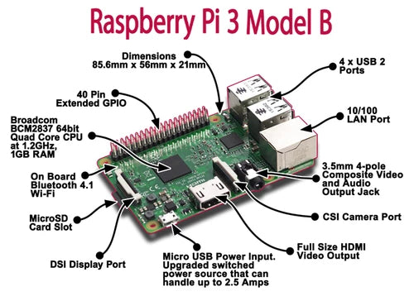
RASPBERRY PI 3
The boards are typically credit card-sized and contain all the essential components of a computer, including
a processor
Memory
input/output (I/O) ports
storage

Slide 6
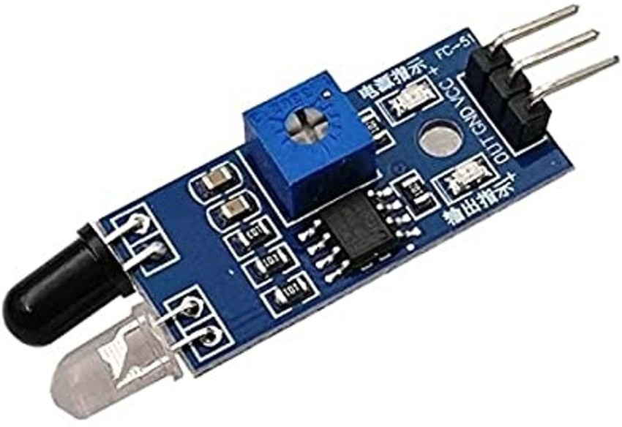
IR SENSOR
IR sensor is often used to detect the presence or absence of infrared light emitted by an IR LED.
The basic principle behind an IR sensor is that it emits infrared light and then measures the intensity of the reflected light.
If an object is present in front of the sensor, it will reflect the emitted infrared light back to the sensor, resulting in a detected signal.
To interface an IR sensor with a Raspberry Pi, you typically connect the sensor's output pin to one of the GPIO (General Purpose Input/Output) pins on the Raspberry Pi.
The sensor's power supply and ground pins are connected to the appropriate power and ground pins on the Raspberry Pi as well.

Slide 7
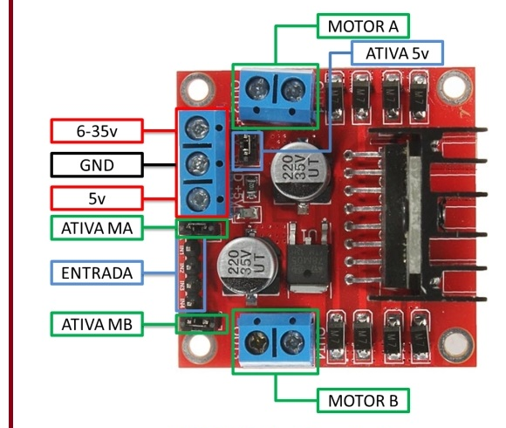
L298N MOTOR DRIVER
The L298N is a popular dual H-bridge motor driver IC that can be used to control the speed and direction of DC motors.
The L298N can handle a wide range of voltages and currents, making it suitable for driving motors with different specifications.
It has two H-bridge channels, which means it can control two motors independently or a single motor with bidirectional control.
To use the L298N motor driver with a Raspberry Pi, you typically need to connect the motor driver to the GPIO pins of the Raspberry Pi and provide an external power supply for the motors.
Raspberry Pi L298N Motor Driver
GPIO Pin (IN1) -----------> IN1
GPIO Pin (IN2) -----------> IN2
GPIO Pin (PWM) -----------> ENA
GND ----------------------> GND
+5V ----------------------> VCC

Slide 8
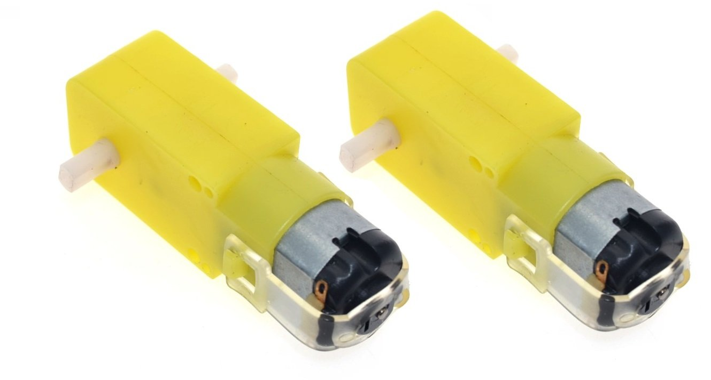
MOTORS:
A DC geared motor, also known as a DC gear motor, combines a DC motor with a gearbox.
The gearbox is used to reduce the speed of the motor while increasing torque output.
This type of motor is commonly used in applications that require precise control over speed and high torque, such as robotics, automation, and industrial equipment.
When it comes to controlling a DC geared motor, following these general steps:
Power Supply
Motor Driver
Control Signals
GPIO Connections
Programming

Slide 9
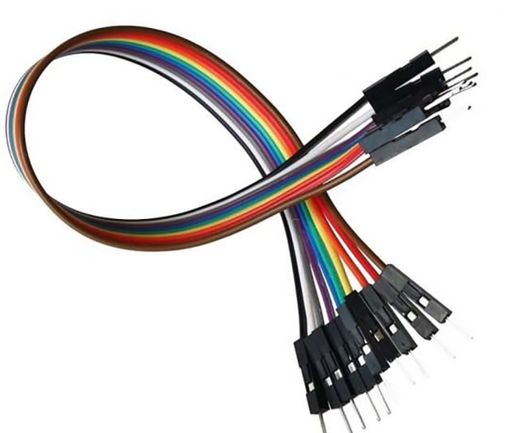
JUMPER WIRES:
Jumper wires are electrical wires with connectors at each end, typically used for connecting components on a breadboard or between different electronic modules.
Jumper wires are commonly used in electronics and prototyping projects, including those involving the Raspberry Pi.
They provide a convenient way to establish electrical connections between various components, such as connecting sensors, actuators, LEDs, and other modules to a microcontroller or development board.

Slide 10
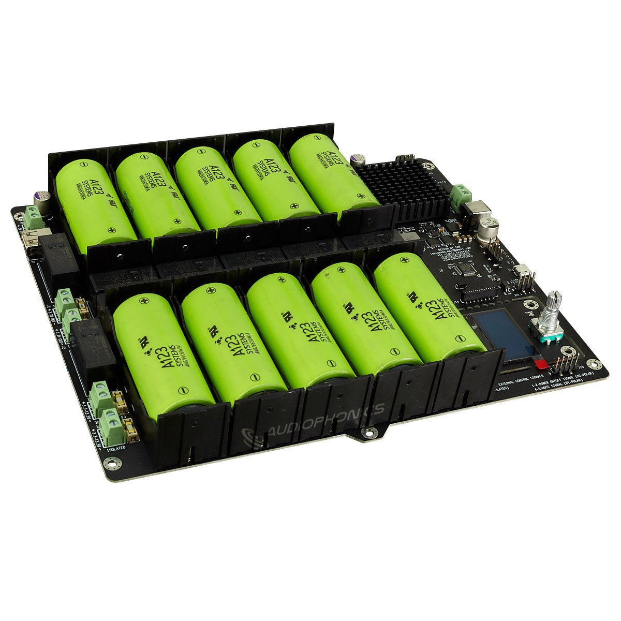
POWER SOURCE

Slide 11
WORKING PRINCIPLE:

Slide 12
Working principle:
Line Follower Robot is able to track a line with the help of an IR sensor. This sensor has a IR Transmitter and IR receiver.
The IR transmitter (IR LED) transmits the light and the Receiver (Photodiode) waits for the transmitted light to return back.
An IR light will return back only if it is reflect by a surface. Whereas, all surfaces do not reflect an IR light, only white the colour surface can completely reflect them and black colour surface will completely absorb them.

Slide 13
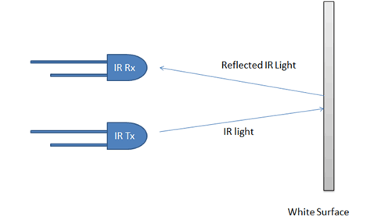
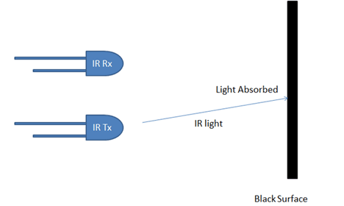
These two IR sensors will be placed one on either side of the line. If none of the sensors are detecting a black line them they PI instructs the motors to move forward
If left sensor comes on black line then the PI instructs the robot to turn left by rotating the right wheel alone.
If right sensor comes on black line then the PI instructs the robot to turn right by rotating the left wheel alone.
If both sensors comes on black line, robot stops as shown in the next slide.

Slide 14
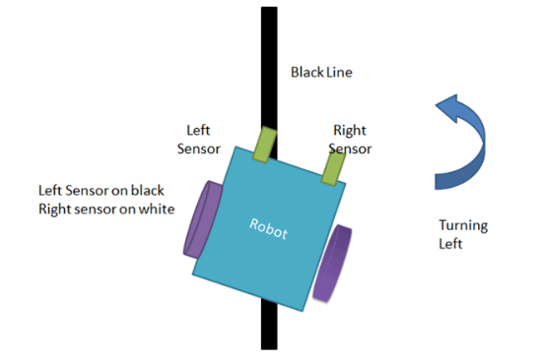
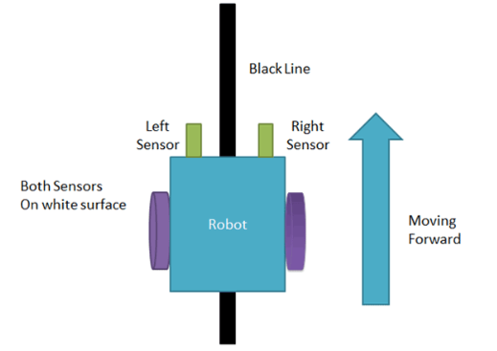
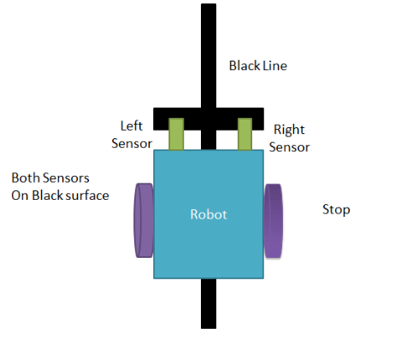
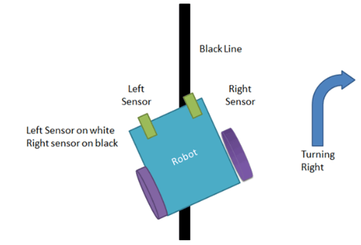

Slide 15
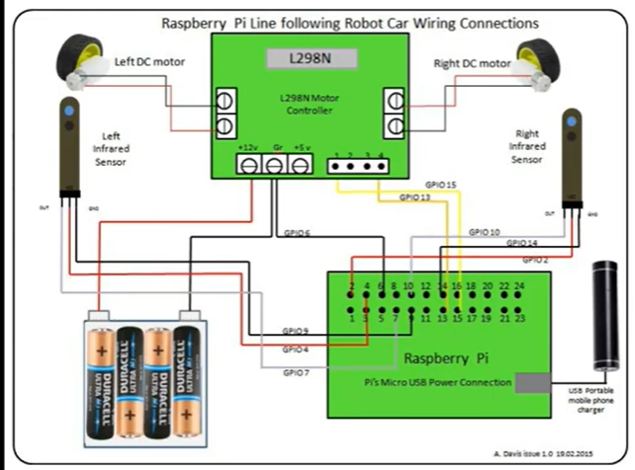
CIRCUIT DIAGRAM:

Slide 16
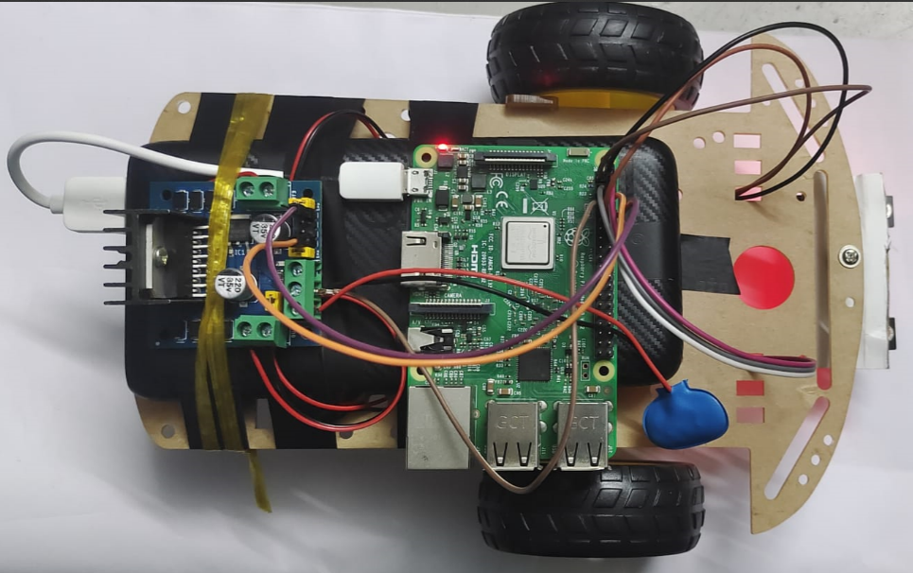
Robot picture:

Slide 17
WORKING WITH RASPBERRY PI:

Slide 18
How to install:
Download the operating system (OS) image from the official Raspberry Pi website.
Flash the OS image to an SD card using a tool like Etcher.
Connect a power supply, HDMI display, USB keyboard, and mouse to the Raspberry Pi.
If using a wired network, connect an Ethernet cable; otherwise, configure Wi-Fi.
Power on the Raspberry Pi and follow the initial setup wizard to configure preferences.

Slide 19
HOW RASPBERRY COMMUNICATES ?

Slide 20
When Raspberry Pi communicates with a laptop over Wi-Fi, several protocols come into play:
Internet Protocol (IP): IP is the fundamental protocol for network communication. Both the Raspberry Pi and laptop need to have IP addresses assigned to them. IP allows the devices to send and receive data packets over the network.
Wi-Fi (802.11): Wi-Fi is the wireless networking standard that enables devices to connect and communicate over a wireless network. It defines the physical and data link layers for wireless communication.
Internet Control Message Protocol (ICMP): ICMP is a network protocol used for diagnostic and error reporting purposes. It is commonly used for functions such as ping requests and replies to check network connectivity and troubleshoot issues.

Slide 21
Transmission Control Protocol (TCP) and User Datagram Protocol (UDP): TCP and UDP are transport layer protocols that facilitate the reliable or unreliable transmission of data between devices. They define how data is packaged into segments and provide mechanisms for error detection, flow control, and retransmission.
Hypertext Transfer Protocol (HTTP): HTTP is a protocol used for communication between web browsers and web servers. If you're developing a web-based interface on the Raspberry Pi, HTTP will be involved in the communication between the laptop's web browser and the Raspberry Pi's web server.
Secure Shell (SSH): SSH is a cryptographic network protocol that provides secure remote access to a command-line interface. It allows you to remotely access and control the Raspberry Pi's terminal from the laptop over Wi-Fi.

Slide 22
CODE:

Slide 23
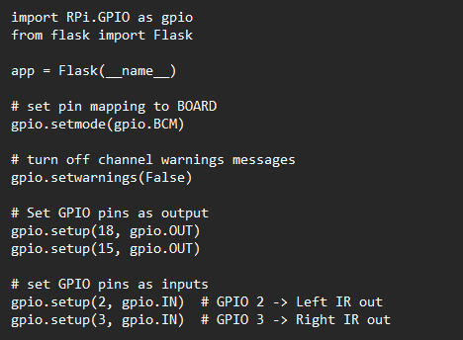
Required libraries and IO pins allocation:

Slide 24
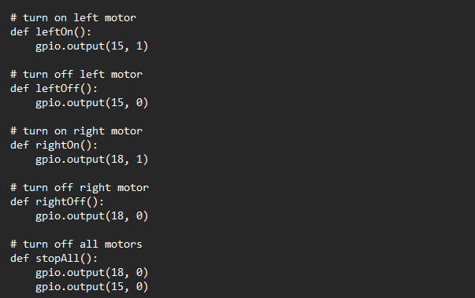
Controlling the motors:

Slide 25
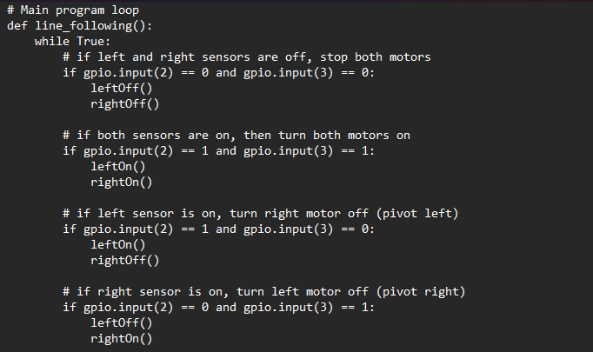
Main program:

Slide 26
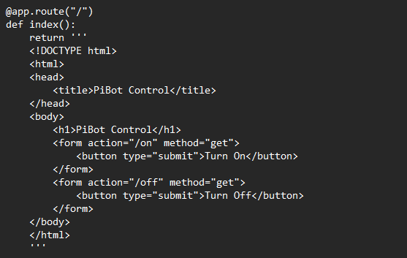
HTML CODE FOR TEMPLATE:

Slide 27
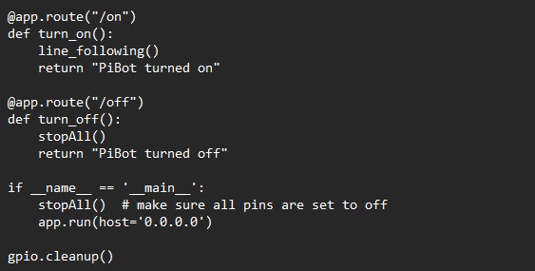
TURN ON/OFF BUTTONS:

Slide 28
PROTOCOLS INVOLVED:

Slide 29
HTTP PROTOCOL
Flask Routes: Flask routes are defined to handle HTTP requests. The / route renders the index template, which is the main web page. The /on route invokes the line_following() function, initiating the line-following behavior. The /off route calls the stopAll() function to stop the motors.
Starting the Flask Application: The if __name__ == '__main__' block ensures that the Flask application runs only if the script is executed directly. It starts the Flask application and sets the host to '0.0.0.0', allowing it to be accessible from any network interface.
Cleaning up GPIO: The gpio.cleanup() function is called to release the GPIO pins and reset them to their default state when the program is terminated.

Slide 30
The HTTP (Hypertext Transfer Protocol) is an application-layer protocol that defines how clients and servers communicate over the web.
When a client (web browser) sends an HTTP request to a server (Raspberry Pi), it includes a request method (e.g., GET, POST) and a URL path.
The Flask routes in the code define the URL paths and associate them with specific functions (index(), turn_on(), turn_off()).
When the client accesses the root URL /, the index() function is called, and the render_template() method returns the contents of the index.html template.
When the client accesses the /on URL, the turn_on() function is called, and it invokes the line_following() function, initiating the line-following behavior.
When the client accesses the /off URL, the turn_off() function is called, and it stops the motors by invoking the stopAll() function.
The Flask framework handles the HTTP requests and responses, allowing communication between the client and server based on the defined routes.
Overall, the HTTP protocol is used to handle client-server communication, enabling control of the Raspberry Pi's motors through HTTP requests triggered by accessing specific URLs.

