Slide 1
21AIE304
BIG DATA AND​
DATABASE MANAGMENT​
END SEM PROJECT PRESENTATION

Slide 2
Members:
MARREDDY MOHIT SASANK REDDY CB.EN.U4AIE21031
YARRAM SRI SATHWIK REDDY CB.EN.U4AIE21077
B.HARISH BALAJI CB.EN.U4AIE21007
PENTYALA SAI VIJAY KUMAR CB.EN.U4AIE21040

Slide 3
Superstore Sales Dataset
Retail dataset of a global superstore for 4 years.

Slide 4
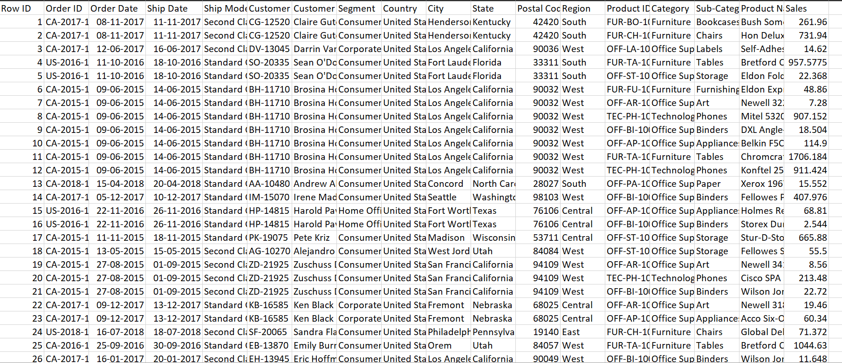
DATASET

Slide 5
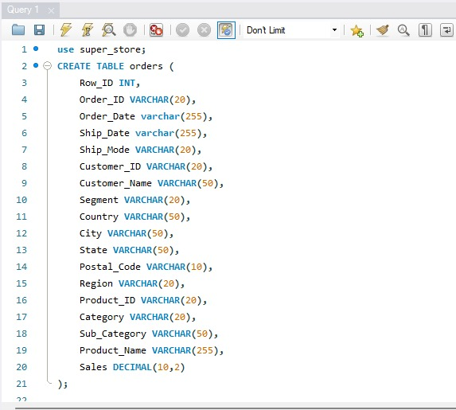

Slide 6
The Dataset contains:
Rows : 9800
Columns: 18
Size: 2.13 mb

Slide 7
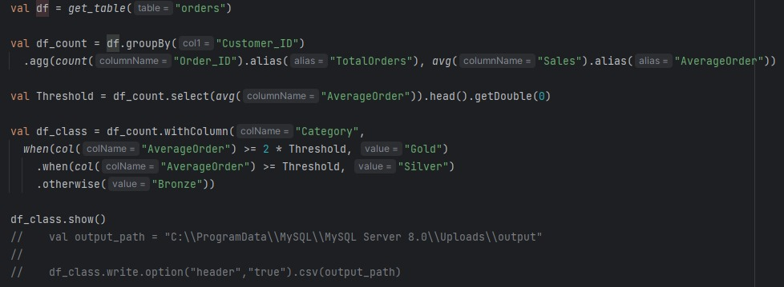
Analysis 1.1

Slide 8
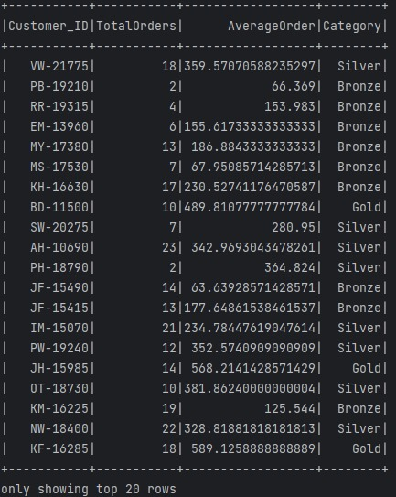
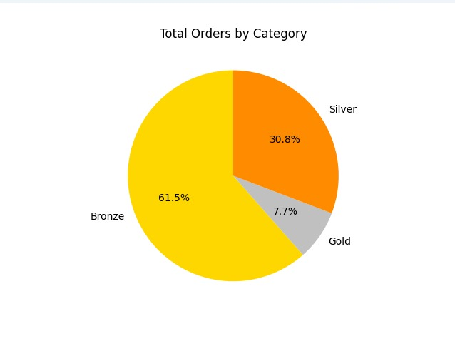
Output:

Slide 9
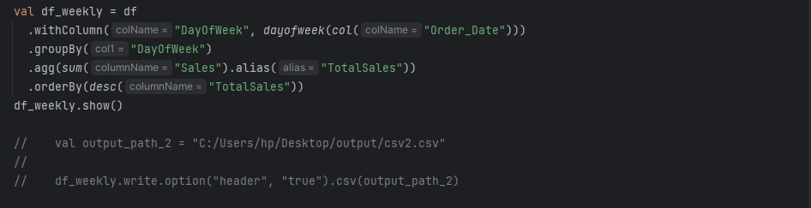
Analysis 1.2

Slide 10
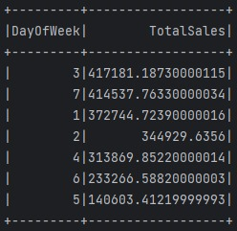
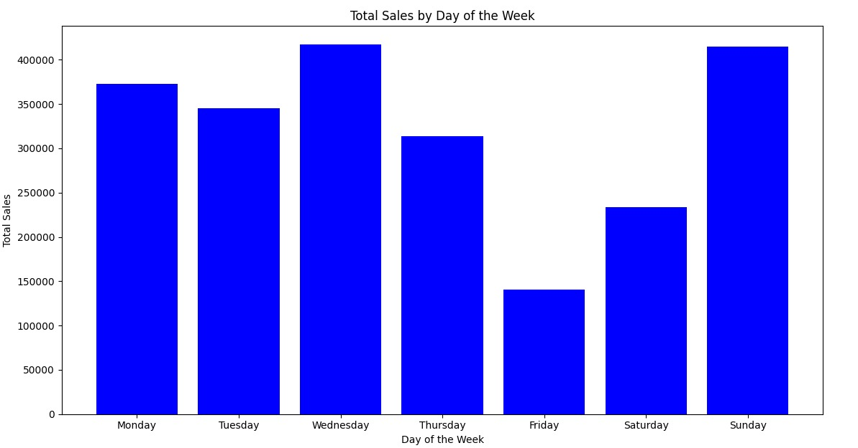
Output:

Slide 11
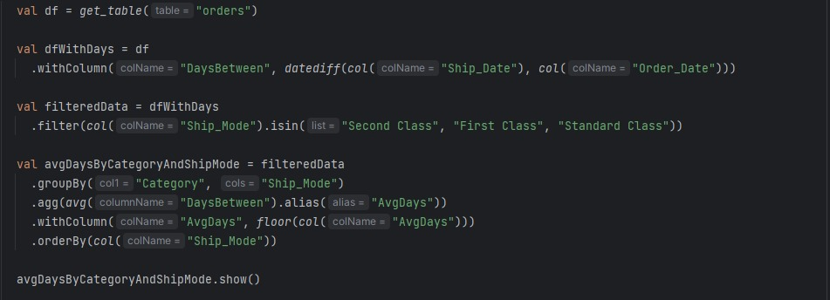
Analysis 2.1

Slide 12
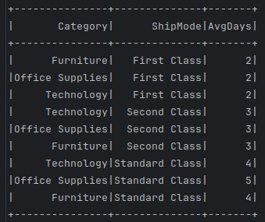
Output:

Slide 13
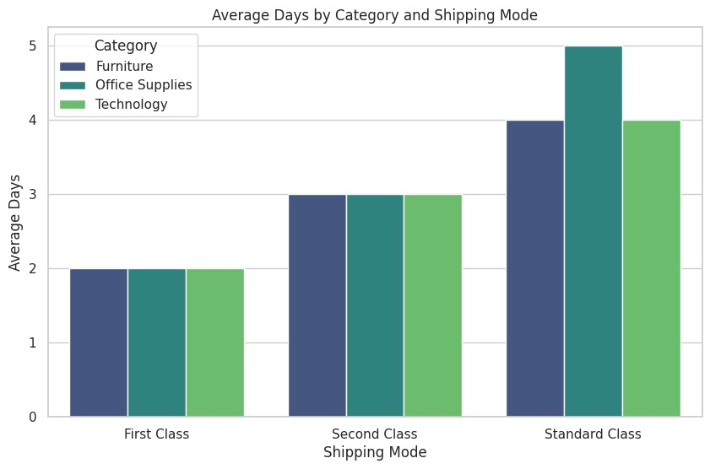
GRAPH:

Slide 14
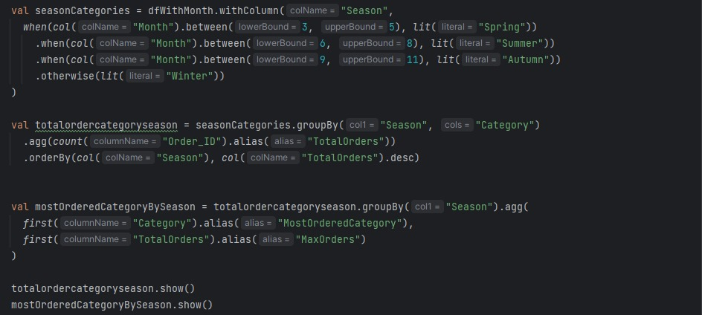
Analysis 2.2

Slide 15
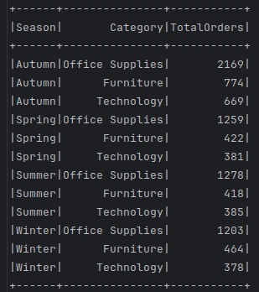
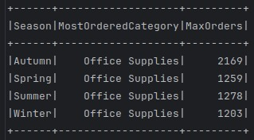
Output:

Slide 16
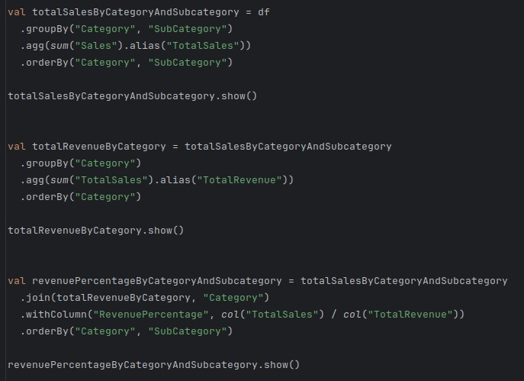
Analysis 2.3

Slide 17
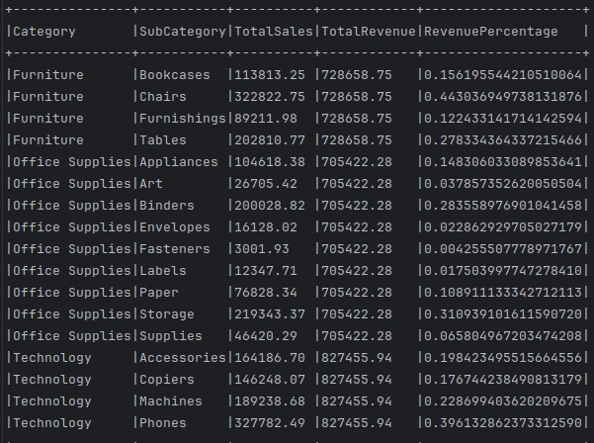
OUTPUT:

Slide 18
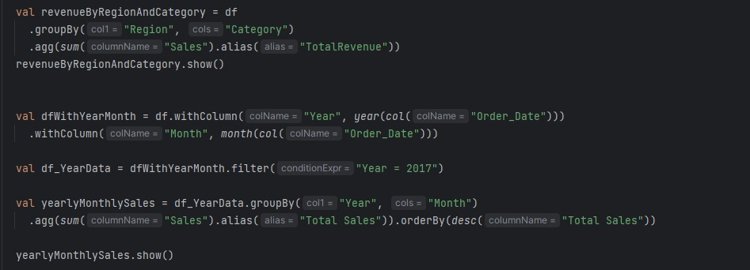
Analysis 3

Slide 19
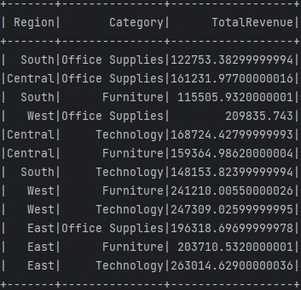
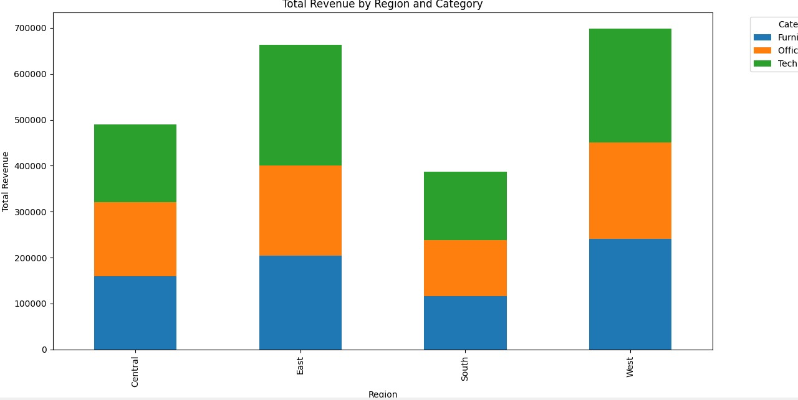
Output:

Slide 20
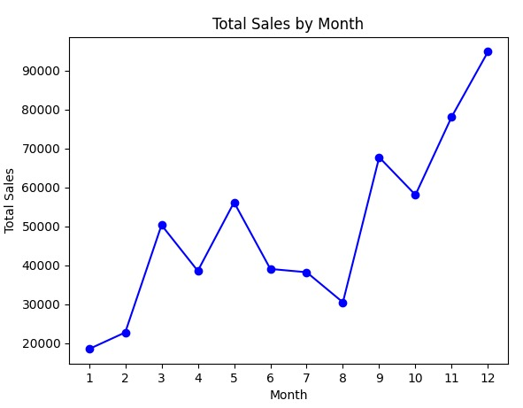
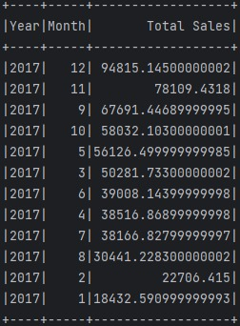
Output:

Slide 21
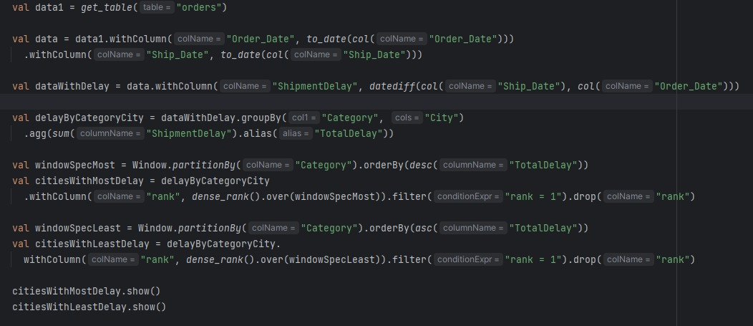
Analysis 4 - Categorizing which city has most delay and which city has least delay

Slide 22
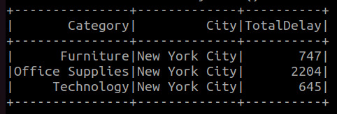
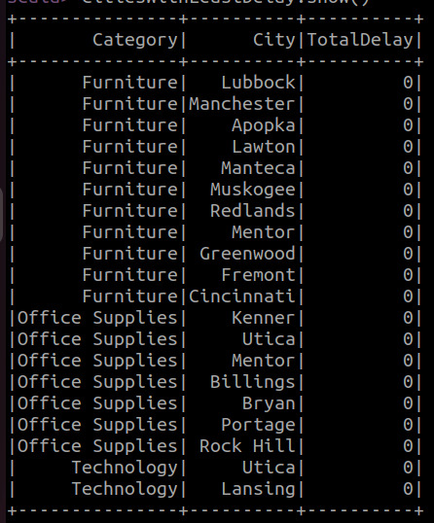
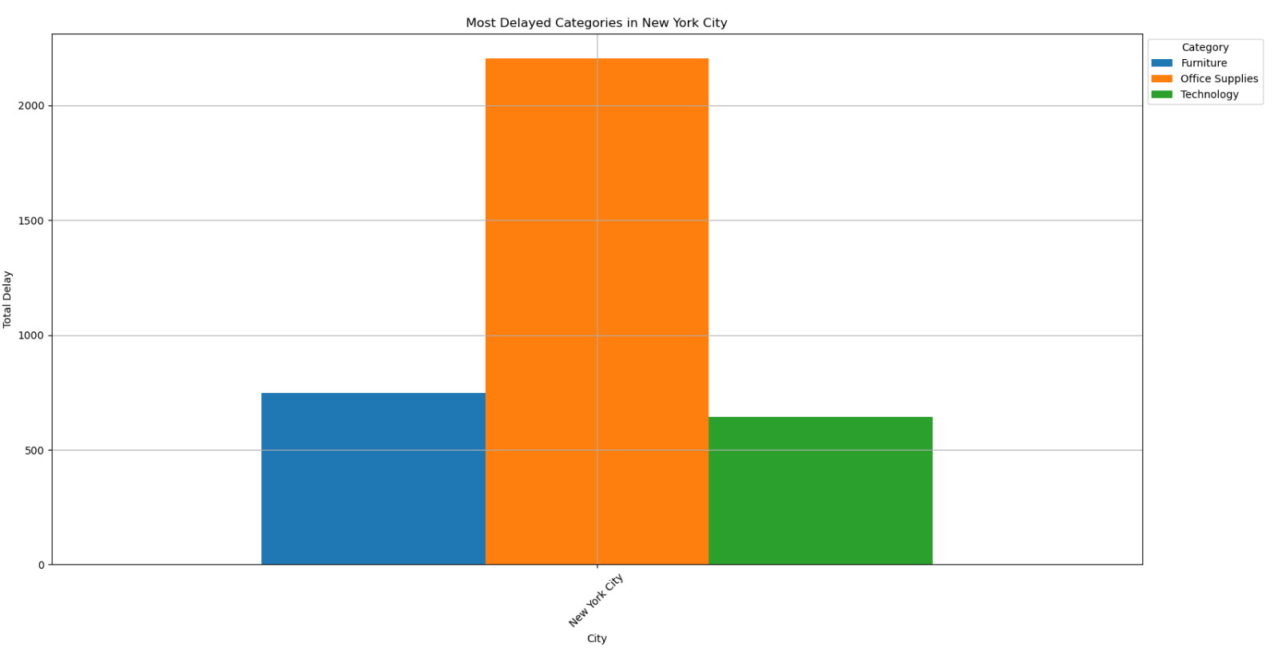
Output

Slide 23
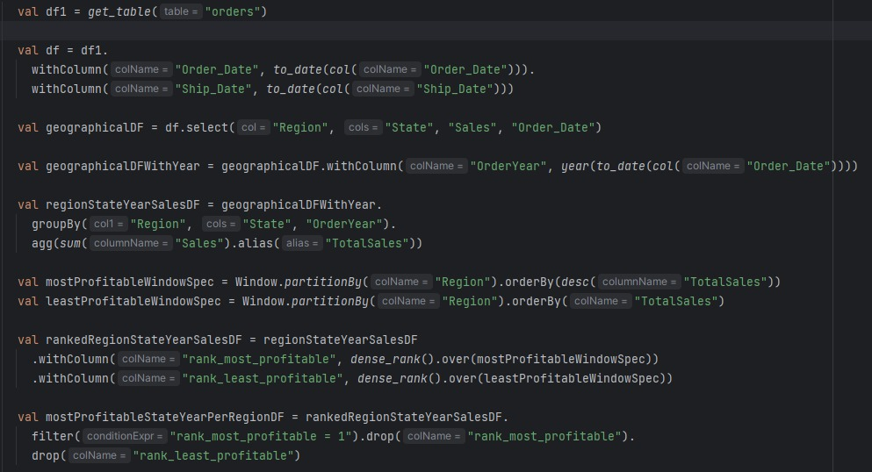
Classifying regions based on most and least profitable states and year

Slide 24
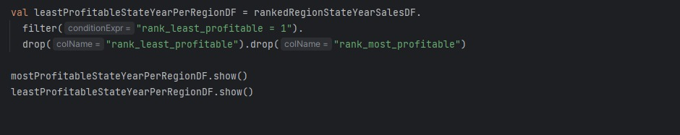

Slide 25
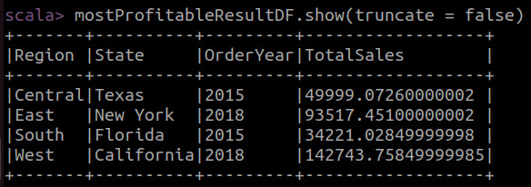
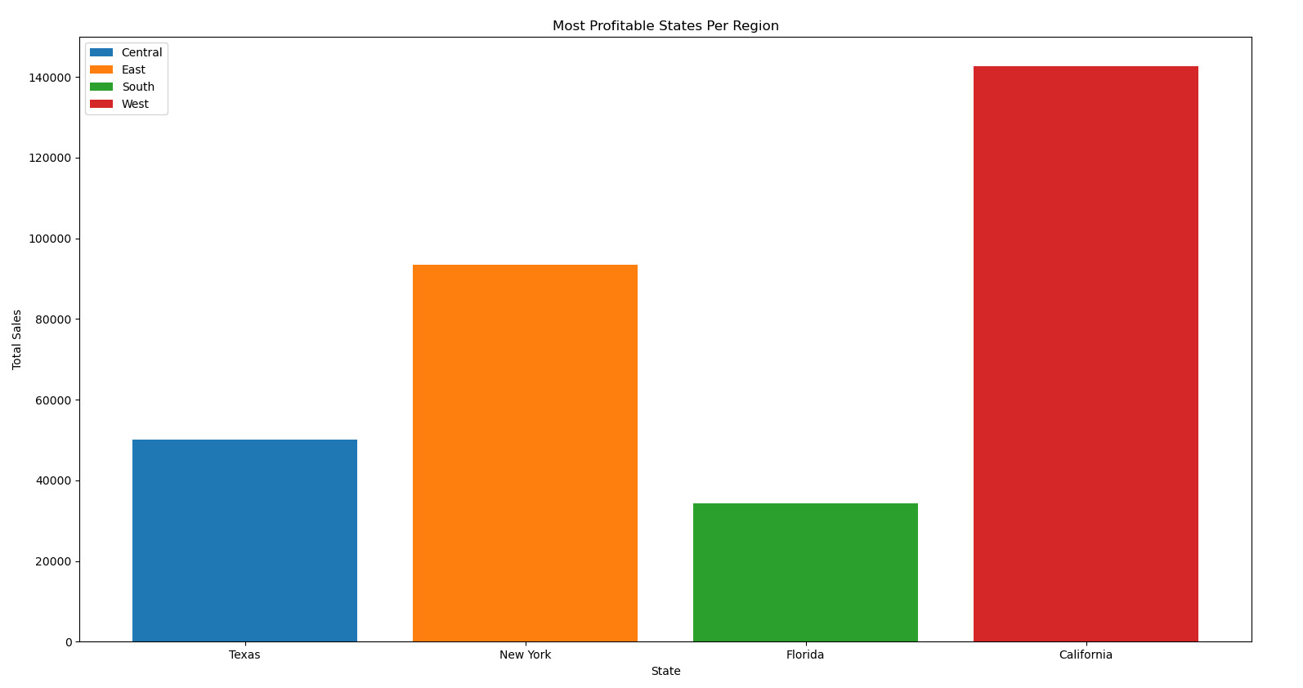
output

Slide 26
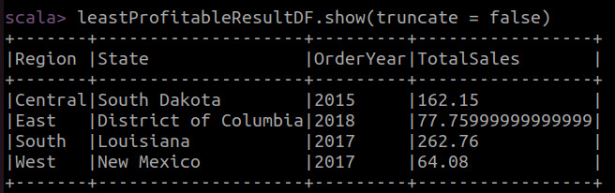
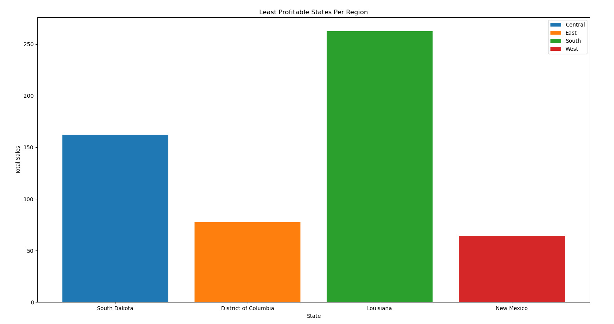
output

Slide 27
Thank you

