Slide 1
21MAT301
Mathematics For Intelligent Systems - 5​
END SEM PROJECT PRESENTATION

Slide 2
Members:
MARREDDY MOHIT SASANK REDDY CB.EN.U4AIE21031
YARRAM SRI SATHWIK REDDY CB.EN.U4AIE21077
B.HARISH BALAJI CB.EN.U4AIE21007
PENTYALA SAI VIJAY KUMAR CB.EN.U4AIE21040

Slide 3
TOPIC:
Trajectory Prediction using Kalman Filter

Slide 4
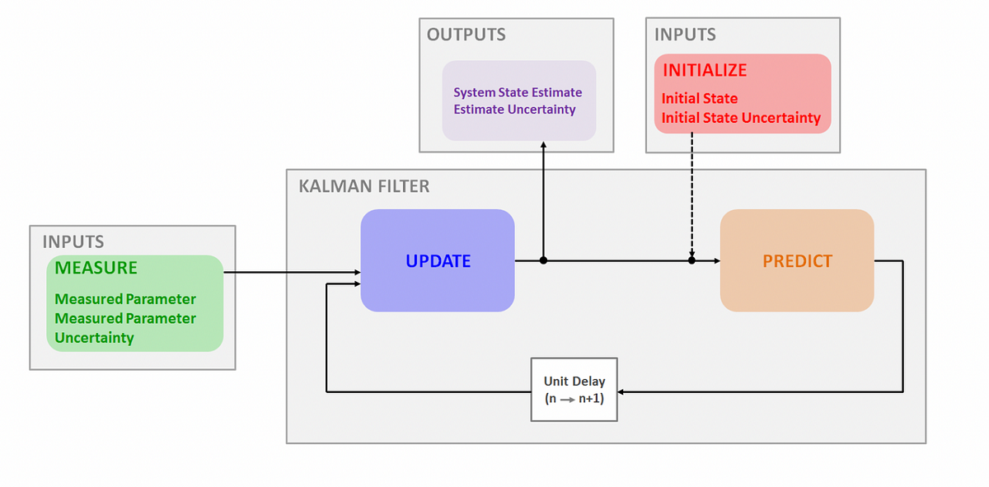
KALMAN FILTER:
Kalman Filtering is an algorithm/technique that does state estimation using measurements that are noisy.
It’s a iterative mathematical process that use a set of equations and consecutive data inputs to quickly estimate the true value value, position, velocity etc of the object being measured, when the measured value contain unpredicted or random error, uncertainty or variation.

Slide 5
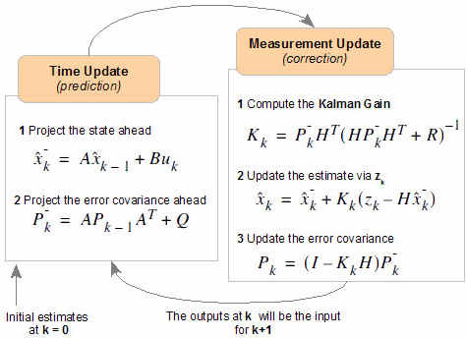
KALMAN FILTER:
x̂̅_k⁻: Priori state estimate
x̂_k: Posteriori state estimate
P_k⁻: Priori estimate covariance
P_k: Posteriori estimate covariance
A: State transition matrix
B: Control input matrix
u_k: Control input vector
K_k: Kalman gain
H: Measurement matrix
R: Measurement noise covariance
Q: Process noise covariance

Slide 6
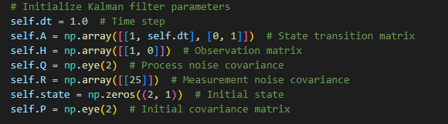

Heading: Kalman Filter Trajectory Prediction for Noisy Measurements in 2D Space:
1)initialization:
2)Prediction step:
3)Update step:

Slide 7
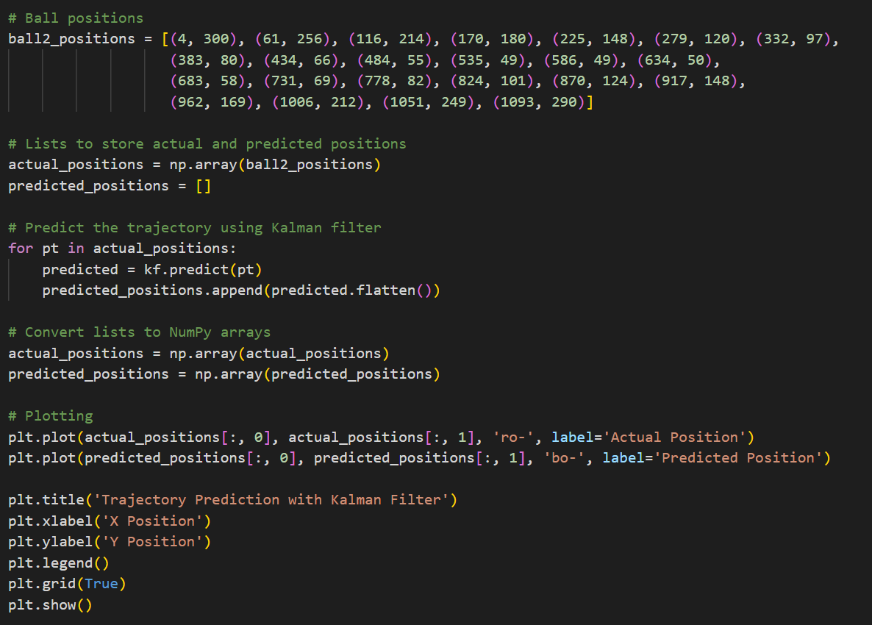
contd:
4)Trajectory prediction:

Slide 8
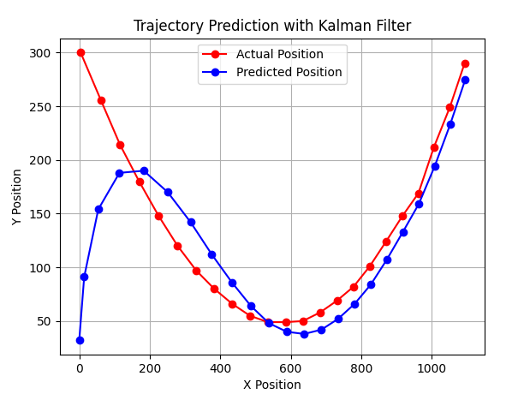
contd:
5)Plotting:
Plotted using matplotlib
6)Outcome:

Slide 9
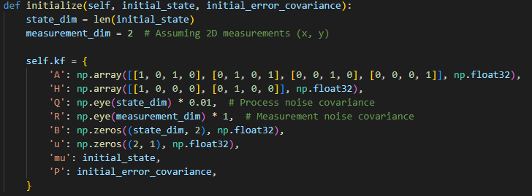
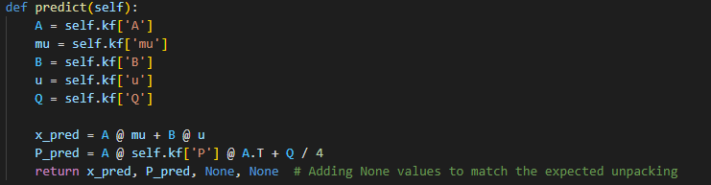
Kalman Filter Cursor Tracking in OpenCV:
1. Initialization:
- Kalman Filter is initialized with matrices A, H, Q, R, initial state, and initial covariance matrix (P).
2. Kalman Filter Predict:

Slide 10
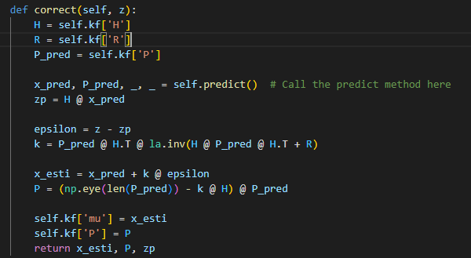
contd:
3. Kalman Filter Correct:

Slide 11
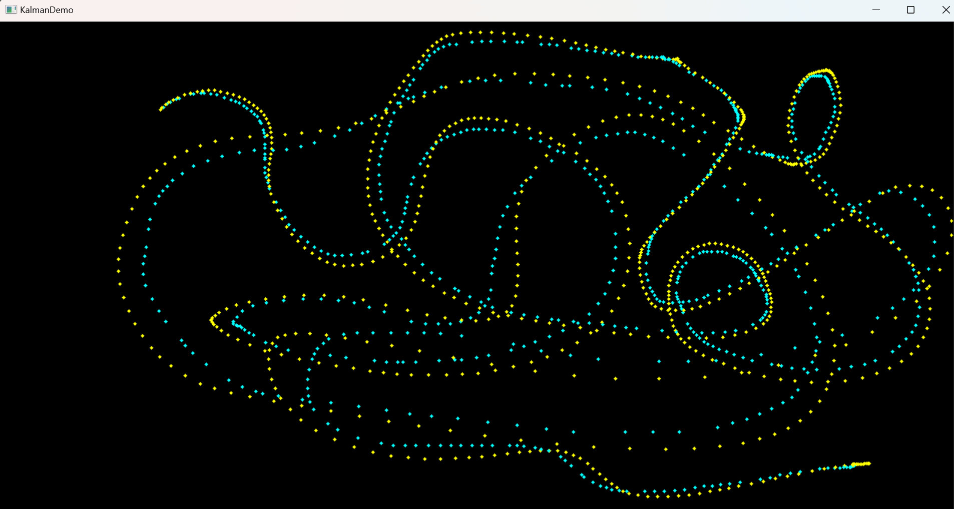
contd:
4. Mouse Event Handling:
- OpenCV window "KalmanDemo" is set up to handle mouse events using `cv2.setMouseCallback`.
- Left-click initializes the cursor position and velocity, triggering the Kalman Filter initialization.
- Double-click clears the display, and mouse movement updates the cursor's position.
5. Visualization:
- Display is continuously updated as the cursor moves.
- Yellow circle marks the measured cursor position, while cyan(blue) circle marks the estimated position from the Kalman Filter.
6. Dynamic Tracking:
- Kalman Filter dynamically adjusts predictions, providing smooth and accurate cursor tracking even in the presence of noise.

Slide 12
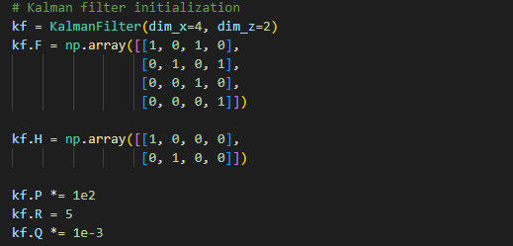

Kalman Filter and Optical Flow-based Car Detection and Tracking:
1)Kalman Filter Initialization:
2) Prediction Function (predict):

Slide 13
contd:
White Car Detection and Tracking:
Convert the frame to HSV and create a mask to detect white cars. Extract white car regions and apply Haar Cascade for car detection in those regions.
For each detected car: Without Optical Flow: Predict the position using Kalman Filter (predicted_position_no_optical_flow).
Draw circles at the predicted positions without optical flow.
Optical Flow-based Motion Estimation: Use Lucas-Kanade optical flow to estimate motion between consecutive frames.
Update the Kalman Filter with the mean motion.
Predict the position using Kalman Filter with optical flow (predicted_position_with_optical_flow).
Draw circles at the predicted positions with optical flow.
Combine Predictions: Calculate the resultant position as the average of both predictions. Draw a circle at the resultant position in red.
Visualize: Draw circles around the detected car and predicted positions.

Slide 14
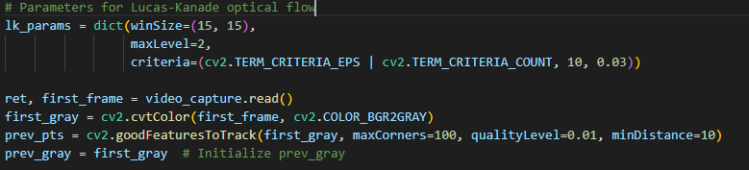
contd:
4.Lucas-Kanade Optical Flow Initialization:
Initialize parameters for Lucas-Kanade optical flow, such as window size, maximum pyramid level, and termination criteria.
5.Video Capture and Processing:
Open a video capture from a file ('pv_2.mp4').
Read frames from the video, detect and track white cars using Kalman Filter and optical flow, and visualize the results.

Slide 15
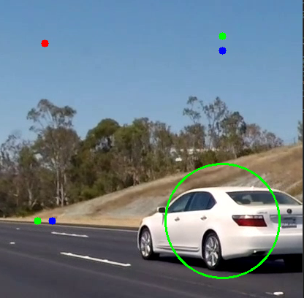
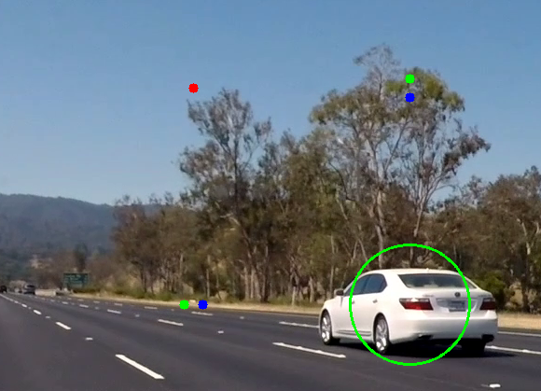
Result:

Slide 16
Future work:
1. Improved Object Recognition
2. Dynamic Adaptive Parameters
3. Multi-Object Tracking
4. Integration with Semantic Segmentation
5. Real-time Processing Optimization
6. Adaptive Optical Flow Strategies

Slide 17
CONTRIBUTION:
MARREDDY MOHIT SASANK REDDY | Kalman Filter Cursor Tracking in OpenCV
YARRAM SRI SATHWIK REDDY | Kalman Filter Trajectory Prediction for Noisy Measurements in 2D Space
B.HARISH BALAJI | Kalman Filter and Optical Flow-based Car Detection and Tracking:
PENTYALA SAI VIJAY KUMAR | Kalman Filter and Optical Flow-based Car Detection and Tracking:

Slide 18
Thank you

