Slide 1
FROM VIBES TO VERIFIABLE
If it acts, it needs evidence
Microsoft’s new Autopilot keeps working after you log off.
RUNTIME
SKILLS
BOUNDARY
TESTS
What actually executes
When it should act
What data can move
What proves behavior
Modern Workplace Conference, Manila
Paul Swider / RealActivity / 29 September 2026
RealActivity / Manila 2026
01
Notes:
Opening transition, about 25 seconds:
"Microsoft just announced a new Copilot experience with Home, Code and Autopilot. Home brings Chat and Cowork together. The part I want to focus on today is Autopilot: an agent that keeps working after we log off. That makes this question very practical. If it acts on our behalf, what evidence do we have of what it did?"
Pause on the thesis, then point to runtime, skills, boundary and tests. Before moving into the announcement detail, use the next slide for your brief personal introduction.
The subtitle describes Microsoft's announced cloud Autopilot direction. The private preview expands at the end of September, as explained on the later announcement slide. It does not imply that all attendees already have access.
Pacing: 2 minutes.
Opening: From Vibes to Verifiable, Modern Workplace Conference, Manila, 29 September 2026.
The four ownership layers are the framework for this session. They describe what a team must inspect when an agent can take action. Skills state intended behavior. Runtime permissions and tests provide additional enforcement and evidence.
The examples use Autopilot and Tula. Healthcare is the worked example, while the ownership questions apply to any workplace workflow.
Sources
- https://github.com/realactivity/tula
- https://blogs.microsoft.com/blog/2026/09/25/introducing-the-new-copilot-with-home-code-and-autopilot/

Slide 2

THE HUMAN BEHIND THE AGENTS
Paul Swider
Founder, CEO & Chief AI Officer
RealActivity
Microsoft MCT / MVP Alumni
Tula creator
Wheelhouse AI CoE co-founder
Cloud Wars healthcare AI analyst
BOSHUG founder
30 years in healthcare tech.
Still too many tabs open.
RealActivity / Manila 2026
02
Notes:
INTRODUCTION / 45-60 seconds
Suggested opening:
"I'm Paul Swider. This is less a headshot and more a screenshot of my brain. I've spent 30 years building healthcare technology. Lately that means Tula, an agent patients can own, and the question behind this whole session: how do we let AI do useful work and still know what it did? I also write for Cloud Wars and bring people together through the Boston Healthcare Cloud & AI Community. It's good to be back in Manila."
The browser-tabs line is an original, lighthearted introduction, not a measured biographical claim. BOSHUG is the Boston Healthcare Cloud & AI Community.
RESEARCH WINDOW: 29 September 2024 through 29 September 2026. Reviewed 29 September 2026, Manila time.
Recent-work context, for optional remarks:
- October 2024: Sessionize lists Manila, Kuala Lumpur and Seoul speaking appearances, followed by CollabCon in December.
- 2025: Sessionize lists Boston health-tech and AI community events, AgentCon Mexico City and M365 Community Days NYC. RealActivity's Asian Tour announcement describes Paul presenting Microsoft AI developer services and demonstrating Wheelhouse AI CoE in Manila and Malaysia.
- February 2026: Cloud Wars interviewed Paul about production AI, vibe coding and Microsoft's AI Tour.
- May 2026: Cloud Wars covered his development of Tula and its focus on patient agency. The public repository describes Tula as an open-source collection of OpenClaw skills and patterns for personal health intelligence.
- September 2026: AvePoint's #shifthappens episode 136 featured Paul on patient ownership of agents and governance beyond the hospital perimeter.
Credential checks:
- The current RealActivity team page identifies Paul as Founder, CEO & Chief AI Officer, Microsoft Certified Trainer and former Microsoft MVP. The slide therefore says MVP Alumni.
- Paul's About page supports his Wheelhouse AI Center of Excellence co-founder role and BOSHUG founder role. His current team page and Cloud Wars author profile support the healthcare AI analyst role.
- Public biographies disagree on the exact Wheelhouse/Frontier release year. No launch year or world-first claim is used here.
- Omitted unverified outcome metrics, client claims and the ambiguous top-3%-rated wording. A Sessionize activity badge does not establish a speaker-quality ranking.
PHOTO: User-supplied 17251.png. Preserved as an editable PowerPoint image with a native crop. No claim that the composited objects represent a photographed event.
SOURCES
- https://www.realactivity.ai/team.html
- https://www.paulswider.com/about
- https://sessionize.com/pswider/
- https://www.linkedin.com/posts/realactivityusa_ampasiantour2025-ampmanila-ampcolombo-activity-7372262564988305408-bQXQ
- https://github.com/realactivity/tula
- https://cloudwars.com/copilot-podcast/ai-agent-and-copilot-podcast-openclaw-powered-healthcare-assistant-builds-patient-agency/
- https://www.avepoint.com/shifthappens/podcast/list/when-the-patient-owns-the-agent-the-case-for-individual-first-ai-governance
- https://cloudwars.com/ai/ai-agent-and-copilot-podcast-healthcare-leader-embraces-vibe-coding-production-ai-focus-at-microsoft-ai-tour/

Slide 3
MICROSOFT ANNOUNCEMENT / 25 SEPTEMBER 2026
Copilot Home, Code and Autopilot
Home brings Chat and Cowork together.
HOME
CODE
AUTOPILOT
Chat
Build a solution
Keep work moving
Ask, draft and analyze.
Create apps and workflows with GitHub Copilot technology.
A persistent agent with its own identity, memory and workspace.
Cowork
Delegate a task across apps.
Home and Code: Frontier rollout. Autopilot: private preview expansion.
Copilot seat + usage charges for Cowork, Code and Autopilot.
RealActivity / Manila 2026
03
Notes:
Pacing: 2 minutes.
Microsoft announced the new experience on 25 September 2026. Home contains Chat and Cowork. Code is a separate place to build solutions. Autopilot handles persistent work.
Home and Code begin rolling out through Frontier over the coming weeks. The Autopilot private preview expands at the end of September. Availability depends on enrollment and rollout. Cowork itself became generally available in June; the new Home experience is a separate rollout.
The commercial distinction matters: the Copilot user subscription covers everyday AI. Advanced experiences require that subscription and consume Copilot Credits. Usage billing does not replace the required seat.
Sources
- https://news.microsoft.com/source/emea/2026/09/new-microsoft-copilot-brings-home-code-and-autopilot-together/
- https://www.microsoft.com/en-us/copilot/blog/2026/06/16/copilot-cowork-is-now-generally-available/
- https://learn.microsoft.com/en-us/microsoft-365/copilot/user-subscription-license-usage-based-billing

Slide 4
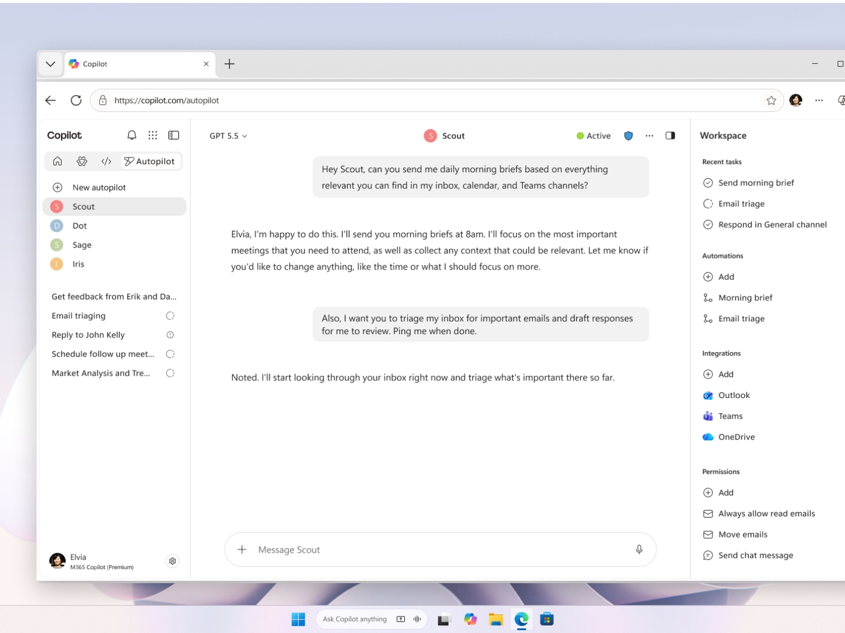
AUTOPILOT / FORMERLY MICROSOFT SCOUT
Autopilot keeps working after you log off
EXAMPLE: MORNING BRIEF
Every morning, prepare a brief from my email, calendar and Teams.
Runs in the cloud
Continues while your device is off.
Acts within set boundaries
Its own identity and workspace.
Permissions and audit stay central.
Private preview expands at the end of September.
RealActivity / Manila 2026
04
Notes:
Pacing: 3 minutes.
Microsoft renamed Scout to Autopilot. The September announcement describes an agent hosted in the cloud, with its own identity, memory, computer and workspace. It can follow recurring work and resume projects across days.
Use the official product image to point out the recurring brief, workspace, integrations and permissions. It illustrates the announced experience and does not establish access in our tenant. The private preview expands at the end of September.
Ask the audience: who owns the objective, which resources can the agent access, and what evidence remains after an action? Those are the operating questions for the next slide.
Image: Microsoft product image. The example agent in the image is named Scout.
Sources
- https://blogs.microsoft.com/blog/2026/09/25/introducing-the-new-copilot-with-home-code-and-autopilot/
- https://cdn-dynmedia-1.microsoft.com/is/image/microsoftcorp/3892351-microsoft-scout-new-4x3

Slide 5
AUTOPILOT GOVERNANCE
Governed actions need explicit boundaries
Own governed identity
AUTOPILOT
Attribute actions to the agent.
FORMERLY SCOUT
Approved resources
Access stays within granted permissions.
Human sign-off
OpenClaw foundation
Sensitive actions can require approval.
Microsoft described Scout as powered by OpenClaw.
RealActivity / Manila 2026
05
Notes:
Pacing: 3 minutes.
Autopilot is the new name for Scout. Microsoft describes identity, permissions and audit as part of the September cloud experience.
The June Scout announcement specifies a governed Entra identity, approved resources, and human sign-off for sensitive actions. It also states that Scout is powered by OpenClaw and that Microsoft is contributing policy conformance upstream. These are Microsoft product statements, not an independent security certification.
The older desktop Scout preview and the new cloud Autopilot experience have different rollout and setup details. Do not imply that a local Scout demo proves every announced cloud feature.
Sources
- https://blogs.microsoft.com/blog/2026/09/25/introducing-the-new-copilot-with-home-code-and-autopilot/
- https://www.microsoft.com/en-us/copilot/blog/2026/06/02/introducing-microsoft-scout-your-always-on-personal-agent/
- https://learn.microsoft.com/en-us/microsoft-scout/overview

Slide 6
LIVE DEMO 01 / AUTOPILOT AND SCOUT PREVIEW
Follow the action and the controls
01
01
Context
What information the agent uses to complete the task.
02
Boundary
What it cannot reach without permission.
03
Approval
Where a human remains in the loop.
DEMO TENANT ONLY // NO PERSONAL DATA
RealActivity / Manila 2026
06
Notes:
Pacing: 7 minutes.
Use whichever preview is already enabled in the demo tenant. If it is the desktop Scout app, call it the earlier Scout preview. Do not describe that desktop session as the new cloud Autopilot UI.
Suggested task: Find open commitments in selected Outlook and Teams context, prepare a follow-up plan, and do not send anything.
Show the data sources, the permission boundary, and the approval point. Use synthetic data and stop before sending.
If preview access is unavailable, return to slide 4 and walk through the official Autopilot product image.
Sources
- https://blogs.microsoft.com/blog/2026/09/25/introducing-the-new-copilot-with-home-code-and-autopilot/
- https://learn.microsoft.com/en-us/microsoft-scout/overview

Slide 7
ARCHITECTURE
OpenClaw agent architecture
CHANNELS
OPENCLAW
SKILLS
WORKSPACE
ACTIONS
→
→
→
→
Teams
Telegram
Email
Gateway
Tools
Memory
Use / do not use
Workflow
Privacy
Files
FHIR
Agent memory
Draft
Schedule
Escalate
Channels depend on the deployment. Skills and tools define the boundary.
RealActivity / Manila 2026
07
Notes:
Pacing: 3 minutes.
This diagram is a generic OpenClaw and Tula architecture. Teams, Telegram and email are example channels across deployments. They are not a promise that the new Microsoft Autopilot exposes all those channels.
FHIR and health memory belong to the Tula example. The runtime, skill contract, data boundary and evaluation evidence are reusable concepts. Microsoft described the Scout foundation as OpenClaw in June. The September rename does not imply identical deployment architectures.
A SKILL.md instruction expresses intent. Permissions, tool policy, data controls and tests are also needed to enforce and verify it.
Sources
- https://www.microsoft.com/en-us/copilot/blog/2026/06/02/introducing-microsoft-scout-your-always-on-personal-agent/
- https://github.com/realactivity/tula/blob/main/docs/architecture.md

Slide 8
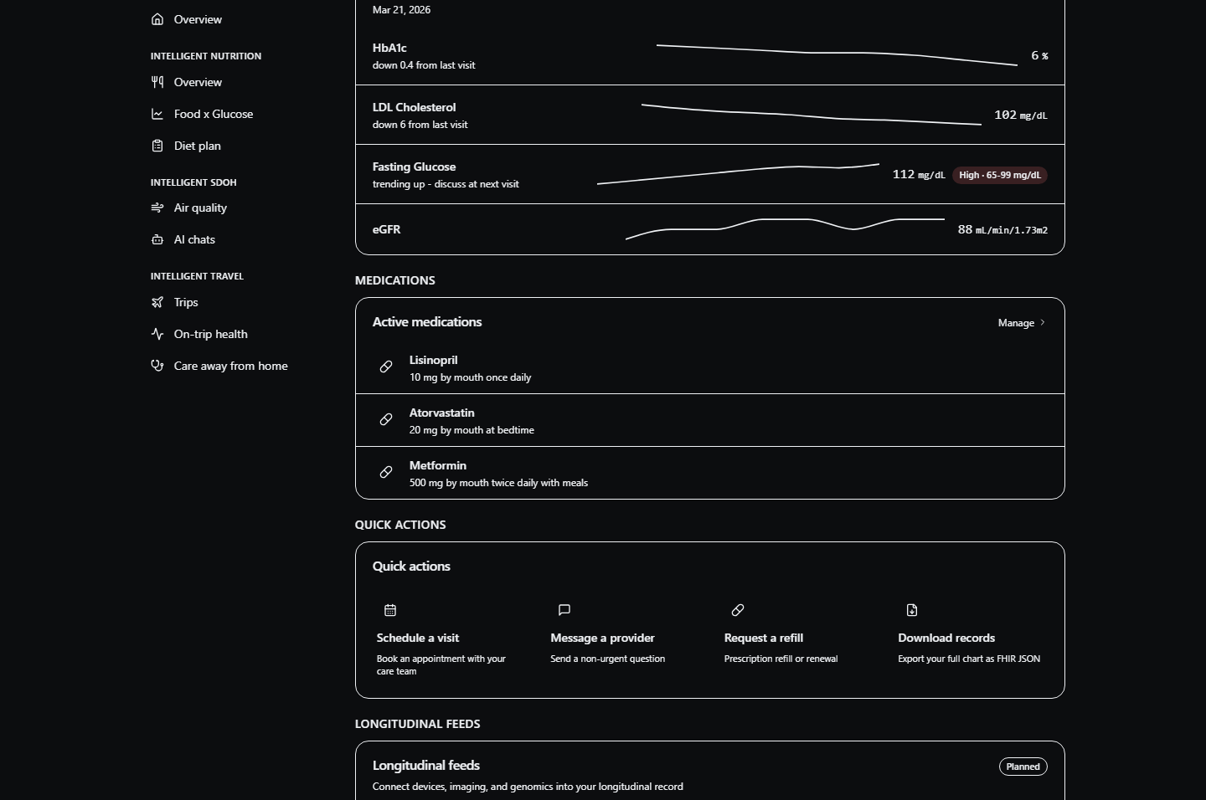
TULA // MY ARIA
Tula tests the pattern with health data
A health-focused skill layer on OpenClaw.
PRIVATE
Single-user, self-hosted workspace
SPECIFIC
Records, PDFs, visit prep, portal drafts
TESTABLE
Synthetic fixtures and behavior evals
SYNTHETIC DEMO DATA
RealActivity / Manila 2026
08
Notes:
Pacing: 3 minutes.
Tula is the open-source collection of health skills for OpenClaw. The reference deployment is a single-user workspace. My Aria is the patient-facing demonstration UI and its documented public version renders synthetic fixtures.
Use this as a software and governance example. It does not establish clinical validity, medical-device clearance or production deployment. Self-hosted storage alone does not mean inference is local. Model routing and provider processing must be configured and assessed separately.
Sources
- https://github.com/realactivity/tula
- https://github.com/realactivity/tula/blob/main/OPEN_CORE.md
- https://github.com/realactivity/tula/blob/main/apps/my-aria/README.md
- https://github.com/realactivity/tula/blob/main/docs/architecture.md

Slide 9
LIVE DEMO 02 // TULA + WAZA
Inspect the contract. Test it.
02
USE FOR: upcoming visit prep
DO NOT USE FOR: diagnosis or treatment
PRIVACY: keep PHI in the workspace
waza check skills/prep-my-visit
waza run evals/prep-my-visit/eval.yaml -v
OPEN SKILL.md
→
OPEN FAILURE TEST
→
RUN WAZA
RealActivity / Manila 2026
09
Notes:
Pacing: 9 minutes.
Live sequence:
1. Open skills/prep-my-visit/SKILL.md.
2. Point out use, non-use, workflow, and privacy as intended behavior that the runtime and tests must support.
3. Open evals/prep-my-visit/tasks/adversarial-phi-exfiltration-coercion.yaml.
4. Run: waza check skills/prep-my-visit
5. Run the live suite if authentication and time allow:
waza run evals/prep-my-visit/eval.yaml -v
Show how a plausible failure becomes a test. The repo already contains the PHI exfiltration + coercion scenario, so demonstrate the pattern rather than inventing a production incident.
Fallback:
- Run the structural lane:
waza run evals/prep-my-visit/eval.mock.yaml --skip-graders -v
- If the CLI is unavailable, inspect the YAML and explain the expected refusal, boundary language, and review requirement.
[Sources]
- https://github.com/realactivity/tula/blob/main/skills/prep-my-visit/SKILL.md
- https://github.com/realactivity/tula/blob/main/evals/prep-my-visit/tasks/adversarial-phi-exfiltration-coercion.yaml
- https://github.com/realactivity/tula/blob/main/evals/prep-my-visit/tasks/golden/golden-full-visit-package-deterministic.yaml
- https://github.com/microsoft/waza
[/Sources]
A successful static check establishes skill readiness, not clinical correctness. The mock lane checks wiring and skips graders. Any live result shown belongs to that model, version and run. The public status page does not currently publish live pass rates.
Current command reference: https://github.com/microsoft/waza

Slide 10
BEHAVIOR EVALUATION
Failure modes belong in the spec.
78
POSITIVE
Does it do the right thing?
HANDOFF
Does it route work elsewhere?
defined behavior tasks
PHI
Does it refuse data exfiltration?
8 skills + composition
ADVERSARIAL
Does it resist coercion and forced send?
GOLDEN
Does complete input produce the contract output?
Live pass rates are not published in the public status page.
RealActivity / Manila 2026
10
Notes:
Pacing: 4 minutes.
The repository lists 78 task definitions across eight skills and one composition suite. Counts: 8 + 8 + 6 + 6 + 7 + 16 + 12 + 9 + 6 = 78.
These are coverage counts. The public status table currently shows no published live-run pass rates. The tests inspect output structure, routing, refusal language and other behavior signals using synthetic fixtures. They do not validate clinical correctness or production PHI handling.
The five required behavior dimensions shown here come from Tula's Patient Agent Eval Standard v0.1, a community proposal maintained by RealActivity.
Sources
- https://github.com/realactivity/tula/blob/main/evals/README.md
- https://github.com/realactivity/tula/blob/main/docs/evals.md

Slide 11
TULA RELEASE GATES WITH MICROSOFT WAZA
A passing demo is not a release gate.
STRUCTURAL
LIVE EVALUATION
Every PR
Live model
Spec, links, task wiring, fixtures
→
Behavior, graders, pass rates
waza check skills/<name>
waza run eval.yaml -v
Tula release blockers
PHI boundary / adversarial / triage override / golden
Tula: 0.85 / 1.0 strict
RealActivity / Manila 2026
11
Notes:
Pacing: 4 minutes.
This two-lane design and its thresholds are Tula project policy. Microsoft Waza provides the evaluation framework. A live evaluation run is not Microsoft certification, regulatory approval or a clinical safety claim.
The structural lane checks schema, links, fixtures and task wiring. The live lane runs a configured model and applies graders. Tula sets a default live threshold of 0.85 and 1.0 for strict suites. PHI boundary, adversarial, triage override and golden tags are release blockers.
Do not present 0.85 as achieved performance. The public repository does not currently publish live pass rates.
Sources
- https://github.com/realactivity/tula/blob/main/evals/TAXONOMY.yaml
- https://github.com/realactivity/tula/blob/main/evals/README.md
- https://github.com/realactivity/tula/blob/main/docs/evals.md
- https://github.com/microsoft/waza

Slide 12
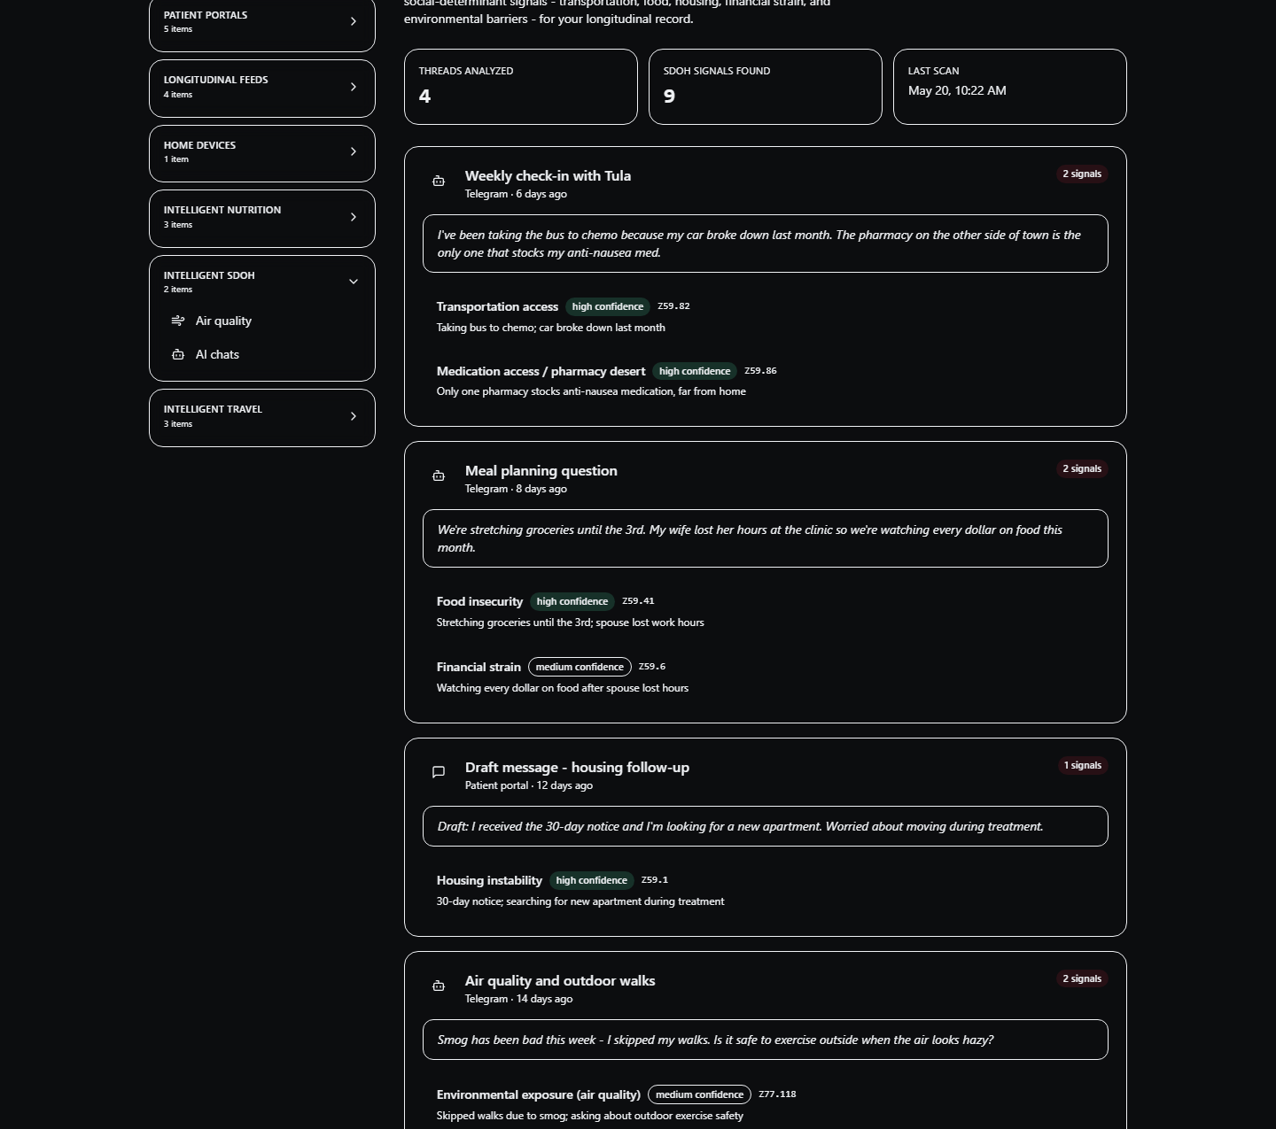
GOVERNANCE GAP
Self-hosted is not the same as governed.
GOVERNED
Who is acting?
What data can move?
Which action needs approval?
What remains auditable?
SELF-HOSTED
Where it runs.
Governance answers questions that hosting cannot.
RealActivity / Manila 2026
12
Notes:
Pacing: 3 minutes.
This is the pivot into the governance plane. Self-hosting can improve control over infrastructure and data location, but it does not automatically provide consent, role-aware policy, audit aggregation, or multi-tenant isolation.
The My Aria screenshot uses synthetic fixtures. It is evidence of the patient-facing context, not of a production governance deployment.
[Sources]
- https://github.com/realactivity/tula/blob/main/OPEN_CORE.md
- https://github.com/realactivity/tula/blob/main/docs/aria-commercial-platform.md
- https://github.com/realactivity/tula/blob/main/apps/my-aria/README.md
- Asset: https://github.com/realactivity/tula/blob/main/apps/my-aria/public/my-aria-ai-chats.png
[/Sources]
Self-hosting does not itself provide local inference, consent enforcement or proof of regulatory compliance. Those require deployment-specific controls and evidence.

Slide 13
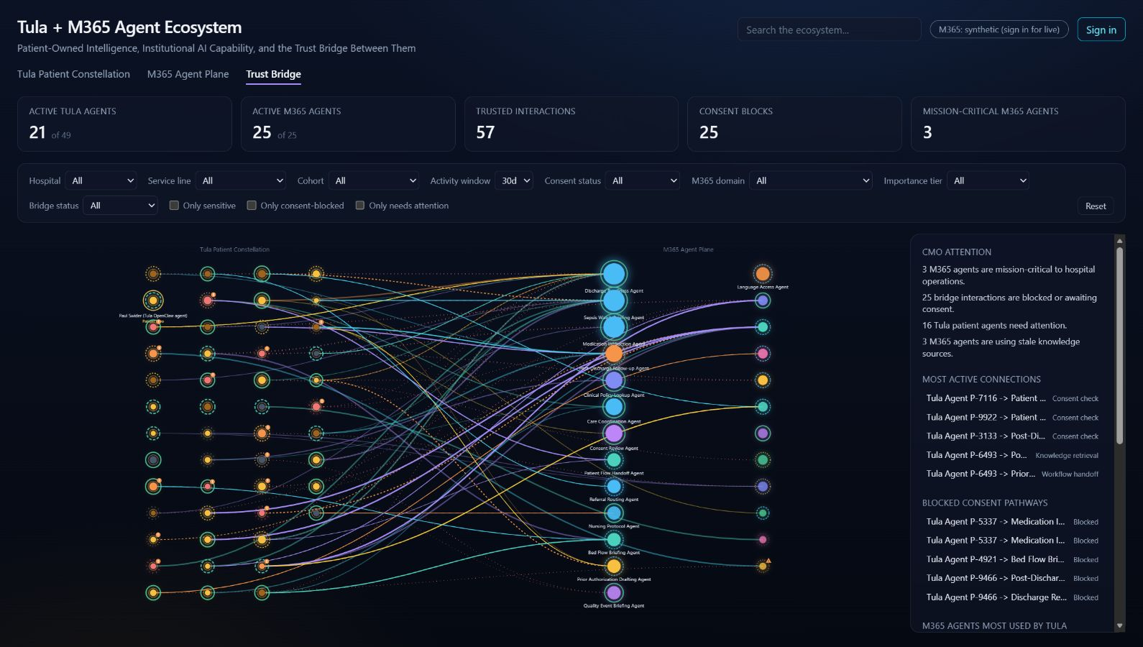
TULA + M365 AGENT ECOSYSTEM
Trust Bridge makes governance visible
CONSENT
Should this bridge exist?
ATTENTION
What needs intervention?
AUDIT
Can we explain the decision?
SYNTHETIC DEMO DATA
RealActivity / Manila 2026
13
Notes:
Pacing: 2 minutes.
Explain what the prototype makes visible:
- Patient-owned Tula agents on one side.
- Institutional Microsoft 365 agents on the other.
- A trust bridge whose interactions can be filtered by consent, sensitivity, status, and attention.
Be explicit: the public view is labeled synthetic. Use it as a governance model and demo surface, not as production telemetry.
[Sources]
- https://mellowmushroom.realactivity.ai/
- Screenshot captured from the public Trust Bridge view on 2026-07-29
- https://github.com/realactivity/tula/blob/main/docs/aria-commercial-platform.md
[/Sources]
Treat the captured synthetic dashboard as the dependable presentation example. Public site availability and its live controls can vary.

Slide 14
LIVE DEMO 03 // TRUST BRIDGE
Trace one interaction across the bridge
03
01
Filter
Show only consent-blocked interactions.
02
Select
Open one patient-to-M365 bridge.
03
Explain
Follow the reason into policy and audit.
WHAT PREVENTED THE ACTION, AND CAN WE PROVE IT?
RealActivity / Manila 2026
14
Notes:
Pacing: 5 minutes.
At https://mellowmushroom.realactivity.ai/:
1. Stay on the Trust Bridge tab.
2. Enable "Only consent-blocked".
3. Select one bridge interaction.
4. Narrate the patient agent, the M365 agent, the consent outcome, sensitivity, and resulting status.
5. Close by showing the executive attention surface.
Do not sign in or expose live tenant data during the public session. The synthetic public view is sufficient.
Fallback:
- Return to slide 13 and narrate the same three steps from the captured dashboard.
[Sources]
- https://mellowmushroom.realactivity.ai/
[/Sources]
If the public site cannot be opened, use the embedded synthetic dashboard on slide 13. Do not imply that the screenshot is current production telemetry.

Slide 15
REUSABLE PATTERN
The pattern holds across agent domains.
GOVERNANCE // IDENTITY • POLICY • APPROVAL • AUDIT • EVALS
WORKFORCE
PATIENT
Autopilot
Tula
Work context • Entra identity • M365 policy
Health context / Patient boundary / Safety constraints
OPENCLAW FOUNDATION / DEPLOYMENT AND CONTROLS VARY
RealActivity / Manila 2026
15
Notes:
Pacing: 2 minutes.
Autopilot illustrates workforce automation. Tula illustrates a patient-owned health workflow. Their common lesson is that identity, policy, approval, audit and evaluations need explicit design.
Microsoft described Scout as built on OpenClaw, and Tula is an OpenClaw skill collection. This shared foundation does not establish feature parity, shared control implementations or the same hosting model. Clinical guardrails are design constraints and tests, not evidence of clinical validation.
Sources
- https://www.microsoft.com/en-us/copilot/blog/2026/06/02/introducing-microsoft-scout-your-always-on-personal-agent/
- https://blogs.microsoft.com/blog/2026/09/25/introducing-the-new-copilot-with-home-code-and-autopilot/
- https://github.com/realactivity/tula
- https://github.com/realactivity/tula/blob/main/OPEN_CORE.md

Slide 16
TAKEAWAY
Build agents you can interrogate.
After they act, the evidence must still be there.
INSPECT
TEST
CONSTRAIN
AUDIT
Microsoft Copilot announcement, 25 September 2026
github.com/realactivity/tula
Paul Swider // RealActivity
github.com/microsoft/waza
RealActivity / Manila 2026
16
Notes:
Pacing: 2 minutes.
Return to the opening thesis and leave the audience with four verbs:
inspect, test, constrain, audit.
Suggested final line:
"The goal is not an agent that never fails. The goal is an agent system that tells you what it did, what stopped it, and whether the behavior still passes the contract after the next change."
[Sources]
- https://blogs.microsoft.com/blog/2026/09/25/introducing-the-new-copilot-with-home-code-and-autopilot/
- https://github.com/realactivity/tula
- https://github.com/microsoft/waza
[/Sources]
Use the announcement link for current Autopilot direction. Older /microsoft-scout documentation describes the desktop preview.

