Slide 1

Raylib4Consoles
https://github.com/raylib4Consoles
ENTER

Slide 2



About me!
01
Before October 3th, 2022
02
Consulting and Technical Project Management
In my free time
Open source projects for PlayStation devices
Homebrew toolchains
Libraries
Emulators (Msx, Retroarch/libretro)
Drivers: EyeToy, ps4eye,PlayStation Camera…
Tools
Security Research and Reverse Engineering
03
04

Slide 3
About me!
01
After October 3th, 2022
02
The Game Kitchen
Publishing/Porting
Escape from Galaxen
AOB
Tormenture
Others under NDA
03
04

Slide 4
“No challenge, no fun”
—me
01
02
03
04

Slide 5
TABLE OF CONTENTS
01
Raylib
Raylib4Dreamcast
02
03
04
Raylib4Nintendo64
Raylib4PlayStation

Slide 6
“Kahoot quiz 1”
01
02
03
04

Slide 7
01.
Raylib
01
02
03
04

Slide 8
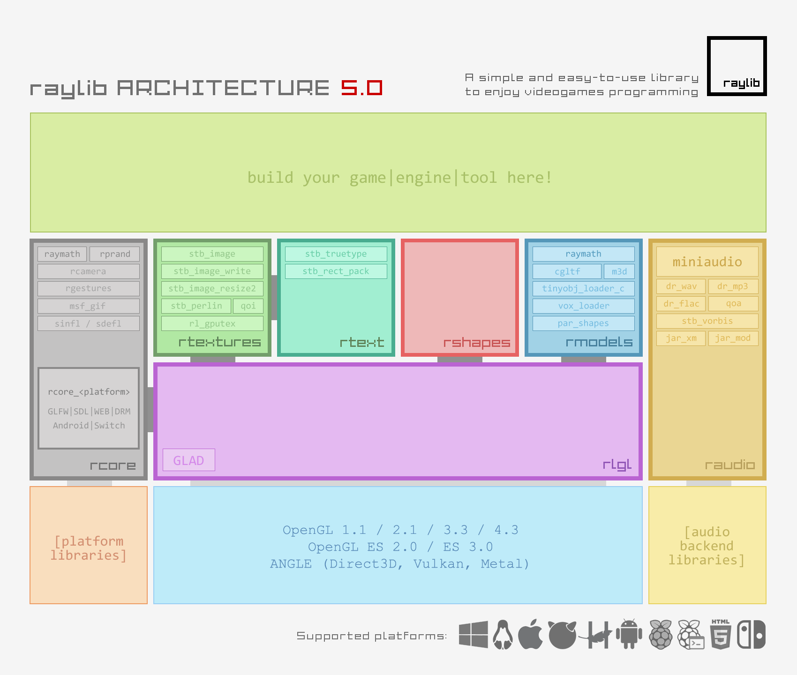
Raylib
https://raylib.com
https://raylib.com/examples
https://github.com/raysan5/raylib
01
02
03
04

Slide 9
Raylib
Recommended requirements for gl backend
Old devices: OpenGL 1.1
Modern devices and embed devices: OpenGL ES 2.0
01
02
03
04

Slide 10
“Kahoot quiz 2”
01
02
03
04

Slide 11
02.
Raylib4Dreamcast
01
02
03
04

Slide 12
Raylib4Dreamcast
https://github.com/raylib4Consoles
https://github.com/raylib4Consoles/raylib/tree/dreamcast
https://github.com/raylib4Consoles/raylib4Dreamcast
01
02
03
04
rcore_dreamcast
https://github.com/KallistiOS/KallistiOS

Slide 13
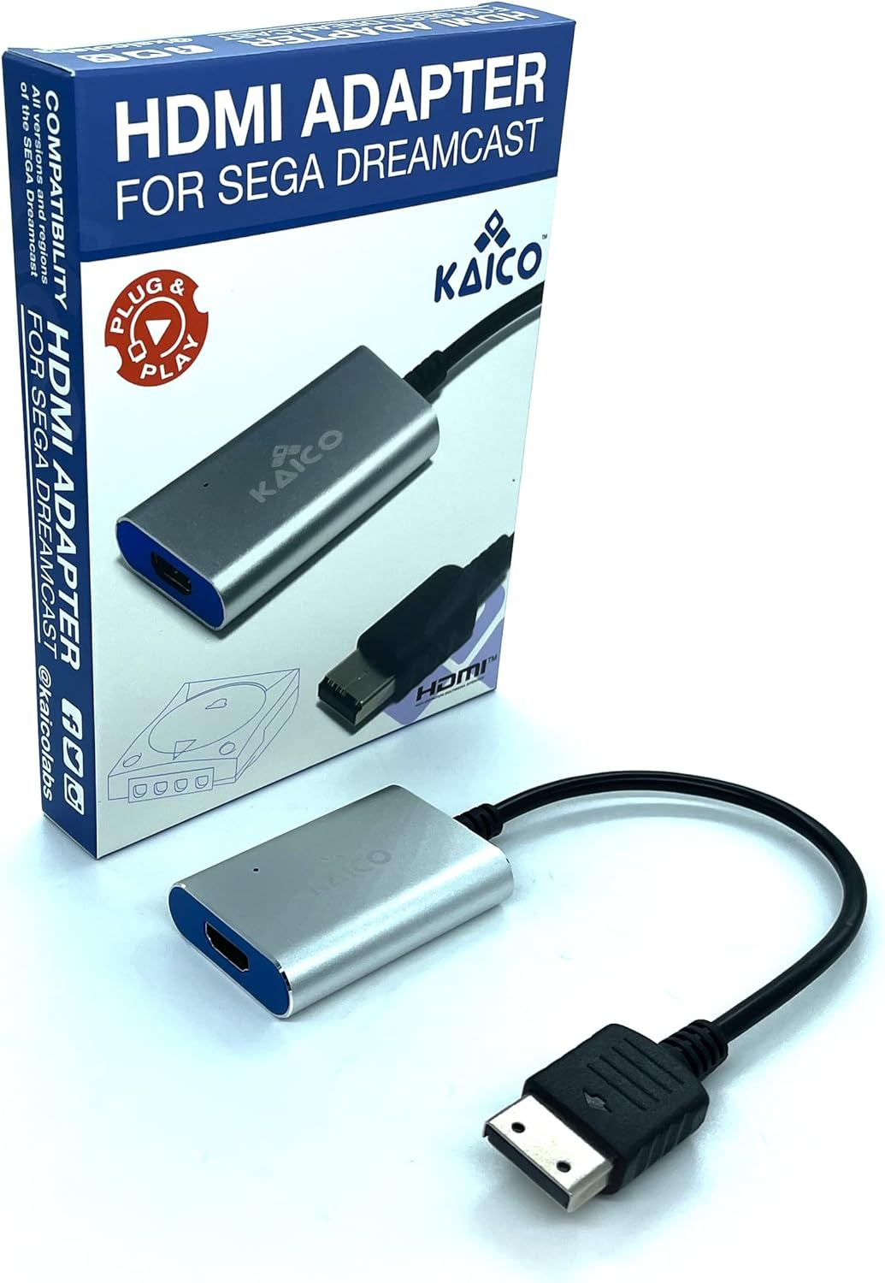
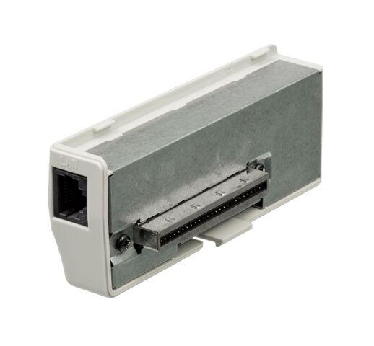
Raylib4Dreamcast
Peripherals
01
02
Broandband adapter let you upload code with ethernet connection using dcload-ip
Hdmi adapter to connect console to a hdmi capture device on development PC
03
04

Slide 14

Some Love for Dreamcast
01
cubicmap
logo_anim
spine
02
03
04

Slide 15
“Kahoot quiz 3”
01
02
03
04

Slide 16
03.
Raylib4Nintendo64
01
02
03
04

Slide 17
Raylib4Nintendo64
https://github.com/raylib4Consoles
https://github.com/raylib4Consoles/raylib/tree/dreamcast
https://github.com/raylib4Consoles/raylib4Nintendo64
01
02
03
04
rcore_nintendo64
libdragon

Slide 18
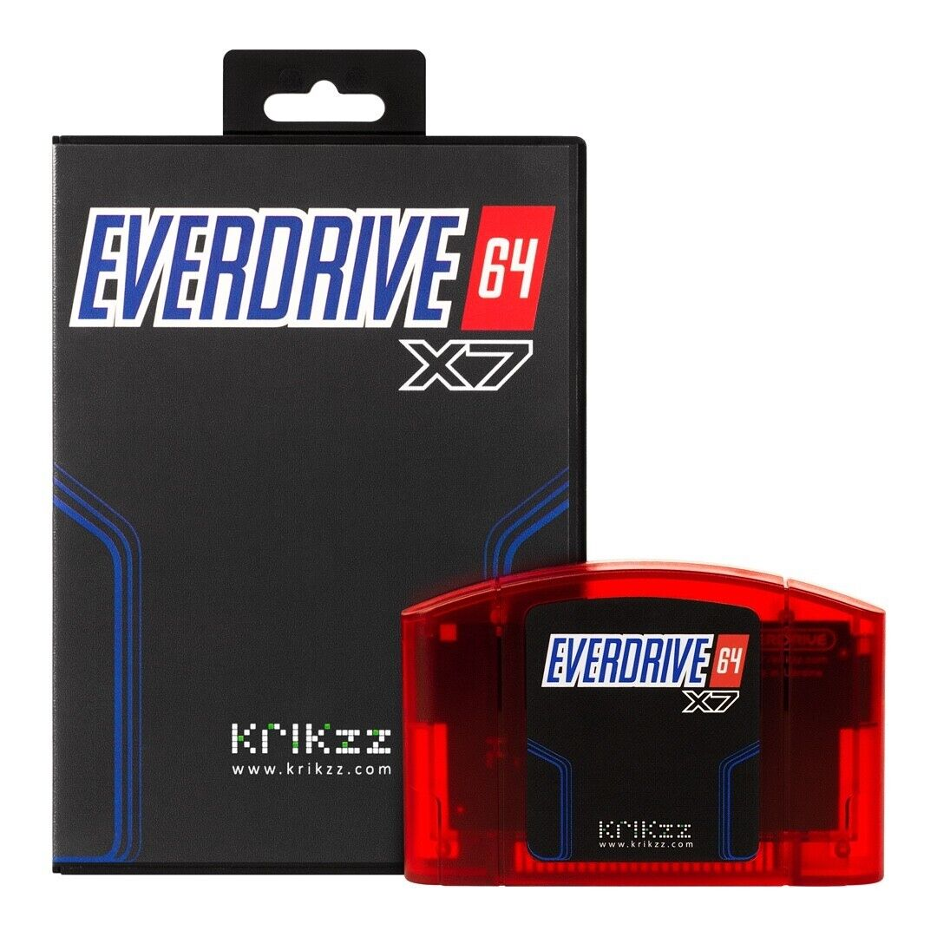
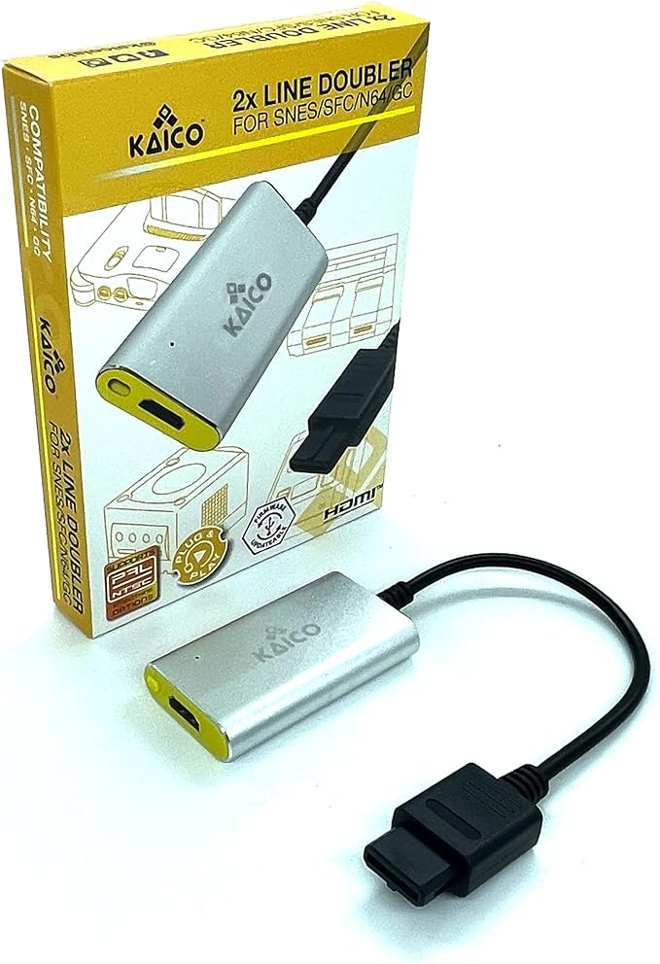
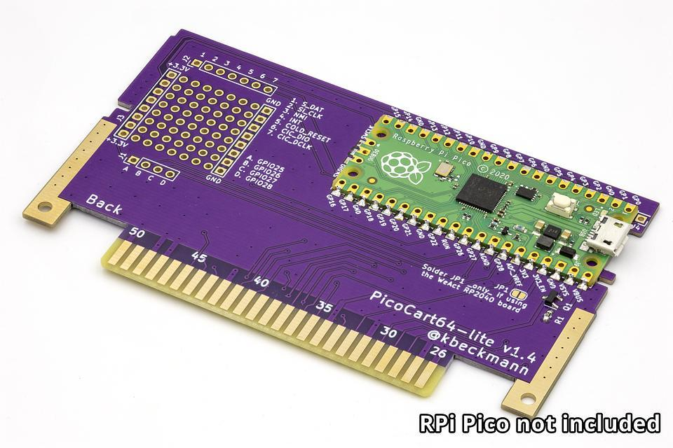
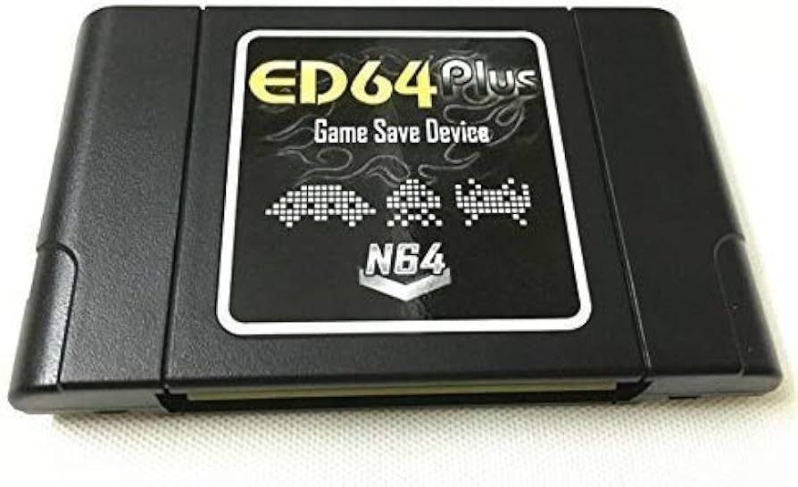
Raylib4Nintendo64
Peripherals
01
02
Different flash cartridges (everdrive64 best option to use with UNFLoader)
Hdmi adapter to connect console to a hdmi capture device on development PC
03
04

Slide 19
Some Love for Nintendo 64
01
logo_anim
collision_area
spine
02
03
04

Slide 20
04.
Raylib4PlayStation
01
02
03
04

Slide 21
Raylib4Nintendo64
https://github.com/raylib4PlayStation
01
02
03
04
rcore_vita rcore_orbis
orbisdev
vitasdk

Slide 22
THANKS!
01
02
Antonio José Ramos Márquez aka bigboss
@psxdev
03
04
Please keep this slide for attribution

