Slide 1

Basic Details of the Team and Problem Statement
Ministry/Organization Name/Student Innovation:
Government of Gujarat
PS Code: SIH 1363
Problem Statement Title: Self-Identifying the Mental Health Status and get guidance for support.
Team Name: PSYCHE SHIFTERS
Team Leader Name: Mr. Yash Mishra
Institute Code (AISHE): U-0841
Institute Name: Indian Institute of Information Technology, Nagpur
Theme Name: Fitness & Sports

Slide 2
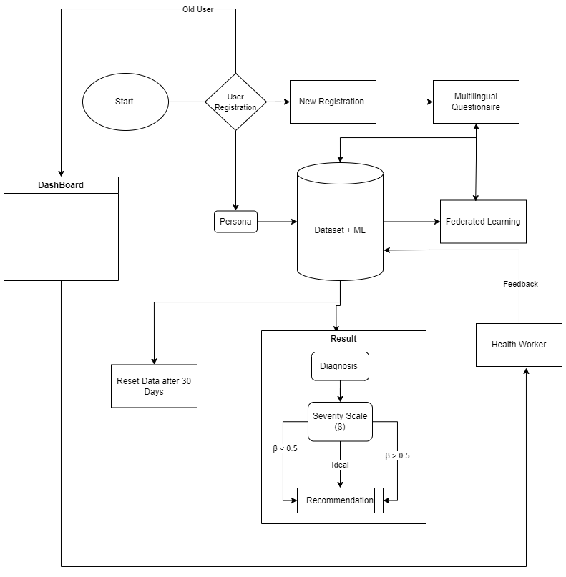
Idea/Approach Details
Idea / Prototype: Main idea is to improve overall well-being of individuals
and society. Some key ideas are:-
Current State of the Crisis:-
1. Increasing prevalence of conditions like depression, anxiety and stress.
The need for accessible and effective solutions:-
1. Stigma associated with seeking help
2. Lack of awareness about available resources.
Our Innovative solution:-
1. PsyAlert - A personalised screening solution with an emphasis on data privacy.
2. A recommendation engine for emotional-well being using federated learning.
Technology stack to be used:
Frontend:- Dart, Figma
Backend:- Node.js, Postman, MongoDB, APIs
Algorithms:- ML Algorithms, Federated Learning

Slide 3
Idea/Approach Details
References:
Standout Features:
GAD -7: Government-Authorized Standard Health Assessment.
PFA: Alleviate stress and support recovery after trauma, disasters, emergencies, or personal crises.
PTSD: App for Veterans coping with post traumatic stress disorder.
Happify: Science-based activities and games to overcome negative thoughts.
Headspace: Simplifying meditation and mindfulness.
Daylio: Diary and mood-tracking app.
Talkspace: Confidential access to licensed therapist.
Hybrid Tool Development: Unites validated assessments for maximum accuracy.
Dynamic Learning: Continuously improves with user data.
Real-time Feedback: Instant insights into mental well-being.
Tailored Recommendations: Personalized guidance and resources.
Frontline Health Worker Support: Empowers healthcare professionals by providing dashboard like Power Bi.
Accessibility and User-friendliness: Inclusive design for all users.

Slide 4
Team Member Details
Team Leader Name: Mr. Yash Mishra
Branch (Btech/Mtech/PhD etc): Btech Stream (ECE, CSE etc): ECE Year (I,II,III,IV): IV
Team Member 1 Name: Mr. Sanil S. Sattarkar
Branch (Btech/Mtech/PhD etc): Btech Stream (ECE, CSE etc): ECE Year (I,II,III,IV): IV
Team Member 2 Name: Mr. Sunny R. Dubey
Branch (Btech/Mtech/PhD etc): Btech Stream (ECE, CSE etc): CSE Year (I,II,III,IV): IV
Team Member 3 Name: Mr. Richaansh Gour
Branch (Btech/Mtech/PhD etc): Btech Stream (ECE, CSE etc): ECE Year (I,II,III,IV): IV
Team Member 4 Name: Mr. Vipra Nagaich
Branch (Btech/Mtech/PhD etc): Btech Stream (ECE, CSE etc): ECE Year (I,II,III,IV): IV
Team Member 5 Name: Ms. Kashish Singh
Branch (Btech/Mtech/PhD etc): Btech Stream (ECE, CSE etc): ECE Year (I,II,III,IV): II
Team Mentor 1 Name: Dr. Nishat A. Ansari
Category (Academic/Industry): Academic Expertise (AI/ML/Blockchain etc): AI-ML Domain Experience (in years): 9
Team Mentor 2 Name: Dr. Mayur R. Parate
Category (Academic/Industry): Academic Expertise (AI/ML/Blockchain etc): ML Domain Experience (in years): 4

