Slide 1
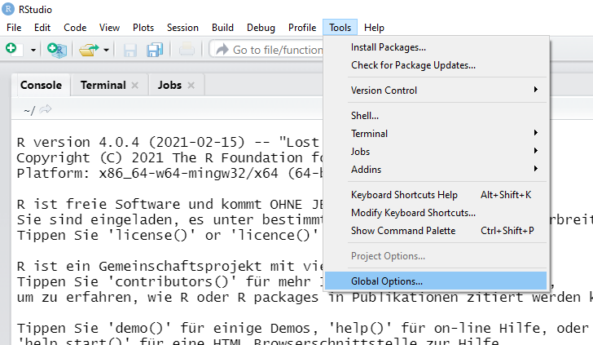
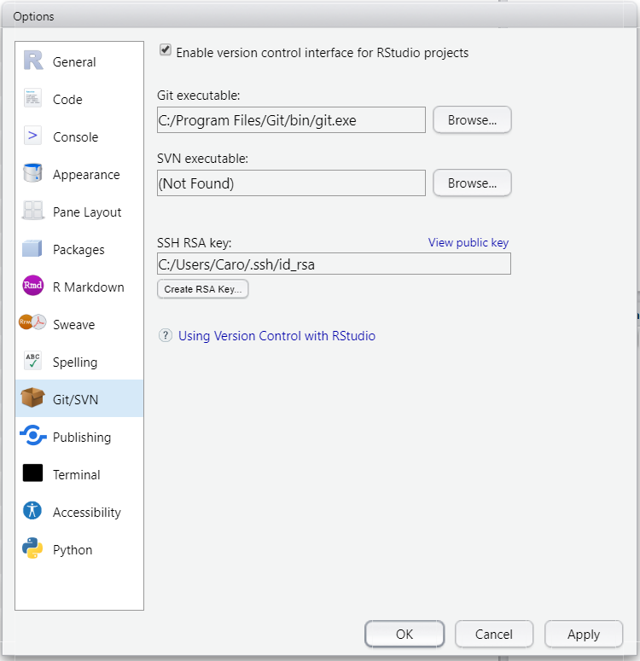
Live Demo – Connect Rstudio and Git (necessary only once)
1
4
5
! You have to install git first !
On mac: /usr/local/git/bin/git
2
We will need the SSH Key later…
This is like a password! Keep it safe!
6
3
7

Slide 2
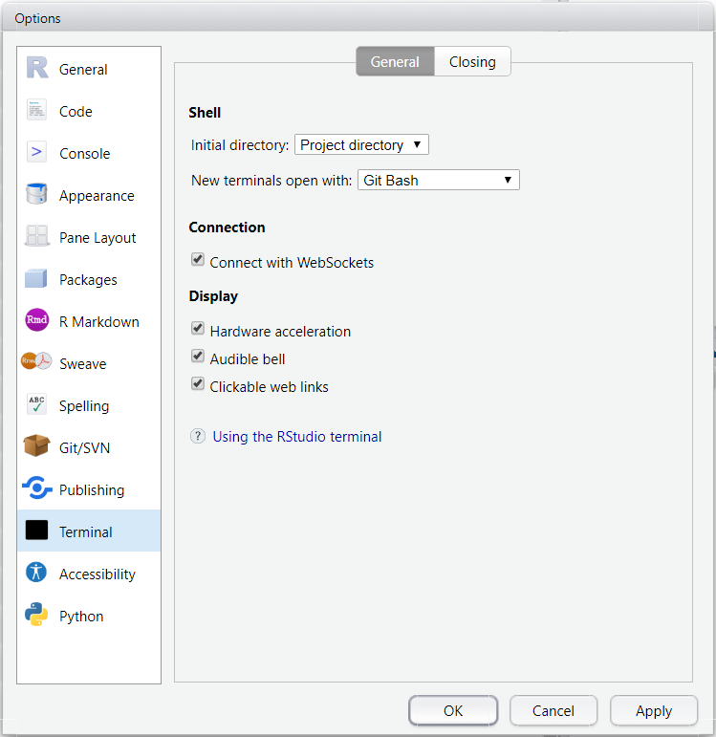
Live Demo
2
1

Slide 3
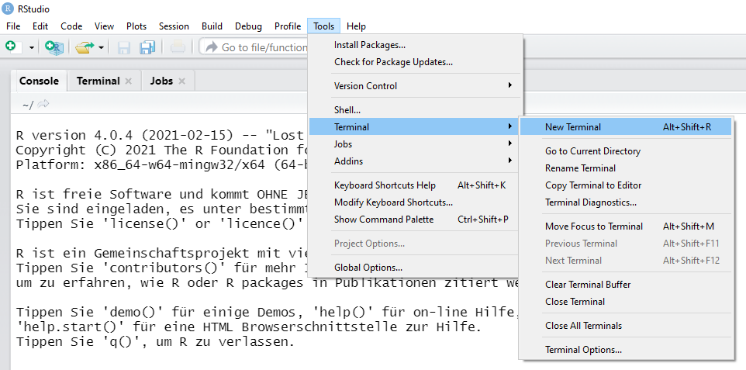
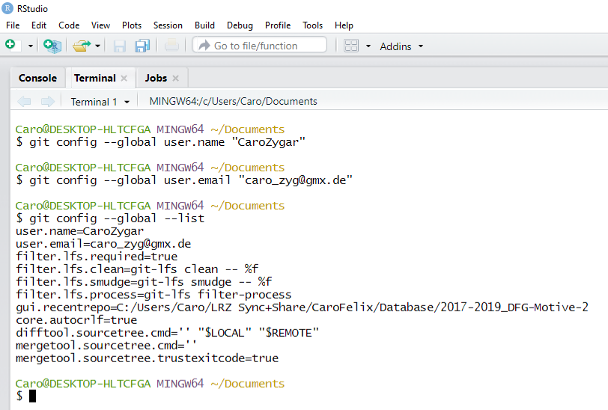
Live Demo – Initialize git (necessary only once)
1
2
3
4
5

Slide 4
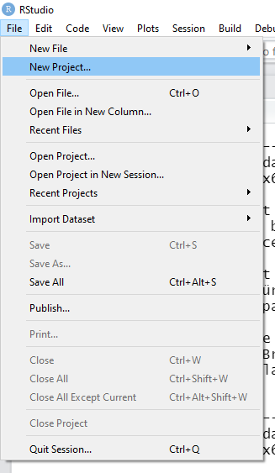
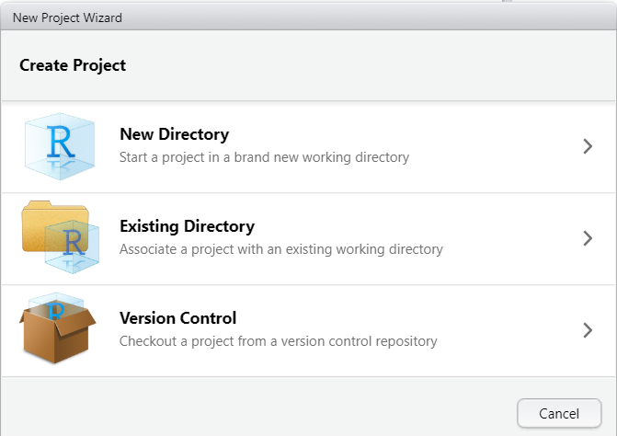
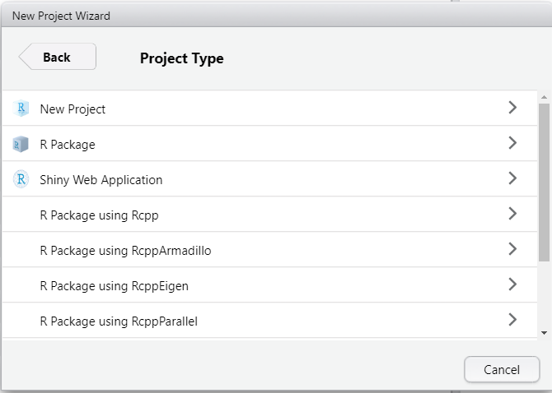
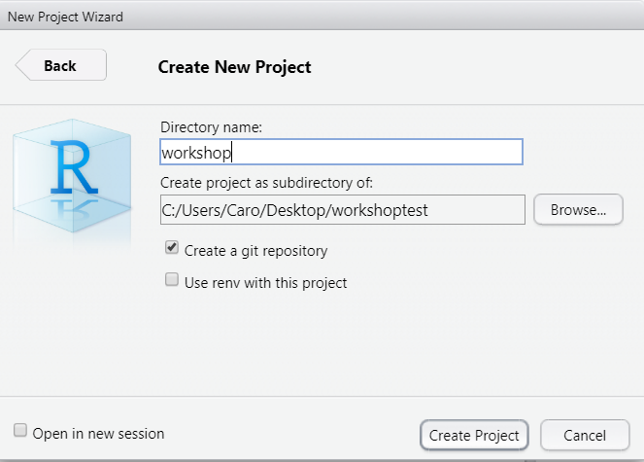
Irrespecitive of git: Using projects in R is useful, because your paths are relative to the project directory and you can re-open all associated R-scripts!
Live Demo – start a new project which includes git
1
2
3
This will be relevant later…
4
5
6
7
8

Slide 5
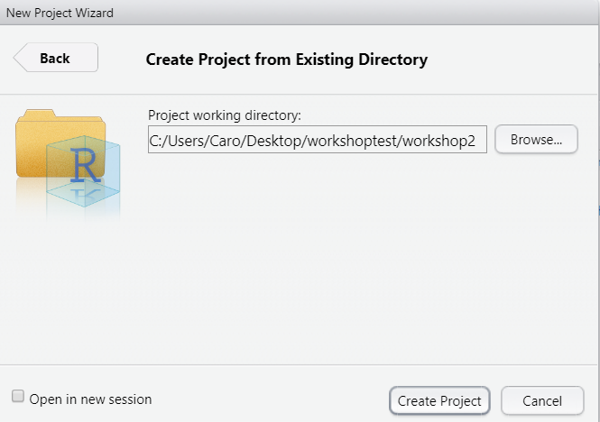
Live Demo – make an existing directory to a project which includes git (1)
1
2
3
4
5

Slide 6
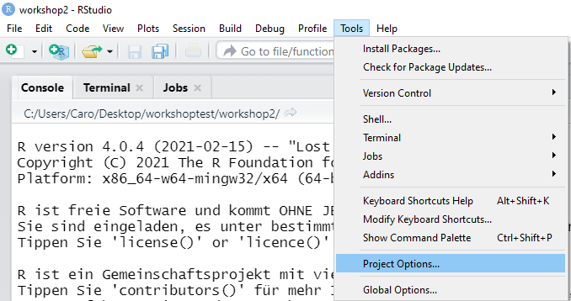
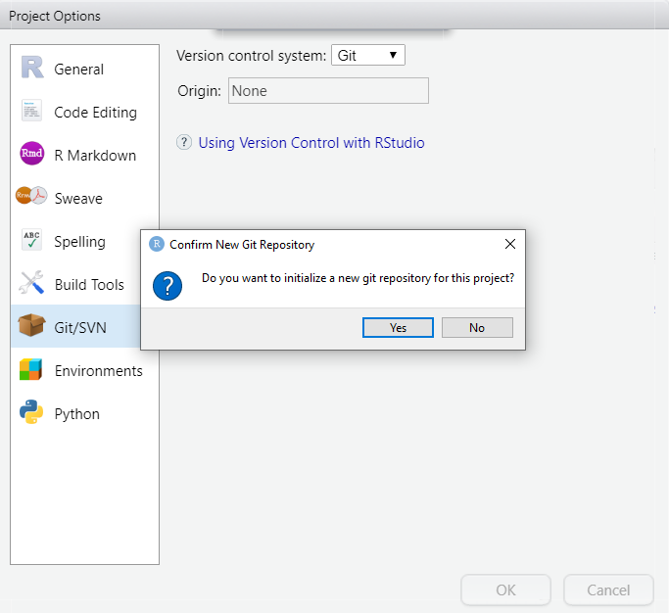
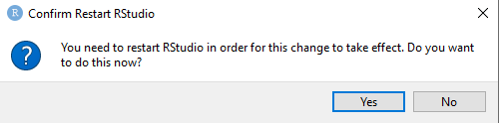
Live Demo – make an existing directory to a project which includes git (2)
1
4
2
3
5
6

Slide 7
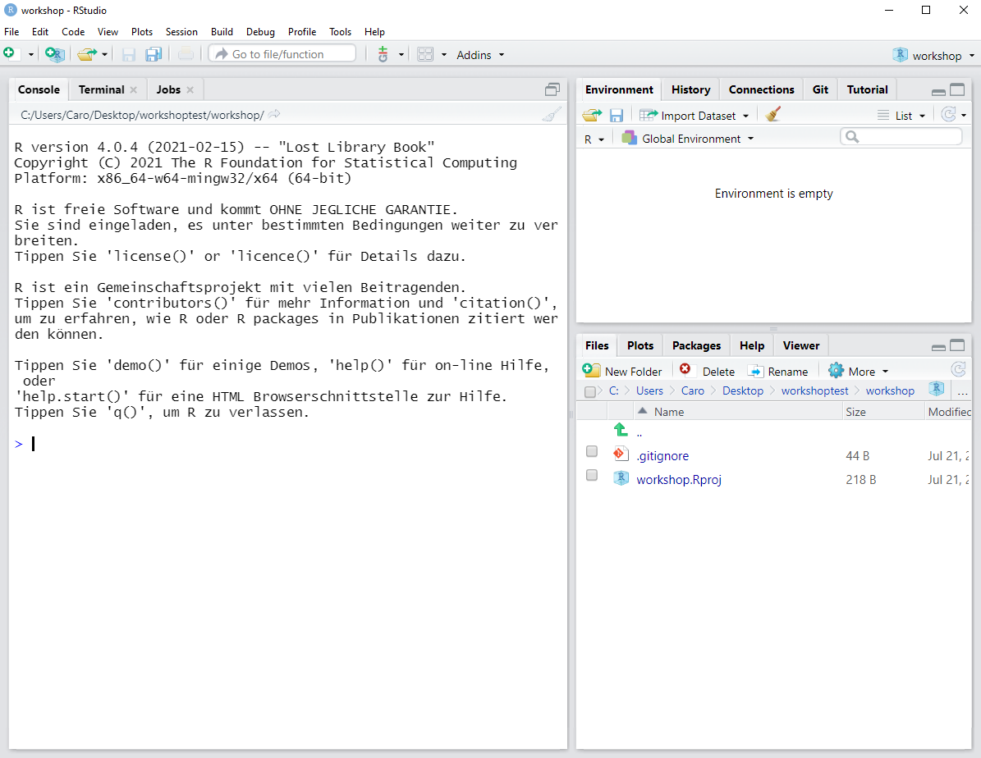
Live Demo – yay, we have a new project which includes git! :-)

Slide 8
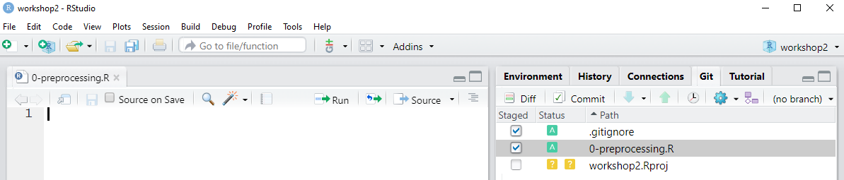
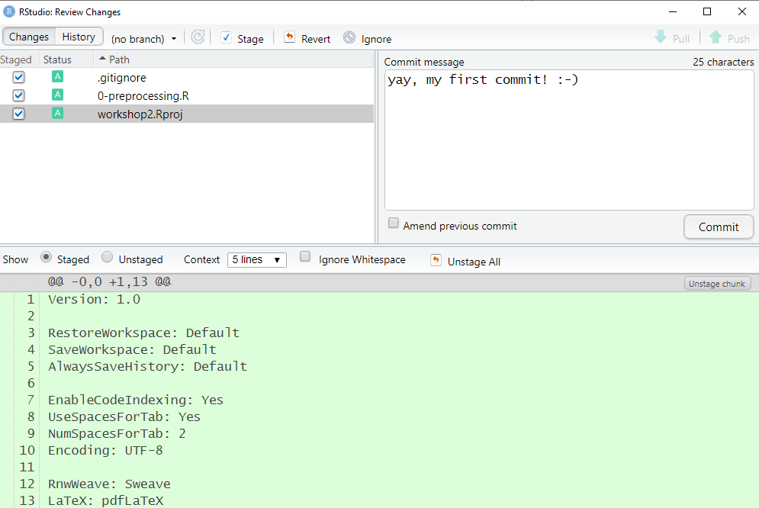
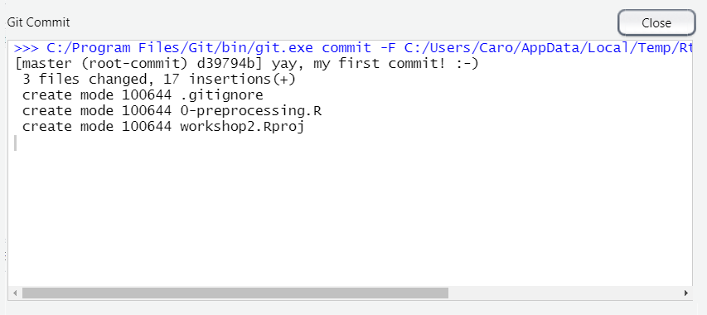
Live Demo – committing
2
1
4
3
7
5
6

Slide 9
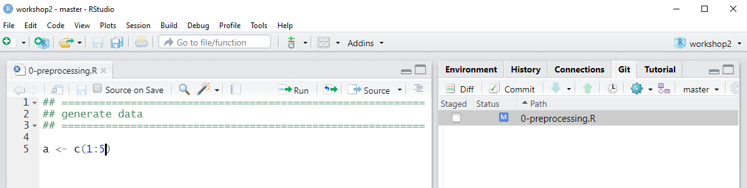
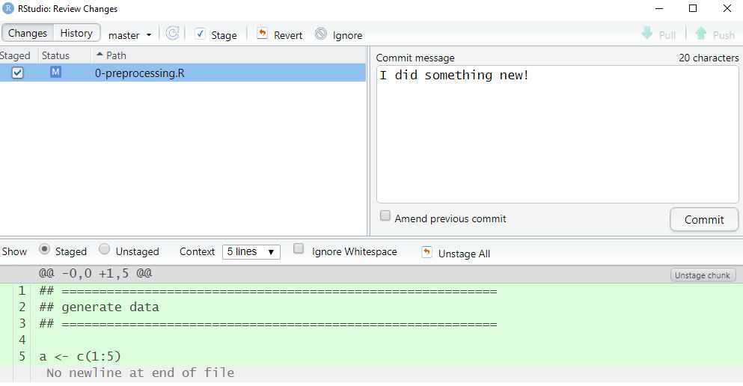
Live Demo – working in R with git
2
1
5
4
6
3

Slide 10
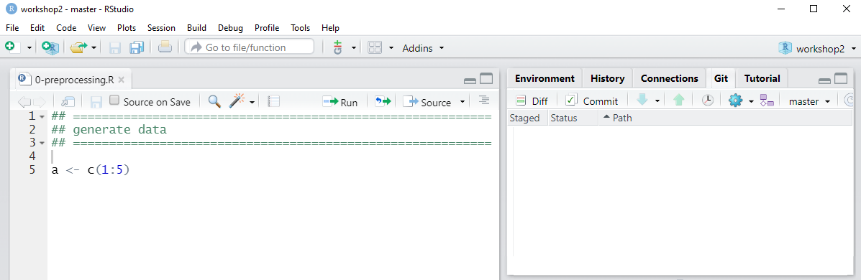
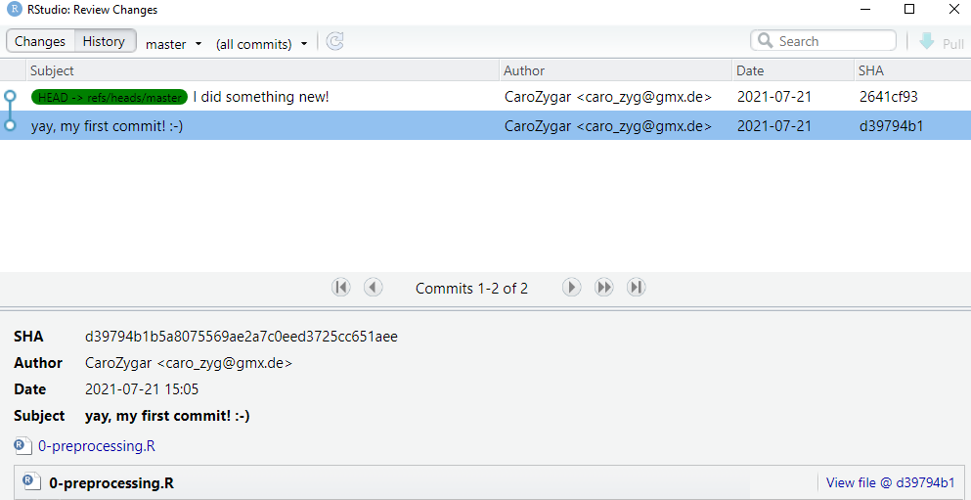
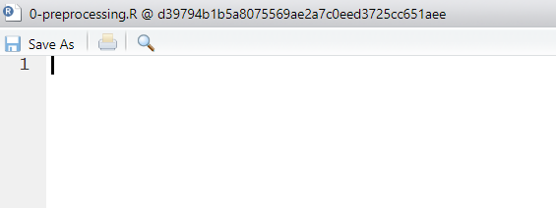
Live Demo – restore earlier versions (of files that can be opened in R)
1
2
4
3

Slide 11
Live Demo – restore earlier versions (of other files)
1
Im R Terminal:
git checkout [SHA-Key]
→ Der Stand des commits wird wiederhergestellt und kann kopiert (und wieder committet) werden
2
4
3

Slide 12
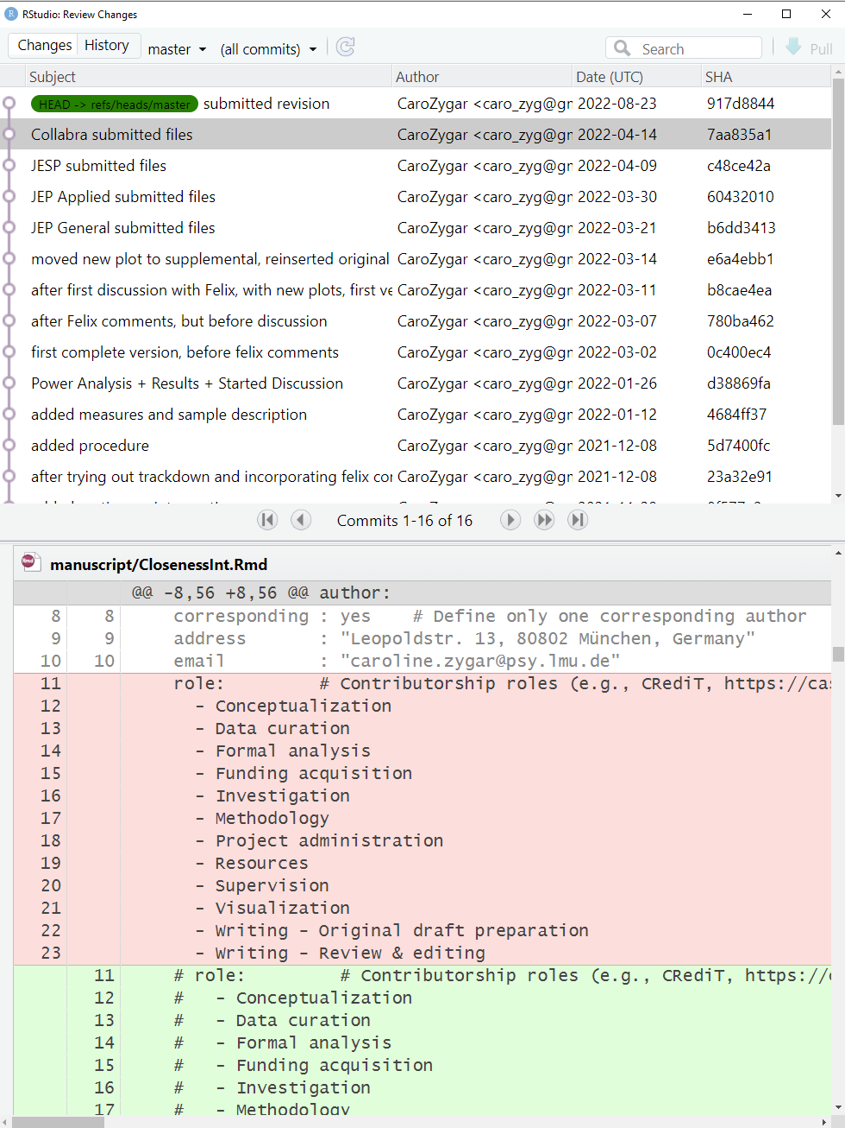
Live Demo – how I use git for papers

Slide 13
Hands-On
Tasks:
Get Git going in RStudio (incl. SSH and setting up name and email address)
Start a local project in R, give it a meaningful name, and activate git
Create two folders “raw_data” and “preprocessing” and make your first commit
Add the folder „raw_data“ to the .gitignore
Start a new r-script in the „preprocessing“-folder, load the packages „dplyr“ and „psych“ and save the script.
Make a new commit and describe it meaningfully
Change the r-script by replacing „dplyr“ with the „tidyverse“, by no longer loading „psych“ and by adding a line which says „a <- 4“
Make a new commit, and have a look at the diff
Revert the r-script bake to the second commit
Notes:
ab 11:00

Slide 14
Git Ressources / Tipps & Tricks
https://docs.google.com/document/d/1WvApy4ayQcZaLRpD6bvAqhWncUaPmmRimT016-PrLBk/edit
https://swcarpentry.github.io/git-novice/
https://happygitwithr.com/
https://guides.github.com/activities/hello-world/
https://ohshitgit.com/
https://twitter.com/aosmith16/status/1382424048857014272?s=09
Rmarkdown + Git:
https://resulumit.com/blog/rmd-workshop/
https://twitter.com/ed_hagen/status/1381746314019414020?s=09

