Slide 1
This study has four tasks.
For each task, you will be looking at one group of pictures.
Some pictures repeat, some pictures do not.
You can look at each picture for as long as you want.

Slide 2

When you are done looking at one picture, pressing the “down” arrow on your keyboard to go to the next one.

Slide 3
Each task will have one target picture. The target picture serves as sequence marker to help you keep track of where you are in this task.

Slide 4
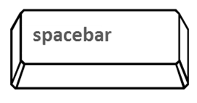
When you see the target picture,
make sure to press the space bar on your keyboard.
If you respond correctly, you will see the picture frame flashing red.

Slide 5
Like other non-target pictures, you need to press the “down” arrow on your keyboard to go to the next one.

Slide 6
You will be prompted about the target picture in the group before starting each task.
The target picture will appear multiple times. Make sure to respond to the target every time you see it.

Slide 7
In the breaks between the parts of the experiment, you can feel free to take a short break.

Slide 8
This study is not about memory. We will not test your memory afterward. Just spend as long as you want on each picture.
People spend 20 minutes on average to finish the study.

Slide 9
Before getting started, we will have a practice phase to familiarize you with the task.

