Slide 1
REPRODUCTION PROJECT · DIFFUSION NEUROIMAGING
Does brain wiring track
how severe OCD is?
Re-testing a landmark ENIGMA-OCD diffusion-MRI finding in a new sample of adults with OCD
Source: Piras et al. (2021), Translational Psychiatry

Slide 2
THE QUESTION
Can Diffusion Neuroimaging show how severe a participant’s OCD is?
Obsessive–compulsive disorder is linked to differences in the brain's wiring. The project asked a simple question: do those wiring differences get bigger as symptoms get worse?
OCD
The wiring (DTI)
Severity (Y-BOCS-II)
A condition of intrusive thoughts (obsessions) and repetitive behaviours (compulsions).
Diffusion MRI that measures the quality of the brain's white-matter cabling.
A standard clinician score of how severe a person's symptoms are.
Reproduction Project Test: Do Baseline dMRI DTI metrics predicts Y-BOCS-II Scores?

Slide 3
THE ORIGINAL FINDING
ENIGMA-OCD (Multisite- International Study)
The ENIGMA-OCD consortium pooled brain scans from across the world. It found subtle wiring differences in OCD, but those differences did NOT grow with symptom severity.
1,345
19
No link
adults scanned
research sites
to symptom severity
Source: Piras et al. (2021), ENIGMA OCD Working Group, Translational Psychiatry, 11, 173.

Slide 4
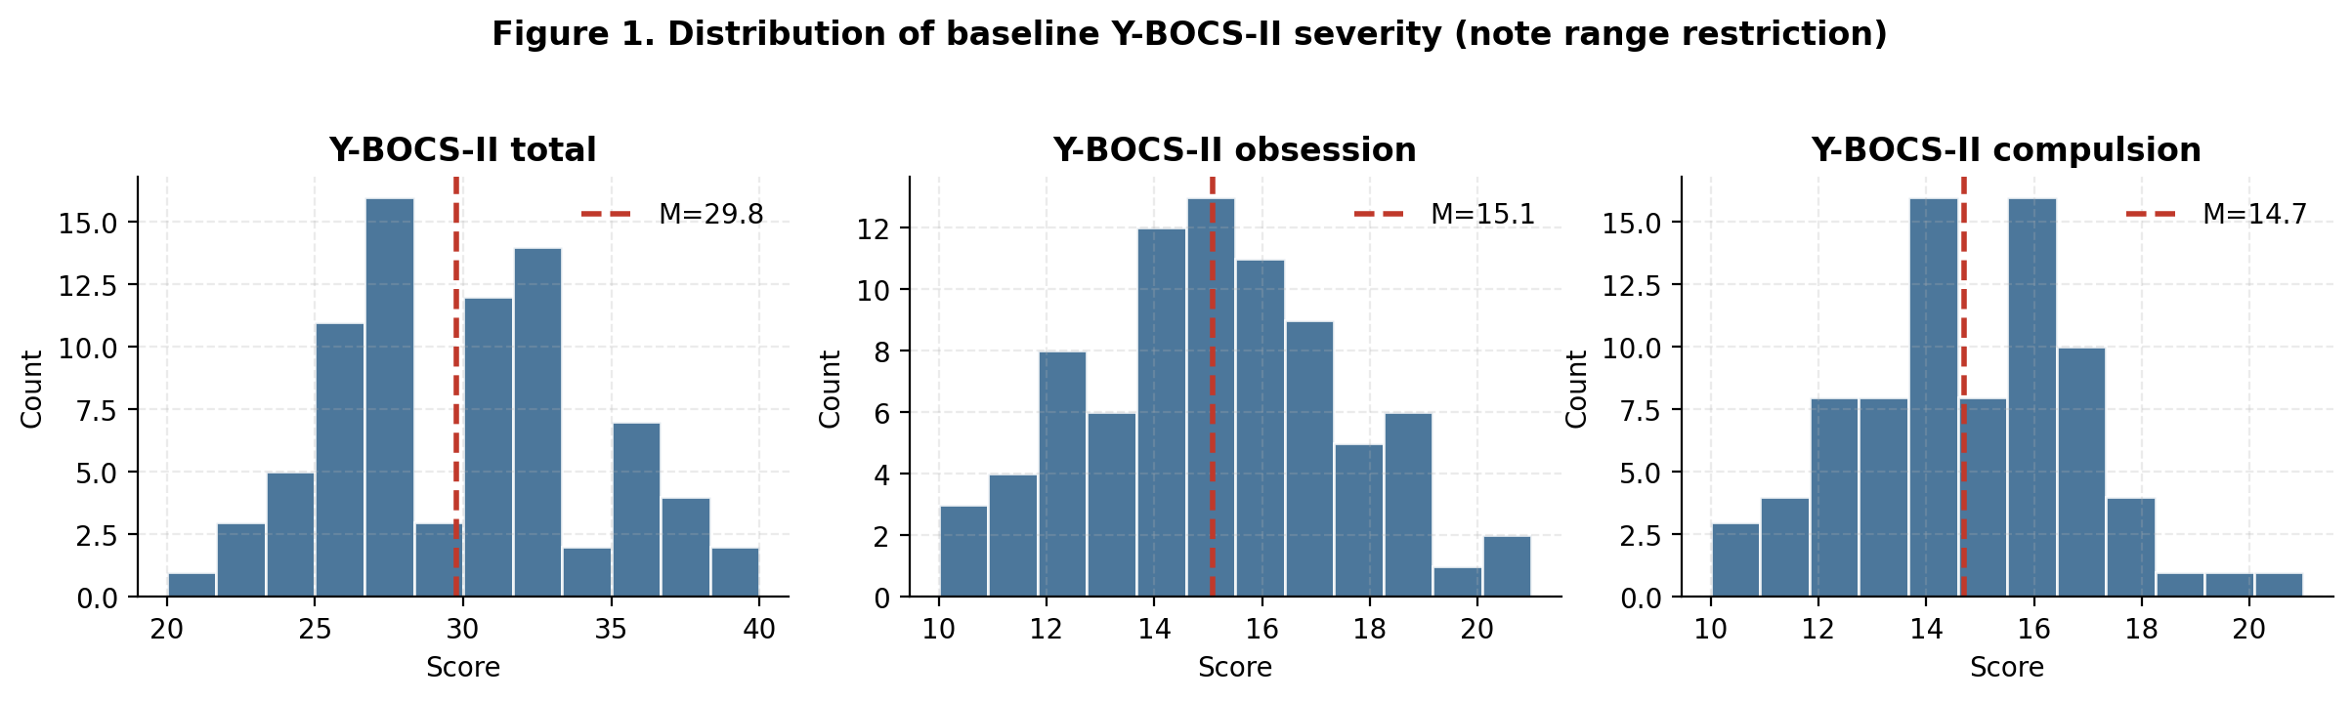
Methods for Reproduction Project
Methods for re-testing
1
59 adults with severe OCD
Who was in the sample
Each had a usable diffusion-MRI and a Y-BOCS-II symptom score.
2
4 wiring measures × 15 key tracts
Focused on the brain pathways the original study flagged.
Everyone was already moderately-to-severely affected — the scores are bunched toward the high end.
3
Compared wiring to symptoms
Adjusting for age and sex, exactly as the original study did.
4
Corrected for many tests
Correcting for multiple comparisons

Slide 5
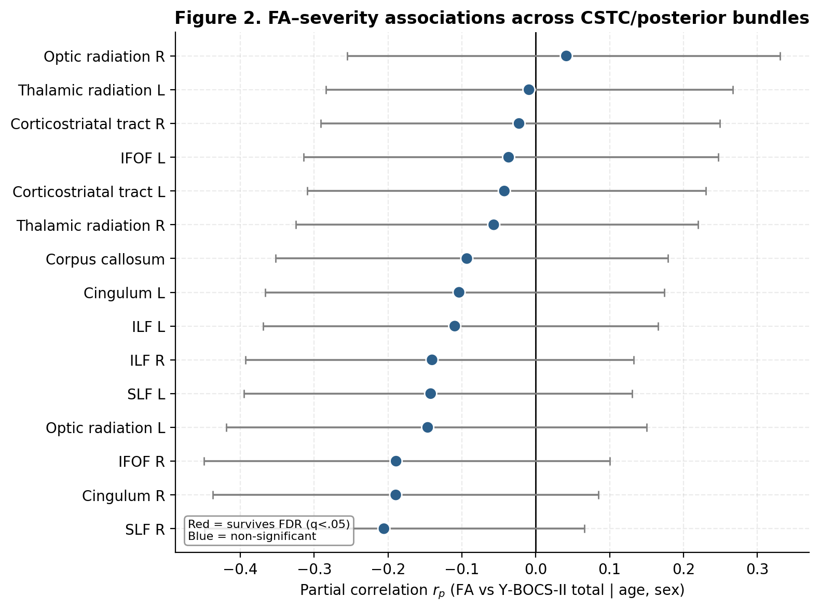
RESULT
No Significant Findings
Each dot is one brain pathway. If wiring tracked severity, the dots would sit far from the centre line. Instead, every one lands on or near zero.
−0.21
strongest correlation found — still not statistically significant
(A correlation of 0 means no relationship; 1 would be a perfect one.)

Slide 6
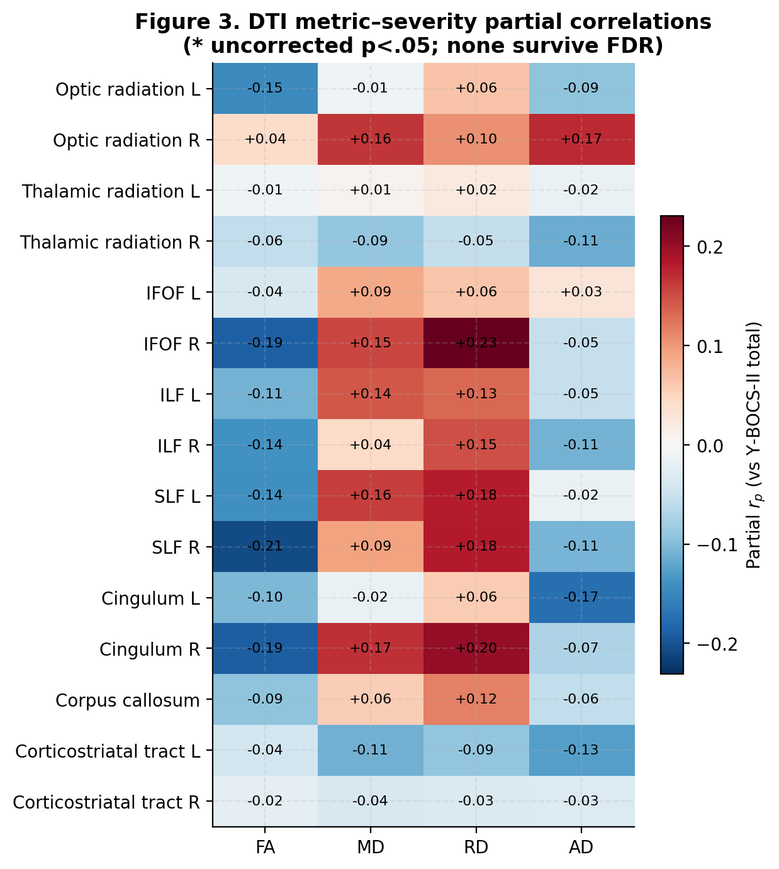
RESULT
The Results Match Engima (Null Findings
Reproduced the test for all four wiring measures and for both symptom types (obsessions and compulsions).
0 of 90
statistical tests showed a real link between brain wiring and symptom severity

Slide 7
WHAT IT MEANS
A fingerprint, not a thermometer
The wiring pattern seen in OCD looks more like a stable trait than a gauge that rises and falls with symptoms. This reproduction dataset reached the same conclusion as the ENIGMA OCD.
Thermometer (a “state”)
Fingerprint (a “trait”)
Would go up and down with current symptoms. The data did NOT behave this way.
A stable feature that doesn't scale with how bad symptoms are today. This fits what the data produced.

Slide 8
WORTH KEEPING IN MIND
Limitations
1
2
3
No healthy comparison group
Everyone was already severe
Modest sample size
Could only test the symptom link, not whether OCD brains differ from others.
With little spread in symptoms, even a real gradient would be hard to see.
Only fairly strong links would reliably show up; small effects could be missed.
In short: the result rules OUT moderate-or-larger links, rather than demonstrating there is none at all.

Slide 9
Discussion
Brain-wiring measures did not track OCD symptom severity — replicating the largest study to date.
Across 15 key pathways and 4 wiring measures, nothing scaled with symptoms.
This supports viewing OCD's wiring signature as a stable trait, not a symptom gauge.
A clean, independent replication of the ENIGMA-OCD severity result.
Full methods, tables, figures and an auditable analysis notebook accompany this reproduction project on github.

