Slide 1
Twilio

Slide 2
What is Twilio?
Twilio is a cloud-based service that allows software developers to create apps capable of sending text messages and place phone calls to mobile phones. (The tutorial will be covering text messaging only)

Slide 3
Limitations of a trial account
Need to verify a phone number before you can send messages to it.
Only one Twilio number can be assgined to a trial account.
An unused Twilio number will be unassigned to a trial account after 30 days.
Messages sent with a trial account will always look like this: “Sent from a Twilio Trial account – [Your message]”

Slide 4
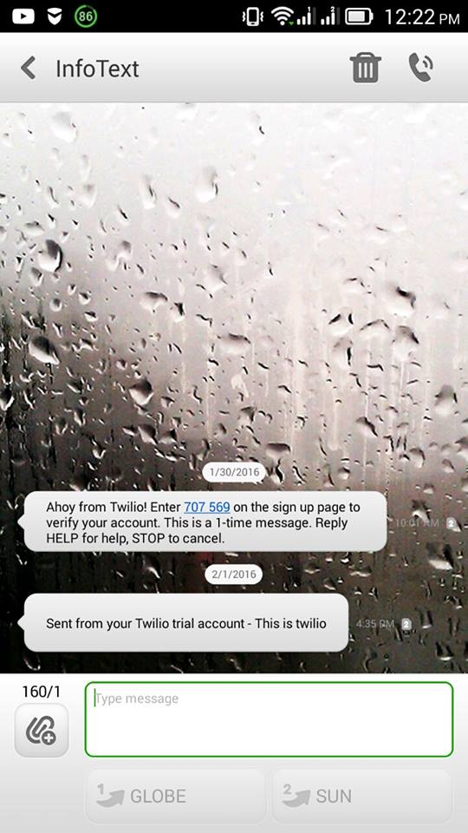

Slide 5
Uses of the SMS service
SMS Alerts/Notifications
Marketing (Introducing new products to customers)

