Slide 1


Spatial Navigation
Data
Kay Otsubo
Priscilla Fung
Prateek Dhamija

Slide 2
Introduction
Question: Are participants more likely to remember items that are congruent with their environment?
Natural Resources (food/water) in a Rural Environment
Artifacts (money) in an Urban Environment
Hypothesis: There will be a greater memory (Bhattacharyya coefficient) for items that are congruent with their environment

Slide 3
Method
Pre-Cleaned Data
2 x 3 ANOVA
Figures
Follow-up Data Cleaning
Created a Summary Dataframe
Removed
P28
Calculated Bhattacharyya Coefficient
Notes:
Bhattacharyya Coefficient = Measure of overlapping search distributions (acquisition and memory)

Slide 4
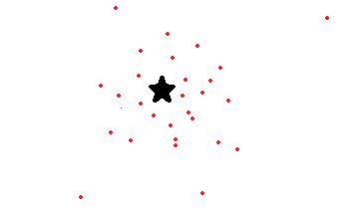
Battacharya Coefficient
Measure of overlapping distributions

Slide 5
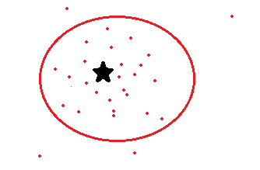
Battacharya Coefficient
Measure of overlapping distributions

Slide 6
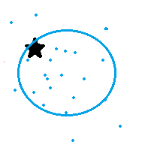
Battacharya Coefficient
Measure of overlapping distributions

Slide 7


Results
Interaction: $F(2,129) = .06, p=.94$
Main Effect: $F\left(1,129\right)=4.81, p=.03$
Notes:
This is the interaction. The main effect of environment was significant.

Slide 8

Results
*
$$t(110) = −2.31, p = .02$$

Slide 9

Conclusion
Item-Environment congruency has no impact on learning
Participants tend to do better in urban environment
This could be due to all participants living in urban environments
Money is required for food and water
Notes:
- urban environments may be easy for us to navigate where we are able to identify the differences amongst the buildings where we may not be as used to rural differentiations
Future studies:

Slide 10
Thank you for listening!

