Slide 1




Analysis of St. Louis County Home Values
AI-AI Team: John Loucks Regan Maher Eric Penrose

Slide 2


Project Overview
Project Goal
Programs Used
Data
Data Clean Up
Data Analysis
Machine Learning
Website Demonstration
Reflection
Questions

Slide 3

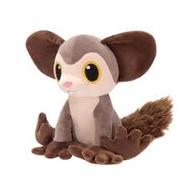
Project Goal
Analyzing trends of home values in St. Louis County and to be able to predict the purchase/sale price of a home by utilizing an html intake form to feed the machine learning to produce the expectant home value.
Lifespan in the wild is unknown but aye-ayes have lived 35 years in captivity.

Slide 4

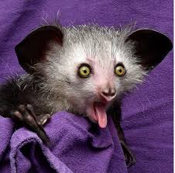
Programs/Modules Used
HTML/CCS/Bootstrap
Tableau
JavaScript
Python
Pandas
SciPy
Matplotlib
Datetime
Selenium
Splinter
BeautifulSoup
Requests
Time
Math
SciKitLearn
NumPy
Pickle
MySQL
Scientists believe there are only 100 or more Aye-Aye left in the wild.

Slide 5

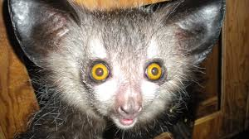
Data
MLS Data for St. Louis County between 2010 -2020
Original dataset had over 115,000 records (nearly exhaustive)
Integration of zip code level demographics
Zip code data scraped separately and joined.
(from Zipcodes.org)
Data Hurdles
Dataset did not contain zip codes
Human error within the dataset
Major outliers for price, both high and low
Duplicated MLS numbers (120)
Listing outside of St. Louis County
AYE means "Yes".
Notes:
Matched on Addr 1 of the postal address.

Slide 6
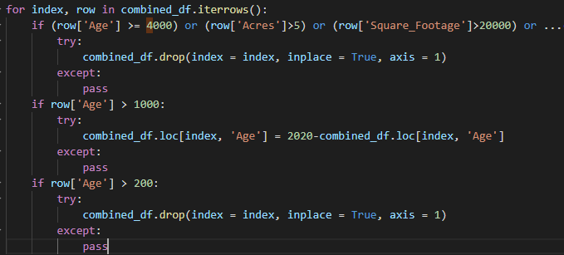
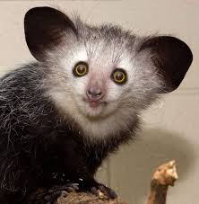
Data – Clean Up
Filter Clean Up For Data Analysis and Machine Learning
Removed:
Houses aged > 4000
Houses on lots > 5 acres
Houses with sq ft >20,000
Houses with sq ft <500
Less than 1 full bath
Less than 1 bedroom
More than 12 combined baths
More than 15 bedrooms
Sale Price < $25,000
Sale Price > $750,000
Status other than “Sold”
Removed Condos
Filter Clean Up for Machine Learning Only
Sale Price < $50,000
The aye-aye is a lemur native to the island of Madagascar and the world's biggest nocturnal primate.
Notes:
These columns were cleaned up to filter out entry errors and these also removed outliers that would have skewed the results.

Slide 7
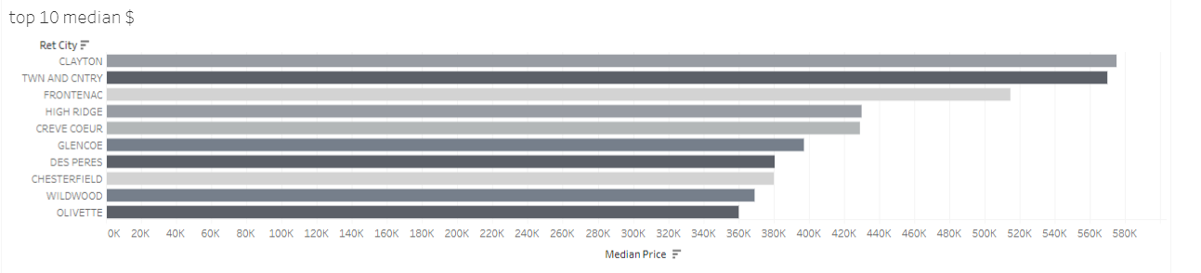
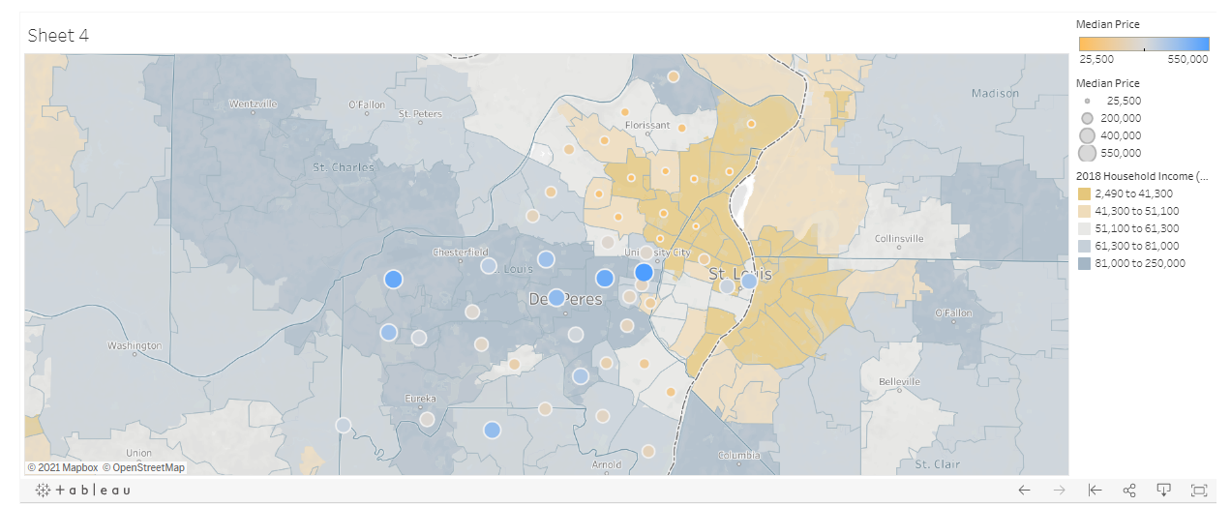
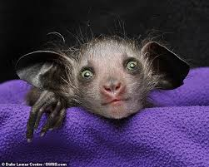
Data Analysis
Tableau was used
Showcase Data
Understand Dataset
The following was reviewed
Reviewed the Median Price by District
Looked at top 10 areas based on price
Mapped areas and concentrations based on median price and household income.
Square Footage vs Price
Days on Market vs Number of Records
Median Price vs Year Built
Sale Year vs Median Price
Monthly Sales vs Number of Records
Aye-ayes teeth never stop growing, like a rodents.

Slide 8
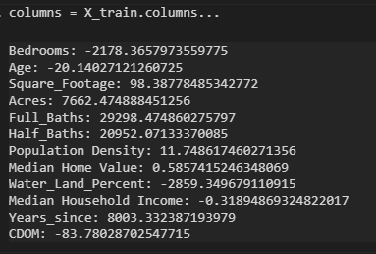
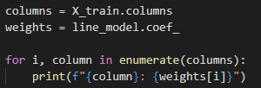



Data Analysis – Linear Analysis
Linear Regression Analysis
Descriptive rather than predictive analysis
(Fed entire dataset rather than doing a train-test split)
Test Score
80% test group scored
22% within 5% with additional testing
Interesting Finds
Bedrooms alone will decrease a homes value
Bathrooms will increase a homes value by $20-30K per.
Aye-ayes are the only primates thought to use echolocation to find prey. Aye-ayes tap a long finger on tree bark, feeling for the vibrations of insect larvae.
Notes:
If you add a bedroom without adding sq footage causes the weight to go down.

Slide 9
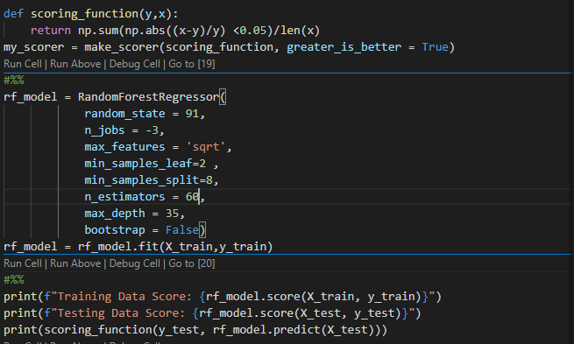
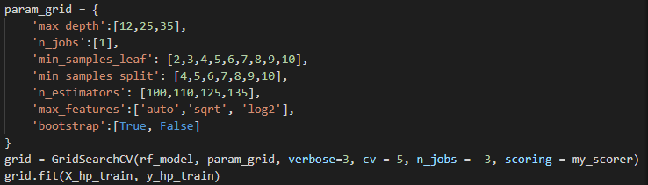

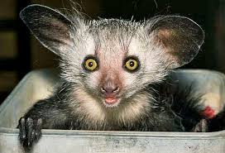
Machine Learning
Random Forest Regressor
Did a 60/20/20 Train/tune/test split
Developed custom scoring method for hyperparameter tuning
More performant than KNeighborsRegressor()
Test Score
89% test group scored
24% within 5% of true price
Machine Learning Limitations
Git Hub had size limitations that required the model to be scaled down.
The aye-aye is often viewed as a harbinger of evil and killed on sight. Others believe, if one points its narrowest finger at someone, they are marked for death.

Slide 10
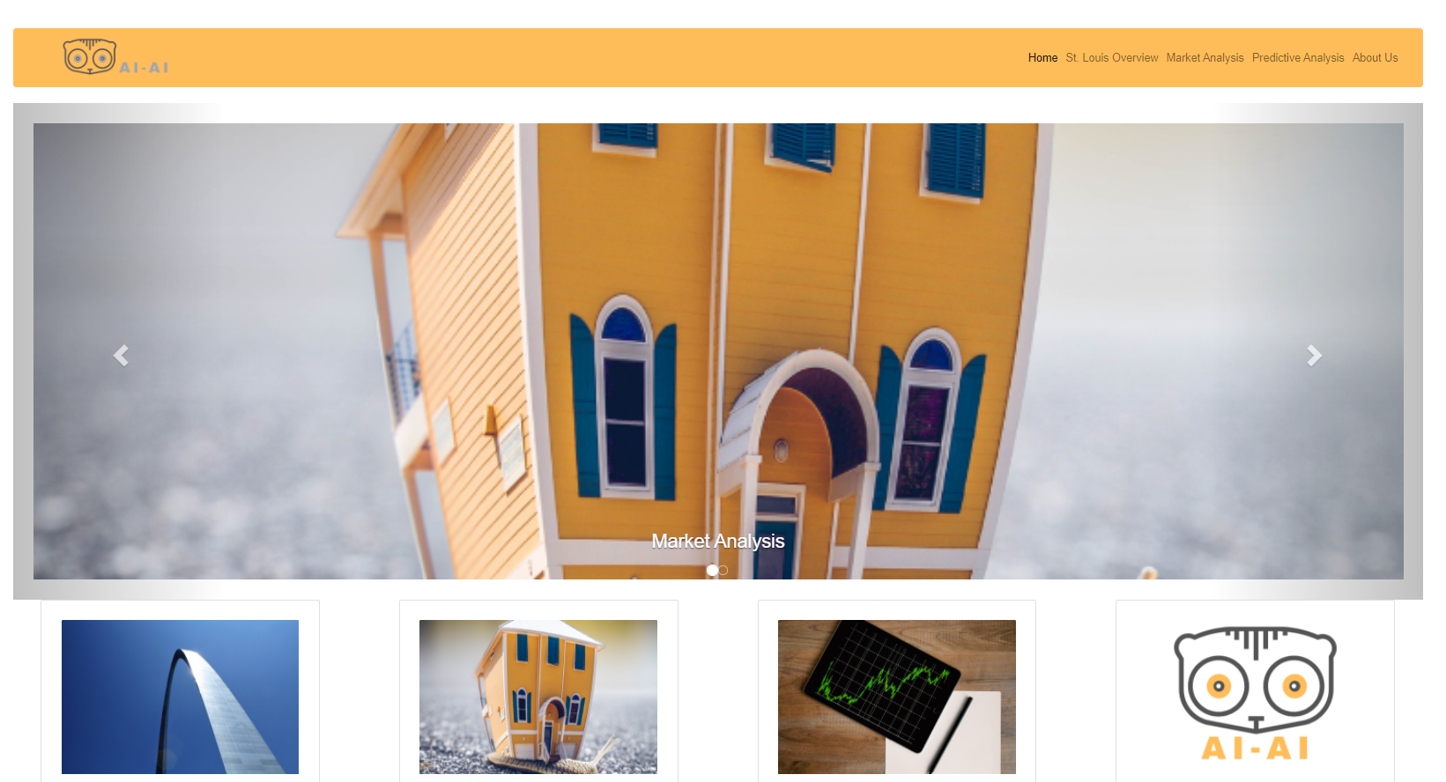
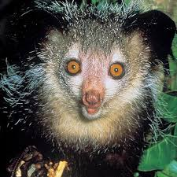
Website Demonstration
https://aiai-stl.herokuapp.com/index.html
Aye aye has the largest middle finger to body ratio of any animal.

Slide 11
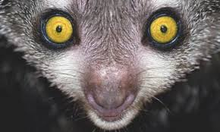
Reflection
More Time
Brought in more areas surrounding St. Louis. ( St. Louis City, St. Charles County, Metro East)
More Budget
Would have either scraped or purchased latitude and longitude of all listings for more granular analysis.
More Server Space
More machine learning models to attempt to increase accuracy.
A full-grown aye-aye is usually about three feet long, with a tail as long as its body.

Slide 12
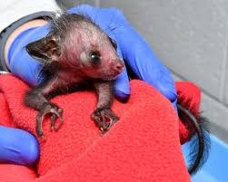
A Special Thanks!!!
A special thanks goes to Stephen Penrose our “STL Real Estate Guy” for his assistance acquiring the dataset for this project.
Aye aye come from the lemur family, and baby aye ayes are known as “infants”, just like you!

Slide 13
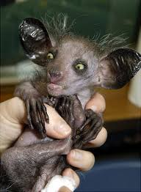
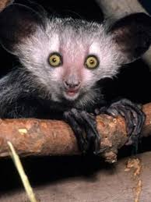

Questions

