Slide 1




Predicting St. Louis City and County Home Values
AI-AI Team: John Loucks Regan Maher Eric Penrose

Slide 2


Project Overview
Project Goal
Programs Used
Data
Data Analysis
Machine Learning
Website Demonstration
Questions

Slide 3

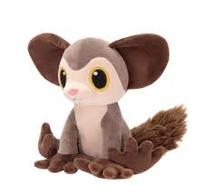
Project Goal
To be able to predict the appraisal price of a home by utilizing an html intake form to feed the machine learning to produce the expectant home value.
Lifespan in the wild is unknown but aye-ayes have lived 23 years in captivity.

Slide 4
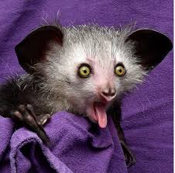
Programs Used
HTML/CCS/Bootstrap
Tableau
JavaScript
Python
Pandas
SciPy
Matplotlib
Datetime
Selenium
Splinter
BeautifulSoup
Requests
Time
Math
SciKitLearn
NumPy
Pickle
MySQL
Scientists believe there may be around 100 or more Aye-Aye left in the wild.

Slide 5
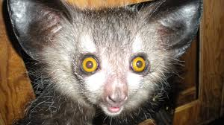
Data
MLS Data for St. Louis City and County between 2010 -2020
Integration of zip code level demographics
Data Hurdles
Dataset did not contain zip codes
Human error within the dataset
Major outliers for price, both high and low
Duplicated MLS numbers (120)
Listing out side of St. Louis City and County
AYE means "Yes".

Slide 6
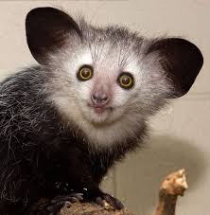
Data – Code Examples
The aye-aye is a lemur native to the island of Madagascar and the world's biggest nocturnal primate.

Slide 7

Data Analysis
Aye-ayes are the only primates thought to use echolocation to find prey. Aye-ayes tap a long finger on tree bark, feeling for the vibrations of insect larvae.

Slide 8
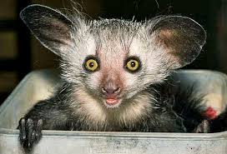
Machine Learning
The aye-aye is often viewed as a harbinger of evil and killed on sight. Others believe, if one points its narrowest finger at someone, they are marked for death.

Slide 9
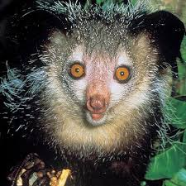
Website Demonstration
Aye aye come from the lemur family, and baby aye ayes are known as “infants”, just like you!

Slide 10
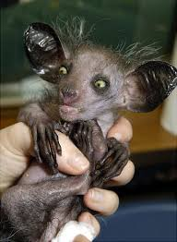
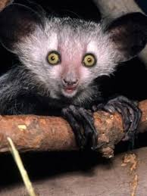

Questions

