Slide 1




Predicting St. Louis County Home Values
AI-AI Team: John Loucks Regan Maher Eric Penrose

Slide 2


Project Overview
Project Goal
Programs Used
Data
Data Analysis
Machine Learning
Website Demonstration
Reflection
Questions

Slide 3

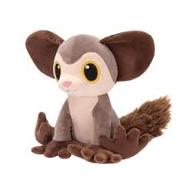
Project Goal
To be able to predict the appraisal price of a home by utilizing an html intake form to feed the machine learning to produce the expectant home value.
Lifespan in the wild is unknown but aye-ayes have lived 23 years in captivity.

Slide 4

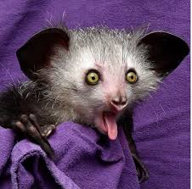
Programs Used
HTML/CCS/Bootstrap
Tableau
JavaScript
Python
Pandas
SciPy
Matplotlib
Datetime
Selenium
Splinter
BeautifulSoup
Requests
Time
Math
SciKitLearn
NumPy
Pickle
MySQL
Scientists believe there are only 100 or more Aye-Aye left in the wild.

Slide 5

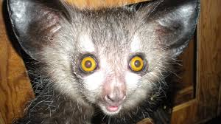
Data
MLS Data for St. Louis City and County between 2010 -2020
Original dataset had over 100,000 records
Integration of zip code level demographics
Data Hurdles
Dataset did not contain zip codes
Human error within the dataset
Major outliers for price, both high and low
Duplicated MLS numbers (120)
Listing out side of St. Louis County
AYE means "Yes".

Slide 6
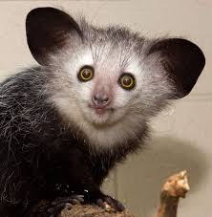
Data – Code Examples
The aye-aye is a lemur native to the island of Madagascar and the world's biggest nocturnal primate.

Slide 7
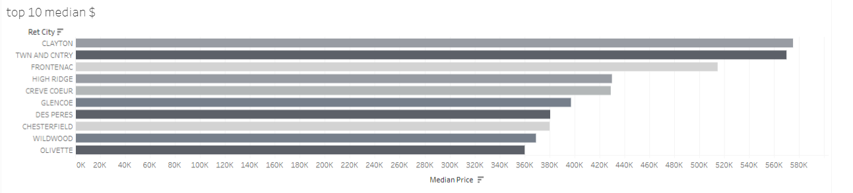
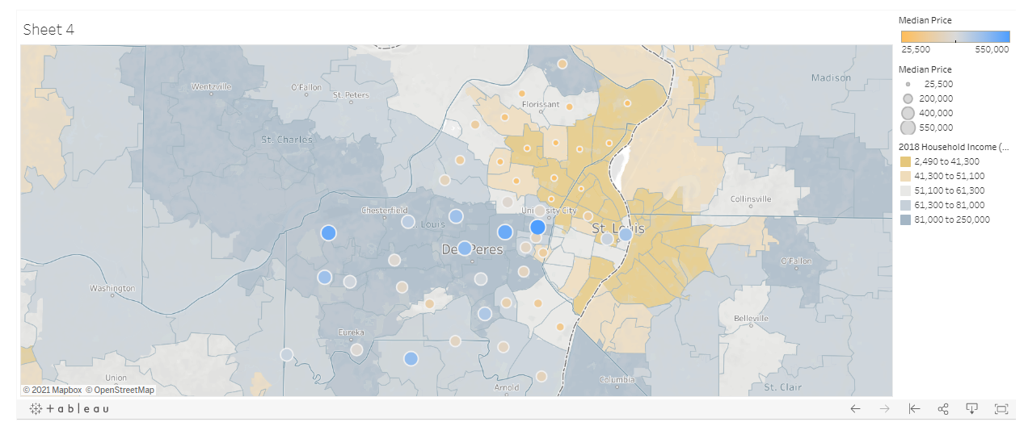
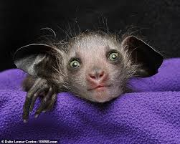
Data Analysis
Tableau was used
Showcase Data
Understand Dataset
The following was reviewed
Reviewed the Median Price by District
Looked at top 10 areas based on price
Mapped areas and concentrations based on median price and household income.
Square Footage vs Price
Days on Market vs Number of Records
Median Price vs Year Built
Sale Year vs Median Price
Monthly Sales vs Number of Records
Aye-ayes teeth never stop growing, like a rodents.

Slide 8

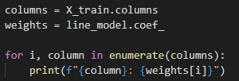

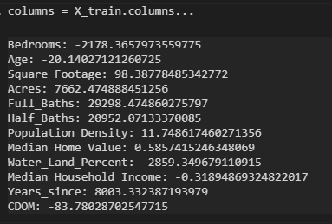
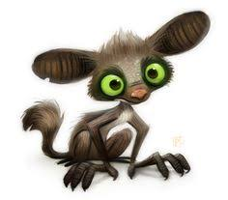

Data Analysis – Linear Analysis
Linear Regression Analysis
Descriptive rather than predictive analysis
(Fed entire dataset rather than doing a train-test split)
Test Score
80% test group scored
22% within 5% with additional testing
Interesting Finds
Bedrooms alone will decrease a homes value
Bathrooms will increase a homes value by $20-30K per.
Aye-ayes are the only primates thought to use echolocation to find prey. Aye-ayes tap a long finger on tree bark, feeling for the vibrations of insect larvae.

Slide 9
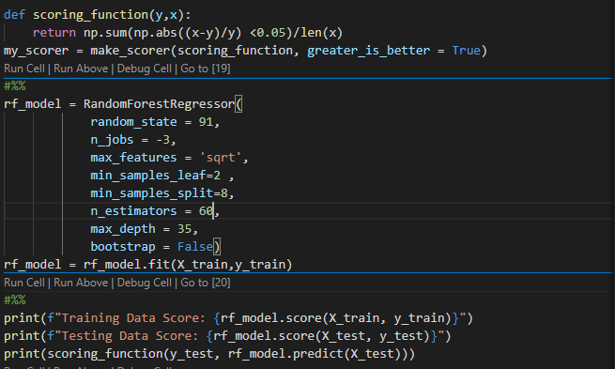
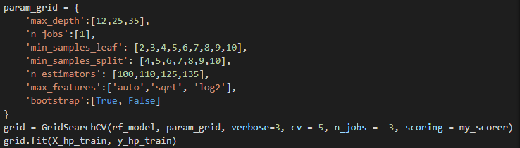

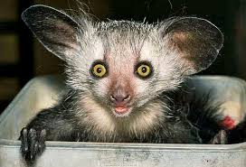
Machine Learning
Random Forest Regressor
Did a 60/20/20 Train/tune/test split
Developed custom scoring method for hyperparameter tuning
More performant than KNeighborsRegressor()
Test Score
89% test group scored
24% within 5% of true price
Machine Learning Limitations
Git Hub had size limitations that required the model to be scaled down.
The aye-aye is often viewed as a harbinger of evil and killed on sight. Others believe, if one points its narrowest finger at someone, they are marked for death.

Slide 10
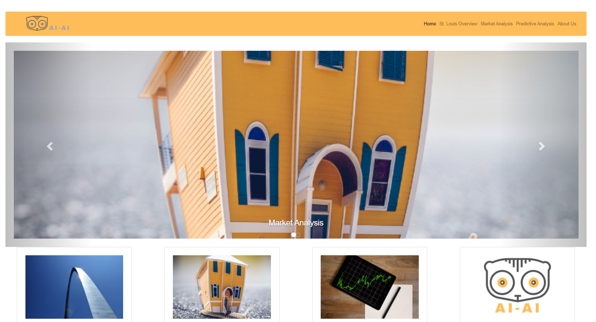
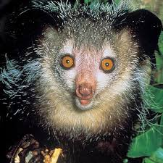
Website Demonstration
Aye aye come from the lemur family, and baby aye ayes are known as “infants”, just like you!

Slide 11
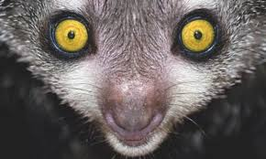
Reflection
More Time
Brought in more areas surrounding St. Louis. ( St. Louis City, St. Charles County, Metro East)
More Budget
Would have either scraped or purchased latitude and longitude of all listings for more granular analysis.
More Server Space
More machine learning models to attempt to increase accuracy.
A full-grown aye-aye is usually about three feet long, with a tail as long as its body.

Slide 12
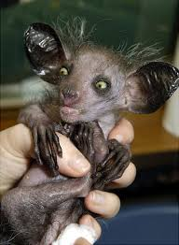
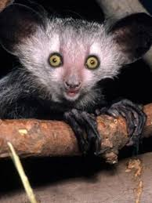

Questions

