Slide 1
Deaths occurring up to 19 June; registered by 27 June
All causes | 3rd Jan | 10th Jan | 17th Jan | 24th Jan | 31st Jan | 7th Feb | 14th Feb | 21st Feb | 28th Feb | 6th Mar | 13th Mar | 20th Mar | 27th Mar | 3rd Apr | 10th Apr | 17th Apr | 24th Apr | 1st May | 8th May | 15th May | 22nd May | 29th May | 5th Jun | 12th Jun | 19th Jun
Brighton and Hove | 44 | 42 | 39 | 42 | 40 | 36 | 33 | 38 | 36 | 56 | 32 | 38 | 60 | 63 | 63 | 72 | 61 | 39 | 53 | 44 | 35 | 41 | 24 | 26 | 38
East Sussex | 167 | 162 | 153 | 142 | 142 | 146 | 137 | 121 | 111 | 119 | 114 | 132 | 133 | 133 | 168 | 184 | 199 | 176 | 157 | 126 | 128 | 113 | 119 | 109 | 115
West Sussex | 214 | 215 | 186 | 197 | 202 | 183 | 196 | 205 | 196 | 203 | 178 | 185 | 203 | 243 | 305 | 309 | 321 | 277 | 213 | 220 | 200 | 169 | 149 | 158 | 144
Sussex areas combined | 425 | 419 | 378 | 381 | 384 | 365 | 366 | 364 | 343 | 378 | 324 | 355 | 396 | 439 | 536 | 565 | 581 | 492 | 423 | 390 | 363 | 323 | 292 | 293 | 297
COVID-19 | 3rd Jan | 10th Jan | 17th Jan | 24th Jan | 31st Jan | 7th Feb | 14th Feb | 21st Feb | 28th Feb | 6th Mar | 13th Mar | 20th Mar | 27th Mar | 3rd Apr | 10th Apr | 17th Apr | 24th Apr | 1st May | 8th May | 15th May | 22nd May | 29th May | 5th Jun | 12th Jun | 19th Jun
Brighton and Hove | - | - | - | - | - | - | - | - | - | - | - | 1 | 6 | 16 | 21 | 26 | 19 | 14 | 14 | 17 | 6 | 5 | 2 | 3 | 2
East Sussex | - | - | - | - | - | - | - | - | - | - | - | 2 | 10 | 22 | 41 | 47 | 53 | 36 | 40 | 33 | 28 | 14 | 9 | 5 | 7
West Sussex | - | - | - | - | - | - | - | - | - | - | - | 3 | 19 | 37 | 80 | 89 | 113 | 77 | 48 | 60 | 44 | 18 | 15 | 9 | 5
Sussex areas combined | - | - | - | - | - | - | - | - | - | - | - | 6 | 35 | 75 | 142 | 162 | 185 | 127 | 102 | 110 | 78 | 37 | 26 | 17 | 14
Non-COVID-19 | 3rd Jan | 10th Jan | 17th Jan | 24th Jan | 31st Jan | 7th Feb | 14th Feb | 21st Feb | 28th Feb | 6th Mar | 13th Mar | 20th Mar | 27th Mar | 3rd Apr | 10th Apr | 17th Apr | 24th Apr | 1st May | 8th May | 15th May | 22nd May | 29th May | 5th Jun | 12th Jun | 19th Jun
Brighton and Hove | 44 | 42 | 39 | 42 | 40 | 36 | 33 | 38 | 36 | 56 | 32 | 37 | 54 | 47 | 42 | 46 | 42 | 25 | 39 | 27 | 29 | 36 | 22 | 23 | 36
East Sussex | 167 | 162 | 153 | 142 | 142 | 146 | 137 | 121 | 111 | 119 | 114 | 130 | 123 | 111 | 127 | 137 | 146 | 140 | 117 | 93 | 100 | 99 | 110 | 104 | 108
West Sussex | 214 | 215 | 186 | 197 | 202 | 183 | 196 | 205 | 196 | 203 | 178 | 182 | 184 | 206 | 225 | 220 | 208 | 200 | 165 | 160 | 156 | 151 | 134 | 149 | 139
Sussex areas combined | 425 | 419 | 378 | 381 | 384 | 365 | 366 | 364 | 343 | 378 | 324 | 349 | 361 | 364 | 394 | 403 | 396 | 365 | 321 | 280 | 285 | 286 | 266 | 276 | 283

Slide 2
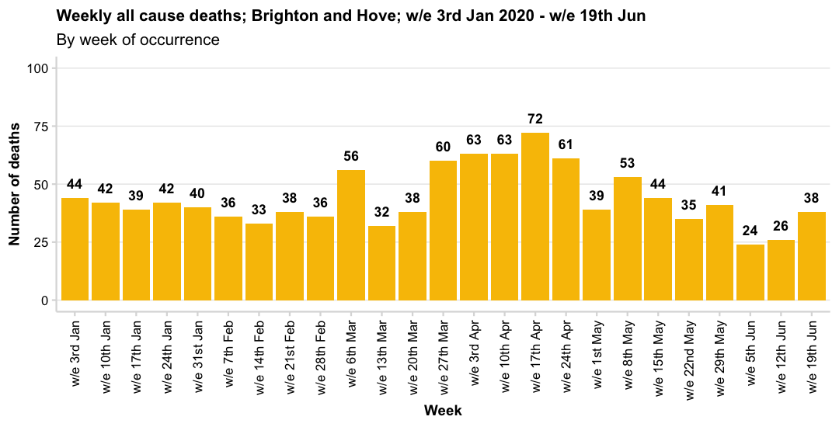
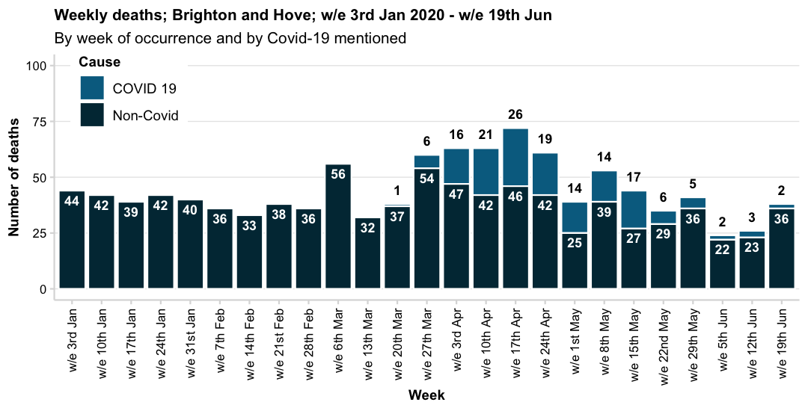
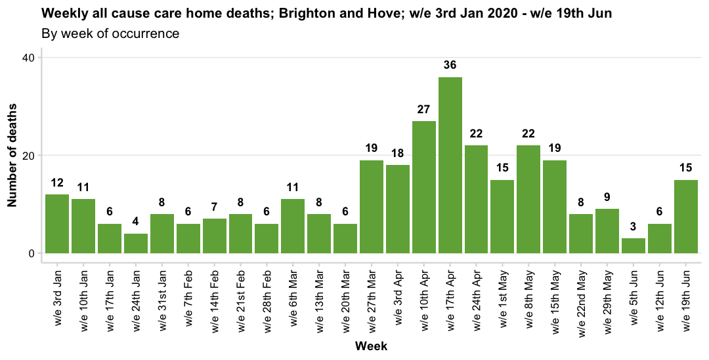
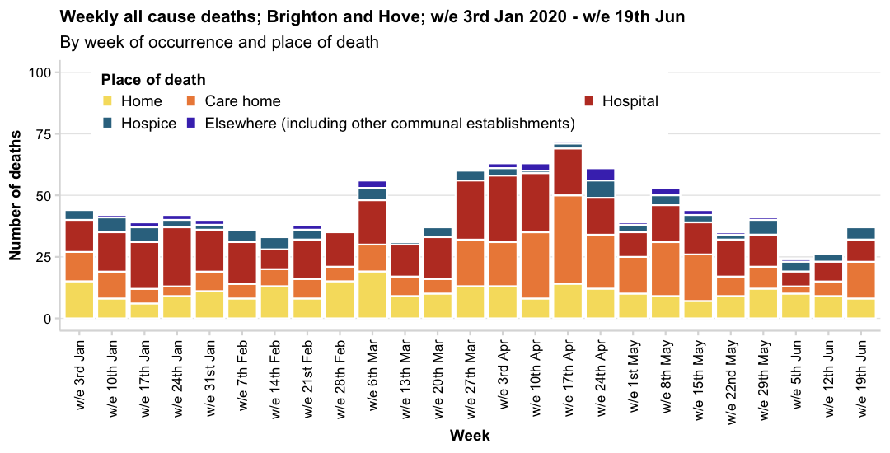

Slide 3
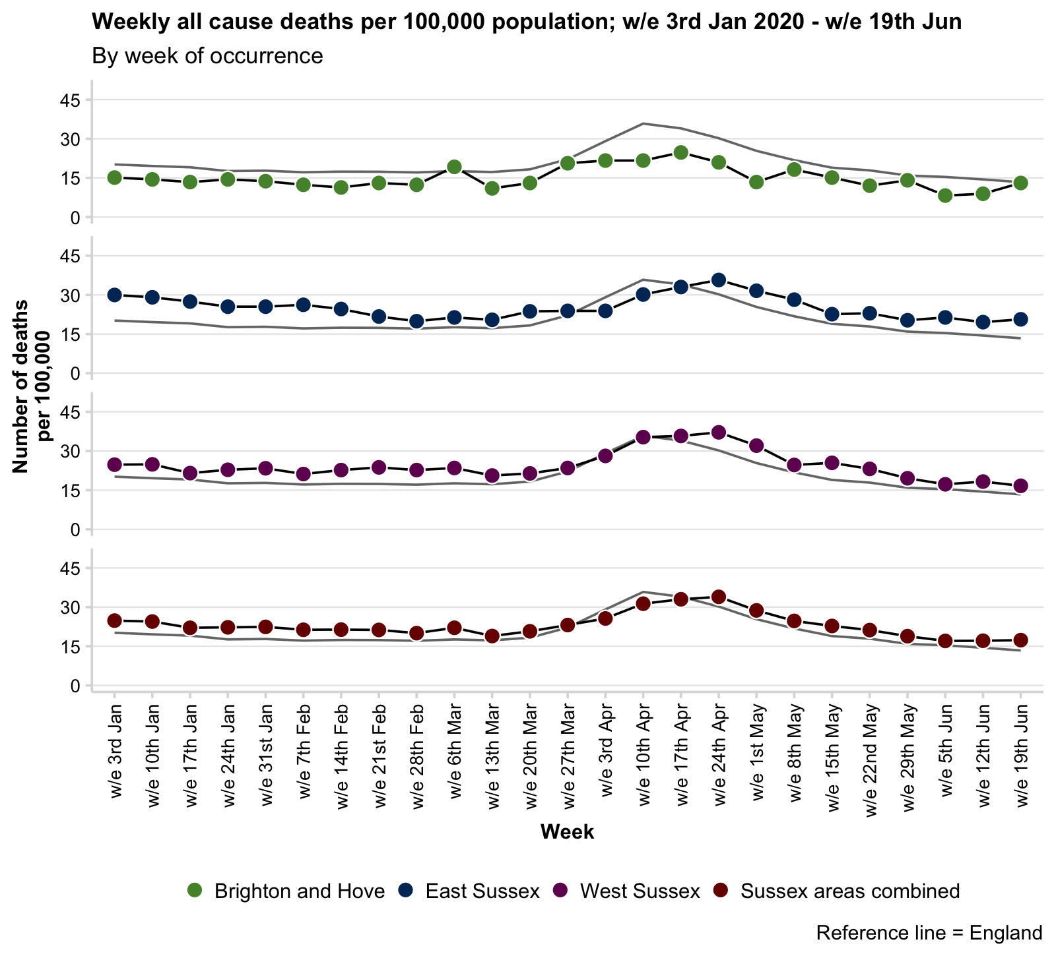
Crude rate of all cause mortality; to week ending 19 June; registered by 27 June
A crude rate is calculated using the mid-2018 population estimates (all ages) for each area. Note that some areas in Sussex, particularly West Sussex, have an older population compared with England and so the rate is usually, and expectedly, above the national rate.
Age/sex standardised rates are not currently available from the weekly ONS realease, although cumulative data for specific time periods (March-May 2020) are available and are presented later in this slide deck.

