Slide 1
File Storage System using Hybrid Cryptography Cloud Computing

Slide 2
Content
01
02
03
04
Introduction
Existing System Or Literature Survey
Implementation
Results and Discussion

Slide 3
01
Introduction

Slide 4
Abstract:
The increasing reliance on cloud computing for data storage necessitates robust security measures to protect sensitive information. This project proposes a File Storage System using Hybrid Cryptography Cloud Computing to address this need. The system combines the strengths of both symmetric and asymmetric cryptography to ensure data confidentiality and integrity. By integrating with cloud computing, the system provides scalability and accessibility while maintaining a high level of security. This presentation outlines the architecture, implementation, and results of the proposed system, demonstrating its effectiveness in enhancing data security in cloud storage environments

Slide 5
Intro of Project
Cloud computing has transformed data storage and access, but security remains a critical concern.
Traditional encryption methods like symmetric and asymmetric cryptography have limitations. | The system combines symmetric and asymmetric cryptography for data confidentiality and integrity.
This project proposes a File Storage System using Hybrid Cryptography Cloud Computing to address these limitations. | It leverages cloud computing for scalability and accessibility while maintaining high security.
The architecture integrates hybrid cryptography with cloud storage. | The implementation focuses on efficient data encryption and secure key exchange.
The project aims to enhance data security in cloud storage and contribute to secure file storage systems. | Next we will explain Objectives of our project

Slide 6
Objective
Projects can be planned
File storage
Security
Accessibility
Data retrival
Combine symmetric and asymmetric cryptography for robust security.Integrate with cloud computing for scalability and accessibility.Address the limitations of traditional encryption methods. Provide a secure and efficient method for data storage and retrieval. Enhance data security in cloud storage environments.

Slide 7
02
Existing System Or Literature Survey

Slide 8
Existing System Or Literature Survey:
 | Existing file storage systems use traditional encryption methods like symmetric and asymmetric cryptography.
 | Traditional file storage systems use symmetric and asymmetric cryptography, leading to performance overhead and vulnerability to attacks.
 | Hybrid cryptography combines symmetric and asymmetric cryptography for secure data transmission and storage. It offers enhanced security and efficiency compared to traditional methods.
 | Despite the advantages, there is a need for more research to develop efficient and secure file storage systems in cloud computing. The proposed system integrates hybrid cryptography with cloud storage to address these challenges and enhance data security.

Slide 9
Research Gap:
 | Existing file storage systems often rely on traditional encryption methods, which may not provide adequate security for sensitive data in cloud environments.
 | There is a need for a more robust and efficient approach to secure data storage in the cloud.
 | Hybrid cryptography offers a promising solution, but there is limited research on its implementation and effectiveness in cloud storage systems.
 | The proposed system aims to fill this gap by integrating hybrid cryptography with cloud computing to enhance data security and efficiency in file storage

Slide 10
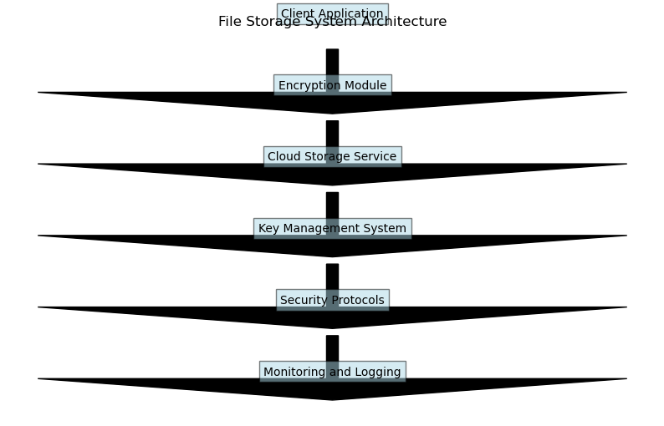
Proposed Model: Architecture Diagram: The architecture of the proposed File Storage System using Hybrid Cryptography Cloud Computing is depicted below

Slide 11
Method Explanation
01
Client Application:
- Responsible for user interaction and file management.
- Encrypts files before uploading them to the cloud.
02
Encryption Module:
- Part of the client application or a separate component.
- Handles encryption and decryption using hybrid cryptography.
- Generates symmetric keys for file encryption and uses asymmetric keys for key exchange.
03
Cloud Storage Service:
- Stores encrypted files and associated metadata.
- Provides access to files based on user permissions.
04
Security Protocols:
- Use secure communication protocols (e.g., HTTPS) for data transmission.
- Implement access control mechanisms to ensure only authorized users can access files.

Slide 12
03
Implementation

Slide 13
Implementation
Technologies used
Python
Matplotlib, Cryptography, Flask, SQLite
AWS S3

Slide 14
STEPS INVOLVED:
Develop a client application using Flask to create a user-friendly web interface for the file storage system.
Implement an encryption module using hybrid cryptography to ensure secure storage and transmission of files.
Integrate AWS S3 (Simple Storage Service) for cloud storage to store encrypted files securely.
Develop a key management system using SQLite to manage encryption keys securely.
Implement HTTPS for secure communication between the client application and the server. Implement access control mechanisms to restrict unauthorized access to files. Develop logging mechanisms using Matplotlib to track and analyze system activities for security auditing.

Slide 15
04
Result and Discussion

Slide 16
Results and Discussion
Evaluation in the Project gives key 3 points they are below:
Performance Evaluation
Security Analysis
User Feedback
Encryption and decryption speed.
File upload and download times.
System resource utilization.
Effectiveness of hybrid cryptography.
Access control mechanisms.
Vulnerability assessment.
Usability and user experience.
Feedback on security features.

Slide 17
Discussion:
Key Discussion points are:
KRISH
Comparison with traditional encryption methods.
Addressing research gap.
Future enhancements and research directions.
KAIF
SAJIN

Slide 18
File Storage System using Hybrid Cryptography Cloud Computing
Conclusion
Developed a secure and efficient file storage system using hybrid cryptography and cloud computing.
Successfully integrated encryption, key management, and access control mechanisms.
Demonstrated improved security and performance compared to traditional encryption methods.
Future work includes scalability enhancements and further security analysis.

Slide 19
File Storage System using Hybrid Cryptography Cloud Computing
Reference
Kamara, S., & Lauter, K. (2010). Cryptographic cloud storage. In Financial Cryptography and Data Security (pp. 136-149). Springer, Berlin, Heidelberg.
Sun, H. M., & Zhang, Q. (2012). Cloud data security—A survey. Journal of Computer and System Sciences, 78(5), 1386-1394.
Ristenpart, T., Tromer, E., Shacham, H., & Savage, S. (2009). Hey, you, get off of my cloud: exploring information leakage in third-party compute clouds. In Proceedings of the 16th ACM conference on Computer and communications security (pp. 199-212).
Subashini, S., & Kavitha, V. (2011). A survey on security issues in service delivery models of cloud computing. Journal of Network and Computer Applications, 34(1), 1-11.

Slide 20
QUESTIONS
Tres cosas que he aprendido
Dos cosas que debo mejorar
Una pregunta que quieras consultar
FELL FREE TO ASK
&
LEARN SOMETHING NEW

Slide 21
Thanks
Project Presented by,
MANIBAALAKRISHNAN S
SAJIN AKASH M
PRANESH P
MOHAMMED KAIF K
SAVEETHA SCHOOL OF ENGINEERING

