Slide 1


Network Meta Analysis (NMA)
Biostatistics Research Program
Spring Statistics/AI Lecture Series
Pei-Shan Yen, PhD Candidate
Division of Epidemiology and Biostatistics
UIC
Mar 01, 2024
https://github.com/psyen0824/NMA
NMA Slide and R code (scanned QR code)

Slide 2



Agenda
Motivation
Conceptual Idea of Network Meta-Analysis (NMA)
Comparison of R tools
Demonstration of R Shiny – MetaInsight
Conclusion and Discussion

Slide 3

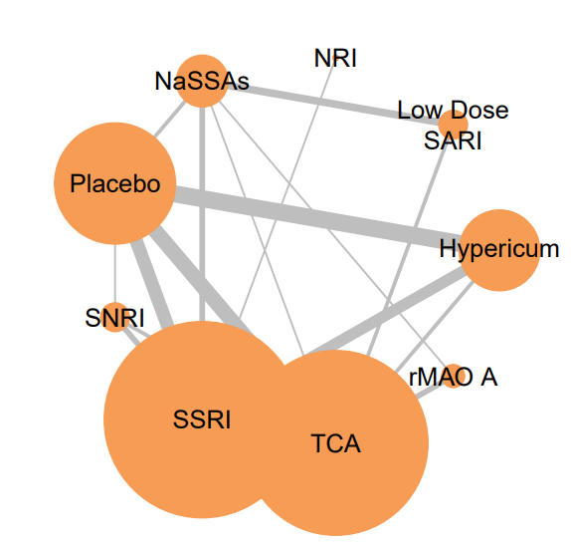

Motivating Example
Known Relative Effect (Grey Solid Line)
$$?$$
Without existing literature/trial data, is it possible to estimate the relative treatment effect between NaSSAs and Hypericum for the patients suffering from MDD?

Slide 4




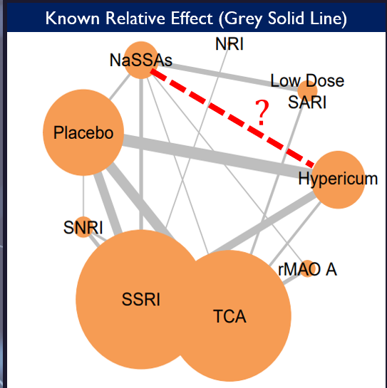
Solution NMA
NMA is an extension of pairwise meta-analysis.
Network Meta Analysis (NMA) is a technique for COMPARING MUTIPLE TREATMENTS simultaneously in a SINGLE ANALYSIS by combining direct and indirect evidence within a network of randomized controlled trials. (Rouse et at., 2017) → aka. multiple-treatment meta-analysis, mixed treatment comparison (MTC).
NMA can 1) estimate the relative treatment effect between any pair of the treatment in the network, and 2) estimate the ranking of all the treatments.
Notes:
https://training.cochrane.org/handbook/current/chapter-11#:~:text=Network%20meta%2Danalysis%20is%20a,across%20a%20network%20of%20studies.

Slide 5
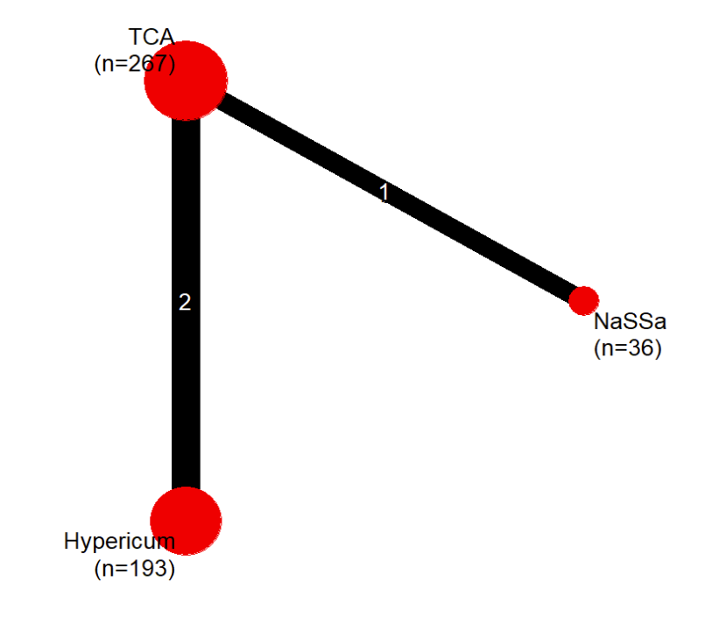





Conceptual Idea of Network Meta-Analysis (NMA)
NMA Procedure
Network Plot
graphical depiction of the structure of a network of interventions (Chaimani et al 2013).
Example
Disease: Major Depressive Disorder (MDD)
Dataset: Linde et al. (2015)
Outcome: Proportion of Early Responders
- 3 Studies; 3 Interventions: TCA(T), Hypericum(H), NaSSAs(N)
Goal: Estimate the relative treatment effect between H and N
$$\text{Direct} \text{Estimation}$$
$$OR: \frac{T}{N}=3.83$$
T
Study 3
Conceptual Idea of NMA
Step 1. Conduct systematic review related to the intervention $H$ and N
Step 2. Produce the Network Plot & identify intermediate comparator $T$
Step 3. Calculate the relative effects within the network directly
→ obtain direct estimation $\left(H/T\right)$ and $\left(T/N\right)$ from existing trials
Step 4. Calculate the relative effects within the network indirectly
→ obtain indirect estimation of $\left(H/N\right)$ through $T$
Study 1 and 2
Direct Estimation
$$OR: \frac{H}{T}=1.15$$
N
NaSSAs
A
Indirect Estimation Approach
$$OR:\frac{H}{N}=\frac{H}{T}×\frac{T}{N}=1.15×3.83=4.41$$
Indirect Estimation Approach (Consistency; Transitivity)
Indirect Estimation = Product of Direct Estimation
H
$$\left(H/N\right) = \left(H/T\right) ×\left(T/N\right)$$
$$4.41 = 1.15 × 3.83$$
Variance is obtained by inverse variance approach
If outcome is continuous
(H – N) = (H – T) + (T – N)
$\frac{1}{Var\left({OR}_{\frac{H}{N}}\right)}=\frac{1}{Var\left({OR}_{\frac{H}{T}}\right)}$+ $\frac{1}{Var\left({OR}_{\frac{T}{N}}\right)}$
5
Notes:
Plot: It consists of nodes representing the interventions in the network and lines showing the available direct comparisons between pairs of interventions.

Slide 6
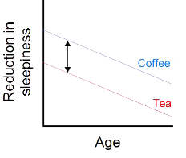

Theoretical Assumption of Network Meta-Analysis (NMA)
Homogeneity
Consistency
The equivalence of trials within each pairwise comparison in the network.
When there is direct evidence, the true treatment effect is the same across all trials that allocate the two treatments →the trials should not differ in any characteristics that may impact the treatment effect (nonexistence of effect modifier)
→ modifier example: study population – different age group or route of administration
Solution to heterogeneity → Random-effect model
Direct estimation $≈$ Indirect estimation
The estimation of the relative treatment effect from direct evidence should align with the estimation from indirect evidence.
The I-squared statistic is commonly used to quantify the degree of heterogeneity within a pairwise comparison
The Cochran’s Q statistic is used to measure heterogeneity (within designs) and inconsistency (between designs)
Solution to inconsistency → network meta-regression or sensitivity analysis
Notes:
https://bookdown.org/MathiasHarrer/Doing_Meta_Analysis_in_R/netwma.html
https://www.quantics.co.uk/blog/an-introduction-to-network-meta-analysis/
https://www.ncbi.nlm.nih.gov/pmc/articles/PMC8497908/#:~:text=To%20perform%20NMA%20using%20data,mixed%20comparisons%20(direct%20and%20indirect

Slide 7
Solution to Heterogeneity→ Choice of Model for NMA
Fixed-effect model
Random-effect model
Assumes that the true effect size is the same for all studies included in the pairwise meta-analysis.
Any differences in observed effect sizes between studies are due to chance, measurement error, or sampling variability
Assumes that the true effect size is a distribution, and it may vary across studies due to differences in study characteristics or populations.
In this model, each study is assumed to estimate a different true effect size, and the observed variation between studies is NOT just due to chance.
The model gives more weight to studies with larger sample sizes, but also allows for the possibility that there is some heterogeneity in the true effect size across studies.
Notes:
https://www.quantics.co.uk/blog/an-introduction-to-network-meta-analysis/

Slide 8
Comparison of R tools

Slide 9
Comparison of NMA tools
NMA can be performed using the following commonly used R tools:
1) R package netmeta is designed to perform frequentist NMA, while 2) the package gemtc is designed to perform Bayesian NMA.
3) R Shiny MetaInsight utilizes both Frequentist and Bayesian approaches through R packages netmeta and gemtc
NMA - R Tools | R package: netmeta (code) | R package: gemtc (code) | R Shiny: MetaInsight (website)
Estimation Approach | Frequentist NMA | Bayesian NMA | Frequentist / Bayesian NMA
R Function: Perform NMA | netmeta() | mtc.model() | V
Forest Plot | forest() | forest() | V
Network Plot | netgraph() | plot() for mtc.network() | V
Inconsistence Test | netsplit() | mtc.nodesplit() | V
Treatment Ranking | netrank() | rank.probability() | V (Bayesian NMA only)
Pair Comparison of Treatment | netleague() | relative.effect.table() | V
Pros | customized plot and output | 1. customized plot and output 2. with small n, prior can be informative*. | 1. easy to use (web-application, no R codes) 2. can perform subgroup analysis
Cons | 1.pre-processing for contrast-based data 2.no subgroup analysis function | computationally expensive | cannot specify prior and MCMC setting**
* When the sample size is large, the results of Bayesian approach tend to converge towards the frequentist approach (reason: n ↑ prior influence ↓)
** Bayesian network meta-analysis with heterogeneity priors accounts for treatment effect variability across studies In MetaInsight, the standard deviation of prior follows U(0,X),
where X represents a large difference in the outcome. Thus, the prior setting allows substantial heterogeneity in the treatment effects across studies, producing stable results.
9

Slide 10
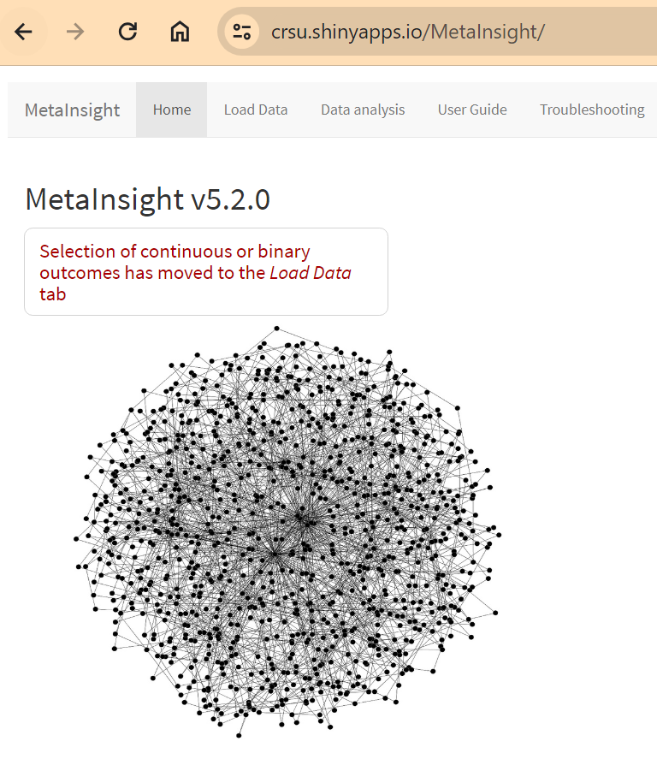
DEMO R Shiny MetaInsight https://crsu.shinyapps.io/MetaInsight/
Disease: MDD
Outcome: Proportion of early responders (Odds Ratio)
Dataset: Linde (2015)
59 Studies
9 Interventions

Slide 11
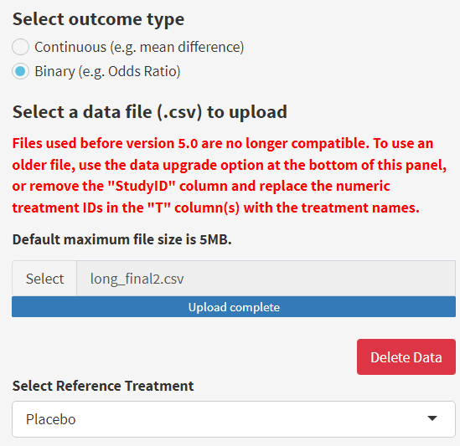
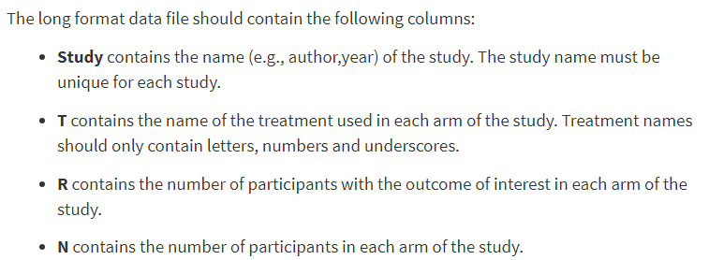
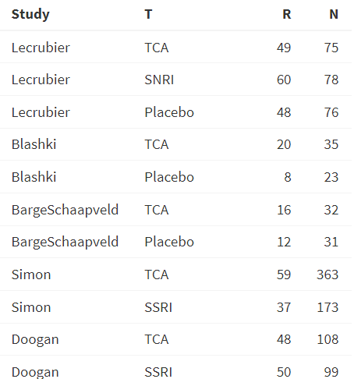
Step1. Data Input (long format or wide format)
Upload Data file and Select Reference Treatment
Header of the Data
Long format (CSV file)

Slide 12
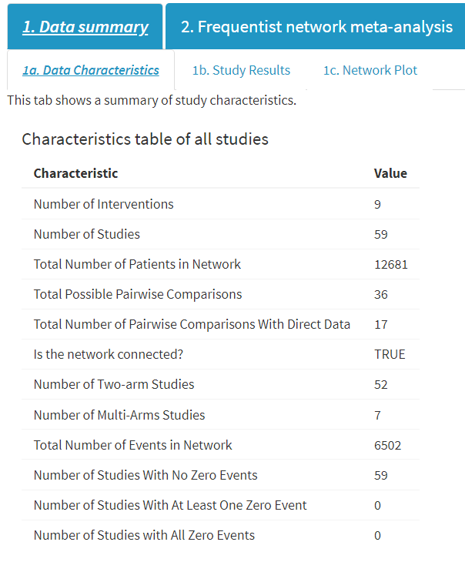
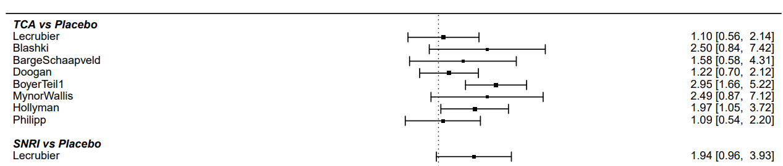
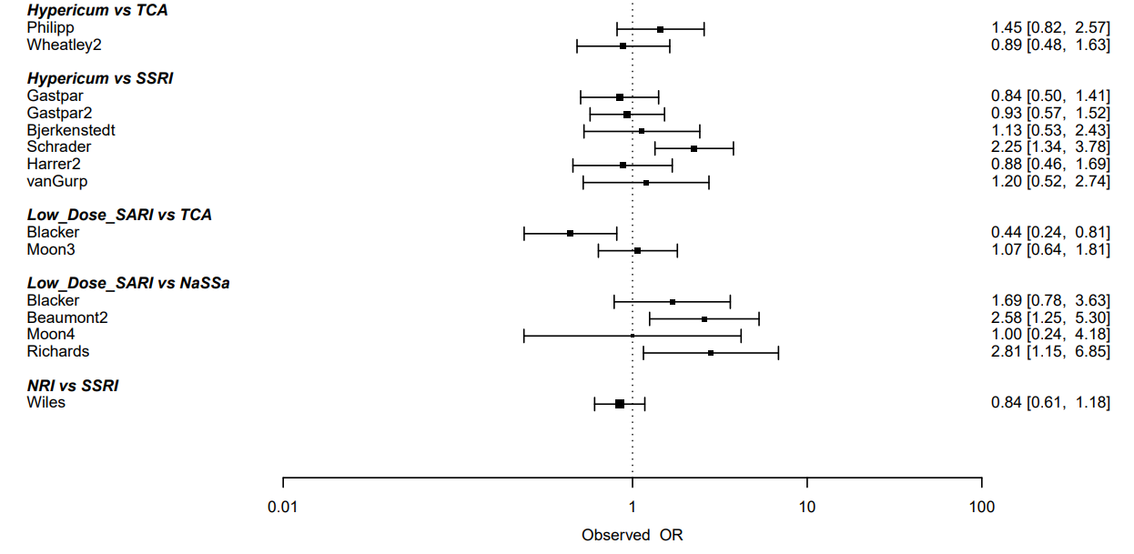
Step2. Data Summary
1b. Study Results
Direct Estimation of Relative Treatment Effect
(Obtained by Pairwise Meta-Analysis Results)
)
1a. Data Characteristics

Slide 13
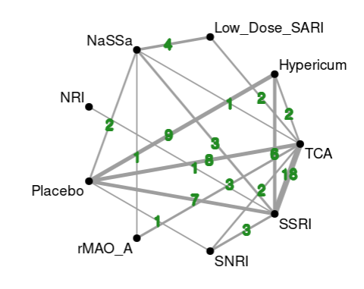
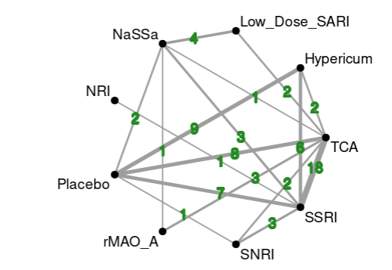
Step3. Network Plot
NMA can estimate the relative effects between any pair of treatments included in the network
(Indirect Estimation: the red dashed line)
Known Relative Effect (Grey Solid Line)
NMA
*Number of trials shown on the line

Slide 14
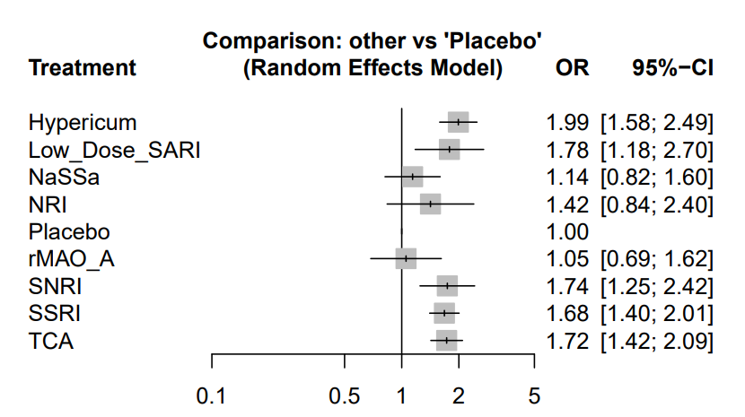
Step4. Obtain the Result of NMA – Forest Plot
R Shiny MetaInsight limitation:
1. CANNOT change the digits for rounding in forest plot 2. CANNOT change prior assumption (default setting: SD follows uniform distribution) and MCMC setting, including number of chain (4), number of iteration (25000), burn-in (5000), sample size per chain (20000), thinning interval (1)

Slide 15
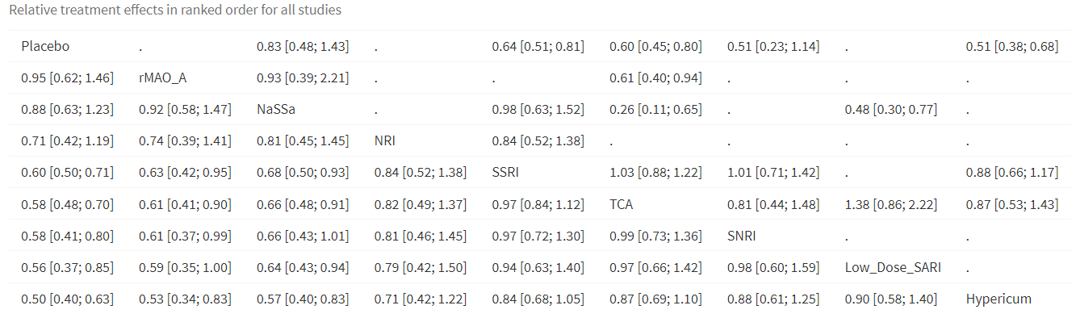
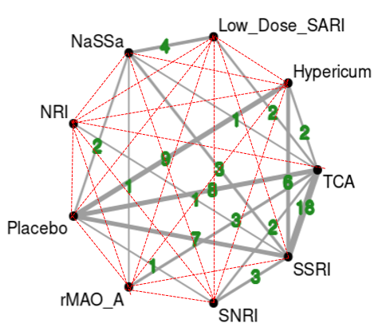
Step5. Obtain the Result of NMA – Comparison of All Treatment Pairs
Given the large sample size (average n = 215 per study), the results of the frequentist and Bayesian approaches in the network meta-analysis are similar.
*R Shiny MetaInsight limitation → CANNOT assign the sequence of the treatments shown in the pair-comparison matrix

Slide 16
Thank You!
Conclusion and Discussion
With the magic of NMA, we can estimate the relative treatment effect without direct evidence

Slide 17
Thank You!
Reference
Cipriani, A., Higgins, J. P., Geddes, J. R., & Salanti, G. (2013). Conceptual and technical challenges in network meta-analysis. Annals of internal medicine, 159(2), 130-137.
Owen, R. K., Bradbury, N., Xin, Y., Cooper, N., & Sutton, A. (2019). MetaInsight: An interactive web‐based tool for analyzing, interrogating, and visualizing network meta‐analyses using R‐shiny and netmeta. Research synthesis methods, 10(4), 569-581.
Rouse, B., Chaimani, A., & Li, T. (2017). Network meta-analysis: an introduction for clinicians. Internal and emergency medicine, 12, 103-111.
Schwarzer, G., Carpenter, J. R., & Rücker, G. (2015). Meta-analysis with R (Vol. 4784). Cham: springer.
Shim, S. R., Kim, S. J., Lee, J., & Rücker, G. (2019). Network meta-analysis: application and practice using R software. Epidemiology and health, 41.

Slide 18


Thank You!
Pei-Shan Yen
pyen2@uic.edu
https://github.com/psyen0824/NMA
NMA Slide and R code (scanned QR code)

