Slide 1

Network Meta Analysis (NMA)
Pei-Shan Yen, PhD Candidate
Division of Epidemiology and Biostatistics
UIC
Mar 01, 2024

Slide 2



Agenda
Motivation
Conceptual Idea of Network Meta-Analysis (NMA)
Comparison of R tools
Demonstration of R Shiny – MetaInsight
Conclusion and Discussion

Slide 3

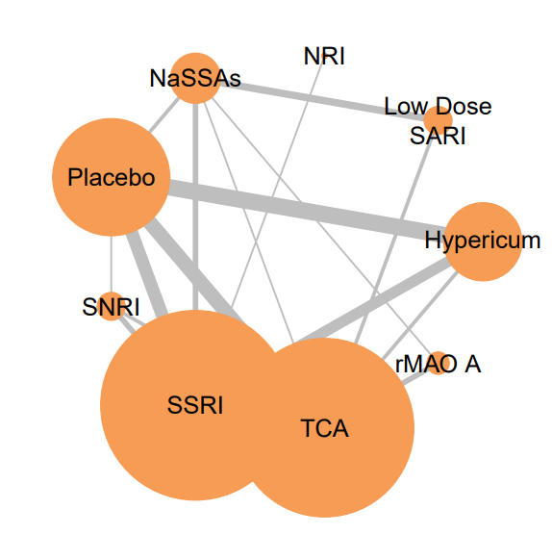

Motivating Example
Known Relative Effect (Grey Solid Line)
$$?$$
Is it possible to estimate the relative treatment effect between NaSSAs and Hypericum for the patients suffering from MDD?

Slide 4




Definition
Network Meta Analysis (NMA) is a technique for COMPARING MUTIPLE TREATMENTS simultaneously in a SINGLE ANALYSIS by combining direct and indirect evidence within a network of randomized controlled trials. (Rouse et at., 2017) (aka. multiple-treatment meta-analysis, mixed treatment comparison)

Slide 5
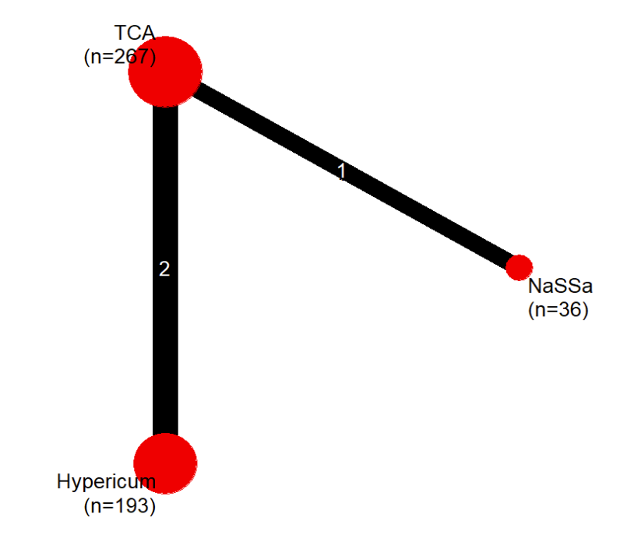




Conceptual Idea of Network Meta-Analysis (NMA)
NMA Procedure
Network Plot
Example
Disease: Major Depressive Disorder (MDD)
Dataset: Linde et al. (2015)
Outcome: Proportion of Early Responders
- 3 Studies; 3 Interventions: TCA(T), Hypericum(H), NaSSAs(N)
Goal: aim to estimate the relative treatment effect between H and N
$$\text{Direct} \text{Estimation}$$
$$OR: \frac{T}{N}=3.83$$
T
Study 3
Conceptual Idea of NMA
Step 1. Conduct systematic review related to the intervention $H$ and N
Step 2. Produce the Network Plot & identify intermediate comparator $T$
Step 3. Calculate the relative effects within the network directly
→ obtain direct estimation $\left(H/T\right)$ and $\left(T/N\right)$ from existing trials
Step 4. Calculate the relative effects within the network indirectly
→ obtain indirect estimation of $\left(H/N\right)$ through $T$
Study 1 and 2
Direct Estimation
$$OR: \frac{H}{T}=1.15$$
N
NaSSAs
A
Indirect Estimation Approach
Indirect Estimation Approach: Indirect Effect = Product of Direct Effects
$$Indirect Effect$$
$$OR:\frac{H}{N}=\frac{H}{T}×\frac{T}{N}=1.15×3.83=4.41$$
H
$$\left(H/N\right) = \left(H/T\right) ×\left(T/N\right)$$
$$4.41 = 1.15 × 3.83$$
5

Slide 6
Comparison of R tools

Slide 7
Comparison of NMA tools
Network meta-analysis (NMA) can be performed using the following commonly used R tools:
1) R package netmeta is designed to perform frequentist NMA, while 2) the package gemtc is designed to perform Bayesian NMA.
3) R Shiny MetaInsight utilizes both Frequentist and Bayesian approaches through R packages netmeta and gemtc
NMA - R Tools | R package: netmeta (code) | R package: gemtc (code) | R Shiny: MetaInsight (website)
Estimation Approach | Frequentist NMA | Bayesian NMA | Frequentist / Bayesian NMA
R Function: Perform NMA | netmeta() | mtc.model() | V
Forest Plot | forest() | forest() | V
Network Plot | netgraph() | plot() for mtc.network() | V
Inconsistence Test | netsplit() | mtc.nodesplit() | V
Treatment Ranking | netrank() | rank.probability() | V (Bayesian NMA only)
Pair Comparison of Treatment | netleague() | relative.effect.table() | V
Pros | customized plot and output | 1. customized plot and output 2. with small n, prior can be informative*. | 1. easy to use (web-application, no R codes) 2. can perform subgroup analysis
Cons | 1.pre-processing for contrast-based data 2.no subgroup analysis function | computationally expensive | cannot specify prior and MCMC setting**
* When the sample size is large, the results of Bayesian approach tend to converge towards the frequentist approach (reason: n ↑ prior influence ↓)
** Bayesian network meta-analysis with heterogeneity priors accounts for treatment effect variability across studies In MetaInsight, the standard deviation of prior follows U(0,X),
where X represents a large difference in the outcome. Thus, the prior setting allows substantial heterogeneity in the treatment effects across studies, producing stable results.
7

Slide 8
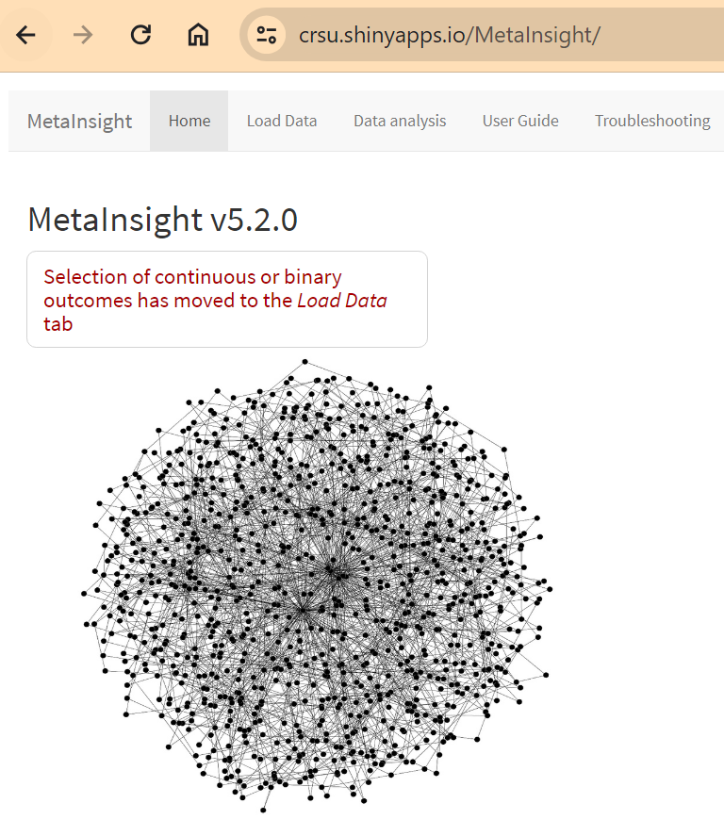
NMA results obtained by R Shiny MetaInsight
Disease: MDD
Outcome: Proportion of early responders (Odds Ratio)
Dataset: Linde (2015)
59 Studies
9 Interventions

Slide 9
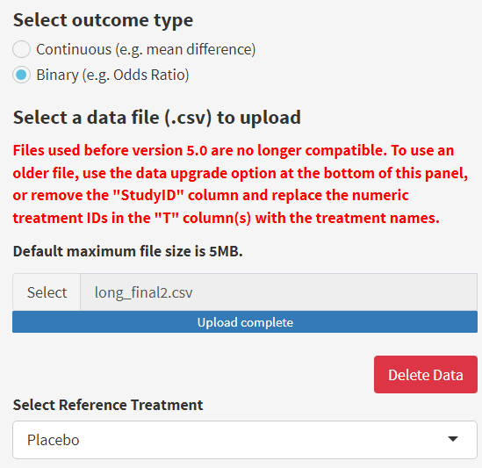
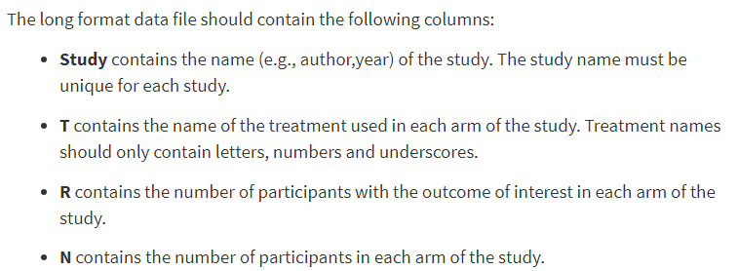
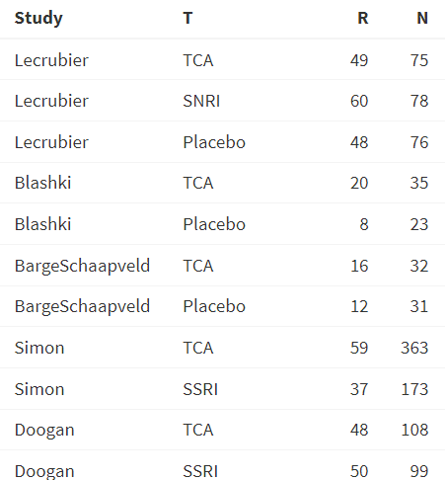
Step1. Data Input (long format or wide format)
Upload Data file and Select Reference Treatment
Header of the Data
Long format (CSV file)

Slide 10
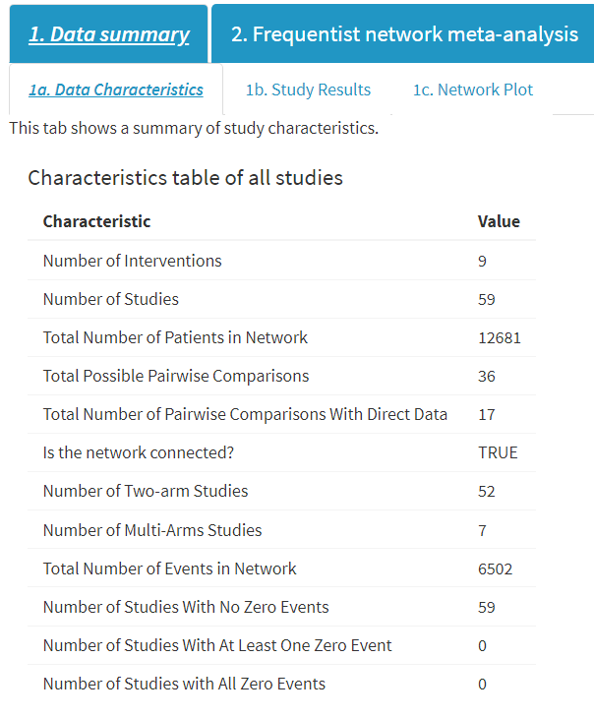
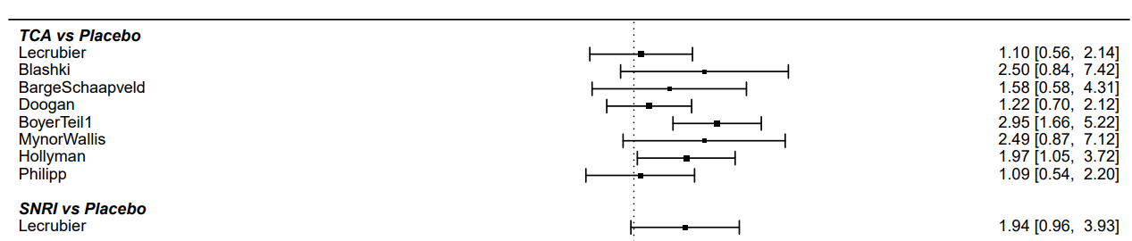
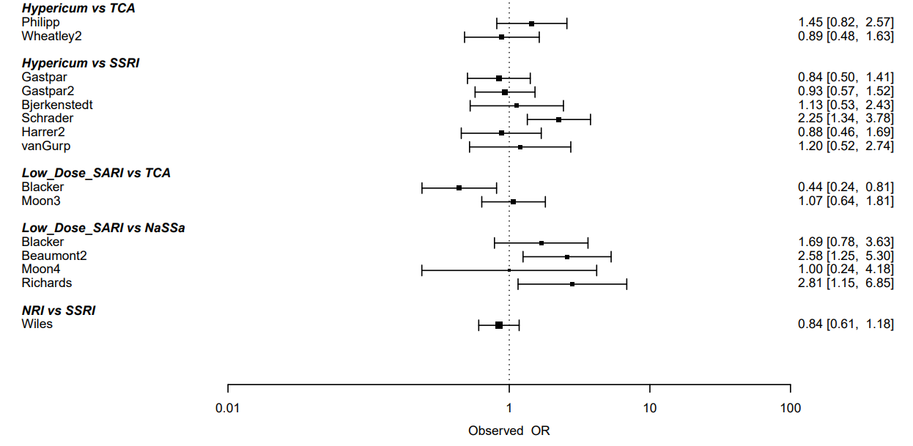
Step2. Data Summary
1b. Study Results
Direct Estimation of Relative Treatment Effect
(Obtained by Pairwise Meta-Analysis Results)
)
1a. Data Characteristics

Slide 11
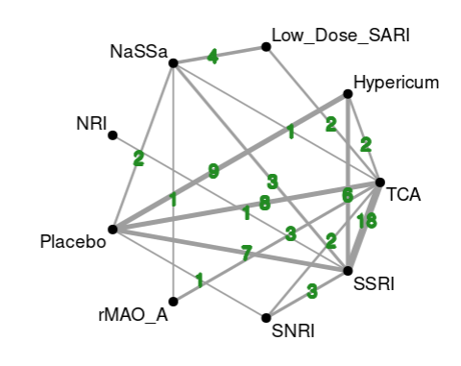
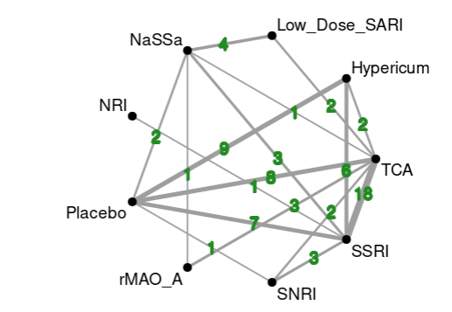
Step3. Network Plot
NMA can estimate the relative effects between any pair of treatments included in the network
(Indirect Estimation: the red dashed line)
Known Relative Effect (Grey Solid Line)
NMA
*Number of trials shown on the line

Slide 12
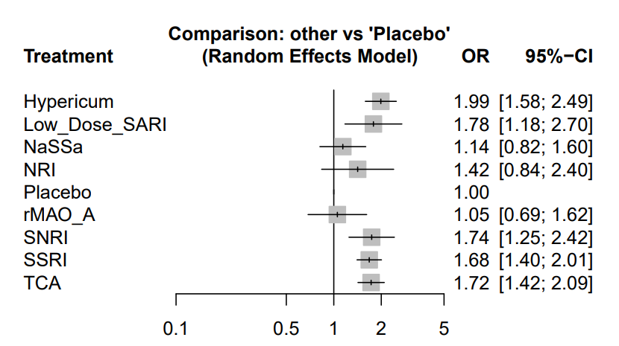
Step4. Obtain the Result of NMA – Forest Plot
R Shiny MetaInsight limitation:
1. CANNOT change the digits for rounding in forest plot 2. CANNOT change prior assumption (default setting: SD follows uniform distribution) and MCMC setting, including number of chain (4), number of iteration (25000), burn-in (5000), sample size per chain (20000), thinning interval (1)

Slide 13
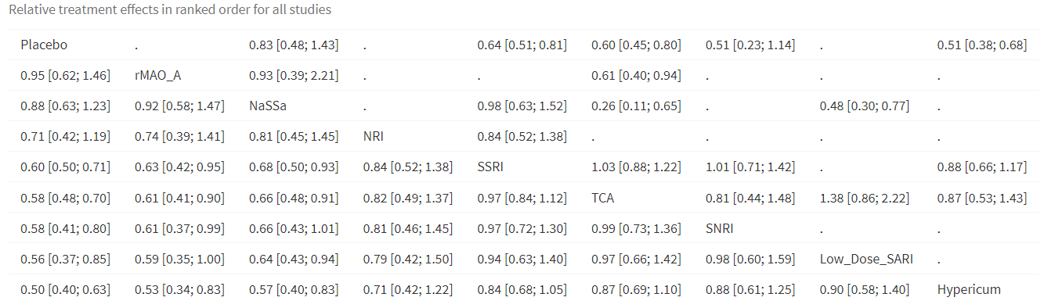
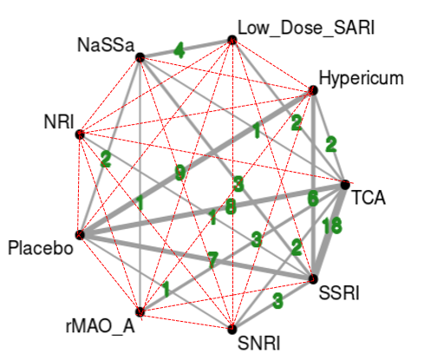
Step5. Obtain the Result of NMA – Comparison of All Treatment Pairs
Given the large sample size (average n = 215 per study), the results of the frequentist and Bayesian approaches in the network meta-analysis are similar.
*R Shiny MetaInsight limitation → CANNOT assign the sequence of the treatments shown in the pair-comparison matrix

Slide 14
R Code for R package netmeta and gemtc

Slide 15
R Code - Frequentist NMA – R package netmeta
library(netmeta)
data.long.arm.base <- read.csv("RGX.NI.test3_long.arm.base.csv")
# pairwise: Transform arm-based formats into contrast-based format
data.parawise <- pairwise(treat = treatment, n = sampleSize, mean = mean, sd = std.dev,
data = data.long.arm.base , studlab = Study)
nma_Freq <- netmeta(data.parawise, sm ="MD", reference.group = "Sham")
summary(nma_Freq, ref="Sham")
forest(nma_Freq, ref="Sham", xlab="Change in BCVA", pooled="common")
# network graph
netgraph(nma_Freq)
# Treatment Ranking
netrank(nma_Freq, small.values = "undesirable", method = "SUCRA")
# 2a. Forest Plot
forest(nma_Freq, ref="Sham", xlab="Change in BCVA", pooled="common")
# 2b. Comparison of all treatment pairs
pairs <- netleague(nma_Freq, digits = 2, seq=c("Aflibercept","Brolucizumab","Faricimab","Ranibizumab","Sham"))
# 2c. Inconsistency
# global approach
decomp.design(nma_Freq)
# local approach
print(netsplit(nma_Freq), digits=2)

Slide 16
R Code - Bayesian NMA - R package gemtc
library(rjags)
library(gemtc)
# network setup: data with long arm-based format
NMA_Baye <- mtc.network(data.ab = data.long.arm.base)
summary(NMA_Baye)
plot(NMA_Baye)
# network model - fixed effect model
model_Baye <- mtc.model(NMA_Baye, linearModel= "fixed", n.chain=4)
# need to install JAGS software
mcmc_Baye <- mtc.run(model_Baye, n.adapt=5000, n.iter=20000, thin=1)
summary(mcmc_Baye)
plot(mcmc_Baye)
gelman.plot(mcmc_Baye)
# Rank probabilities indicate the probability for each treatment to be best, second best, etc.
ranks <- rank.probability(mcmc_Baye)
print(sucra(ranks))
# 2a. Forest Plot
forest(relative.effect(mcmc_Baye, t1="Sham"), digits=4)
# 2b. Comparison of all treatment pairs
round(relative.effect.table(mcmc_Baye, covariate=NA), 2)
# 2c.Inconsistency
# Split nodes
nodesplit <- mtc.nodesplit(NMA_Baye, linearModel = "fixed", n.adapt = 5000, n.iter = 20000, thin = 1)

Slide 17


Thank You
Pei-Shan Yen
pyen2@uic.edu
Website address

