Slide 1


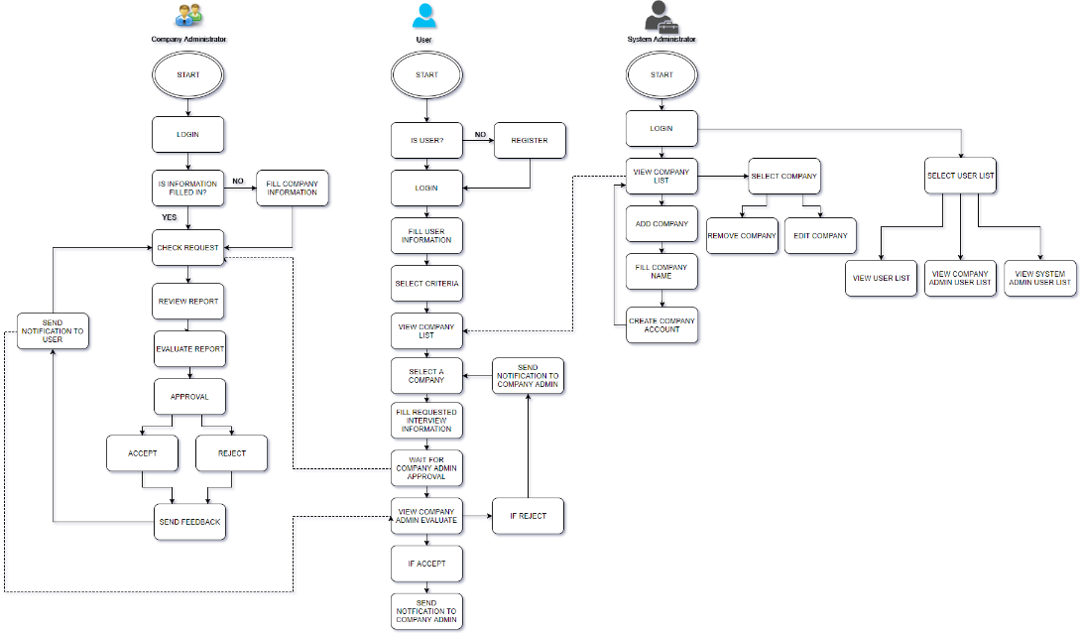
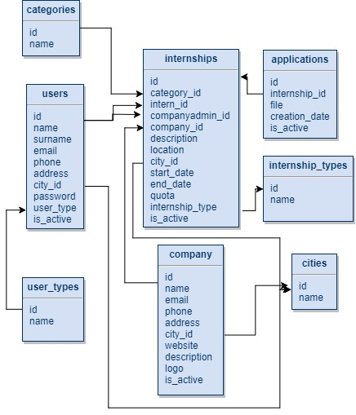

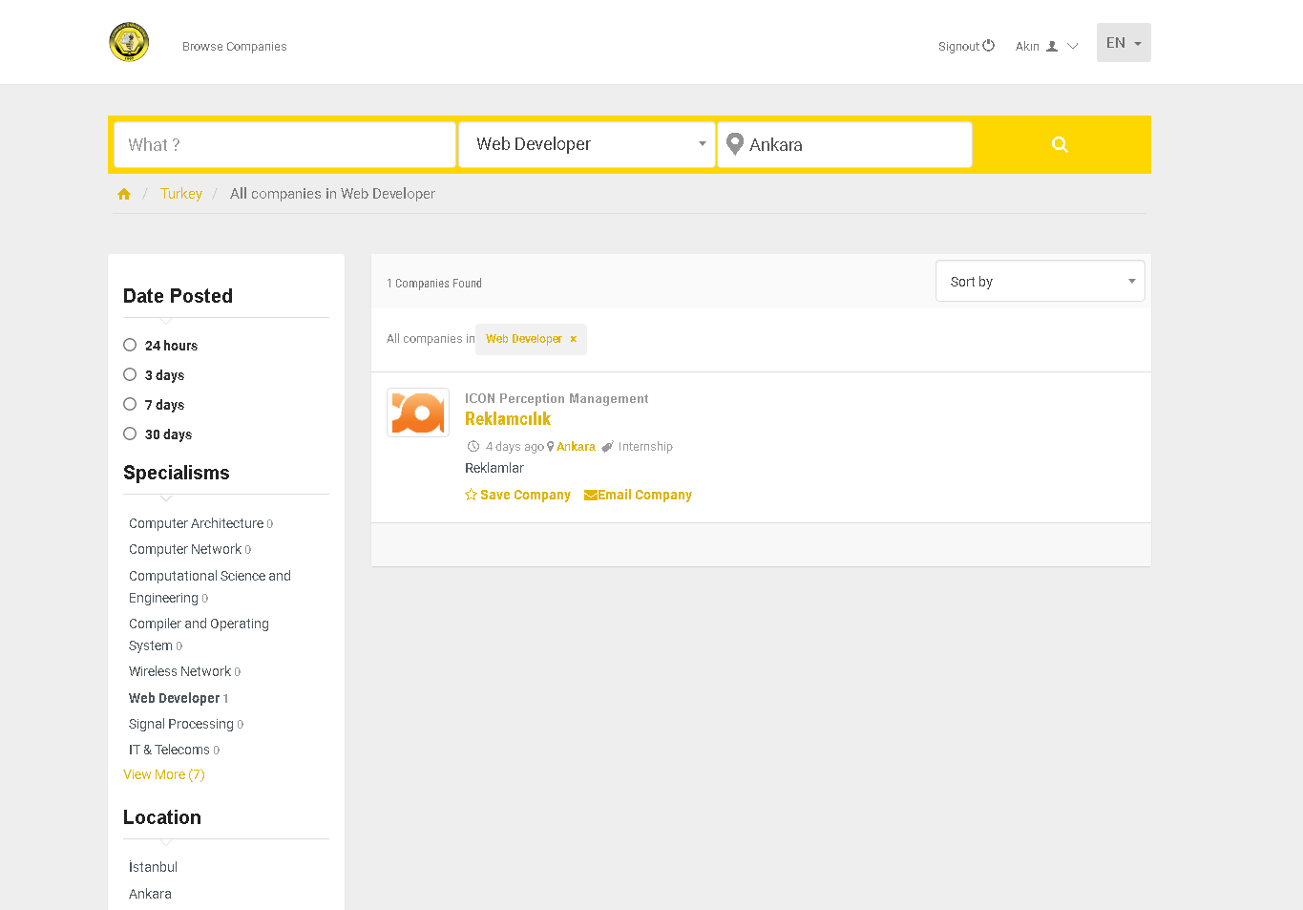
INTERNSHIP MANAGEMENT SYSTEM
Akın TAŞKIN
Advisor Assoc. Prof. Reza ZARE HASSANPOUR
Çankaya University, Department of Computer Engineering
Abstract
Computer engineering students need to have internship experience that is as important as theoretical part of education to be graduated. However, finding an appropriate workplace can take too much time in education semester and it is possible that a student can miss intern requests of most wanted companies. Moreover, each student has different skills and variety of interest on computer science. In our “Internship Management System”, project attempts to provide a solution to these problems. Student skills will be transcripts of computer engineering students and the project was determined based on Çankaya University Engineering Faculty’s internship regulations. With this project, we aim to facilitate the work of computer engineering students of Çankaya University who want to find appropriate internship workplace to translate their theoretical skills to efficient internship experience.
Keywords: internship, maximal matching, assignment, online interview.
Solution
To eliminate these problems which we mentioned, our project’s aim is to developed a user-friendly web-based system to pair students with companies according to theoretical skills of students and requests of organizations. To make this possible, we will design and develop a novel maximal matching algorithm with using multiple criteria. The companies can arrange online interviews to test students that the system matches. The system will collect feedbacks from both students and companies for maintenance.
Results & Conclusion
As a result, this web application will bring improvement to Internship Management System and I believe that there is requisition for such a web application system. After finishing the project, Computer Engineering students at Çankaya University will facilitate the study of students who want to find suitable internships to translate their theoretical skills into productive internship experiences.
Acknowledgement
I would like to than my advisor Assoc. Prof. Reza ZARE HASSANPOUR for his guiding and supporting me over the semester. His discussion, ideas, and feedback of computer science have been invaluable and helped us during the preparing this statements and his support kept us on the track.
Figure 1 - Flowchart
Introduction
Internship of university students is quite important as theoretical part of their education life. Students have opportunity to understand working areas and translate their theoretical skills to practical. However, there is no automation system that search internship opportunities. Students have responsibility to find organization to work for it. Opportunities to find an internship workplace on the Internet are increasing with the developing technology. Students can fill application forms of companies and wait for the answer like an acceptance mail. However, time is the most important problem for students like for other people. In their intensive education life, students may not have time to search for appropriate workplace.
Figure 2 – Database
Figure 3 – Finished Product
201111047 - Akın TAŞKIN

