Slide 1

Internship Management System
Project Member: Akın TAŞKIN
Advisor: Asist. Prof. Dr. Engin DEMİR

Slide 2
Contents
Problem
Analysis
Solution
Results and Conclusion
Demo
References

Slide 3
Problem
Many companies accept internships for computer engineering students. However, there is no quick way to find a suitable organization for students’ theoretical competence.
In addition, Department of Computer Engineering at Çankaya University does not have an automated system to record and manage internships for students.

Slide 4
Problem
If a student does not find a suitable organization, he/she can work on the undesirable sector.
As a result, this issue leads to an ineffective and depressive internship process.

Slide 5
Analysis
Assignment Problem
The aim of the assignment models is to assign the most suitable workers to task and to set the lowest cost placement.
The goals are the minimum cost and maximum profit.

Slide 6
Analysis
Maximal Matching Problem
Self-stabilizing maximal matching algorithm combines all of these algorithms in the same time complexity as the previous best algorithms for opposing, equitable class, successive opposing daemon and simultaneous daemon.
Also, this algorithm improves the previous best time complexity for a distributed opposing daemon.

Slide 7
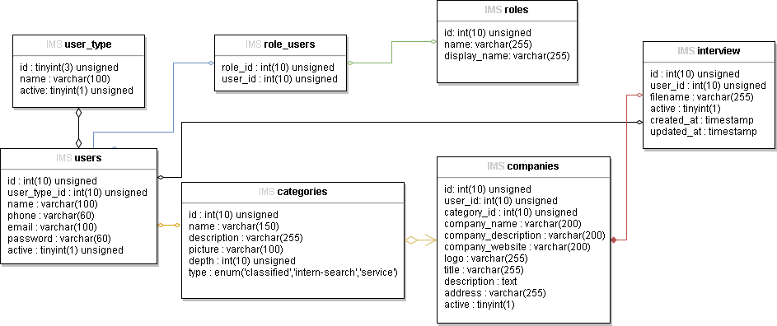
Solution
Figure 1: Database Diagram

Slide 8
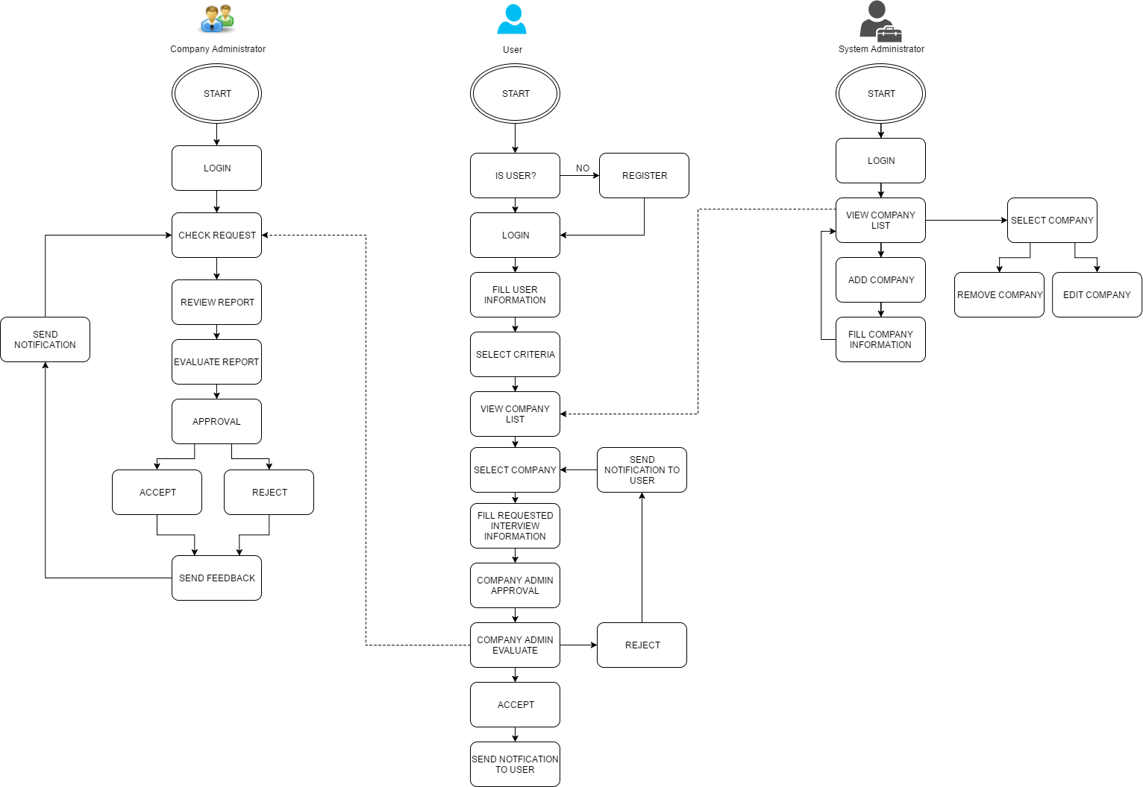
Solution
Figure 2: Flowchart

Slide 9
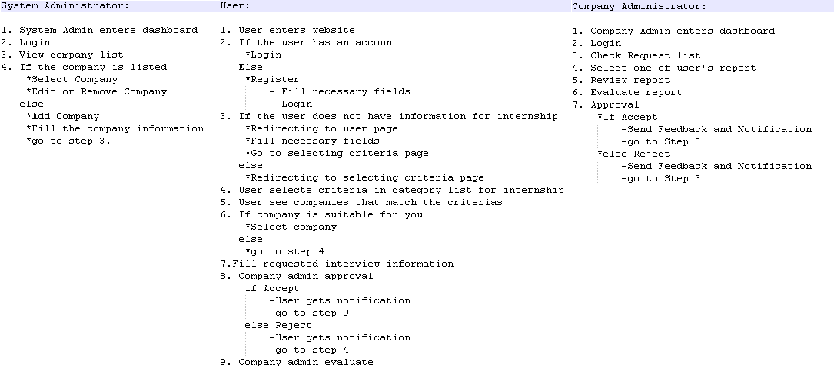
Solution
Figure 3: Pseudo Code

Slide 10
Solution
PHP (Hypertext Preprocessor): A powerful tool for making dynamic and interactive Web pages.
phpMyAdmin: An open source tool written in PHP. Its primary use is to manage MySQL database over the internet.
MySQL: An open-source relational database management system.

Slide 11
Solution
Database Management System: Software that handles the storage, recovery, and updating of data in a computer system.
Adobe Dreamweaver CC: A software program for designing web pages.
Wamp Server: An integrated system software that combines MySQL, PHP installation and Apache HTTP Server.

Slide 12
Results and Conclusions
As a result, this web application will bring improvement to Internship Management System and I believe that there is requisition for such a web application system.
After finishing the project, Computer Engineering students at Çankaya University will facilitate the study of students who want to find suitable internships to translate their theoretical skills into productive internship experiences.

Slide 13
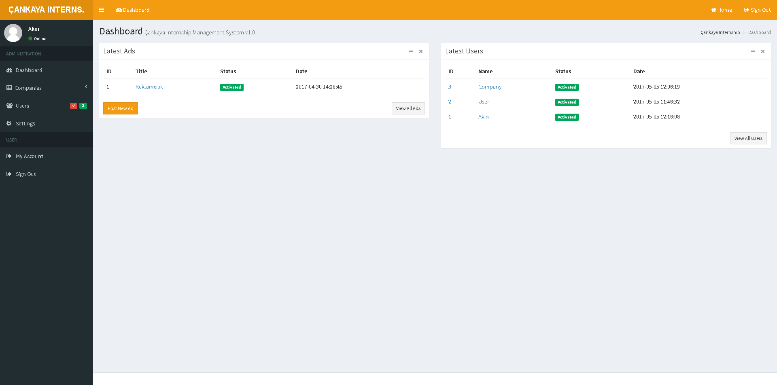
Demo
Figure 4: System Administrator Dashboard

Slide 14
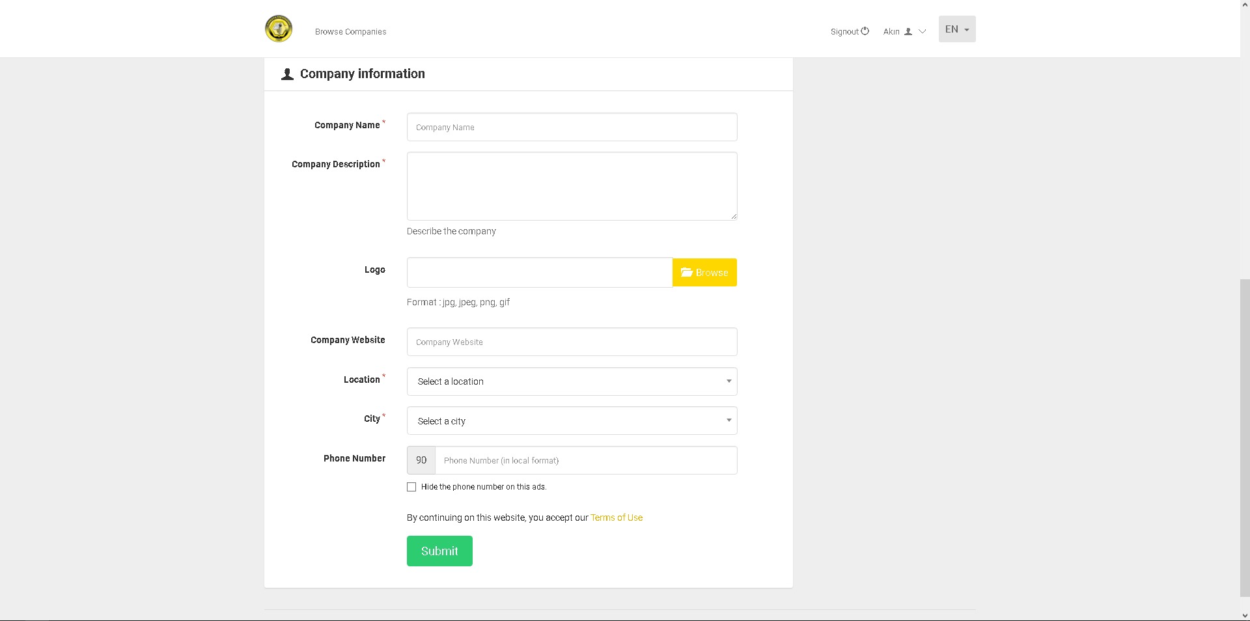
Demo
Figure 5: Add Company Interface

Slide 15
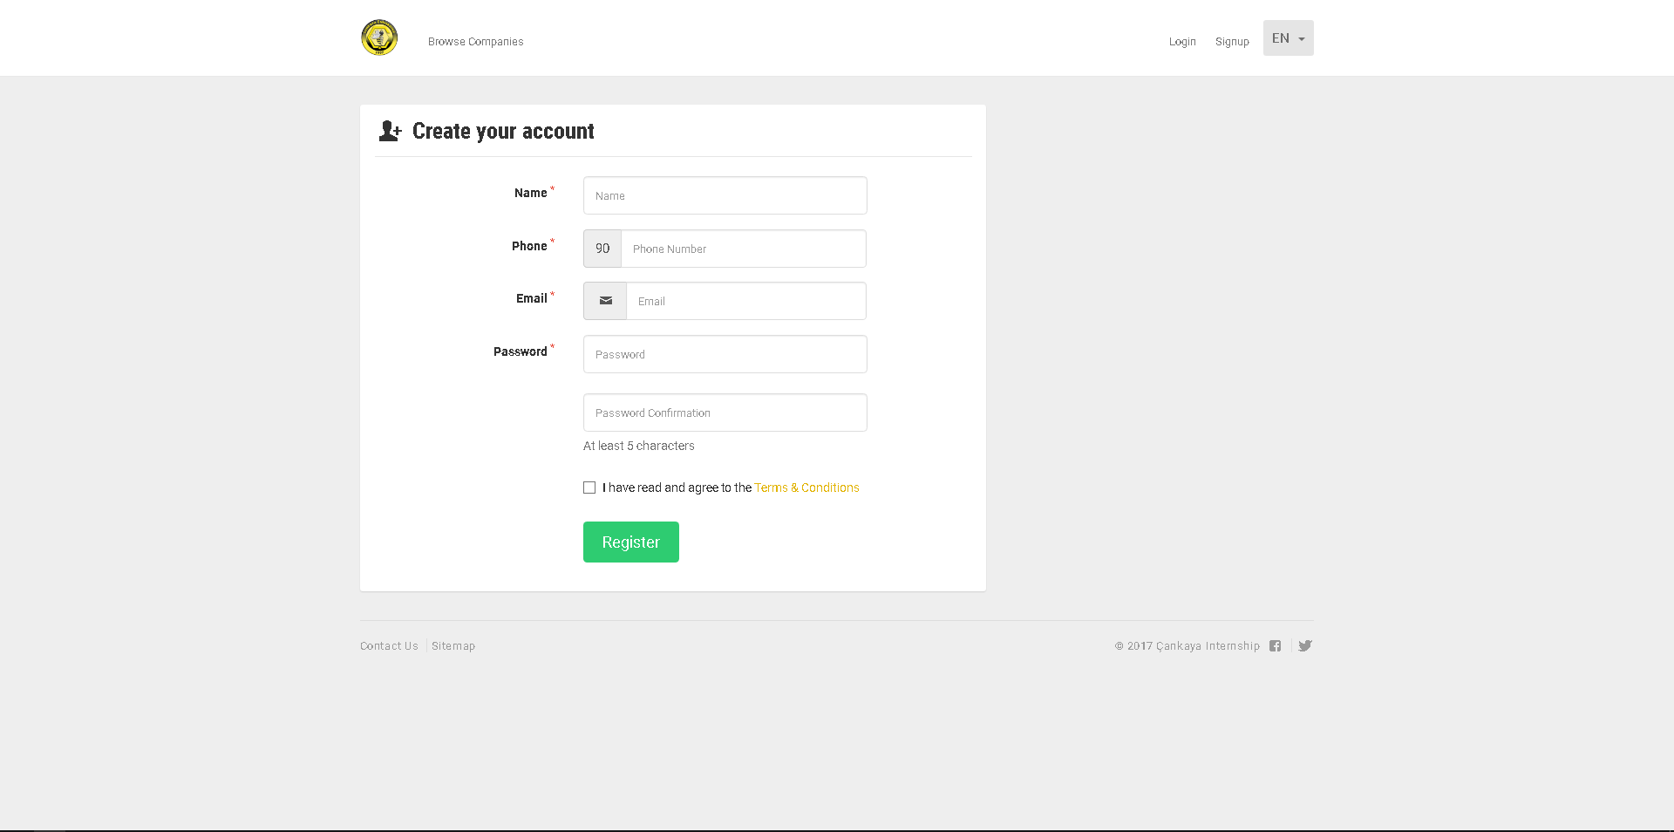
Demo
Figure 6: User Register Interface

Slide 16
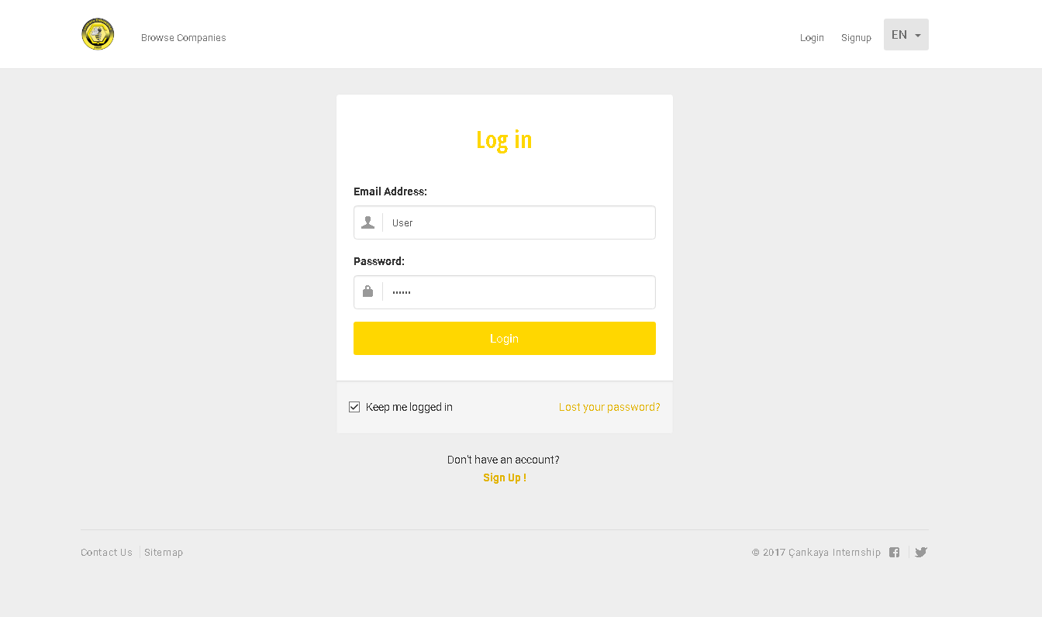
Demo
Figure 7: User Login Interface

Slide 17
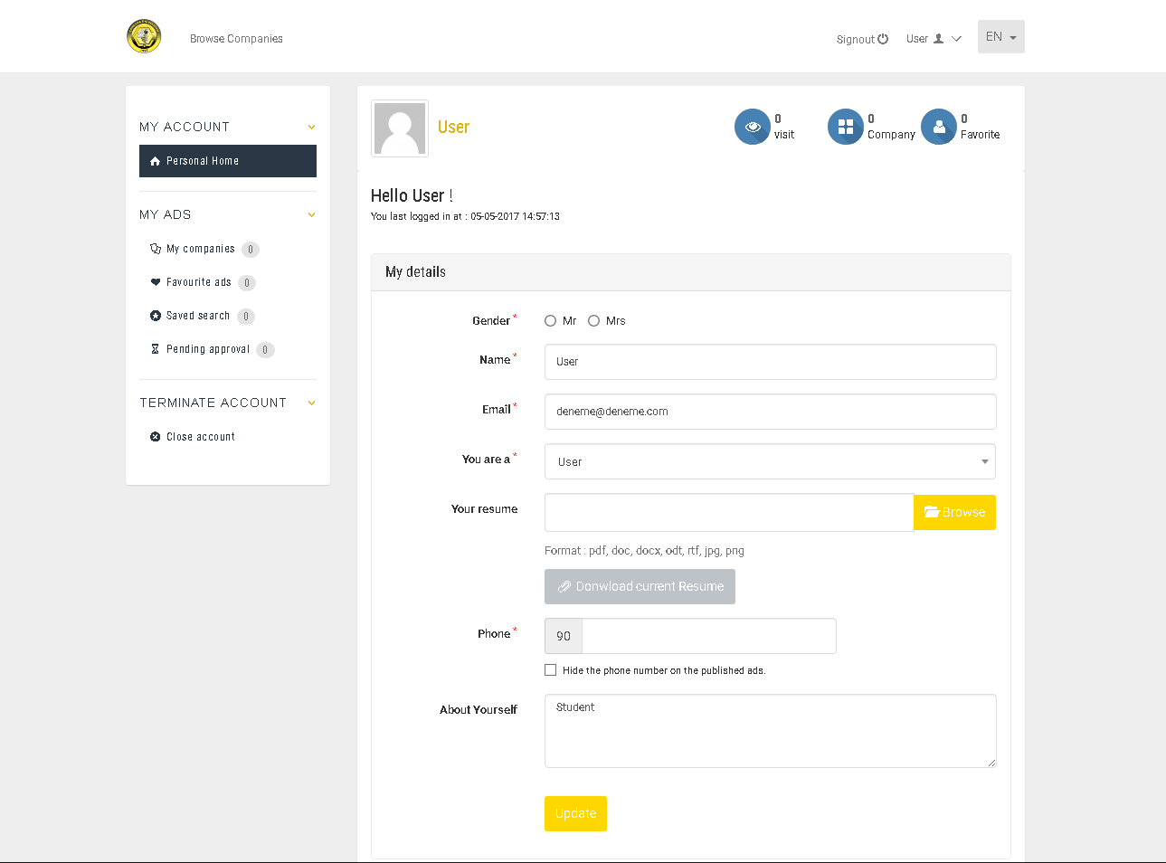
Demo
Figure 8: User Profile Interface

Slide 18
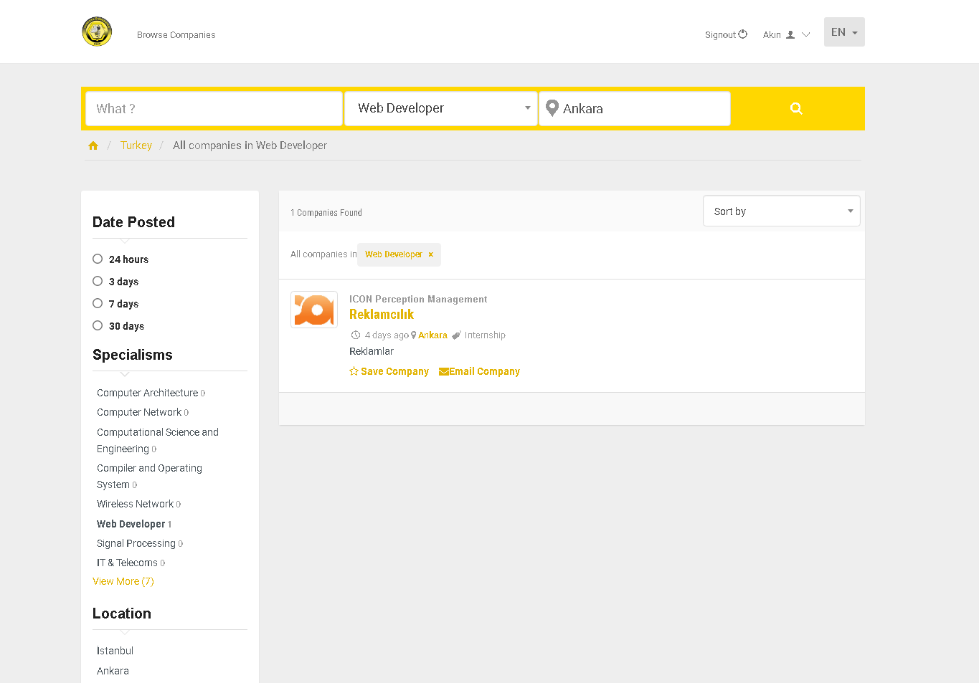
Demo
Figure 9: Search/Select Company Interface

Slide 19
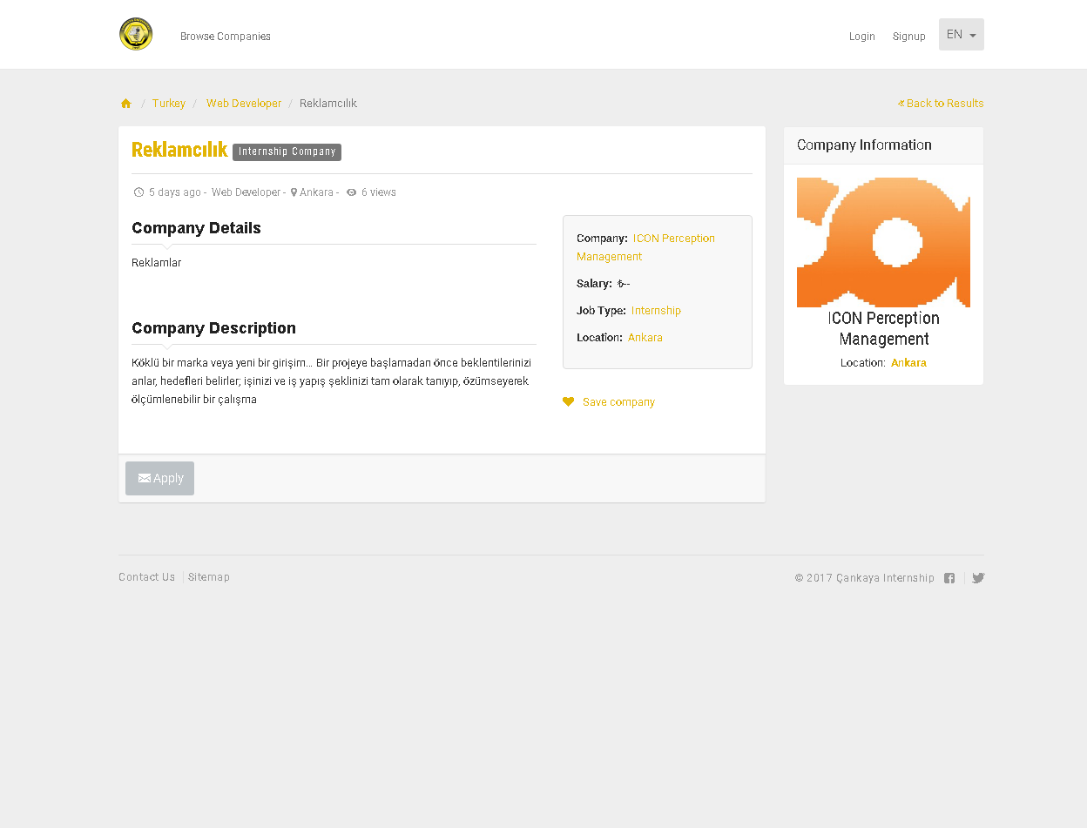
Demo
Figure 10: Company Information Interface

Slide 20
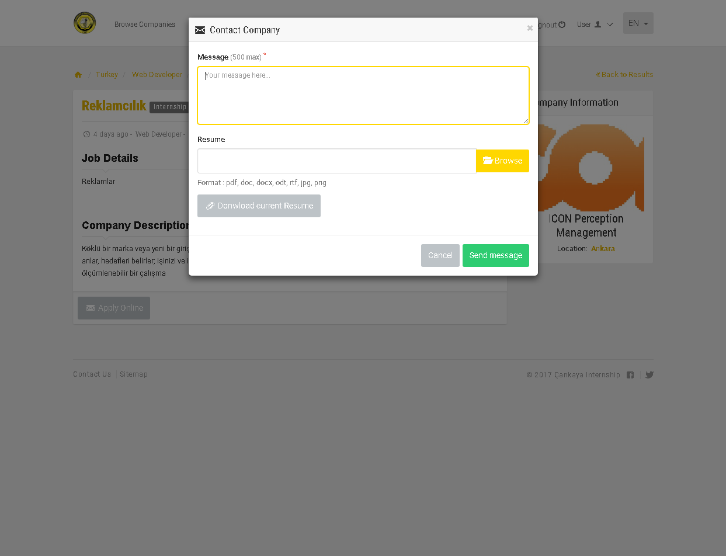
Demo
Figure 11: Interview Interface

Slide 21
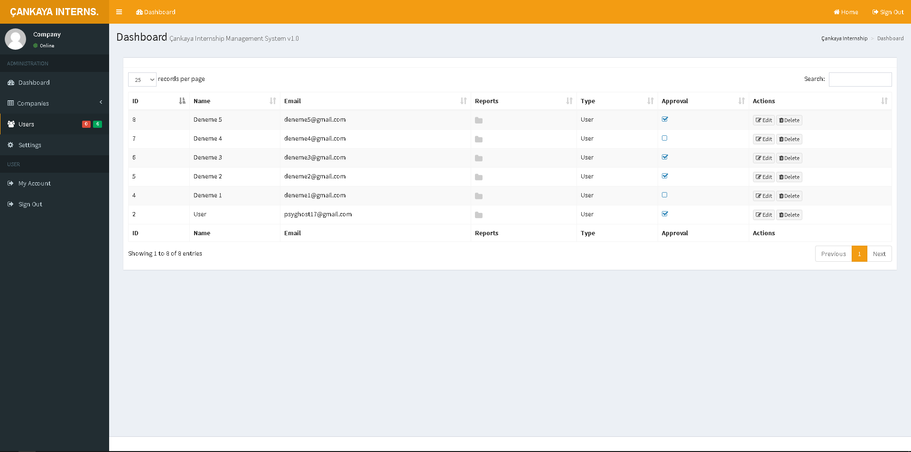
Demo
Figure 12: Company Administrator Dashboard

Slide 22
References
Burkard, R. E., & Çela, E. (1998). Linear assignment problems and extensions. Graz: Universität Graz/Technische Universität Graz. SFB F003 - Optimierung und Kontrolle.
Kakasevski, G., Mihajlov, M., Arsenovski, S., Chungurski, S., (2008). Evaluating usability in learning management system moodle. Information Technology Interfaces.
Manne, F., Mjelde, M., Pilard, L. and Tixeuil, S. (2009). A new self-stabilizing maximal matching algorithm. Theoretical Computer Science, 410(14), pp.1336-1345.
Scott, S. (2005). A study of stable marriage problems with ties.
Irving, W, R., (1990). Stable marriage and indifference. Discrete Applied Mathematics, pp.261-272.

Slide 23
Thanks for joining and listening us…

