Slide 1
Unifying Count-Based Exploration and Intrinsic Motivation
The 34th Reinforcement Learning Study Group in RECRUIT
Katsuki Ohto @ YuriCat (github)
원자료 링크 - http://www.slideshare.net/KatsukiOhto/unifying-count-based-exploration-and-intrinsic-motivation
* 구글 번역기로 원자료의 일본어를 영어로 번역함.

Slide 2
Thesis summary
Unifying Count-Based Exploration and Intrinsic Motivation (Bellemare et al. 2016)
NIPS 2016 selected paper
At MONTEZUNA'S REVENGE which was considered to be the most difficult in the game of Atari 2600
Dramatic improvement
（Play movie of MONTEZUNA'S REVENGE）
https://www.youtube.com/watch?v=0yI2wJ6F8r0
Subsequent ceremonies and figures are cited
from this paper unless otherwise noted

Slide 3
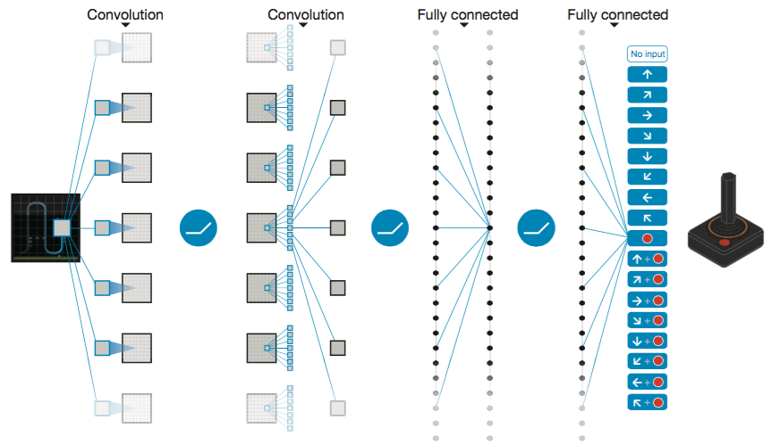
DQN (Mnih et el., 2013), (Mnih et al., 2015)
deep Q-network Prediction of the value of discrete behavior by convolutional neural network from screen pixel information
(Mnih et al., 2015)

Slide 4
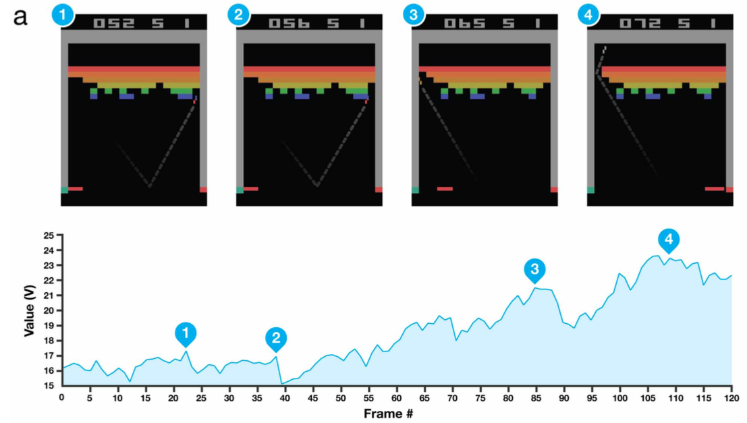
DQN (Mnih et el., 2013), (Mnih et al., 2015)
In many games of Atari 2600 I succeeded in reinforcement learning only from "image of play screen" and "reward" and improved from human Example) Block breaking
(Mnih et al., 2015)

Slide 5
Progress of DQN
Gorila DQN (Nair et al., 2015) ... Learning DQN in parallel environment
Double DQN (van Hasselt et al., 2015) ... apply Double Q-learning to learn two Q functions (in detail later)
Hierarchical-DQN (Kulkarni et al., 2016) ... DQN of hierarchical structure of low level behavioral policy and meta behavioral policy （For details, Mr. Akira Koyamada's slide http://www.slideshare.net/sotetsukoyamada/kulkarni-et-al-2016）

Slide 6
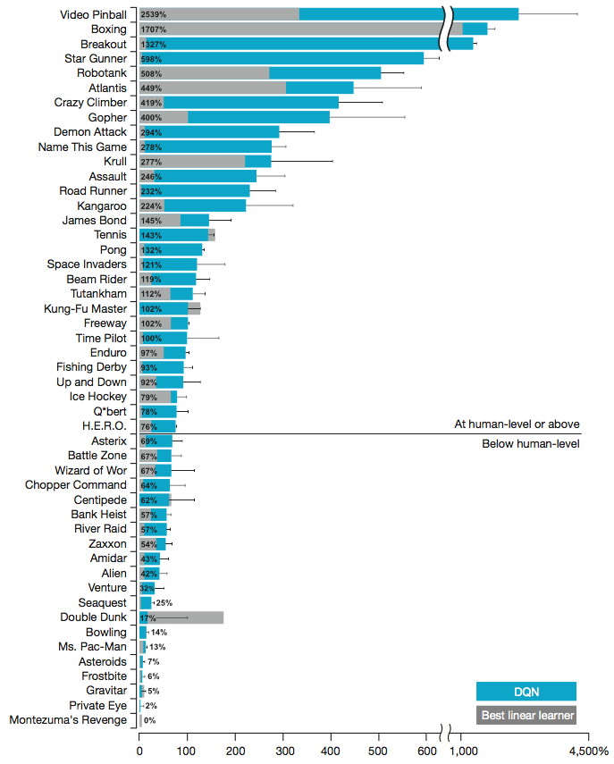
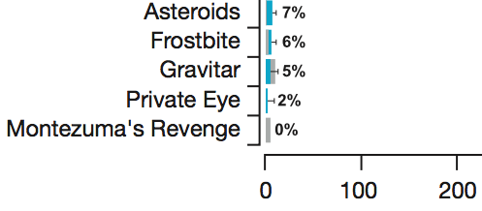
MONTEZUNA’S REVENGE
Of the games of Atari 2600, one of the games that was said to be the most difficult for DQN
(Mnih et al., 2015)
ここ

Slide 7
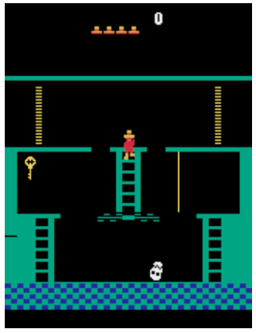
MONTEZUNA’S REVENGE
Of the games of Atari 2600, one of the games that was said to be the most difficult for DQN
・Many enemies and traps ・Maze-like configuration by many rooms ・There is little reward, less immediacy
(Kulkarni et al., 2016)

Slide 8
Motivation of this thesis
・When the reward is sparse and delayed →Exploratory behavior (exploration) is important. Therefore, I want to know if the observed state is novel
・If the state is high →Even if you actually count the number of experiences such as state, (state, action), (state, reward) Useless (less likely to reach exactly the same state)
Therefore, a pseudo number of experiences is calculated for
(no strictly) new condition, I want to promote exploratory behavior

Slide 9





Notations
A collection of alphabets
alphabet
length The column of alphabet
Combine alphabet at the end of the column

Slide 10
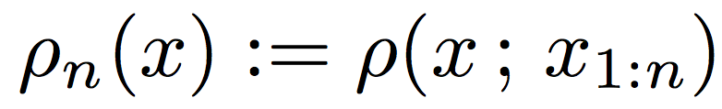
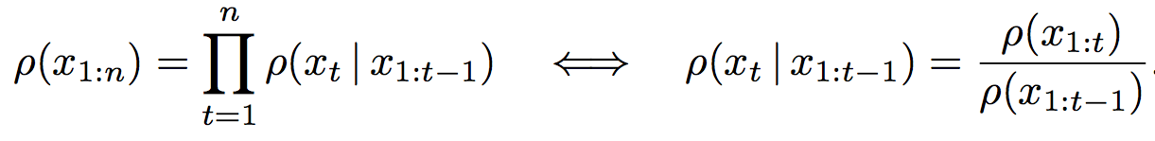
sequential density model
A model of the probability of observing x next when observing a column of length n
Especially when all the probabilities are positive
At this time it is called universal model

Slide 11
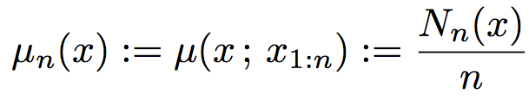
empirical estimator
Likewise, the probability of observing x next when observing a column of length n
Number of times x actually occurred in the column
The unobserved alphabet is not universal because the probability is 0

Slide 12

Proposal pseudo-count (preparation)
We observe x once and then define the probability of observation as follows
Especially in case of universal model, it can express with the following conditional probability

Slide 13
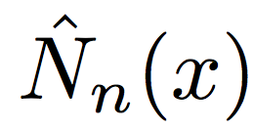
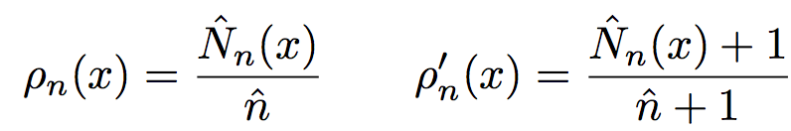
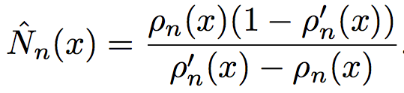
Proposal pseudo-count
At this time pseudo-count I'd like to satisfy the following formula (equation (1) on page 4)
In other words, when observing 1 time x, the total number of times and the number of times of observing x are each one
I want you to have the probability that it increased
Solving the simultaneous equations (equation (2) on page 4)

Slide 14


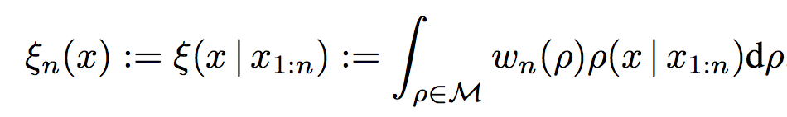
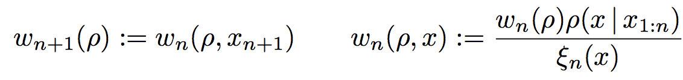
information gain
Class of sequential density model The mixed model above Use the following probability distribution function
The update formula by observation x of this weight w is
The Kulback-Leibler divergence between
the probability distributions of weights is the information gain

Slide 15

prediction gain
Calculation of information gain is difficult or undecidable
Prediction gain is a good approximation
Difference in information amount due to one observation of x

Slide 16
Relationship between pseudo-count and information gain (Theorem 2)
information gain prediction gain pseudo-count Satisfy the following relationship
Information gain is a value calculated on a mixed model, Prediction gain and pseudo-count do not need it

Slide 17
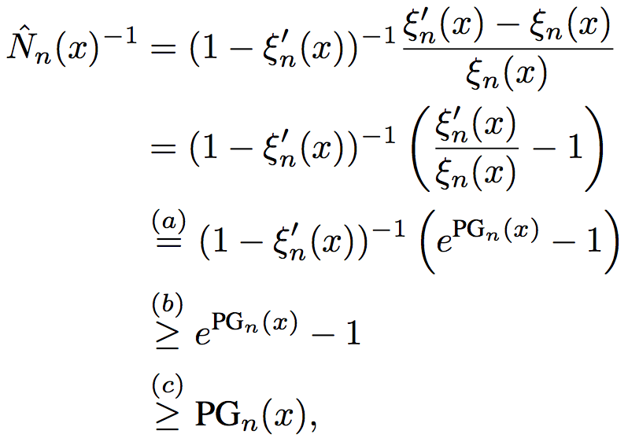
Proof of Theorem 2
Left side: KL information amount nonnegative
Right side: Expanding the expression of pseudo-count (expression (2) in p.4) and reverse the definition of prediction gain

Slide 18
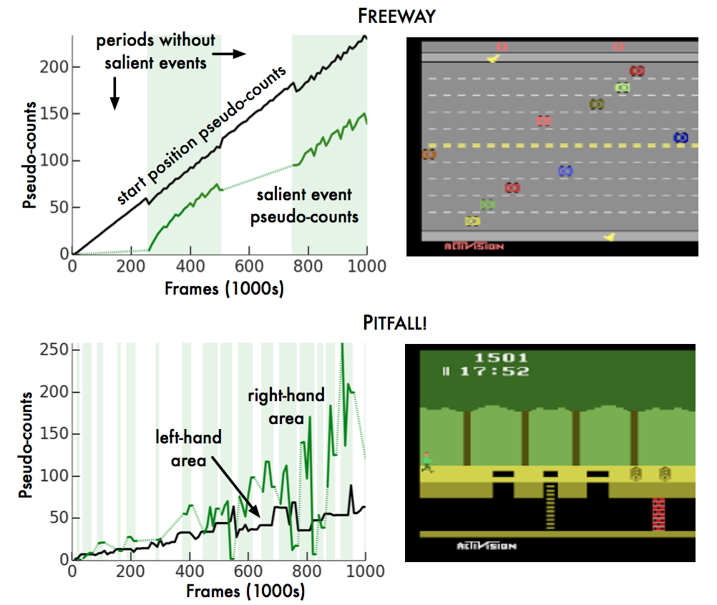
Performance experiment of pseudo-count (Figure 1)
As a probability distribution model Using the CTS model (Bellemare et al., 2014)
At FREEWAY and PITFALL of Atari 2600 Of baseline event and salient event Calculate pseudo-count
・Pseudo-count of baseline event increases linearly with frame number ・The salient event's pseudo-count increases in the section where the salient event can be observed (the background is green)

Slide 19
CTS density model
As a probability distribution model Using the CTS model (Bellemare et al., 2014)
The value of each pixel in the state x (the entire screen) is considered as a factor,
(I, j) pixel is
(i - 1, j), (i, j - 1), (i - 1, j - 1), (i + 1, j - 1)
Graphical model with pixel as parent
Probabilistic model to predict the value of each pixel of a frame

Slide 20
Double DQN (van Hasselt et al., 2015)
Prepare two Q functions and update their values ​​using mutual values Apply Double Q-Learning (van Hasselt, 2010) to DQN
Prevent overestimation by taking argmax of the current estimated value during Q learning

Slide 21

Double Q-learning (van Hasselt, 2010)
General Q-learning update formula
Update formula in Double Q-learning
または

Slide 22
exploration bonus with pseudo-count
Give an exploration bonus according to the following equation (6)
Use a factor of 0.05
+0.01 for stabilization This value limits the reward to [-1, +1] in this DQN
No need for normalization

Slide 23
Double DQN with exploration bonus + MC return
Add "reward" sum by Monte Carlo method to update formula Add exploration bonus here as well
The Monte Carlo term is added for shortening the calculation time, Almost all games contribute to performance improvement
Since it is experience replay,
the delay of Monte Carlo term calculation is no problem

Slide 24
Experiment: Comparison of progress of learning in 5 games
Five games of Atati 2600 (Of the difficult things, CNN's value function and CTS density model can be used) ・Exprolation bonus none DQN
・Every frame and get a negative reward at the end of the episode DQN (optimistic initialization) (Machado et al., 2014)
・DQN with exploration bonus added
Compare

Slide 25
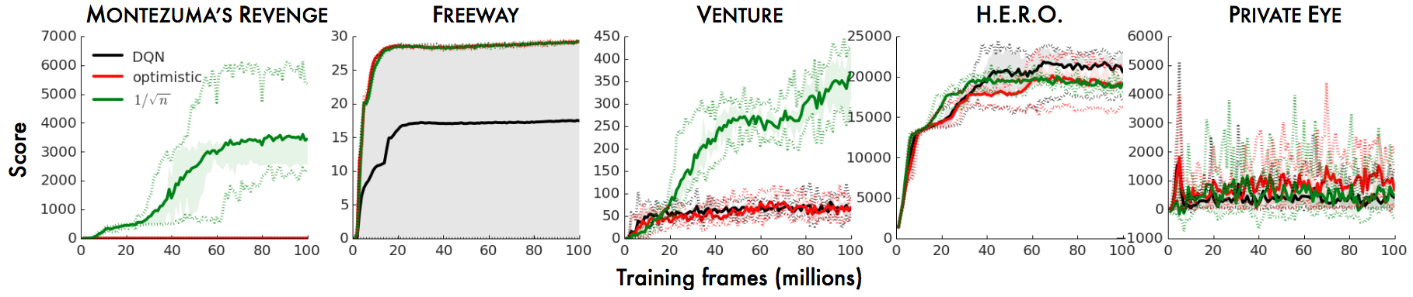
Result: Progress of learning in five games (Figure 2)
Average scoring transition in each game (~ 100 million frames) DQN optimistic bonus
・
MONTEZUNA'S REVENGE, bonus is overwhelming at VENTURE ・FREEWAY also good results even with optimistic (no bonus probably failed twice) ・PRIVATE EYE can not do exploration bonus

Slide 26
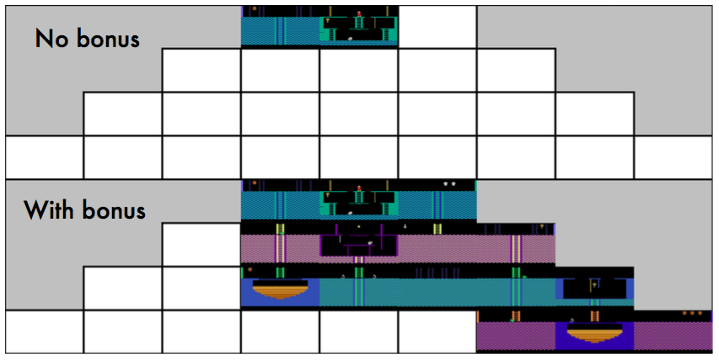
Result : “known worlds” for agent (Figure 4)
Above: no exploration bonus Under: with exploration bonus By adding bonus it reaches more rooms (50 million frames from the beginning of learning)

Slide 27
A3C (Mnih et al., 2016)
Abbreviation for Asynchronous Advantage Actor-Critic
①Running learning with multiple agents asynchronously → Learning goes well without the experience replay
②Make it actor-critic (learn both policy and value estimation)
③Value function minimizes advantage (R - V (s)) squared, measures maximize advantage
For details see Yasuhiro Fujita's slide http://pt.slideshare.net/mooopan/a3c-62170605

Slide 28
Result: Comparison between A3C and A3C+
A3C+ plus an exploration bonus as compensation for A3C parameter update is taken as A3C+
Compare A3C and A3C+ in 60 games of Atari 2600
Base A3C failed to learn with 15 games (not more than 50% more than random)
On the other hand, A3C+ failed to learn only with 10 games
(DQN is 8)

Slide 29
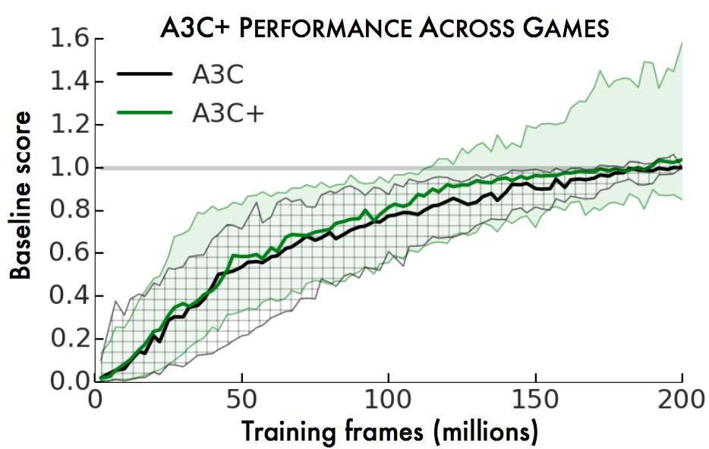
Result: Comparison of A3C and A3C+ (Figure 5)
A3C against the score at 200 million frames
Percentage of score at each stage (formula of p.15)
・There is no big difference in the median (thick line) around 200 million frames
・A3C+(with exploration bonus)
With about 1/4 games, half of the 100 million frames are equivalent to A3C

Slide 30
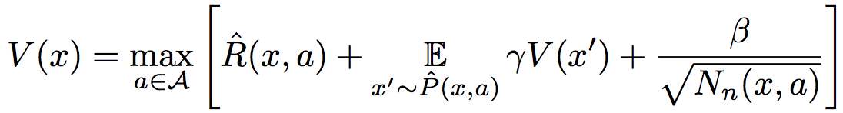
Experiment: Examination of how to give exploration bonus
In Expression (6) exploration bonus is given by the following expression
This is a model-based interval estimation with exploratory bonus (MBIE-EB) (Sterl and Littman, 2008) was the same shape as the exploration bonus

Slide 31
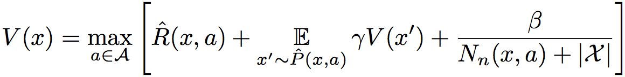
Experiment: Examination of how to give exploration bonus
Here we change the expression of exploration bonus to the following form
Bayesian Exploration Bonus (Kolter and Ng, 2009)
Or by a method close to compression progress (Shumidhuber, 2008)
Predictive gain is multiplied by a factor to be a bonus term

Slide 32
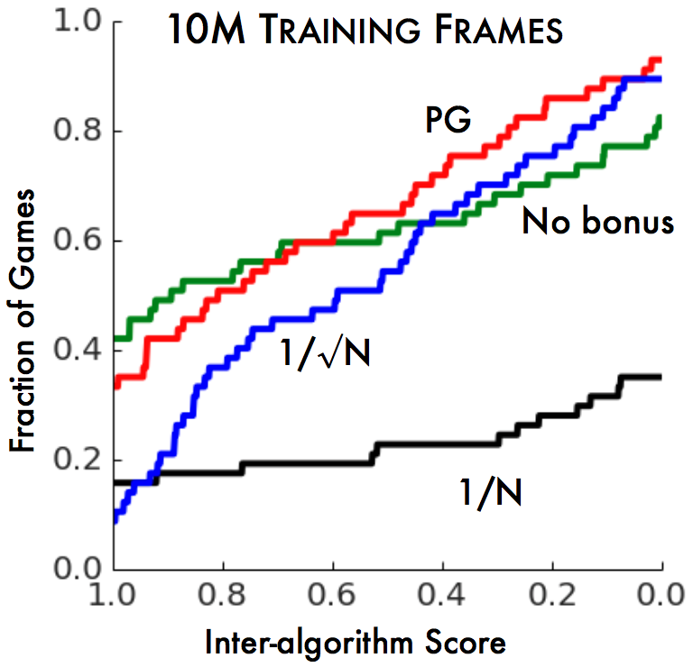
Result: How to give exploration bonus (Figure 6)
Learning with each condition in 60 games of Atari 2600
Using the inter-algorithm score distribution (Bellmare et al., 2013) as an index Review overall score in all games
（How to read the graph） Gaming ratio that gave high score ←→ I gave a low score Game Percentage

Slide 33
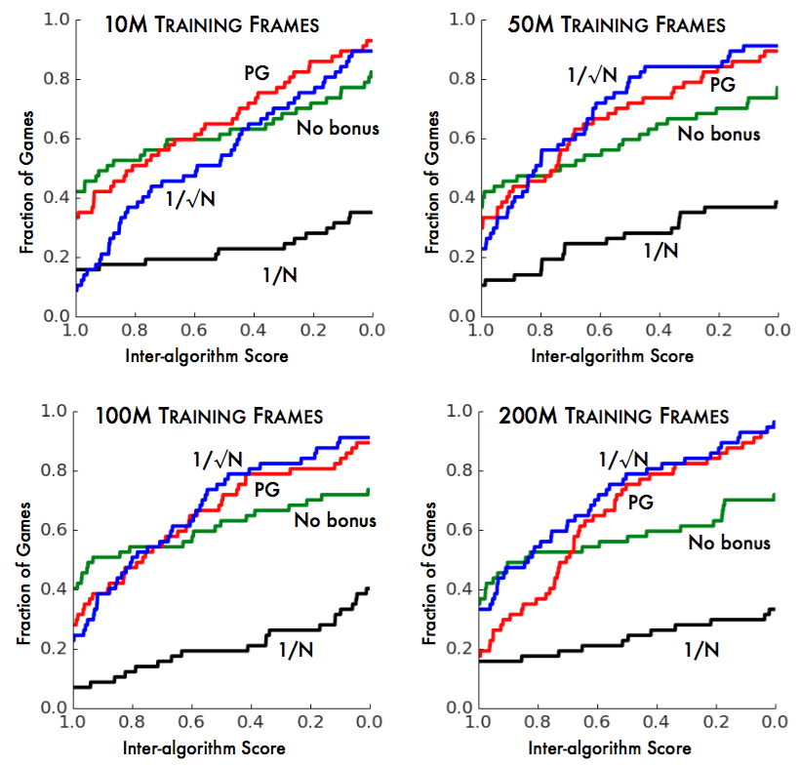



Result: How to give exploration bonus (Figure 6)
・No bonus is a high score in some (probably less exploring importance) games
・ Early onset of learning
・ In the 10 million frames, especially high scores are hard to come out (focus on searching) but 200 million frames will be a good result
・ The score is low

Slide 34
Future Work
・Whether the distance on state space can be defined by selecting sequential density model
・Analysis of global probability density model like Solomonoff induction (Hutter, 2005)
・Because there is not learning speed of Q-learning in the sequential density model and DQN, introduce oblivion to the density model or make correspondence between density model and Q function
・Even in continuous space pseusdo-count
Verifies whether it meets the concept of number of times

Slide 35
引用文献
Bellemare et al. (2016). Unifying Count-Based Exploration and Intrinsic Motivation. NIPS2016
Mnih et al. (2013). Playing Atari with Deep Reinforcement Learning.
Mnih et al. (2015). Human-level control through deep reinforcement learning.
Nair et al. (2015). Massively Parallel Methods for Deep Reinforcement Learning.
van Hasselt et al. (2015). Deep Reinforcement Learning with Double Q-learning.
Kulkarni et al. (2016). Hierarchical Deep Reinforcement Learning: Integrating Temporal Abstraction and Intrinsic Motivation. NIPS2016
Bellemare et al. (2014). Skip Context Tree Switching. 31st ICML

Slide 36
引用文献
van Hasselt et al. (2015). Double Q-learning. NIPS2010
Machado et al. (2014). Domain-independent optimistic initialization for reinforcement learning. arxiv:1410.4604
Mnih et al. (2016). Asynchronous methods for deep reinforcement learning. arXiv:1602.01783
Strehl and Littman. (2008). An analysis of model-based interval estimation for Markov desicion process. Journal of Computer Science, 74(8):1309 - 1331.
Kolter and Ng. (2009). Near-bayesian exploration in polynominal time. 26th ICML
Shumidhuber. (2008). Driven by compression progress.

Slide 37
引用文献
Bellemare et al. (2013). The Arcade Learning Environment: An evaluation platform for general agents. Journal of Artificial Intelligence Research, 47: 253-279
Hutter (2005). Universal artificial intelligence: Sequential decisions based on algorithmic probability. Springer

Slide 38
Purpose of exploration using pseudo-count
The degree of exploration can be divided into the following four stages (Odori consideration)
0. Select actions that are always considered optimal (SARSA etc.)
1. Sometimes you choose actions that are not optimal (epsilon-greedy etc.)←DQN
2. Select actions that are likely to transition to a novel state
3. Select an action that seems to be able to explore a novel state (ideal)
Though Q can reach up to 3 Especially learning for 3 was promoted by adding the Monte Carlo term

