Slide 1
Structured Streaming
소개 및 데모
오재혁

Slide 2
1. Structured Streaming 소개
https://databricks.com/blog/2016/07/28/structured-streaming-in-apache-spark.html
Consistency: process in order
Fault tolerance: checkpoint
Out-of-order data: watermark
https://www.slideshare.net/databricks/arbitrary-stateful-aggregations-using-structured-streaming-in-apache-spark
Append Mode : ETL
Complete mode : Monitoring
Update mode : Alerting, Sessionization

Slide 3
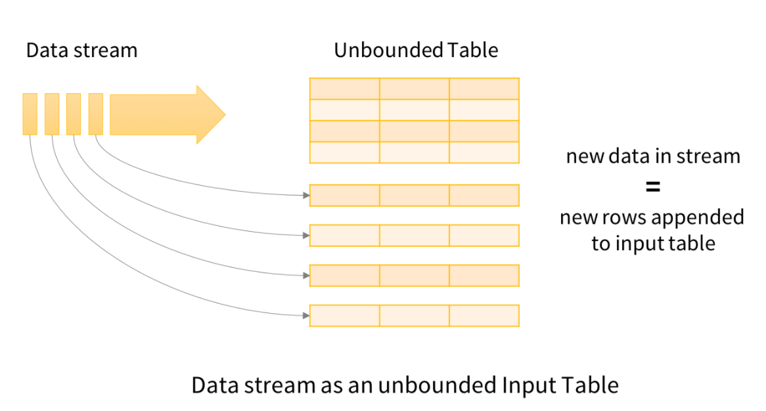
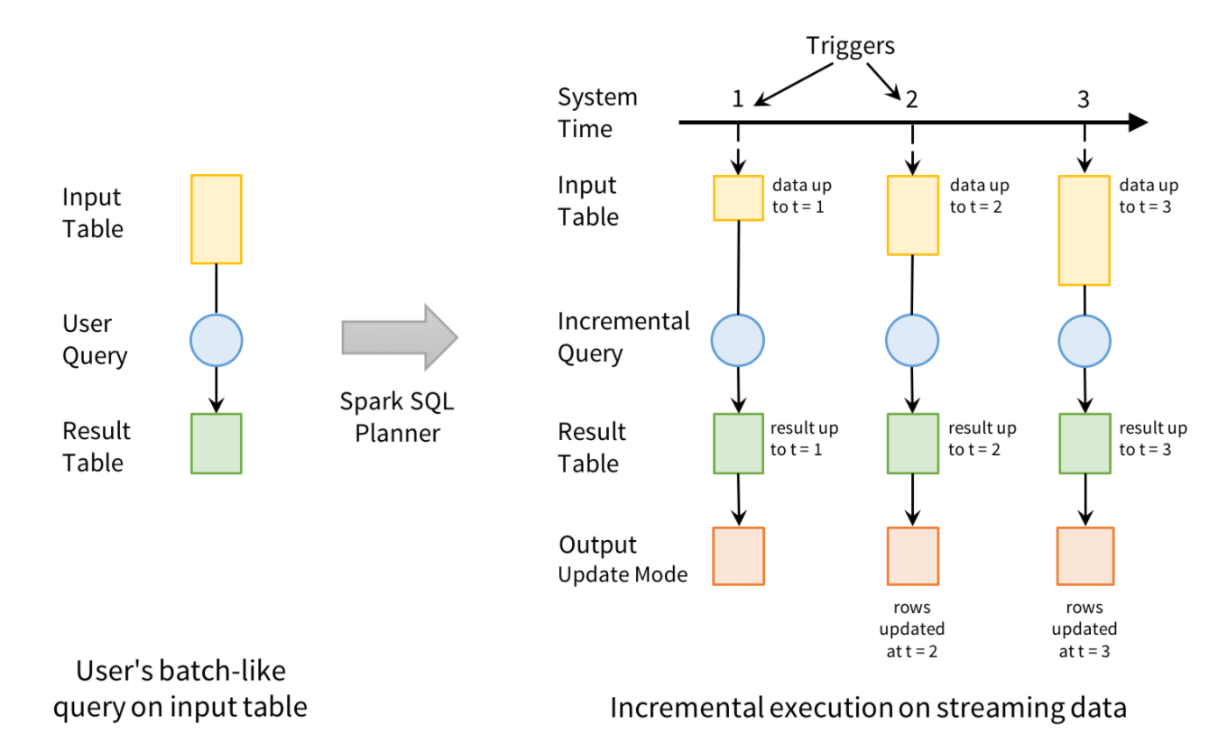
2. Window
Watermark
Checkpoint
3. Select
Project
Aggregate
4. Output
Mode

Slide 4
2. CountByWindow
+ windowDuration / slideDuration
+ TriggerBy10Seconds

Slide 5
3. StreamFromFile
+ SelectionProjectionAndAggregation (연산)
+ Unsupported Operations
https://spark.apache.org/docs/latest/structured-streaming-programming-guide.html#unsupported-operations

Slide 6
4. CountWithWindowAndWatermark : Watermarking (2.1)
+ AppendCompleteUpdate : output mode (2.2)
Append Mode : ETL
Complete mode : Monitoring
Update mode : Alerting, Sessionization

Slide 7
5. ManageAndMonitor : StreamingQueryListener (2.1)
+ query plan

Slide 8
6. OutputForEach
+ open / process / close
https://spark.apache.org/docs/latest/structured-streaming-programming-guide.html#using-foreach

Slide 9
7. RecoveringWithCheckpointing
+ PartitionByName : store by partition

Slide 10
8. JoinWithCustomerDate
Joins with static data
with user property ?

Slide 11
9. SessionBy1Minute : Arbitrary Stateful Operations (2.2) (WIP)
*** mapGroupsWithState

Slide 12
10. flatMapGroupsWithState (WIP)
for alerting

