Slide 1
Simulation renewed, Making plans
Sep 16, 2024 Yuhao Zhu

Slide 2
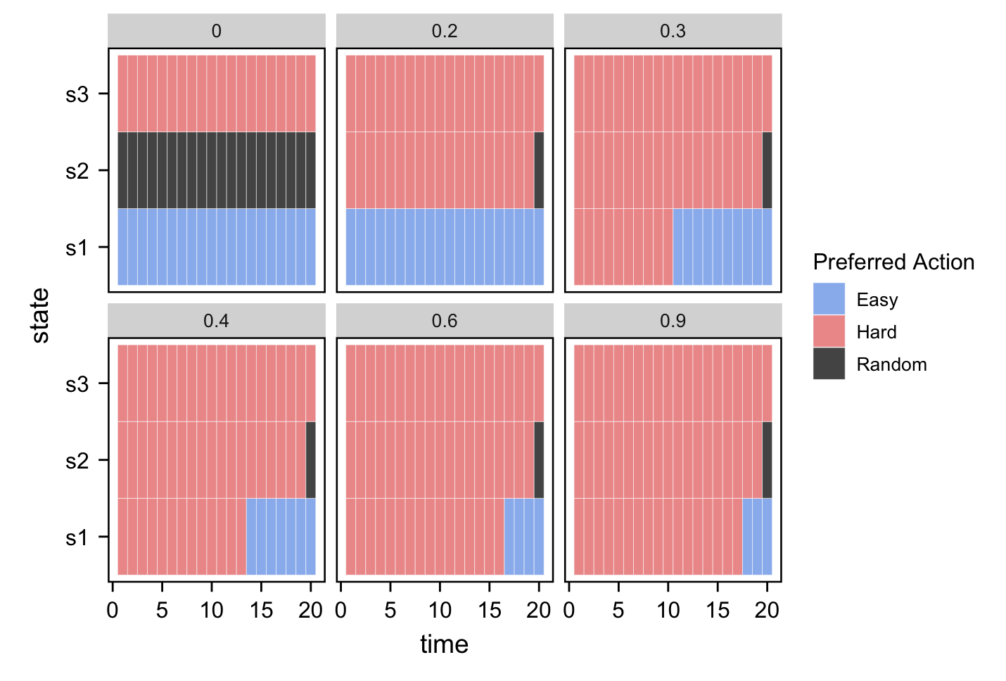

Slide 3
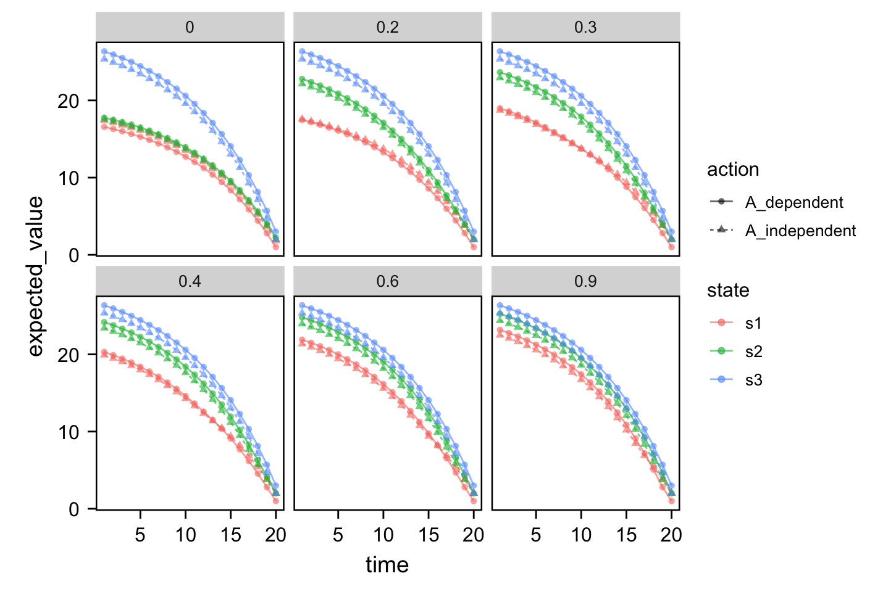
Hard
easy

Slide 4
web
Branch password
Wiki
Hlink
Lil
What to put in
search

Slide 5
designer
IT person
LLM
web
Js psch
Psych sci
Server: check
Visualization
Mindset
email
4 arm
Measure: count
Psych sci
scenario
Role play
Food
judge
Meta: risk aversion
utility
Exploration rate
Framework js psych
Game: images
Bernoulli;
100

