Slide 1
Vocabulary Data

Slide 2
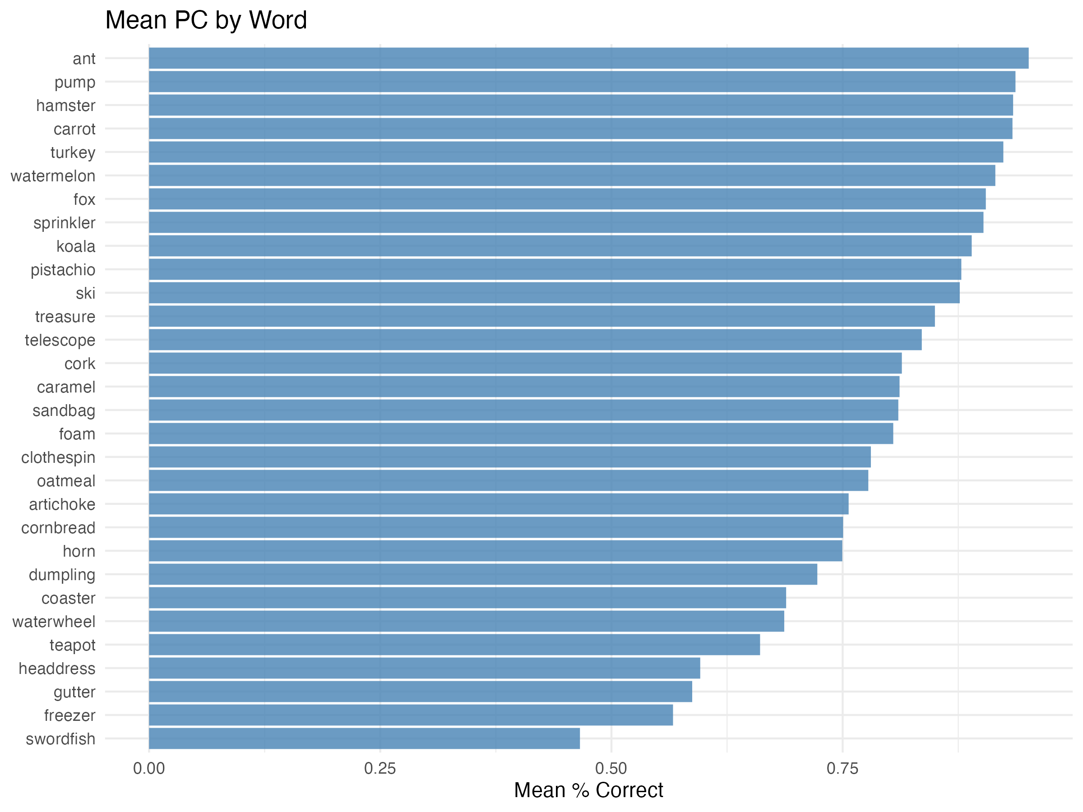
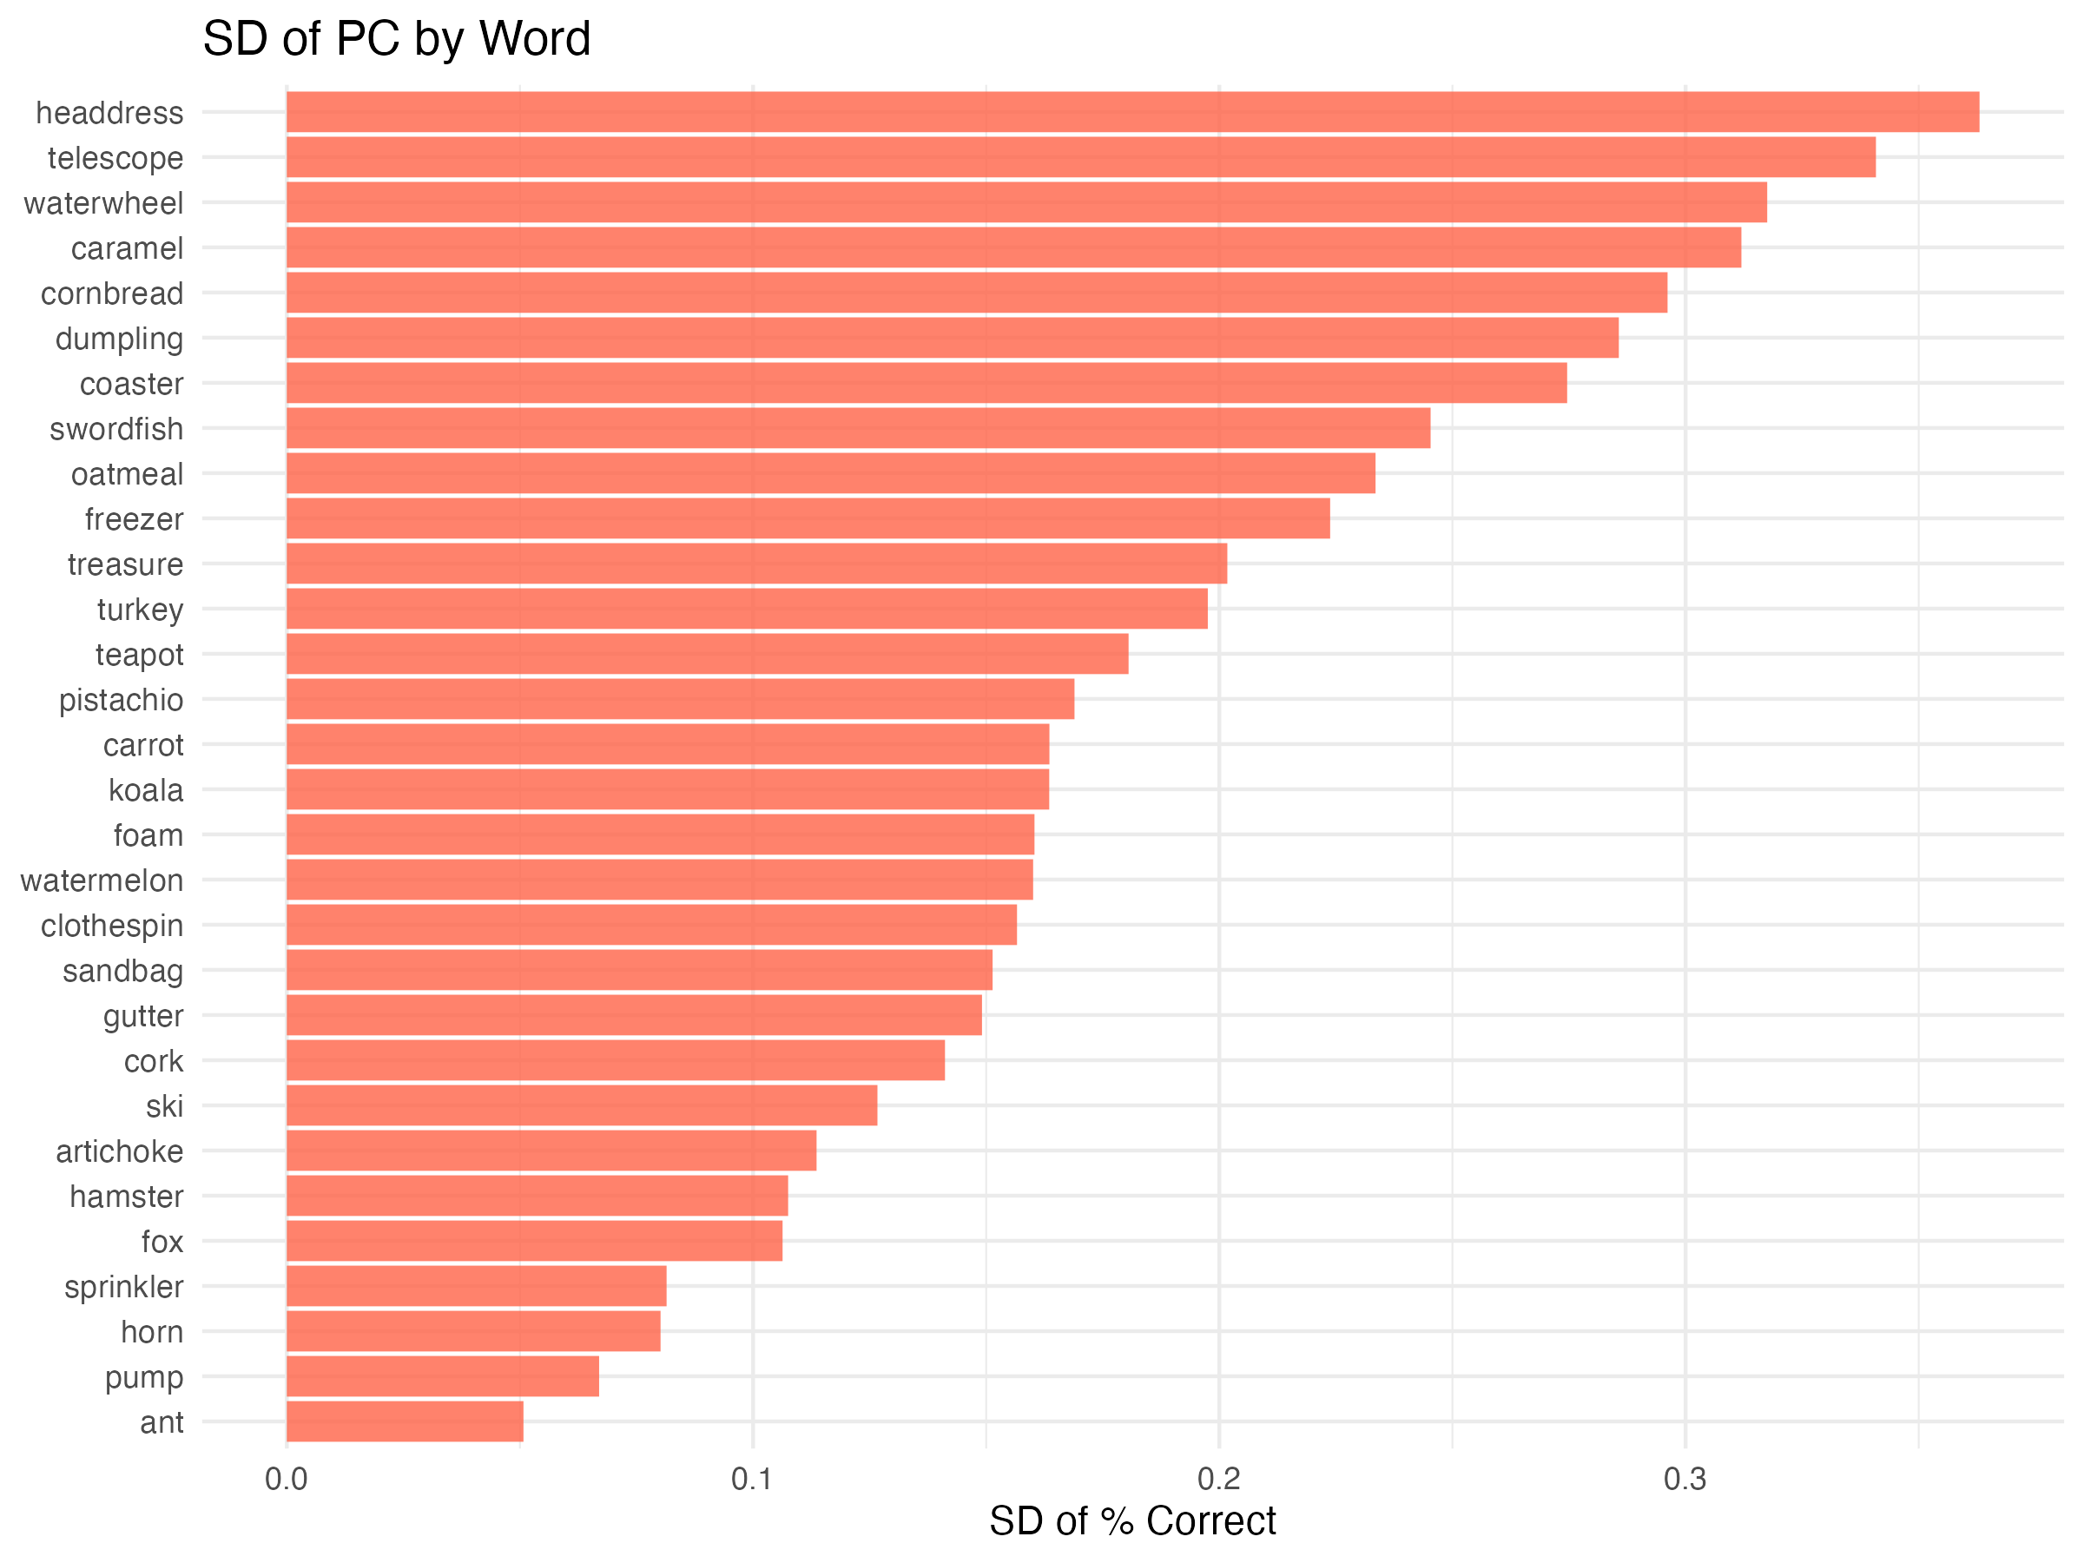
2-2. PC by Word
2-2-1. Mean PC by Word
2-2-2. SD of PC by Word

Slide 3
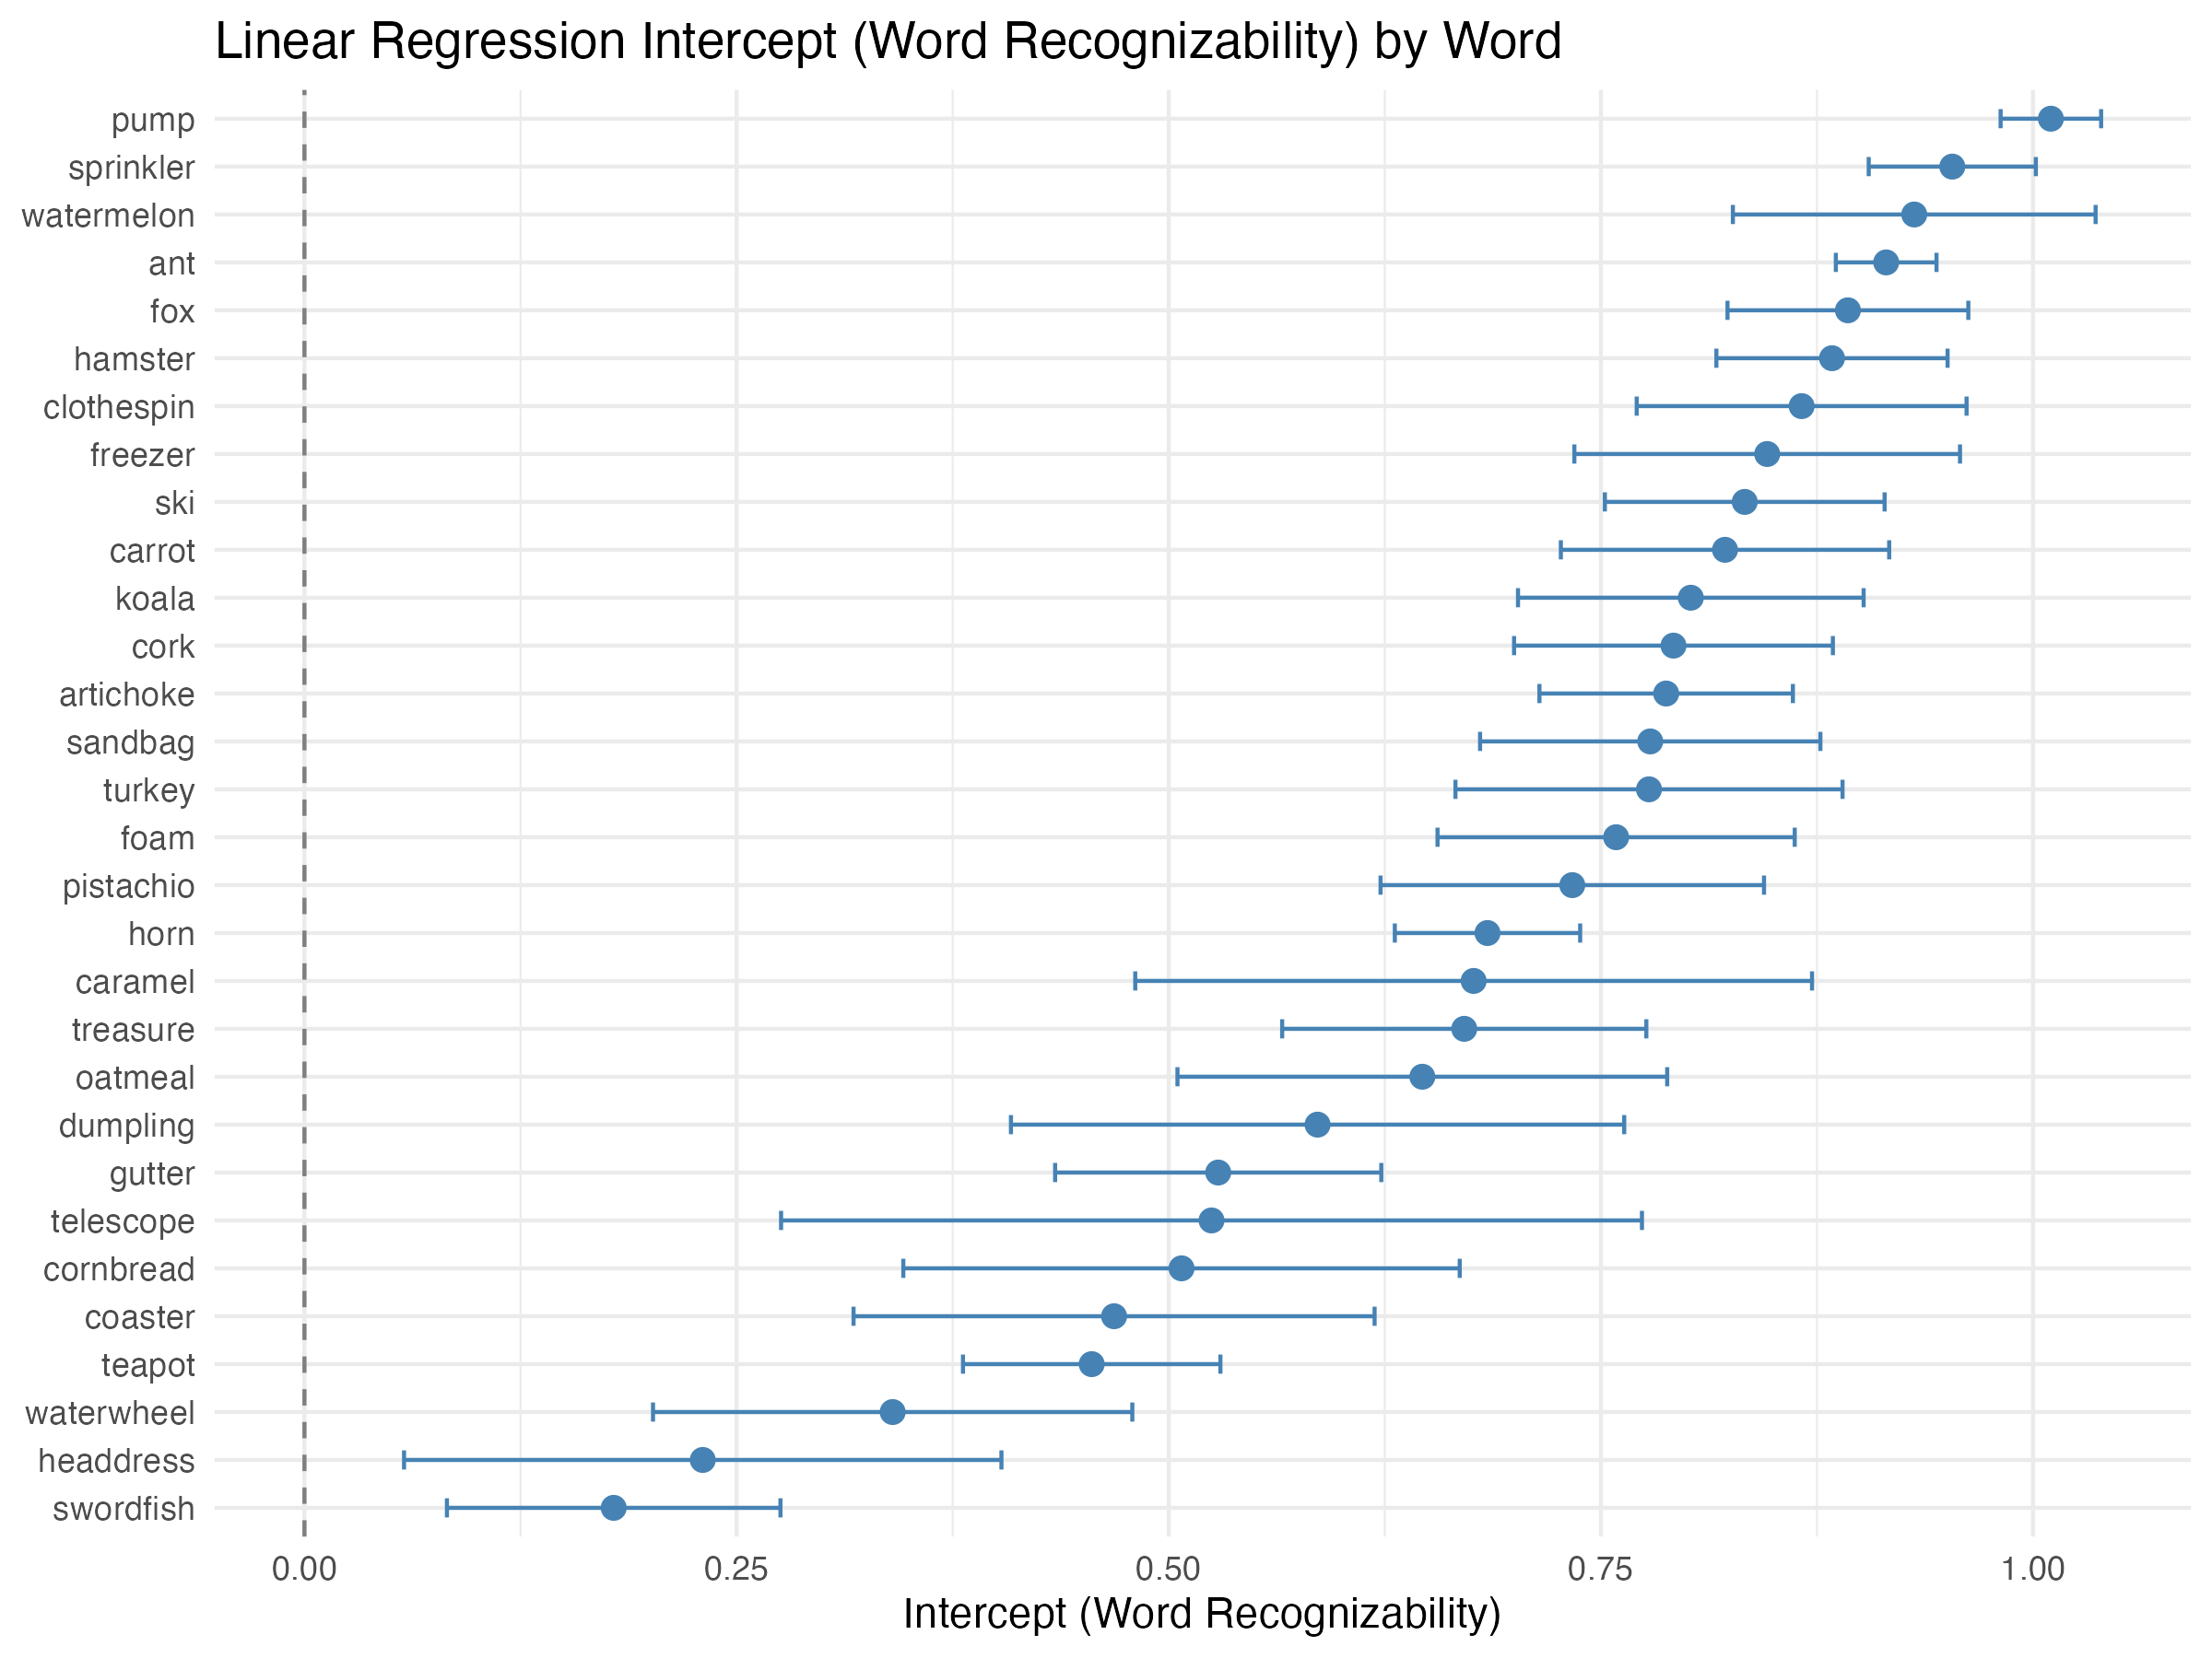
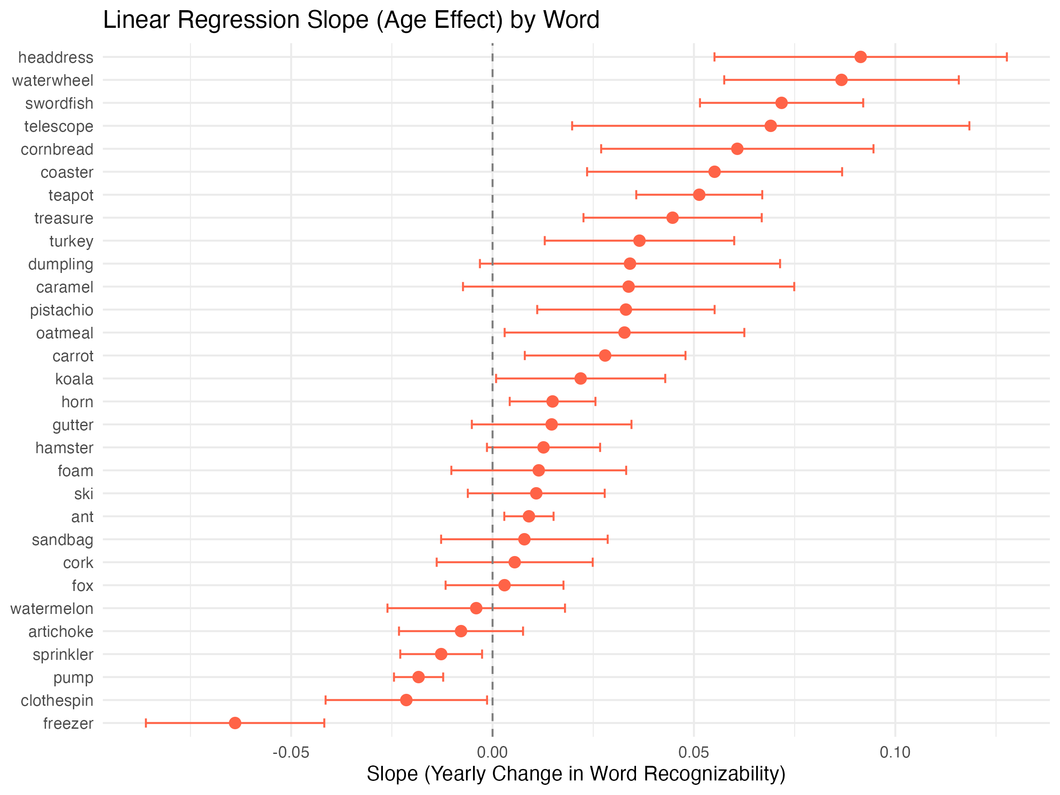
3. Word-level LM
3-1. Intercept
3-2. Slope

