Slide 1
Advanced C++ Programming
By Philipp Tiso

Slide 2
Welcome to the advanced c++ course
Today will serve as a review session for key concepts required for this course
If you don’t have an IDE configured on your machine you can use an online compiler provided by codeboard.io
All slides and code will be available on the github page

Slide 3
A bit about me!
My Name: Philipp Tiso
I don’t have my PhD yet so there is no need to call me “Dr.” or “Professor”
But if you are so inclined, you may call me Dr. Tiso (just don’t let the rest of academia know, Dr. is a protected title)
Completed Education: Graduated from ZIS in 2017, IB graduate
Current Occupation: Studying Computer Science (MSci) at the University of Nottingham
Fields of interest: Operating Systems, Parallel Systems, Compilers, Security, AI
Completed research: I have completed a research paper regarding human robot collaboration for complex sorting
Favorite Language: C / C++ (Both are near and dear to my heart)

Slide 4
A bit about you!
Let’s go around the room and introduce ourselves!
While introducing yourself, address the following questions:
Q1: Why did you choose to take this course?
Q2: What are you expecting to get out of this course?
Q3: What languages have you used before (other than C/C++)?

Slide 5
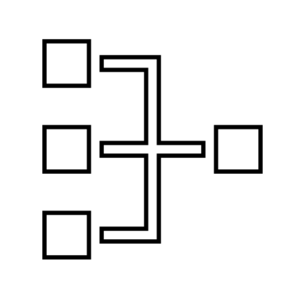

Goals
Before we get into the review, lets just outline the main concepts that we will cover in this course:
Parallelism
We will first take a look at how threading works (we won’t go into multi-processing)
Object Oriented Paradigm
An alternative to iterative programming which is what we have been doing up until now

Slide 6
Plan for today
Functions
Function definition
Function declaration
Function calls
Variable locality
Variable scope & locality
Pointers
C-style pointers
Type casting
Note: I will assume that everyone is familiar with the basic C++ datatypes, operators and loop constructs

Slide 7
Functions
Definition: A piece of code that can be called by our program, in order to perform some action for us.
Function DEFINITION syntax:
return-type function-name ( data-type argument-name) {}
Note: A function definition is where we are implementing our function
Simply: The function definition is where we are saying “This is the code that belongs to this function”

Slide 8

Return type
The return type is the type of data that our function will give us back once it has finished its task
Reminder: If our function doesn’t need to return any values, we can use the void key word to signify that nothing is returned

Slide 9


Exercise: Work out the return-type
bool
didFail(bool var) { return var; }
int
addInts(int x, int y) { return x + y; }
void
printStr(string str) { cout << str << endl; }

Slide 10
Function-name
The function-name is a name that we give to our method, so that we know what it is called.
The function name can be anything as long as it’s not a number
void 2(bool var) is NOT allowed
void myFunc2(bool var) IS allowed

Slide 11
Function Argument
Function arguments are what gets passed into a function [passed into the brackets of the function].
They can have any name we want, as long as it’s not a number.
Function arguments are proceeded by their type
If var is an integer, then it will have the int type before it

Slide 12



Function declaration
A function declaration basically says: “Hey there exists a function called $δ$, I’m not telling you what it does, but I’ll tell you the arguments and return-type.”
A declaration for a function that takes an int and returns a bool will look as follows:
IMPORTANT: The function declaration is NEVER inside another function
A function declaration is NEVER in the main()

Slide 13

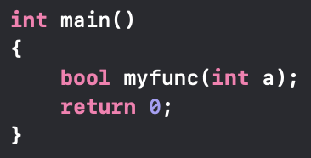
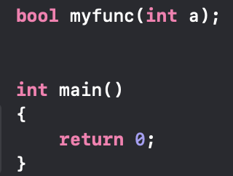
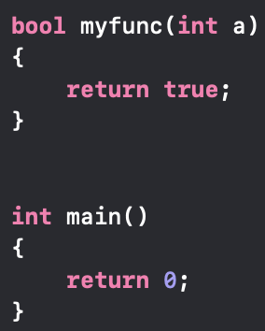

Regarding the important note
Which one (if any) of these function declarations is correct for a function (myfunc) that takes an int and returns a bool?

Slide 14

Function call
We have now created a function (did the function definition) & want to use it
This is know as a ”function call”
Question: Why do you think its called that?
Function calls look confusingly similar to a function declaration

Slide 15
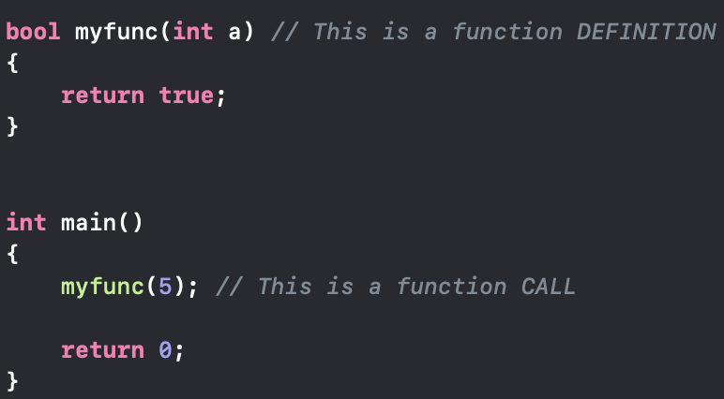
Function call vs. declaration
There are TWO major difference between a function call & function declaration!
A function call MUST be done inside another function
A function call doesn’t list the return-type, nor does it specify the argument-type, it just passes an argument into the function
Function call (done in main):
Function declaration:

Slide 16

Lets Take a short break
If any of the discussed concepts are confusing please let me know
It is important that you have a good understanding of these concepts so that we can focus on new content

Slide 17
Variable scope & lifetime
So far all the variables we have used were member variables of a function.
We may call these types of variables LOCAL variables
There is another type of variable that we may utilize called GLOBAL variables

Slide 18
Local Variable
A variable that is local to a single function. The variable only exists inside a specific function
The variable gets destroyed once its parent function returns.
Methods outside are NOT allowed to access

Slide 19
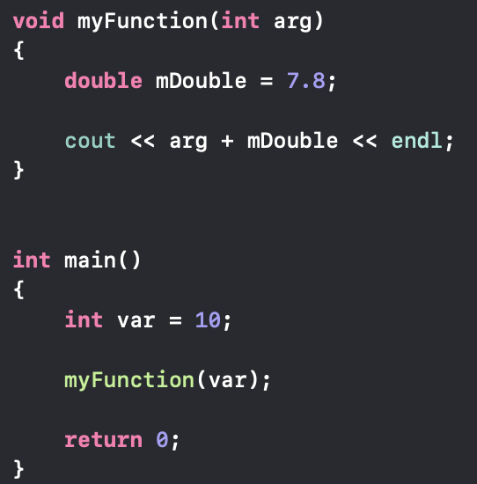
Example of Local variables
int var is a local variable for main()
int arg and double mDouble are local variables for myFunction()

Slide 20
Global variables
Global variables are a bit different, they can be accessed from anywhere.
They are created at the start of our program and are declared & defined OUTSIDE the main()
Global variables are destroyed once the PROGRAM ENDS

Slide 21
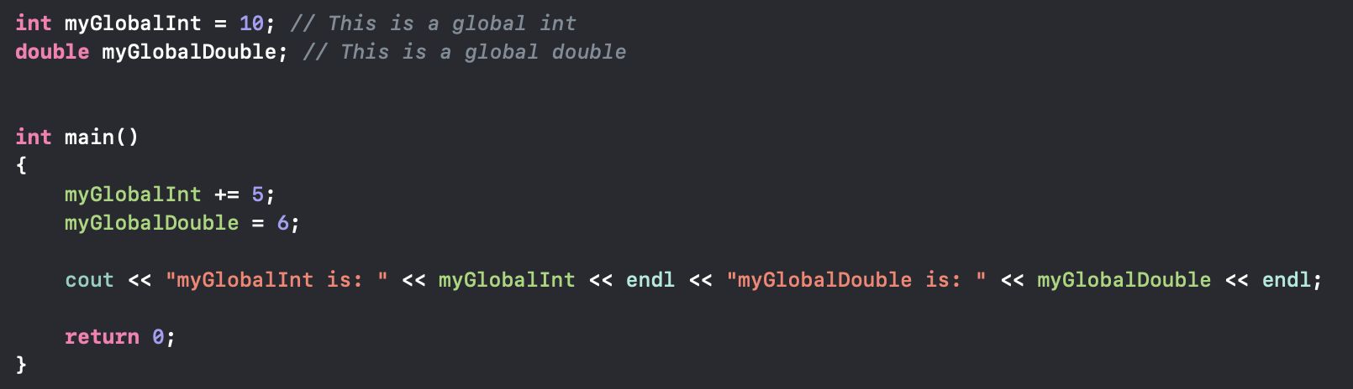

Example of Global variables
Question: What will this print?

Slide 22
The Static keyword
DISCLAIMER: static is one of the most overloaded terms in C++
This means that depending on context static will change how it operates
Let’s say we create a function that contains a variable who's value we want to keep, even after the function ends

Slide 23
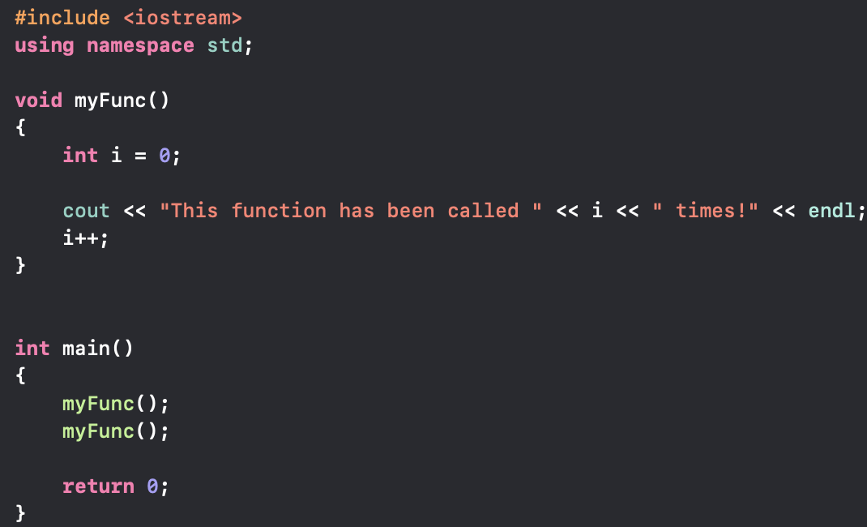

Sample Code
What will the following code print?
OUTPUT:

Slide 24

WELL THAT’S not helpful.
We called the function twice, why didn’t it work?!
We even incremented i!
Task: You have 5 ($±$2) minutes to come up with a solution to this problem
Problem recap: “we want to have a variable that keeps track of the number of times we called a function”

Slide 25
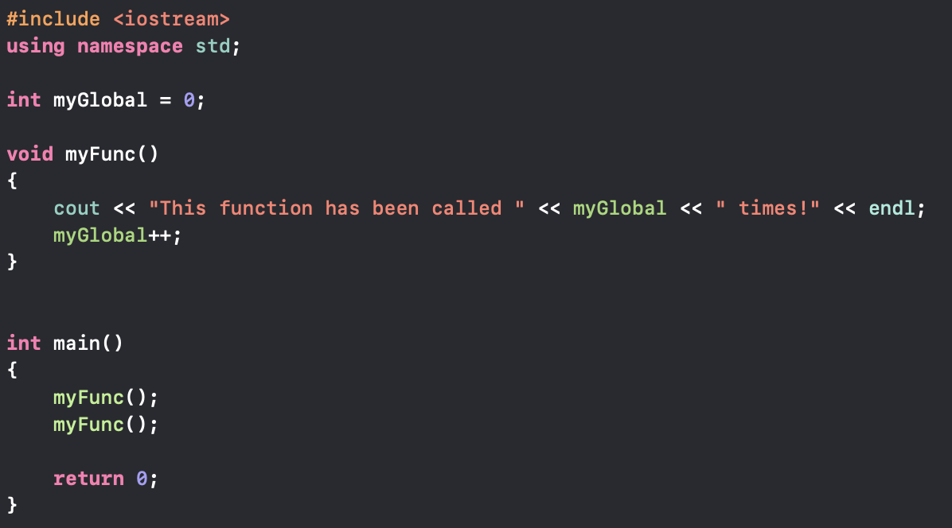
Possible solution
You may have come up with something like this:
OUTPUT:
NOTE: This output is acceptable since we are indexing from 0
BUT THERE IS ANOTHER WAY

Slide 26
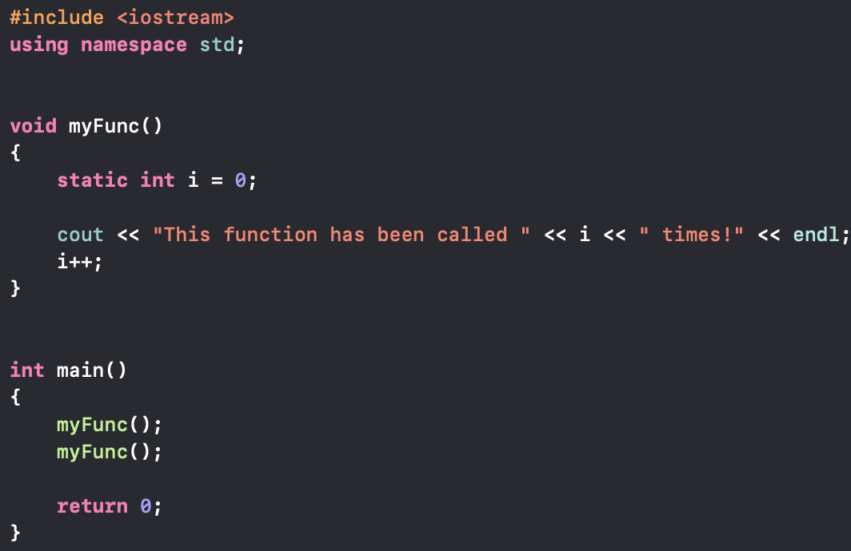
Using static local variables
We can use something called a static local variable
The code will look as follows:
What would the output be?

Slide 27
What does a static local variable do?
Simply: “So I want to be part of this function, but I don’t want to be deleted when the function ends. OS can you place me somewhere were I can be safe? Thanks.”
Static local variables are initialized ONCE, which is when they are created
After that they don’t need to be reinitialized (since they exist until the end of the program)
Question: Why do you think this works?
This works because the variable is stored on the stack, hence it will prevail as long as the program stack does

Slide 28
POINTERS
Pointers allow us to use an alternative to “pass by value”
When we pass an argument to a function, we are creating a temporary copy “pass by value”
We never actually change the value of our actual variable
A variables memory address changes every time we run the program
So trying to remember the address is useless
Pointers will solve BOTH of these issues
Change the value of the argument passed to a function
The ability to always know a variables address

Slide 29
What is a pointer?
Simply: A pointer is a variable, who's value is the memory address of another variable.
In other words: “A pointer points to the address of another variable”
Let’s look at how we actually create a pointer.

Slide 30

Pointer syntax

Slide 31

What does * and & mean?
The former is what tells us: “This is a pointer”
The latter expresses: “We want to get the address of what follows &”
So what’s the meaning of

Slide 32
Pointer types
A pointer points to a variable that is the same type as the pointer!
So what type of variable does int *ptr; point to?
This is a pointer to an int
Let’s play around with this for a bit, and see what sorts of pointers we can come up with

Slide 33
Dereferencing pointers
If we want to actually see what the value of the variable which we are pointing to, then we need to do something called dereferencing
This just means: “Instead of giving me the address of i, give me its value”
Let’s look at how we can actually do this.

Slide 34
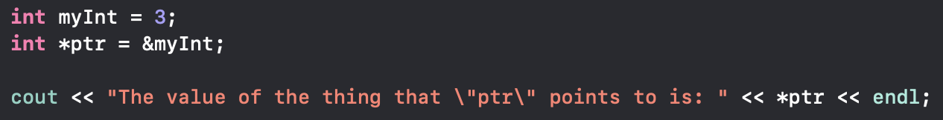

Dereferencing pointers
The key thing is: in the cout

Slide 35
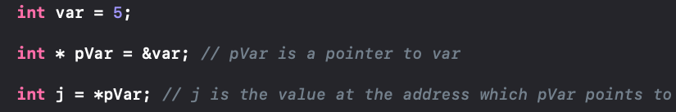
Potential Confusion
Int *pVar = &var vs Int j = *pVar
Which one is a pointer declaration and which one is dereferencing?
Int *pVar = &var is a pointer declaration
Int j = *pVar is pVar being dereferenced

Slide 36
Pointer Exercise
Play around with pointers to different types of variables
See what happens if you point a int pointer to a char variable
In other words: “Try to deliberately mix conflicting types”
Try doing the same thing but in reverse (point a char pointer to a int pointer)
What did you observe?
Unless you were casting from pointer to pointer you should have seen errors

Slide 37

How could we make this work?
Casting is one way to make this work
We cast a char pointer to a int pointer and then assign to another int pointer
But is there another way to do this?

Slide 38

VOID Pointer

Slide 39
What is a void pointer?
A VOID POINTER is a pointer that can point to ANY TYPE
This is why void is so powerful
In order to see what the actual type was we can do something called a cast
A cast is a way of changing the type of pointer

Slide 40

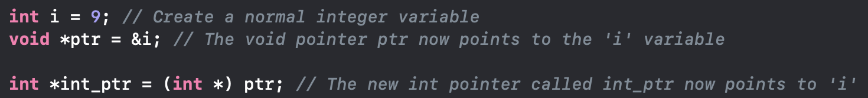
Cast syntax
This here is saying: “From the void pointer called ptr, return a temporary int pointer ”
QUESTION: What would happen if we printed int_ptr, do we even need it?
Let’s play around with this and see what happens when we cast to random types

Slide 41
Recap of today
Today was purely to review the basics
Functions
Variable scope
Pointers
casting
Tomorrow we will start with threading
I highly recommend that you review what we covered today and what was discussed last week

