Slide 1

Threading
By Philipp Tiso

Slide 2
Plan for today
Today is all about threads and we will be answering the following questions:
What is the definition of a thread?
Why would we want to use threads?
How do we use threads in C++?
But first we will look at process states and transitions to further understand how programs work under the hood

Slide 3
Process states & transitions
Modern computers can have a lot of programs running concurrently, hence the CPU has to manage multiple processes
Process: A process is a running instance of a program
So how could we approach this?
We could put all processes into a queue and give them to the CPU
Once a process has finished the next one can be consumed
What issues could arise when trying to manage multiple processes using this?
One process could be hogging the CPU
Switching processes too frequently can be incredibly inefficient

Slide 4




So what can we do?
We can define a set of states through which processes can transition
We can come up with some clever scheduling (we won’t look at this since we aren’t doing scheduling algorithms)

Slide 5
So what states should there be?
Four states should be sufficient for this, providing all the functionality we need
So what are these states?
New: A new process is initialized and enqueued for the CPU
Ready: The process is ready to be executed
Running: The process is currently executing
Blocked: The process was running but has been swapped out before completing
Exit: The process has finished executing

Slide 6
What Transitions should there be?
New → Ready: Process is committed to execution
Ready → Running: Process is selected by scheduler
Running → Blocked: Process is waiting for some I/O operation to finish
Blocked → Ready: I/O operation has finished
Running → Ready: Process is preempted (timer interrupt or pause)
Running → Exit: Process has finished or thrown an exception

Slide 7
Visual representation of states & transitions of a process
Start
Ready
Exit
Blocked
Running

Slide 8
Processes
Before we look at threads, we need to understand processes and a bit about process states
A process is “a running instance of a program” composed of two components
Resources: Logical address space (program, data, stack, heap), Files and I/O
Execution trace: The entity which gets executed by the computer (threads)
A process can share its resources between multiple execution traces

Slide 9
Lets visualize what processes look like
Every process must have at least one thread (main execution thread)
Single threaded process, what our programs have been thus far
Code
Data
Files
Registers
Stack

Slide 10
So how does this relate to threads?
Recall that “every process must have at least one thread”, the implication is that there can be multiple threads within one process
To illustrate this we can have a single process with three individual threads
Code
Data
Files
Registers
Registers
Registers
Stack
Stack
Stack

Slide 11
But what exactly is a thread?
A thread can be seen as “a sequential strand of execution”
Simply, a thread contains the instructions that the CPU will execute
Every thread has its own execution context (stack, register, program counter)
Threads can access all resources of their host process
Think of this like variable scoping, where every thread represents its own scope

Slide 12
Lets take a short break
While you wait, attempt the following:
Can you explain the difference between a process and a thread?
Discuss why you think threads are useful?

Slide 13
Recall that processes can host multiple threads
So what can we do knowing that multiple threads can exist within a single process?
Why not delegate some of the programs work to a separate thread?
But why would we want to do that?
Any ideas?

Slide 14
Simultaneous Multithreading (SMT)
Modern CPUs and operating systems support concurrent thread execution
Simply: A single core can execute multiple instructions (received from individual threads) concurrently
Hyperthreading on Intel superscalar chips is an example of this since a single physical core appears as two individual cores to the OS
So what do you think this means?
A task performed by a process can be split into parts and executed in parallel

Slide 15
So where is threading used?
Threading is used almost everywhere where concurrency employed!
GPU: GPUs are tailored towards tasks which are parallel by nature
Every kernel sent to a GPU is executed on a separate thread (Sobel operators, convolutions, rendering, tensor operations, etc.)
Desktop applications (Chrome, Xcode, VMFusion, etc.)
Desktop/Server Operating Systems (Daemon threads, background services)
Mobile Phone Operating Systems (iOS, Android)
The list goes on…

Slide 16
Portable Operating System Interface (Posix)
POSIX is a standard interface used to make programs which use threading compatible with different Operating Systems (Unix based systems)
If <pthread.h> isn’t working on windows, use http://cpp.sh/
Use the C++11 or C++14 standard for this
Because threads are software abstractions of a single processor, its implementation can be hidden and an interface can be used to expose the relevant functionality
Simply: We will be using the POSIX interface to maintain compatibility

Slide 17
Lets take a break
Now is the time to set up your IDE if you haven’t done so already
If you are on Unix/Linux POSIX should be included already
OSX will require you to download either Xcode or the gcc/g++ compiler

Slide 18
Posix threads
In order to use the POSIX API we need to include the relevant library
#include <pthread.h>
There are numerous library functions and types which we will be looking at in the following sections

Slide 19

Creating a thread
Before we can do anything, we need to create a variable which will represent the thread
Note that the variable is not initialized, its only declared
Why do you think we haven’t initialized the thread variable?

Slide 20
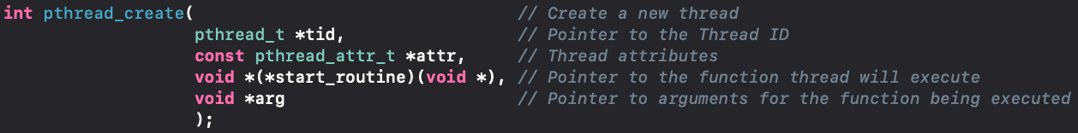
Pthread_create()
There is a dedicated function which will actually create a thread in the POSIX API
This will actually create the thread and run it once it has been created

Slide 21

Did you pay attention?
What should the function declaration of the start_routine look like?
This is actually a semi trick question
We have looked at pointers to variables but what about functions

Slide 22
Function pointers
We can point to variables as we have seen yesterday, but who says we can’t do that with functions
When a function is called, its not just called out of nowhere
Functions are stored in memory (on the stack) which means they can be accessed
So if its in the memory that we can access, then we can point to it!

Slide 23
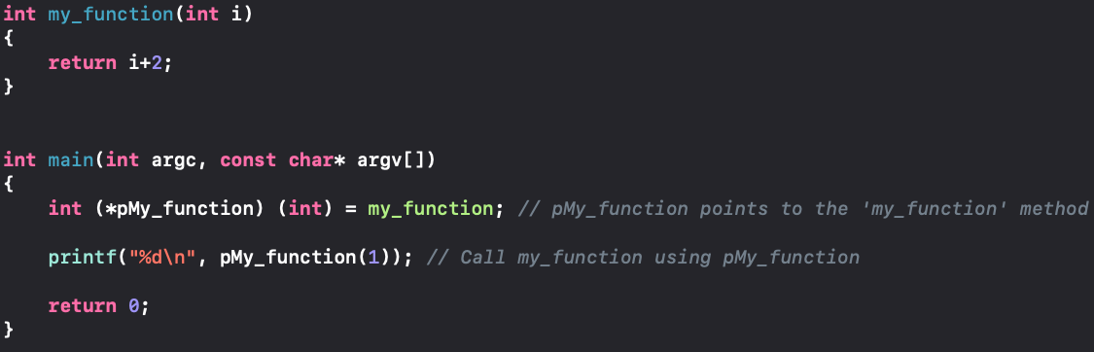
Function pointer syntax
Can you guess what this may look like?
The syntax used to declare a function pointer is as follows:
The initialization and application can be done as shown below:

Slide 24
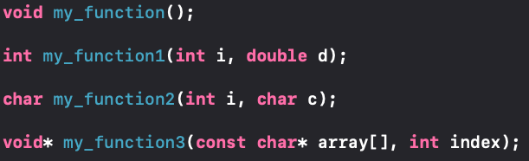
Quick Exercise
What are the function pointers for the following functions?

Slide 25
Why would we want this?
Why don’t we just call the my_function method directly?
What if we wanted to pass a function into another function as an argument?
Just like the pthread_create function seems to do

Slide 26
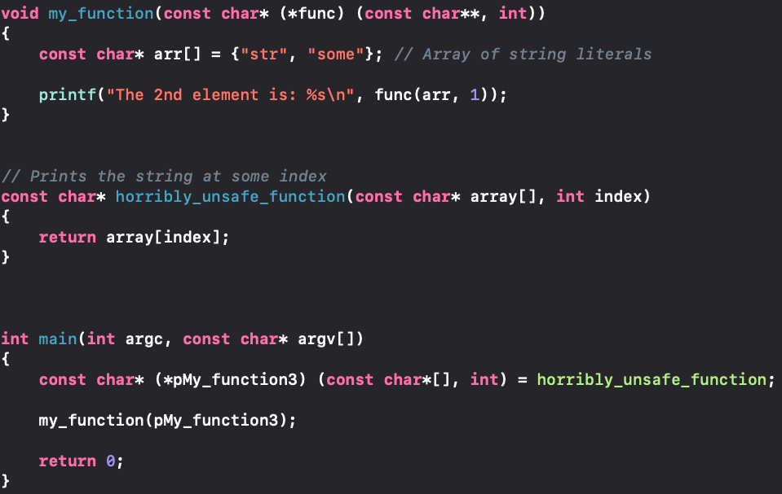
Simple Example
The “horribly_unsafe_function” is the callback function that is given to “my_function” such that it can be used later

Slide 27
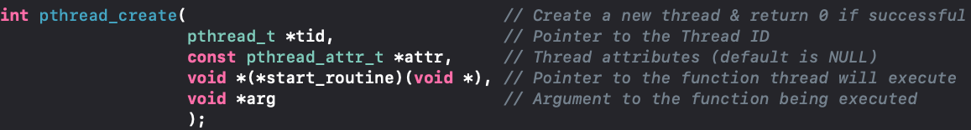
Back to pthread_create()
Knowing what we just looked at, what should the start_routine function be declared as?
Solution:

Slide 28
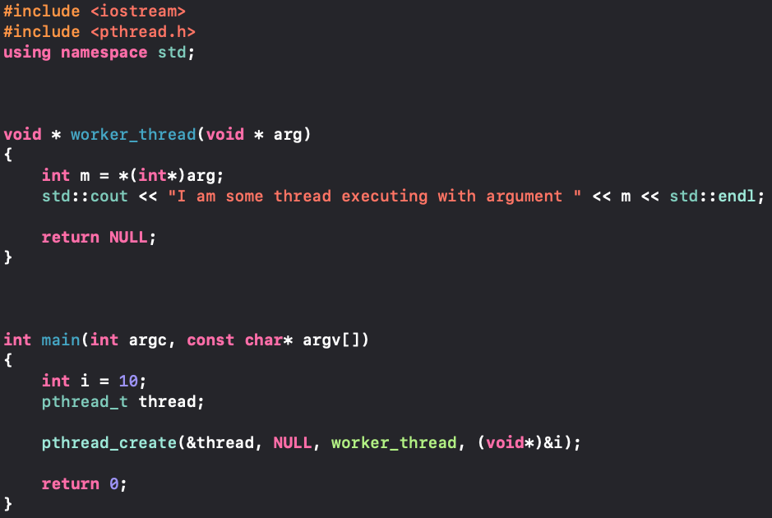
Lets create & run a thread

Slide 29
What did you notice?
Probably that nothing printed to the screen!
So what happened? What did we do wrong?
Well we didn’t do anything wrong syntactically, but we did forget something rather important.

Slide 30
So what happened?
Every process will always have as single main thread, despite its ability to host multiple threads
The nature of the program caused the main thread to terminate before the newly spawned thread
Simply: The main thread completed before the worker thread, terminating the process before the worker thread had time to print

Slide 31
Lets take a short break
During the break, think about what could be done to resolve this issue
If you are not sure about anything we have talked about up until now, don’t hesitate to ask

Slide 32
How do we fix this?
First lets reiterate the problem: “The main thread finishes before the newly created thread, terminating the process before the new thread can complete”
So what is it that we want to do?
We want to force the main thread to wait until the new thread has completed

Slide 33
Pthread_join()
The POSIX API provides a function that is specifically designed to resolve this issue
The pthread_join method will force the calling thread to suspend until the specified thread has terminated
_Nullable can be set to NULL, if it isn’t then the value passed to pthread_exit will be stored at the location pointed to by _Nullable

Slide 34
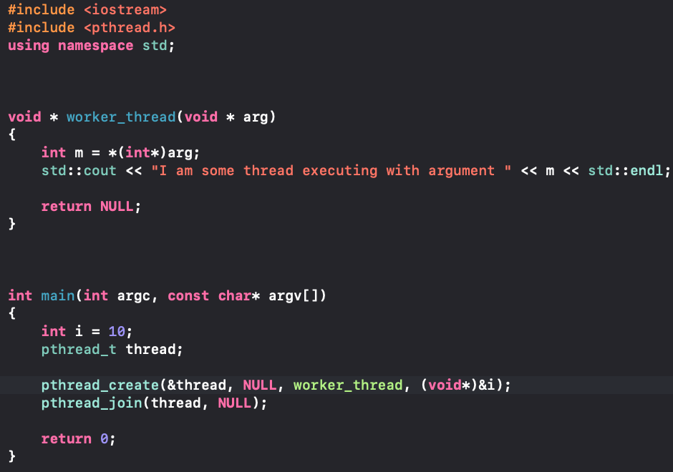
So how would we use this?
Can you try to make use of the pthread_join method to prevent the main thread from terminating prematurely?
Lets try it ourselves

Slide 35
Exercise
Create a program that uses a thread to execute some task of your choosing
Create a program that uses two threads to execute unique and disjoint tasks
Did you notice anything when running the second task?

Slide 36
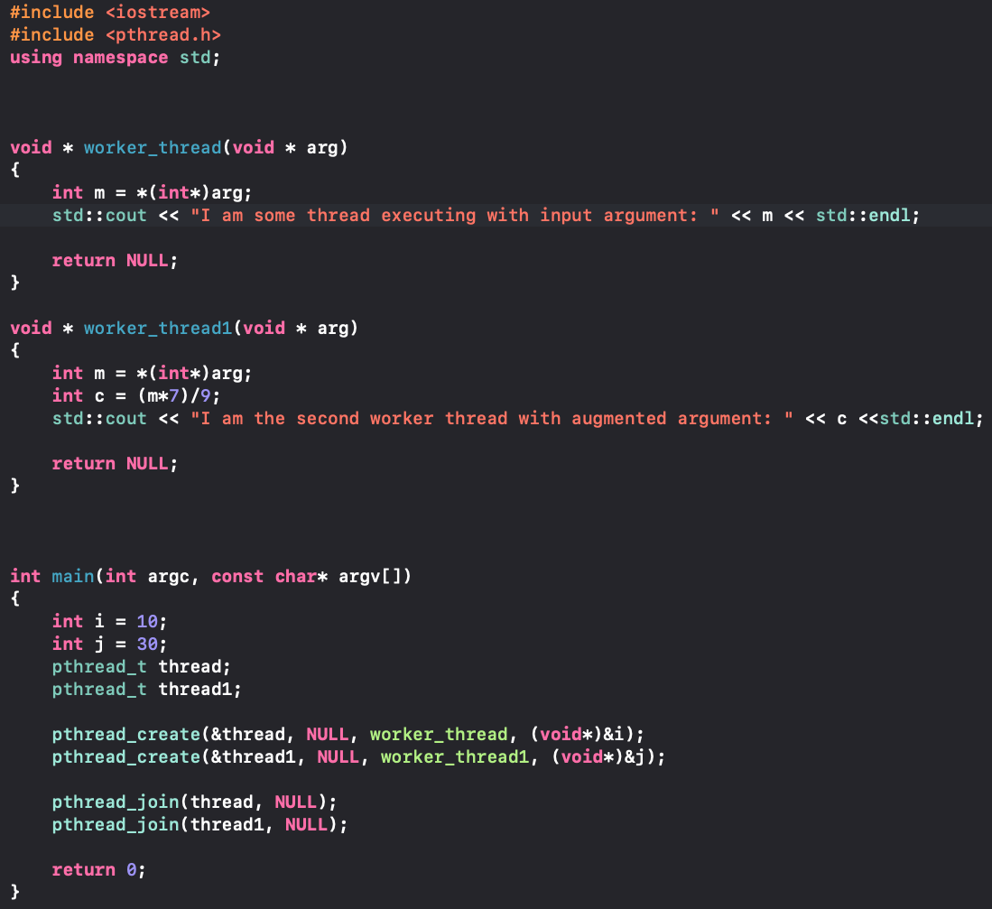
Question 2 Solution
Tomorrow we will take a look at how to address the anomalous behavior we observed

Slide 37
That’s all the content for today
This is all the content for today, if there is still something you find confusing, now's your chance to ask
Tomorrow we will be looking at mutual exclusion constructs and how we can control order of execution for threaded programs

