Slide 1

Multi-Threading & Mutual Exclusion
By Philipp Tiso

Slide 2
Recap from yesterday
POSIX functions and types for threading
Pthread_t
Pthread_create()
Pthred_join()
Process: A running instance of a program
Thread: The component of a process which dictates the sequence and instructions executed on the CPU

Slide 3
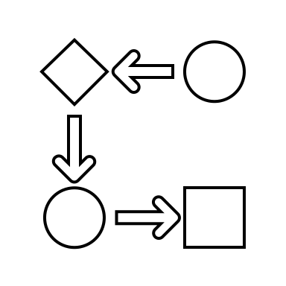
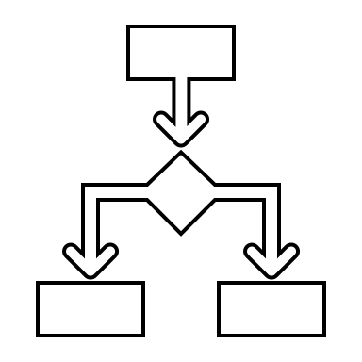



Objectives for today
Parallelizing sequential programs
How do we take a sequential program and parallelize it?
Mutual Exclusion constructs
Writing parallel programs
How do we use threads to work on a single task?
$$A$$
$$B$$
$P\left(A∪B\right)=P\left(A\right)+P\left(B\right)→P\left(A∩B\right)= ∅$

Slide 4
Sequential Programs
A sequential program is one which executes every block of code in a defined sequence
Not all parts of sequential programs can be parallelized
Lets look at a program which can be easily parallized

Slide 5
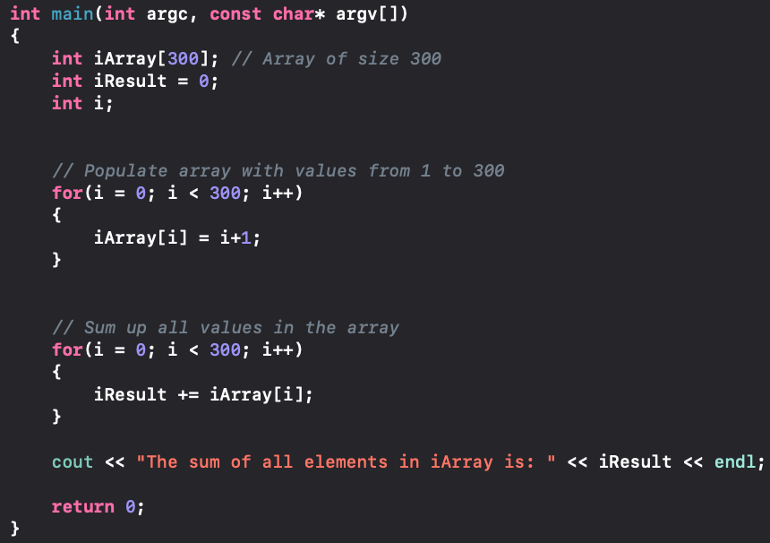
Simple Sequential program

Slide 6
So what can we parallelize?
The array initialization can’t be parallelized since this must be completed before any other calculations can be done
The summation can be parallelized
But we must split the array and delegate different parts to worker threads
So lets look at the summation and how we can parallelize it

Slide 7
Splitting the array
Before we can add things together using threads, we need to divide up the work
Lucky for us the array is easily divisible into even parts
Have a go at splitting the array appropriately for the next 5 mins
How many threads should we use once we have split the array?

Slide 8
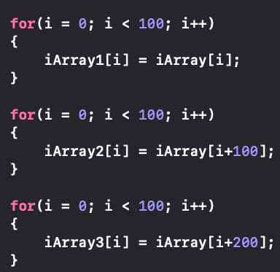
Splitting the array (simple Solution)
Using 3 threads sounds like a reasonable solution (1 thread per array segment)

Slide 9
Worker Function
Now that we have split the array, try defining a threading method which replicates what the sequential program did (add some elements)
This should take no more than 10 mins
What are some challenges you have encountered?
Notes:
Challenges:
Getting back the final result
Getting things with void pointers

Slide 10
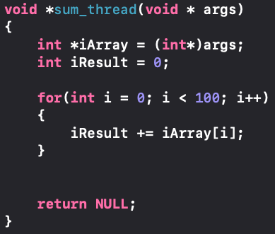
Basic Summation implementation
Unfortunately, the function is absolutely useless in its current state!
It doesn’t return anything or contribute towards solving the task in any meaningful way!

Slide 11
So what’s the problem?
First of all, the function doesn’t return anything useful (a NULL pointer is hardly useful)
That’s pretty useless considering we want a result back
Second of all, even though we are calculating a result, it is confined to the scope of that function
Simply: “When the thread dies all of the work gets lost”
So how can we fix that, without needing to worry about returning void pointers or static local variables ?

Slide 12
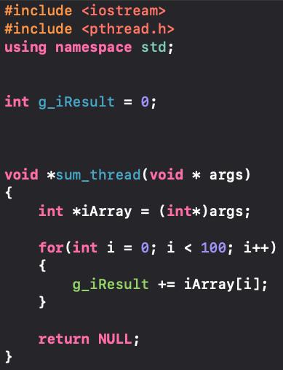
Global Variable for summation Result
Why not write into a global variable, that way everything in our program can access it
Task: Create a global variable where the thread function can just write into it
This should take around 15 seconds to do

Slide 13
Now let’s actually thread the program
For the next 10 minutes, use what we just did & what you know about threads to:
Create some threads
Assign the appropriate function and pass in the relevant arguments
Prevent premature process terminations
Print the final result

Slide 14
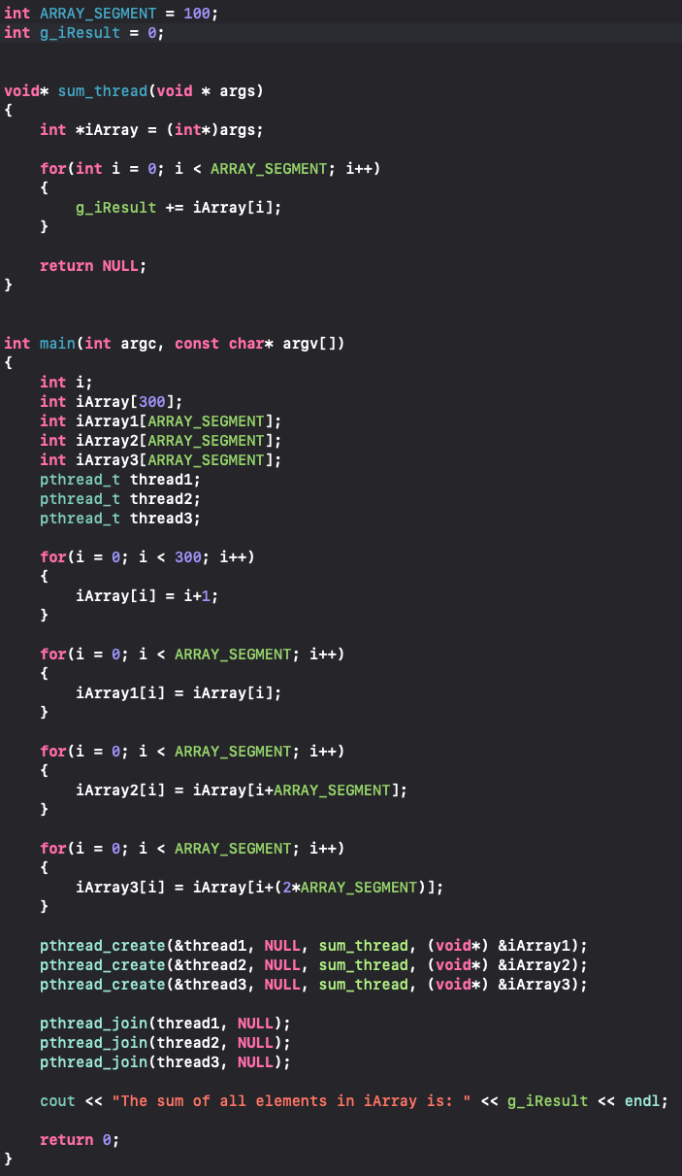
Solution

Slide 15
So did it work?
Lets run it and see if we did this whole threading thing correctly
Yes it looks like it did, the sum of all values from 0 to 300 is 45150
So that’s pretty cool, so what if we made our array 30000 elements long?
The sum of all elements would be 450015000
Lets try that!

Slide 16

Well… That’s odd
It looks like were getting every number, except the one we want
So what on earth did we do wrong? Math can’t just change on the fly can it?
What could have happened to mess up our program that bad?

Slide 17

Lets think about what we did
We divided up an array into 3 parts
We then delegated each part to a separate thread
Each thread then writes into a global variable
Can you spot the issues?

Slide 18
But why on earth is this an issue?
This has to do with the fact that we are creating race conditions
The result will vary depending on what thread gets there first
But why is that the case, the threads are just adding to the register so what's the big deal?
Lets just visualize what is actually going on

Slide 19
Adding to an existing variable
When we do something like a += 1, we are doing the following:
Copy the current value stored at the address of a
Add 1 to the value copied from the address of a
Write the result back into the address of a
Note: a += 1 is the same as a = a + 1

Slide 20
So what happens when a thread is context switched?
Context Switch: The CPU has decided that the thread has had its turn and switches it for another one
Lets just run through the operations together assuming that there are just two threads
Thread 1 will be adding [1,2,3]
Thread 2 will be adding [4,5]

Slide 21

Thread 1 starts summing all values from 1 to 5
Value Thread 1 writes into G (T1R)
0
=
Thread 1
Current Operation: Copy value of G
Global Var (G)
Value Thread 2 writes into G (T2R)
0
0
Thread 2
Current Operation: NOP
Note: NOP means “No operation”

Slide 22
Thread 1 evaluates g+1
Value Thread 1 writes into G (T1R)
1
0
0
= +1
Thread 1
Current Operation: T1R = G + 1
Global Var (G)
Value Thread 2 writes into G (T2R)
0
0
Thread 2
Current Operation: NOP
Note: NOP means “No operation”

Slide 23
Thread 1 writes 1 back into G
Value Thread 1 writes into G (T1R)
1
Thread 1
Current Operation: Write T1R into G
Global Var (G)
Value Thread 2 writes into G (T2R)
0
0
Thread 2
Current Operation: NOP
Note: NOP means “No operation”

Slide 24
Thread 1 Reads G from memory
Value Thread 1 writes into G (T1R)
0
=
Thread 1
Current Operation: Copy value of G
Global Var (G)
Value Thread 2 writes into G (T2R)
1
0
Thread 2
Current Operation: NOP
Note: NOP means “No operation”

Slide 25
Thread 1 Evaluates G+2
Value Thread 1 writes into G (T1R)
3
0
1
= +2
Thread 1
Current Operation: T1R = G + 2
Global Var (G)
Value Thread 2 writes into G (T2R)
1
0
Thread 2
Current Operation: NOP
Note: NOP means “No operation”

Slide 26


Thread 1 Is Context switched!
Value Thread 1 writes into G (T1R)
3
1
= +2
Thread 1
Current Operation: Write T1R into G
Global Var (G)
Value Thread 2 writes into G (T2R)
1
0
Thread 2
Current Operation: NOP
Note: NOP means “No operation”

Slide 27
Thread 2 continues (add 4)
Value Thread 1 writes into G (T1R)
3
1
= +2
Thread 1
Current Operation: Write T1R into G
Global Var (G)
Value Thread 2 writes into G (T2R)
1
0
=
Thread 2
Current Operation: Copy value of G
Note: NOP means “No operation”

Slide 28
Thread 2 evaluates G+4
Value Thread 1 writes into G (T1R)
3
1
= +2
Thread 1
Current Operation: Write T1R into G
Global Var (G)
Value Thread 2 writes into G (T2R)
1
0
1
5
= +4
Thread 2
Current Operation: T2R = G + 4
Note: NOP means “No operation”

Slide 29
Thread 2 Writes 5 back into G
Value Thread 1 writes into G (T1R)
3
1
= +2
Thread 1
Current Operation: Write T1R into G
Global Var (G)
Value Thread 2 writes into G (T2R)
1
5
Thread 2
Current Operation: Write T2R into G
Note: NOP means “No operation”

Slide 30
Thread 2 is context switched!
Value Thread 1 writes into G (T1R)
3
1
= +2
Thread 1
Current Operation: Write T1R into G
Global Var (G)
Value Thread 2 writes into G (T2R)
5
0
Thread 2
Current Operation: Write T2R into G
Note: NOP means “No operation”

Slide 31
Thread 1 continues (finish writing into G)
Value Thread 1 writes into G (T1R)
3
Thread 1
Current Operation: Write T1R into G
Global Var (G)
Value Thread 2 writes into G (T2R)
5
0
Thread 2
Current Operation: Write T2R into G
Note: NOP means “No operation”

Slide 32

HAHA! There we go! That’s the issue!
Did you see what just happened with G’s register?
The value that Thread 1 calculated was outdated, but it still wrote it into G
Thread 1 assumed that G was not augmented when it added its result
But G was augmented since Thread 2 wrote its result (5) into G
Consequently Thread 1 was overwriting the work done by Thread 2

Slide 33
But why didn’t this happen the first time?
Yeah, why didn’t it happen when we had the array at size 300?
Any ideas why that could be?
There’s a very simple answer to that: “Thread 1 was too fast. It was so fast that the CPU had no reason to switch it out for Thread 2”
This only became an issue when Thread 1 reached the end of its allocated time and was forcefully removed by the CPU before it finished writing its result

Slide 34
So that’s a bit of an issue
When we work with small data sets its all well and good, but why use a computer then?
We need to find a way to prevent this from happening, we can’t just overwrite things randomly
So we will take a look at that after the break

Slide 35
Mutual Exclusion
As stated before, we are having issues with threads overwriting our variables
Mutual exclusion aims to protect critical sections while they are in use
Critical Section: A section of a program which aught to be executed atomically
So lets look at how we can think of this in a simple way

Slide 36

The Mutex, Nothing more than a lock
The Mutex is the construct which we will use to enforce mutual exclusion
Mutual Exclusion basically says: “I’m going to put a lock around something, such that no two things have simultaneous access”
So lets think about where we should put these locks to eliminate our threading issue

Slide 37
What do we want to lock?
This should be pretty self explanatory (the variable that causing issues)
Any guesses of what it is?
We want to prevent both threads from accessing the global variable before they have completed their critical sections
So lets look back at our simulation and see how it would play out with locks

Slide 38



Thread 1 Reads G from memory
Value Thread 1 writes into G (T1R)
0
=
Thread 1
Current Operation: Copy value of G
Global Var (G)
Value Thread 2 writes into G (T2R)
0
0
Thread 2
Current Operation: NOP
Note: NOP means “No operation”

Slide 39
Thread 1 evaluates G+1
Value Thread 1 writes into G (T1R)
1
0
0
= +1
Thread 1
Current Operation: T1R = G + 1
Global Var (G)
Value Thread 2 writes into G (T2R)
0
0
Thread 2
Current Operation: NOP
Note: NOP means “No operation”

Slide 40
Thread 1 writes and unlocks G
Value Thread 1 writes into G (T1R)
1
Thread 1
Current Operation: Write T1R into G
Global Var (G)
Value Thread 2 writes into G (T2R)
0
0
Thread 2
Current Operation: NOP
Note: NOP means “No operation”

Slide 41
Thread 1 locks G and reads its value
Value Thread 1 writes into G (T1R)
0
=
Thread 1
Current Operation: Copy value of G
Global Var (G)
Value Thread 2 writes into G (T2R)
1
0
Thread 2
Current Operation: NOP
Note: NOP means “No operation”

Slide 42
Thread 1 evaluates G+2
Value Thread 1 writes into G (T1R)
3
0
1
= +2
Thread 1
Current Operation: T1R = G + 2
Global Var (G)
Value Thread 2 writes into G (T2R)
1
0
Thread 2
Current Operation: NOP
Note: NOP means “No operation”

Slide 43
Thread 1 Is Context switched!
Value Thread 1 writes into G (T1R)
3
1
= +2
Thread 1
Current Operation: Write T1R into G
Global Var (G)
Value Thread 2 writes into G (T2R)
1
0
Thread 2
Current Operation: NOP
Note: NOP means “No operation”

Slide 44

Thread 2 continues (add 4)
Value Thread 1 writes into G (T1R)
3
1
= +2
Thread 1
Current Operation: Write T1R into G
Global Var (G)
Value Thread 2 writes into G (T2R)
1
0
=
Current Operation: Copy value of G
Thread 2 can’t access G since G is currently locked by Thread 1
Thread 2
Note: NOP means “No operation”

Slide 45
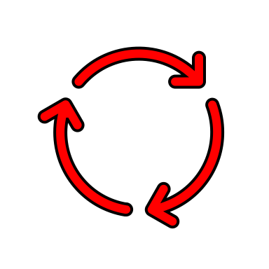
Thread 2 is busy waiting
Value Thread 1 writes into G (T1R)
3
1
= +2
Thread 1
Current Operation: Write T1R into G
Global Var (G)
Value Thread 2 writes into G (T2R)
1
0
0
Since Thread 2 can’t do anything, it just sits and waits for a context switch
Thread 2
Current Operation: Copy value of G
Note: NOP means “No operation”

Slide 46
Thread 2 is context switched!
Value Thread 1 writes into G (T1R)
3
1
= +2
Thread 1
Current Operation: Write T1R into G
Global Var (G)
Value Thread 2 writes into G (T2R)
1
0
Thread 2
Current Operation: Copy value of G
Note: NOP means “No operation”

Slide 47
Thread 1 finishes updating g & unlocks
Value Thread 1 writes into G (T1R)
3
Thread 1
Current Operation: Write T1R into G
Global Var (G)
Value Thread 2 writes into G (T2R)
1
0
Thread 2
Current Operation: Copy value of G
Since Thread 2 can’t do anything, it just sits and waits for a context switch
Note: NOP means “No operation”

Slide 48
Thread 1 Is Context switched!
Value Thread 1 writes into G (T1R)
3
Thread 1
Current Operation: NOP
Global Var (G)
Value Thread 2 writes into G (T2R)
3
0
Thread 2
Current Operation: Copy value of G
Note: NOP means “No operation”

Slide 49

Thread 2 continues (add 4)
Value Thread 1 writes into G (T1R)
3
Thread 1
Current Operation: NOP
Global Var (G)
Value Thread 2 writes into G (T2R)
3
0
=
Thread 2
Current Operation: Copy value of G
Note: NOP means “No operation”

Slide 50
Thread 2 evaluates g+4
Value Thread 1 writes into G (T1R)
0
Thread 1
Current Operation: NOP
Global Var (G)
Value Thread 2 writes into G (T2R)
3
0
7
3
= +4
Thread 2
Current Operation: T2R = G + 4
Note: NOP means “No operation”

Slide 51
Enough of that
I think you are starting to see the picture, we could keep going but lets actually try it ourselves
Actually implementing this is incredibly easy using POSIX

Slide 52



MUTEX
The POSIX API includes a type called MUTEX, which will be our lock
The actual type is just mutex which can be invoked via POSIX
The mutex type has 2 member functions
lock()
unlock()
Note: Calling member function can be done as follows:

Slide 53
Lock it down
Use the next 5 minutes to make your code threadsafe
This can be done by literally adding 3 lines of code

Slide 54
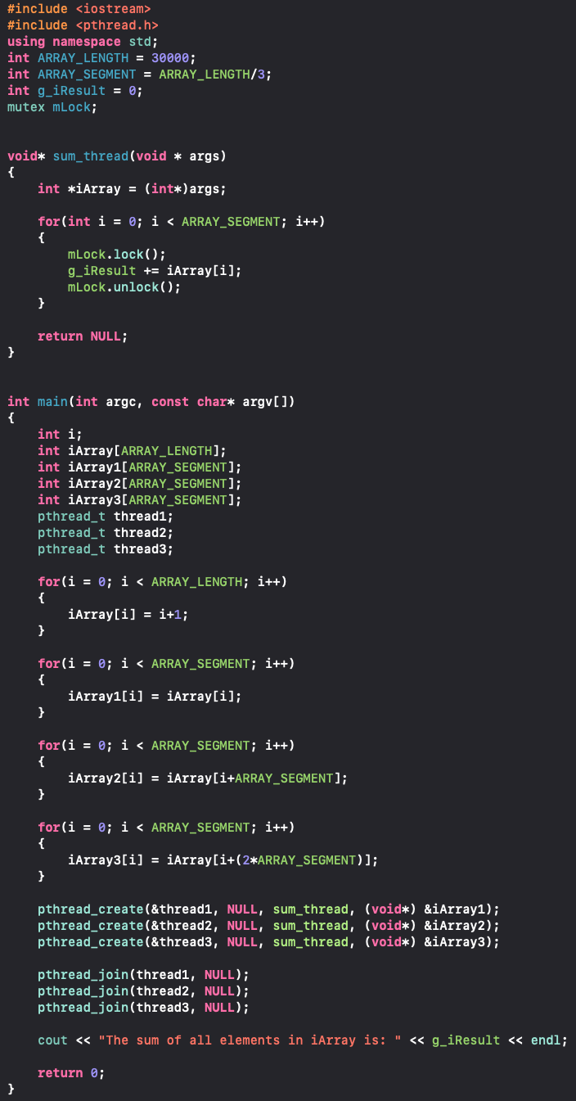
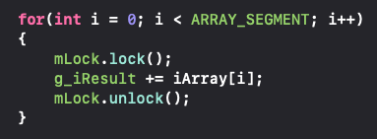
Solution
There is something that is pretty annoying about this solution
What do you think it is?

Slide 55
Why is that so bad?
Its not wrong is it? Its doing exactly what we want, so why is it such a big deal?
Have you check how many times the mutex is locked and unlocked?
The member functions of this mutex are collectively invoked 60 thousand times
That means that the CPU is accessing and manipulating the memory an extra 60 thousand times
That’s twice what the program does WITHOUT the mutex
And all of that takes time, so we’ve basically slowed down our program
Would you believe me if I told you that the same thing can be done while only calling the lock and unlock function 6 times collectively?
Try and figure out how this can be done for the next 10 minutes

Slide 56
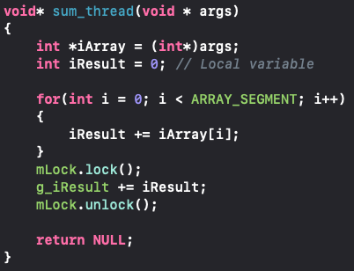
Solution
Locality is the key, instead of just accessing the global variable all the time, a local variable can be used to accumulate all the values
Once the summation is complete, the local result can be added to the global variable

Slide 57
That’s it for now
Parallel systems is a massive field and we don’t have time to look into it as much as I would like
But fear not, for this is not the last time we will use threads
I will continue to include some threading stuff as we move on to OO tomorrow
But the main threading content is mostly completed for now

