Slide 1
C++ classes (part 2)
By Philipp Tiso

Slide 2
Objectives for today
Constructor overloading
Static member variables
File I/O
2 Mini projects (The majority of today will be dedicated to this)

Slide 3
Header files
Previously we have been putting our classes into the same file which contains the main method
This is usually not the case, instead we have a header file (.h) which includes the class declarations (no variable initialization or function definitions)
The implementation of the class is done in a separate C++ file

Slide 4
Constructor
Yesterday we said that “A constructor gets called when the new operator is used, and builds an object according to our specifications or some default values”
But what if we wanted multiple constructors, each of which acts in a unique way?

Slide 5
Constructor overloading
Overloading: When two or more things have the same name, but take different declarations
We basically want to create multiple constructors, each of which will be relevant for a specific scenario

Slide 6
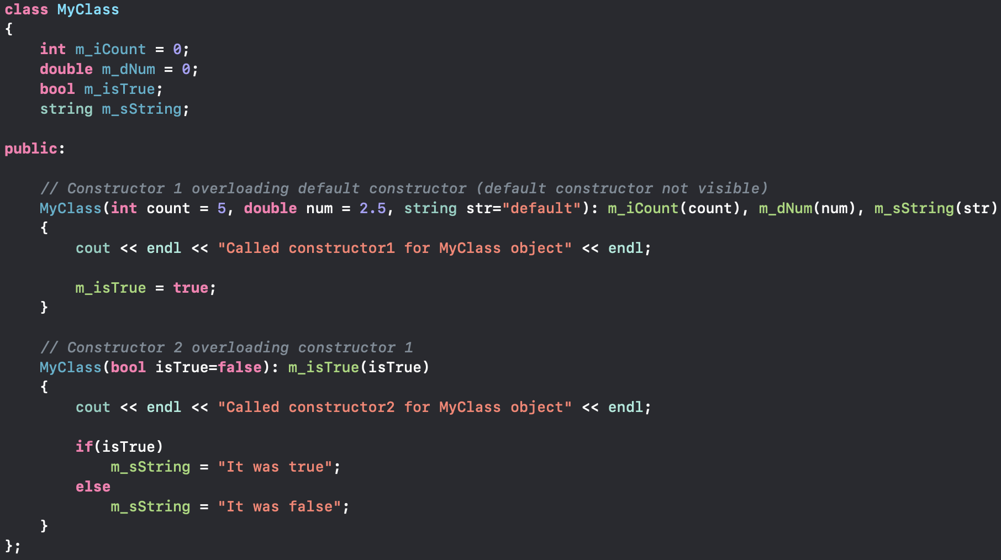
Example of constructor overloading

Slide 7
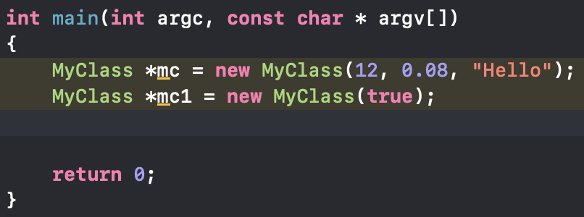
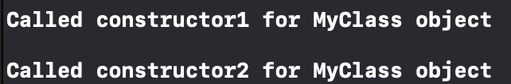
What would the output be for this?

Slide 8
Exercise
Create a class with some overloaded constructors
Use your class in a program to perform some operations using the overloaded constructors
This should take no more than 15 mins

Slide 9
Static member variables
Thus far all member variables have pertained to a specific class instance (object)
But sometimes we may want to share the value of one variable between all associated class instances
Static member variables allow us to do just that
Simply: Static member variables are shared between all objects derived from a specific class
Note: In order to use a static variable, we need to have a static member function

Slide 10
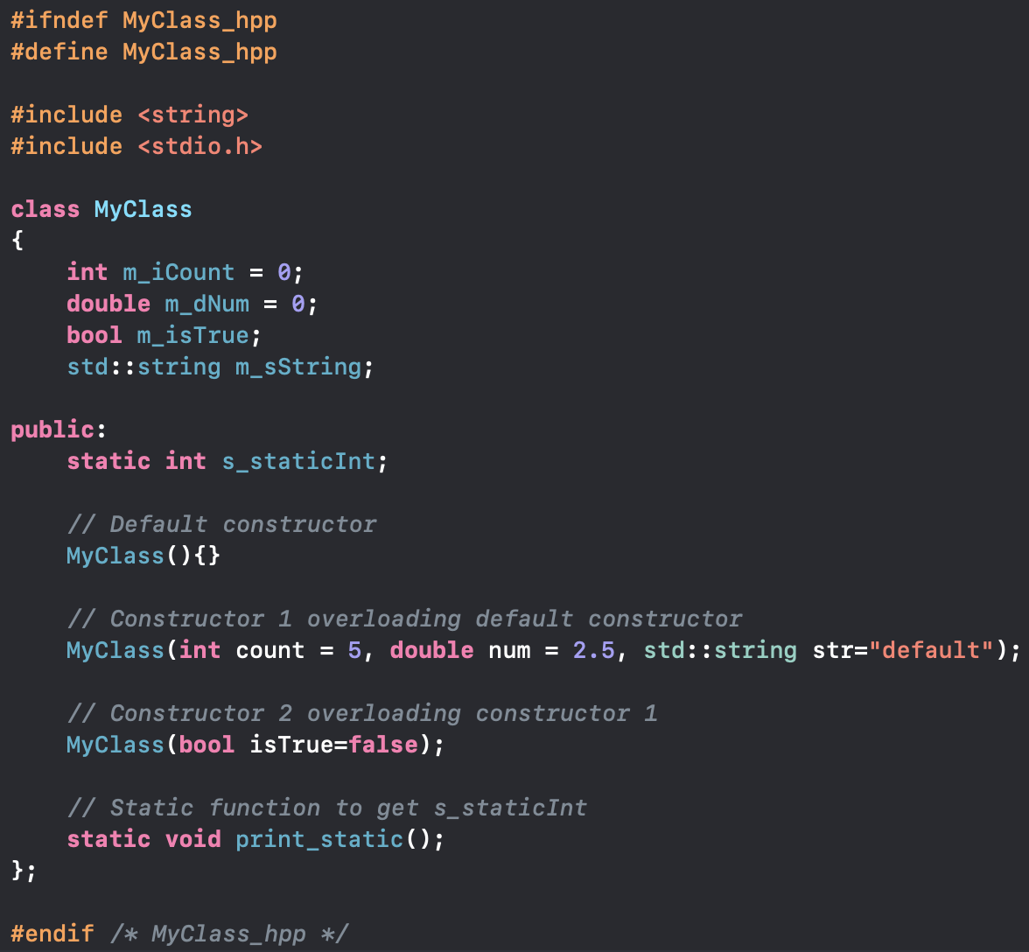
myClass.hpp

Slide 11
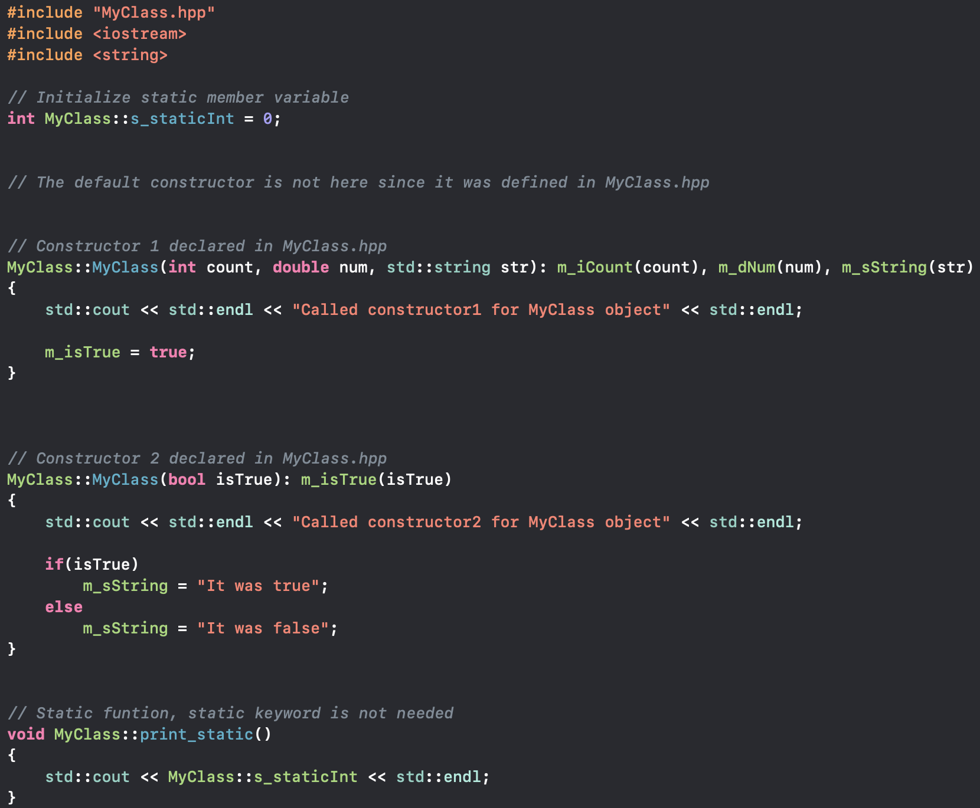
MyClass.cpp
Note that we use the scoping operator :: to disambiguate the namespace to which something (variable/function) belongs to

Slide 12
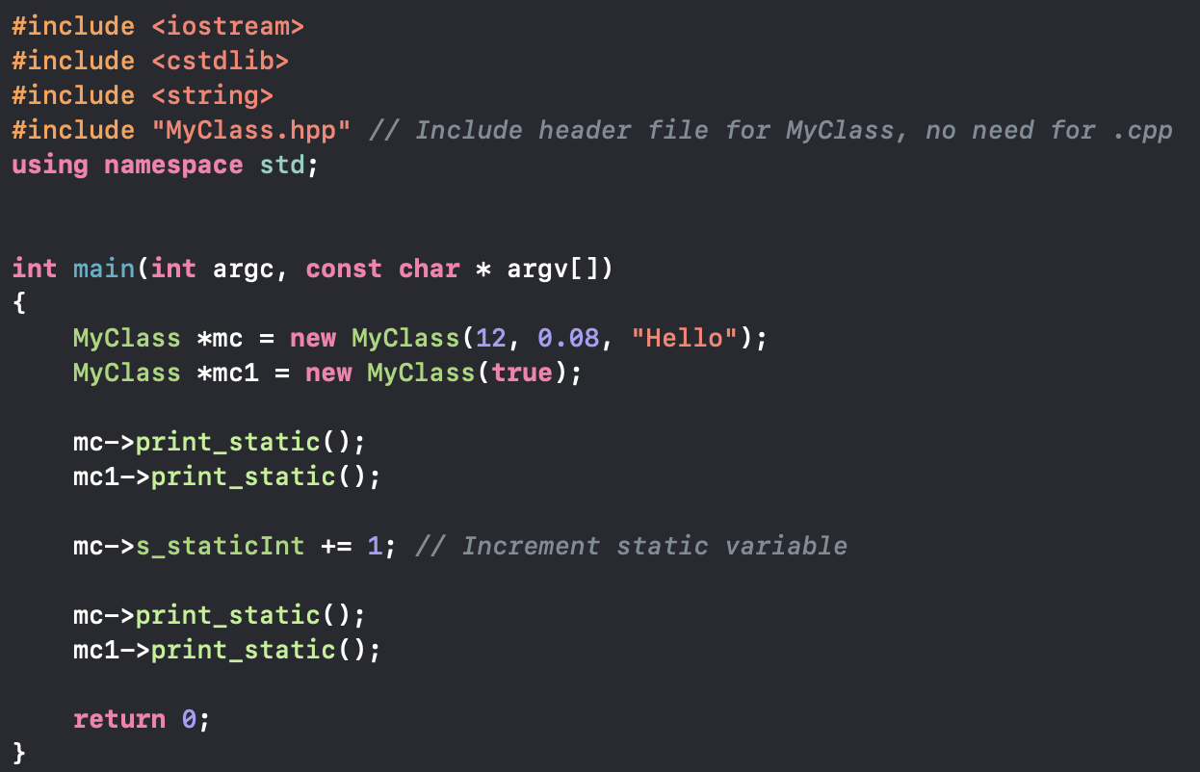
Main.cpp

Slide 13
Exercise
Create a class using the method shown above
Create 2 separate files, a .cpp file and .hpp
Note: The .hpp and .cpp files should have the same name as your class
Remember to use the scoping operator ::
This tells C++ that some variable or function belongs to a specific namespace or class (i.e. your class)

Slide 14
That’s it for classes
In the context of this course this is all that we will cover in terms of classes
Don’t be fooled, we haven’t even come close to covering the basics of classes, there is a lot more that we just don’t have time to look at
We have had a very basic look at C++ classes but it should be enough for you to understand how they are created and how they can be used
So lets take a short break before we continue

Slide 15
File I/O
C++ can do more than just printing things to the command line, we can read and write files
The fstream library provides us with methods that allow us to work with files
Lets take a look at a simple File I/O script

Slide 16
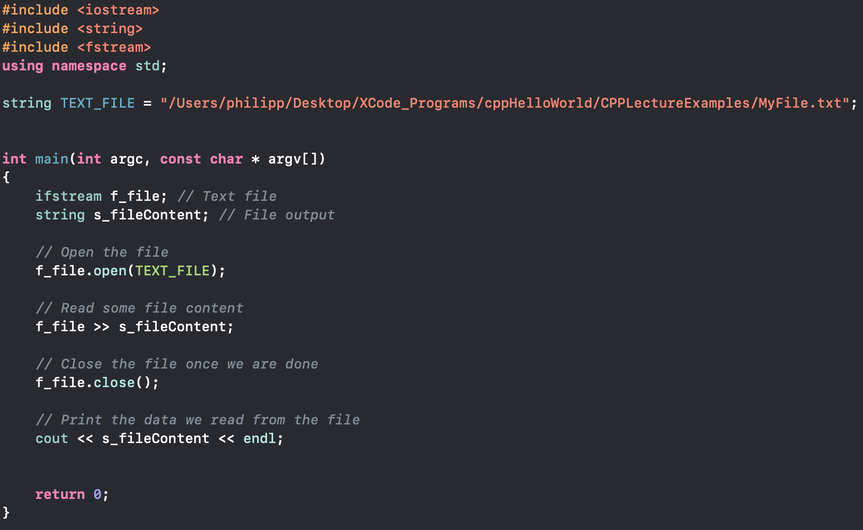
File Script

Slide 17



Key points
Files which we read from have the type ifstream
Files are opened using .open(string file_path)
Files are closed using .close()

Slide 18

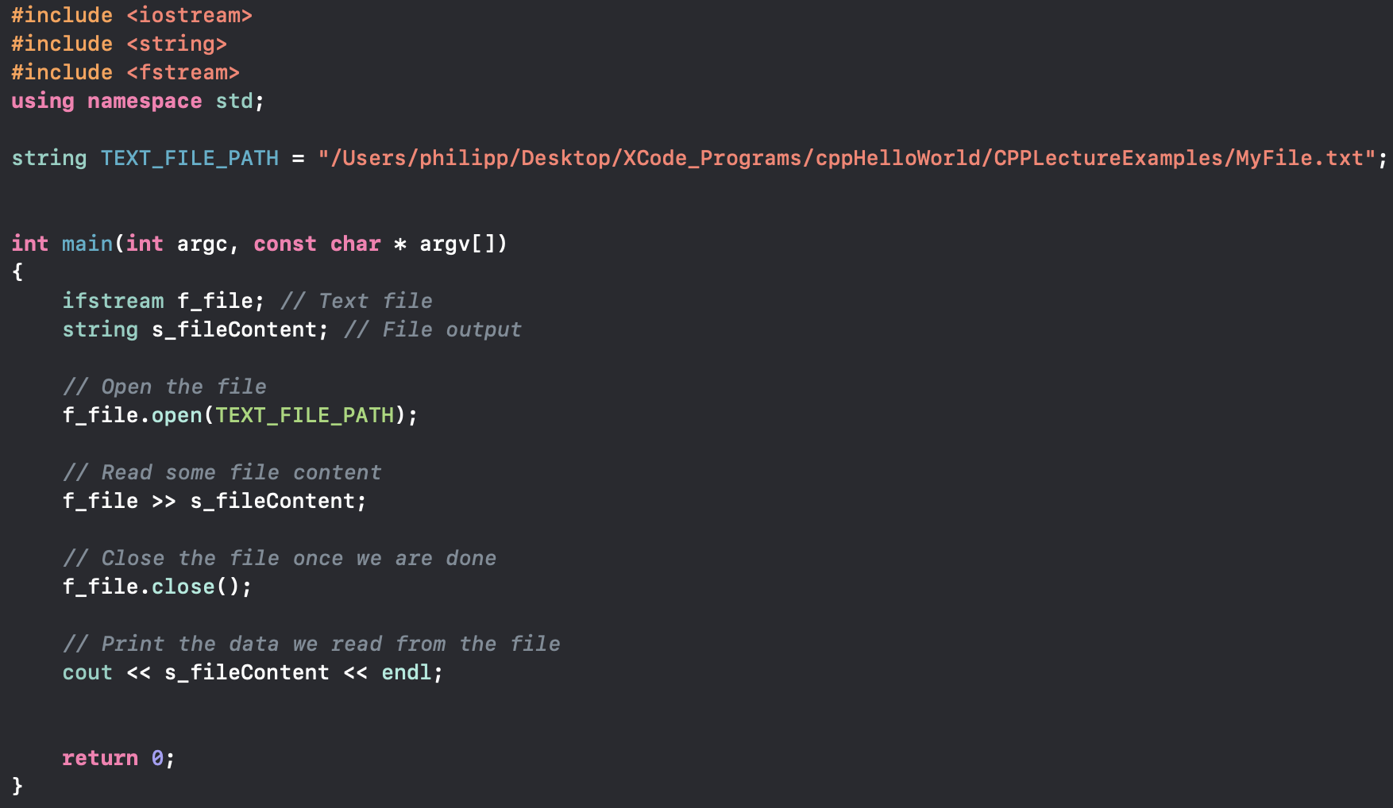

What would the output be?
Text file content
Output

Slide 19
This? Is that really it?
This happens because we are only reading one string, “This” just so happens to be the first string
How could we move through the entire file?

Slide 20
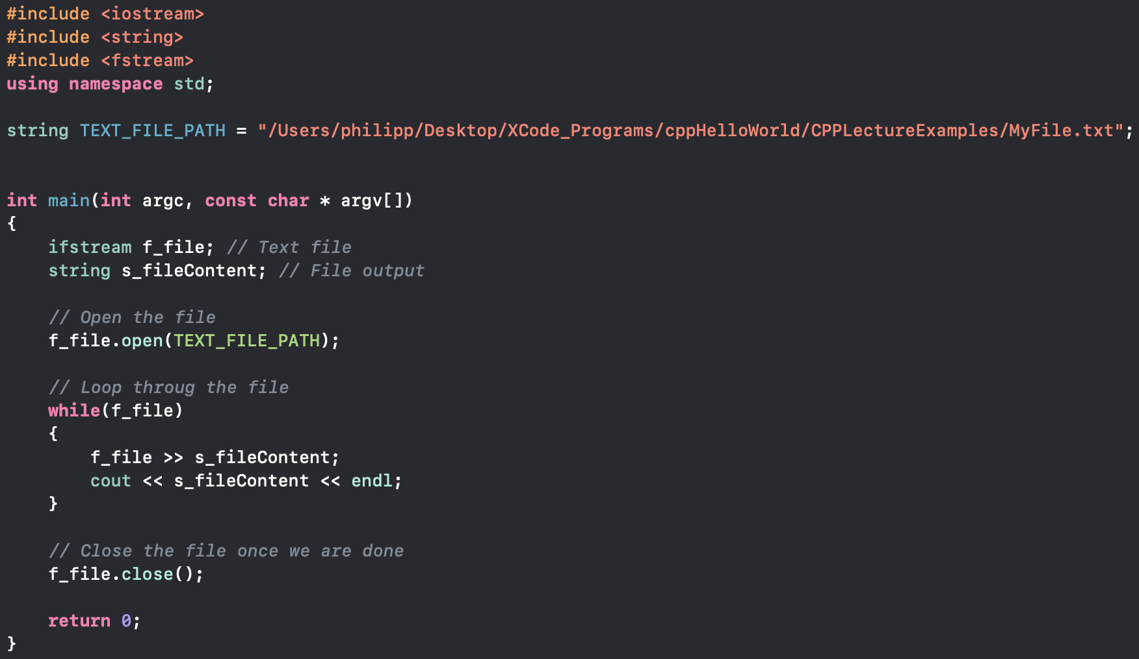

Iterating over the file
What would the output be?

Slide 21
But why is the last string there twice?
This happens because after the last line is read, the file is not at EOF (end of file) but file buffer still contains the last string
So the last line is printed again since the loop is executed for one more iteration before it hits EOF
But there is a simple fix for this

Slide 22
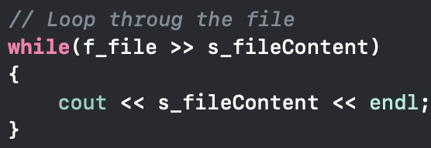
Solution
We just need to move the stream operation into the condition
This way EOF gets read inside the condition which wasn’t the case before
Because the EOF was read outside the condition, the while loop iterated one more time

Slide 23
Writing into a file
Before we saw how to read a files content, writing into a file is almost identical to reading
Be careful, when you write to a file, you are overwriting all the content inside the file and replacing it with your input
One difference is that, files which we write into have type ofstream

Slide 24
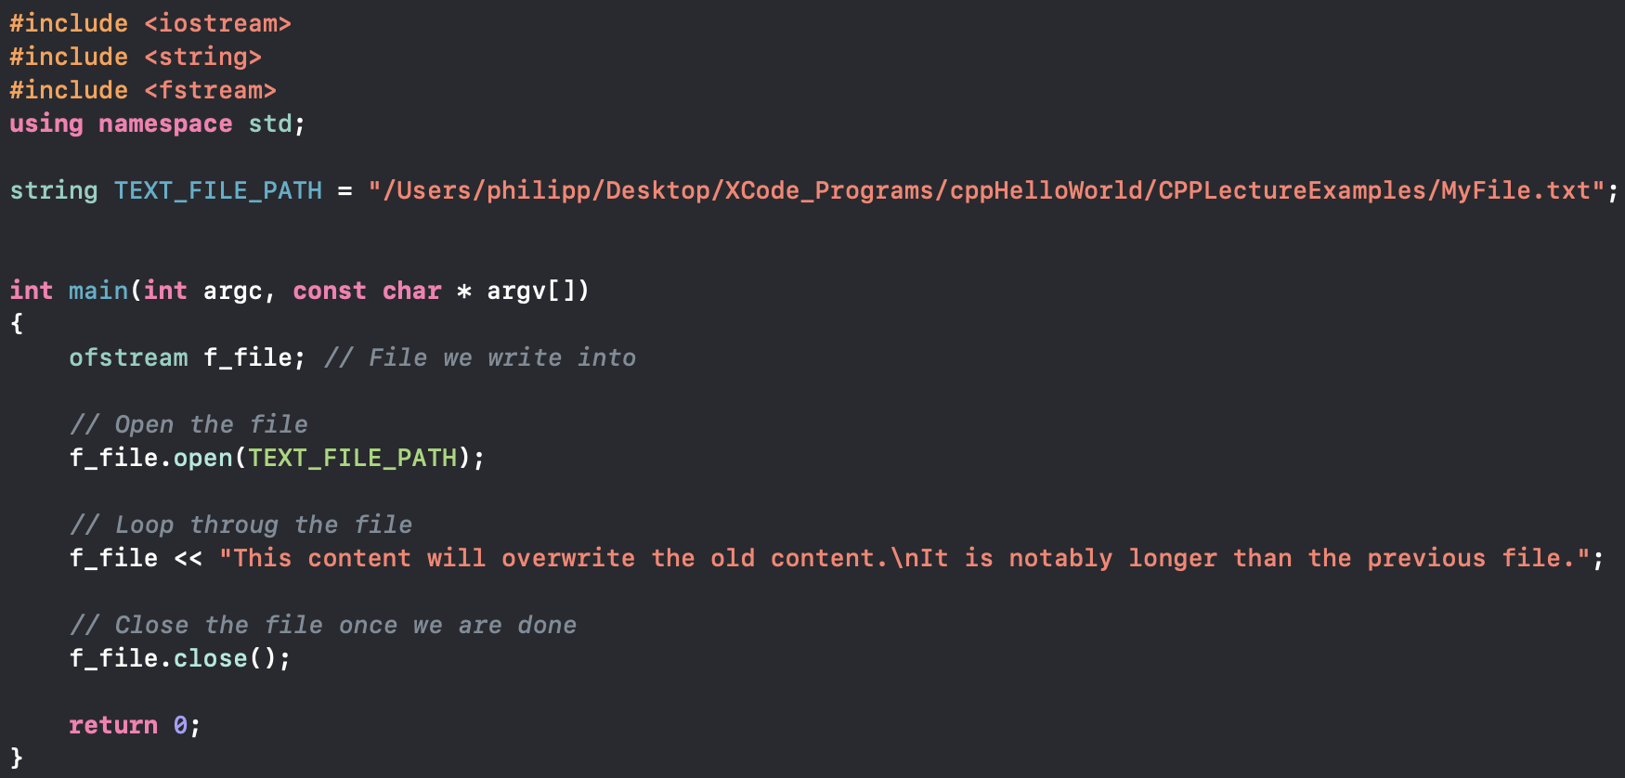
Simple Example

Slide 25
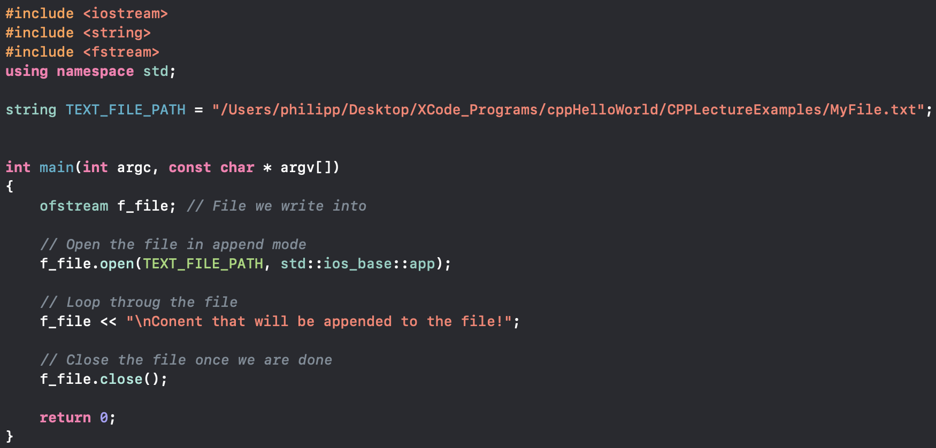
Appending to files
Sometimes we don’t want to overwrite content in a file, instead we just want to append some data to it
We can specify this using the std::ios_base::app flag in the .open() method

Slide 26
Any questions?
Before we move onto creating some projects, are there any concepts that you are uncertain about?

